Slide 1
SDN Project:
Data Migration Informed by OpenFlow Statisitcs
David Polikoff
David Ozog
University of Oregon
6/6/2013

Slide 2
Motivation
PGAS
  Data locality
  Load balancing
Portability of network measurements
  OpenFlow statistics
Callback-based load balancing (application agnostic)

Slide 3
Motivation
PGAS
  Data locality
  Load balancing
Portability of network measurements
  OpenFlow statistics
Callback-based load balancing (application agnostic)

Slide 4
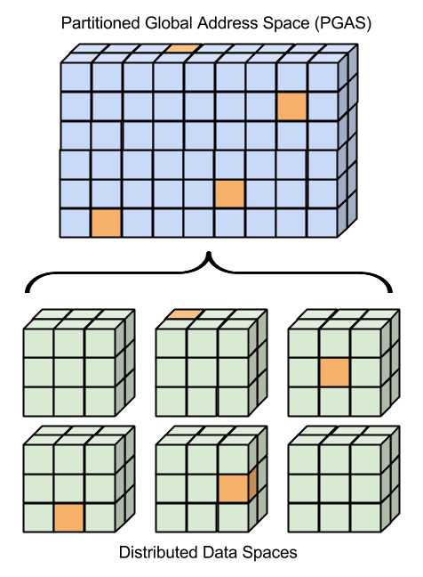
Background
PGAS
Global Arrays
  NWChem
  Molpro
OpenFlow statistics

Slide 5
Proposal

Slide 6
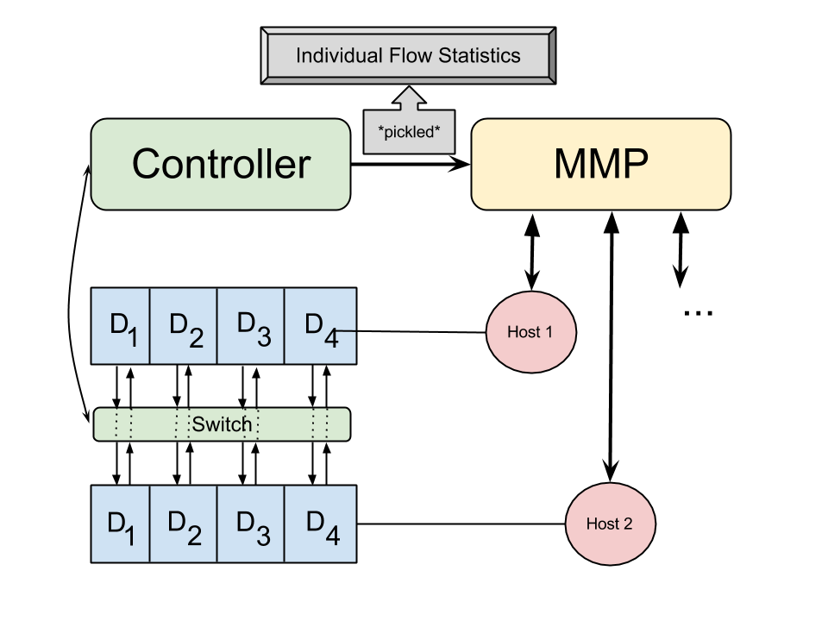
Architecture

Slide 7
Demo

Slide 8
Experiments

Slide 9
Conclusions and Future Work

