Slide 1

Introduction to OpenCV

Slide 2
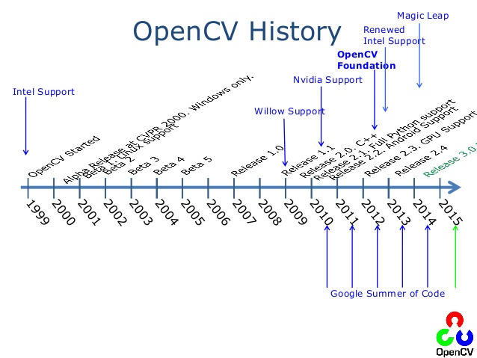
OpenCV History
OpenCV is an open library with programmation fonctions for implementing computer vision tasks:
      Main interface in C++
      Also interfaces in Java, Matlab and Python:
      https://opencv-python-tutroals.readthedocs.io
  History :
      1999 : Original version
      by Intel Research
      2006 : Version 1.0
      2008 : Support by
      Willow Garage
      2009 : Version 2.0 (OpenCV 2)
      2012 : Support by OpenCV.org
      2015 : Version 3.0 (OpenCV 3)
      2018 : Version 4.0 (OpenCV 4)
Source: http://fr.slideshare.net/embeddedvision/e04-open-cvbradsk

Slide 3
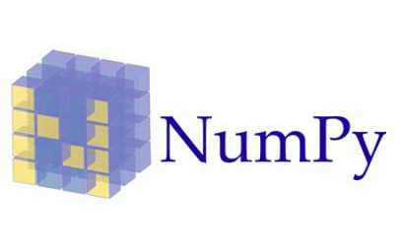
OpenCV-Python Installation
Command for installation in Ubuntu/Raspbian:
sudo apt-get install libopencv-dev python-opencv python-matplotlib
  For Windows, follow tutorial in :
  https://opencv-python-tutroals.readthedocs.io/en/latest/py_tutorials/py_setup/py_setup_in_windows/py_setup_in_windows.html
  For verifying, execute python in terminal :
      >>> import cv2
      >>> print cv2.__version__
  Why using Python ? :
      Programming simplicity
      Support of library Numpy :
          Optimised for numerical operations
          Similar syntax to Matlab
          Conversion between OpenCV et Numpy data

Slide 4
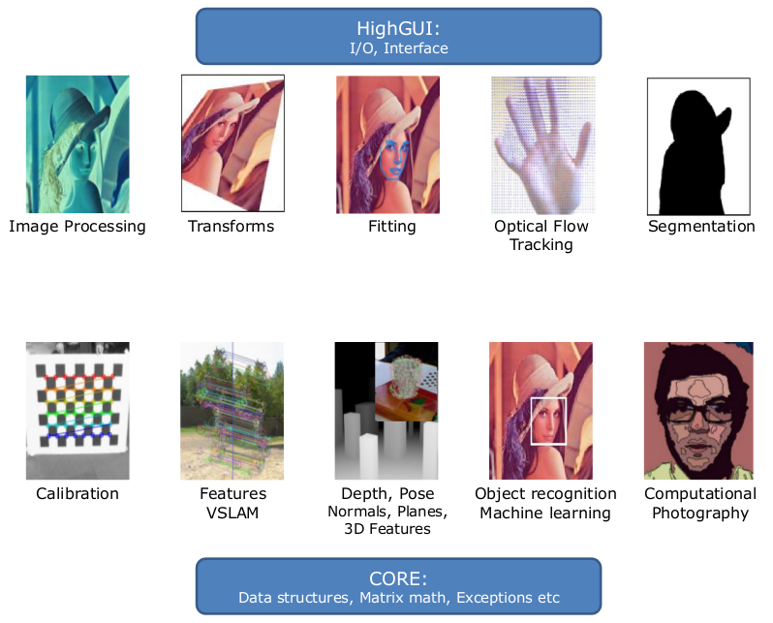
OpenCV Functions
Source: http://fr.slideshare.net/embeddedvision/e04-open-cvbradsk

Slide 5
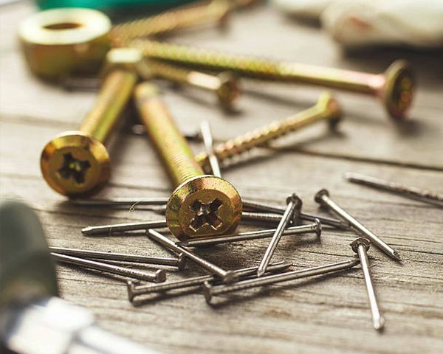
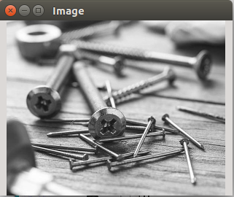
Read/Write of Image Files
Commands for capturing images with the camera :
      With PiCam: raspistill -o cam.jpg
      With Ubuntu Webcam: cheese
  Reading/Writing an image (file.py) :
import numpy as np
import cv2
img= cv2.imread('cam.jpg', cv2.IMREAD_GRAYSCALE)
cv2.namedWindow('Image', cv2.WINDOW_NORMAL)
print img.shape # (rows,cols,channels)
cv2.imshow('Image', img)
k = cv2.waitKey(0) & 0xFF
if k == ord('s'): # 's' key
  cv2.imwrite('camGray.png', img)
cv2.destroyAllWindows()

Slide 6
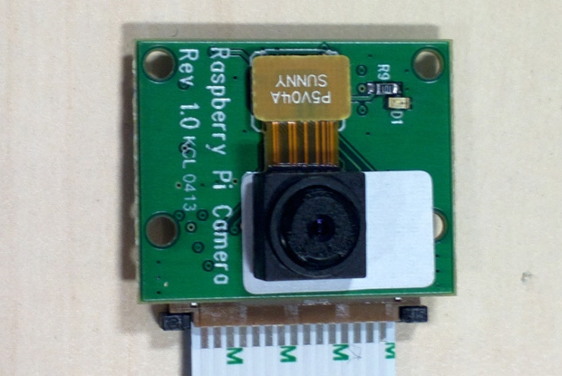
Capturing video from PiCamera
Install PiCamera package:
sudo apt-get install python-picamera
Recovering video frames from PiCamera (cameraPi.py) :
from picamera.array import PiRGBArray
from picamera import PiCamera
import time, cv2
camera= PiCamera()
camera.resolution= (320,240)
rawCapture = PiRGBArray(camera, size=(320,240))
time.sleep(2) # Allow the camera to warmup
for frame in camera.capture_continuous(rawCapture, format='bgr', use_video_port=True):
  image= frame.array # Get raw NumPy array of the frame
  cv2.imshow('Frame',image) # Show frame
  rawCapture.truncate(0) # Clear stream for next frame

Slide 7
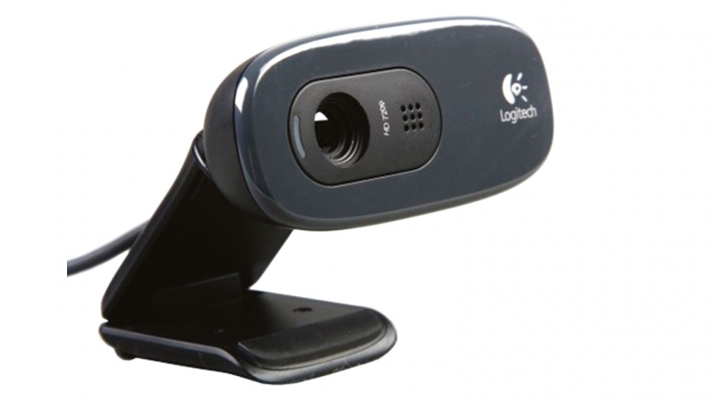
Capturing video from webcam
Recovering video frames from webcam (camera.py):
import numpy as np
import cv2
cap = cv2.VideoCapture(0)
while(True):
# Capture frame-by-frame
ret, frame = cap.read()
# Our operations on the frame come here
gray = cv2.cvtColor(frame, cv2.COLOR_BGR2GRAY)
# Display the resulting frame
cv2.imshow('frame',gray)
if cv2.waitKey(1) & 0xFF == ord('q'):
break
# When everything done, release the capture
cap.release()
cv2.destroyAllWindows()
Modify this code for discovering the size of each frame and reduce its resolution to a half.
Use :
cap.get(propId)
cap.set(propId, value)
Modify the code for showing the frames in color

Slide 8
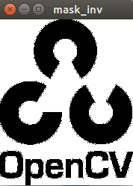
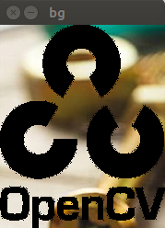
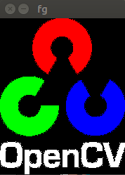
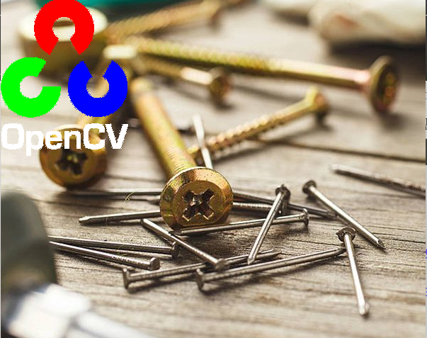
Binary Operations with Images
How to overlap one image over another (bitwise.py):
# Load two images
img1 = cv2.imread('cam.jpg')
img2 = cv2.imread('opencv_logo.png')
# I want to put logo on top-left corner, So I create a ROI
rows,cols,channels = img2.shape
roi = img1[0:rows, 0:cols ]
# Now create a mask of logo and create its inverse mask also
img2gray = cv2.cvtColor(img2,cv2.COLOR_BGR2GRAY)
ret, mask = cv2.threshold(img2gray, 10, 255, cv2.THRESH_BINARY)
mask_inv = cv2.bitwise_not(mask)
# Now black-out the area of logo in ROI
img1_bg = cv2.bitwise_and(roi,roi,mask = mask_inv)
# Take only region of logo from logo image.
img2_fg = cv2.bitwise_and(img2,img2,mask = mask)
# Put logo in ROI and modify the main image
dst = cv2.add(img1_bg,img2_fg)
img1[0:rows, 0:cols ] = dst
cv2.imshow('res',img1)

Slide 9
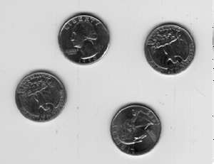
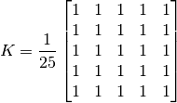
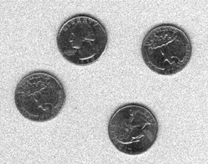
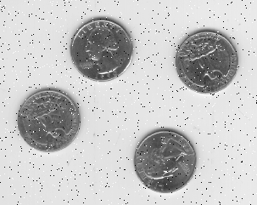

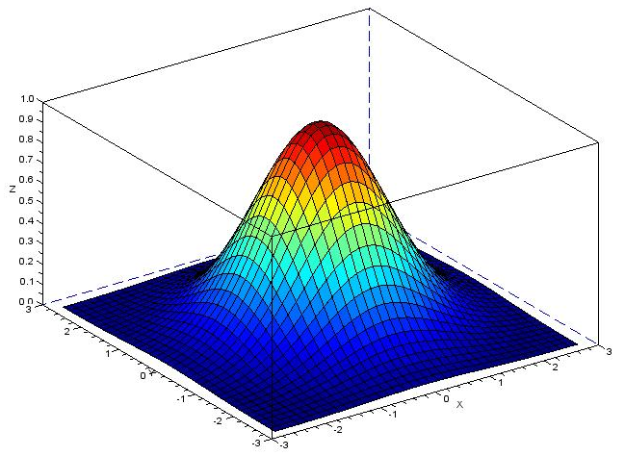
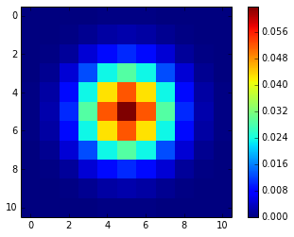
Filtering : Convolution-Smoothing
Filtering an image with noise (‘smoothing.py’):
img = cv2.imread('bike.jpeg')
cv2.imshow('original',img)
# 2D convolution with 5x5 mean kernel
kernel = np.ones((5,5),np.float32)/25
filtered2D = cv2.filter2D(img,-1,kernel)
# Blur with 5x5 kernel (equal to 2D convolution)
blur = cv2.blur(img,(5,5))
# Gaussian blur (Gaussian kernel)
GaussianBlur = cv2.GaussianBlur(img,(5,5),0)
# Median blur
median = cv2.medianBlur(img,5)
Original
Gaussian Noise
Salt & Pepper Noise
Test different sizes of kernel for filtering Gaussian noise in ‘bike.jpg’
Test différent sizes of kernel for filtering ‘salt & pepper’ noise in ‘cameraman.jpg’

Slide 10





Edge Detection : Sobel, Laplacian
Detecting the edges in an image (‘borders.py’) :
ddepth = cv2.CV_64F
img = cv2.imread('sudoku.jpg')
img = cv2.GaussianBlur(img,(3,3),0)
gray = cv2.cvtColor(img,cv2.COLOR_BGR2GRAY)
# Laplacian
laplacian = cv2.Laplacian(gray,ddepth)
# Sobel Gradient-X
grad_x = cv2.Sobel(gray,ddepth,1,0,ksize = 3)
# Sobel Gradient-Y
grad_y = cv2.Sobel(gray,ddepth,0,1,ksize = 3)
# Converting back from 64-bit floating-point (CV_64F)
# into original 8-bit unsigned integers (CV_8U)
abs_grad_x = cv2.convertScaleAbs(grad_x)
abs_grad_y = cv2.convertScaleAbs(grad_y)
abs_laplacian = cv2.convertScaleAbs(laplacian)
# Combining both gradients into one Sobel image
dst = cv2.addWeighted(abs_grad_x,0.5,abs_grad_y,0.5,0)
Laplacian = 2nd order derivatives in x and y
Discrete approximation of Laplacian by the kernel :
Sobel = Discrete differentiation of image intensity
Horizontal changes
Vertical changes
Total gradient approximation
or

Slide 11
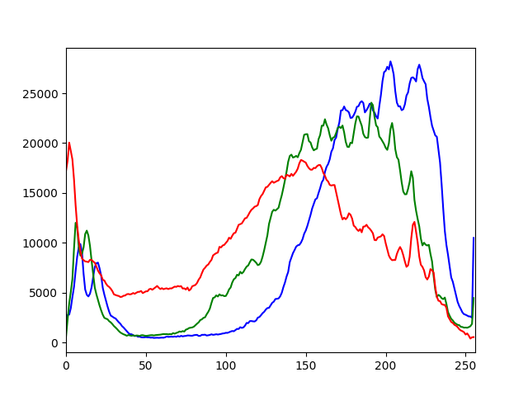
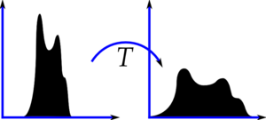
Contrast Adjustment :
Histogram Equalization
How to compute histograms and equalize them (‘histogram.py’) :
from matplotlib import pyplot as plt
img = cv2.imread('dark.png')
color = ('b','g','r')
for i,col in enumerate(color):
histr = cv2.calcHist([img],[i],None,[256],[0,256])
plt.plot(histr,color = col)
plt.xlim([0,256])
gray= cv2.cvtColor(img,cv2.COLOR_BGR2GRAY)
histr_gray= cv2.calcHist([gray],[0], None,[256],[0,256])
plt.plot(histr_gray,color='k') # Black plot
# histogram equalization
equ = cv2.equalizeHist(gray)
histr_equ= cv2.calcHist([equ],[0], None,[256],[0,256])
plt.plot(histr_equ,color='m') # Magenta plot
plt.show()
Histogram = Frequency of pixel intensities
Histogram Equalization

Slide 12
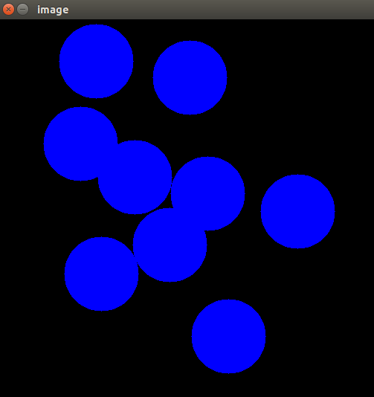
Mouse Events Handling
Drawing circles by double-clicking on the window (‘mouse.py’):
import cv2
import numpy as np
def draw_circle(event, x, y, flags, param): # mouse callback
  if event == cv2.EVENT_LBUTTONDBLCLK:
    cv2.circle(img, (x,y), 50, (255, 0, 0), -1)
img = np.zeros((512,512,3), np.uint8) # black image
cv2.namedWindow('image')
cv2.setMouseCallback('image',draw_circle)
while(True):
  cv2.imshow('image',img)
  if cv2.waitKey(1) & 0xFF == 27: # ESC key
    break
cv2.destroyAllWindows()

Slide 13
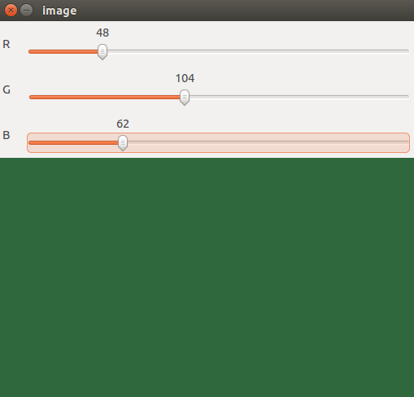
Trackbar Handling
Choosing a color with 3 RGB trackbars (‘trackbar.py’):
import cv2
import numpy as np
def nothing(x):
  pass
img = np.zeros((300,512,3), np.uint8)
cv2.namedWindow('image')
cv2.createTrackbar('R','image',0,255,nothing)
cv2.createTrackbar('G','image',0,255,nothing)
cv2.createTrackbar('B','image',0,255,nothing)
while(True):
  r = cv2.getTrackbarPos('R','image')
  g = cv2.getTrackbarPos('G','image')
  b = cv2.getTrackbarPos('B','image')
  img[:] = [b,g,r]
  cv2.imshow('image',img)
  if cv2.waitKey(1) & 0xFF == 27: # ESC key
    break
cv2.destroyAllWindows()

Slide 14
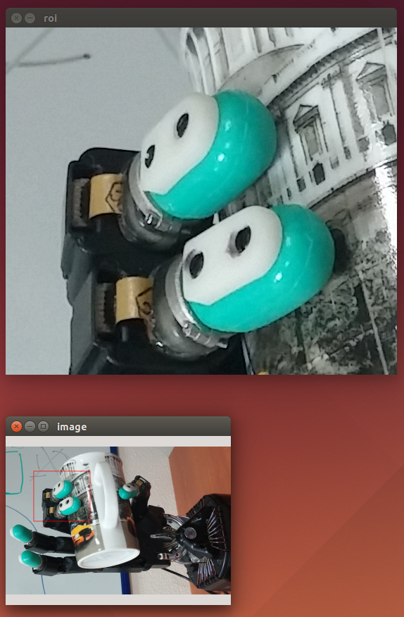
ROI selection with the mouse
Choosing a ROI with the mouse and copy it (‘roi.py’):
import cv2
img= cv2.imread('cam.jpg')
drag=False, point1=None, point2=None, selection=False
def choose_roi(event, x, y, flags, param): # mouse callback
  global drag, point1, point2, selection
  img2=img.copy()
  if event == cv2.EVENT_LBUTTONDOWN:
    point1=(x,y)
    drag=True
  if event == cv2.EVENT_MOUSEMOVE and drag:
    point2=(x,y)
    cv2.rectangle(img2,point1,point2,(0,0,255),4)
  if event == cv2.EVENT_LBUTTONUP and drag:
    point2=(x,y)
    cv2.rectangle(img2,point1,point2,(0,0,255),4)
    drag=False
    selection=True
  cv2.imshow('image',img2)
cv2.setMouseCallback('image', choose_roi)
while(True):
  if selection:
    cv2.imshow('roi',img[point1(0):point2(0),point1(1):point2(1)])
    selection= False

Slide 15
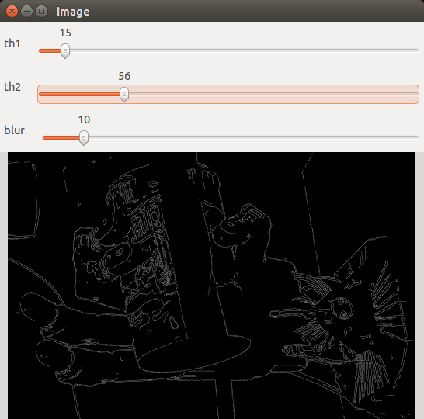
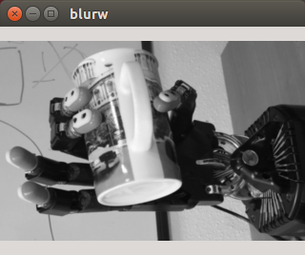
Canny Edge Detection
Fixing thresholds for Canny edge detection (‘cannyDetector.py’) :
import cv2
import numpy as np
img= cv2.imread('cam.jpg')
gray=cv2.cvtColor(img,cv2.COLOR_BGR2GRAY) # Change to gray
def nothing(x):
  pass
cv2.namedWindow('image',cv2.WINDOW_NORMAL)
cv2.namedWindow('blurw',cv2.WINDOW_NORMAL)
cv2.createTrackbar('th1','image',0,255,nothing)
cv2.createTrackbar('th2','image',0,255,nothing)
cv2.createTrackbar('blur','image',1,10,nothing)
while(True):
  th1=cv2.getTrackbarPos('th1','image')
  th2=cv2.getTrackbarPos('th2','image')
  size=cv2.getTrackbar('blur','image')
  kernel= np.ones((size,size),np.float32)/(size*size)
  filteredGray= cv2.filter2D(gray, -1, kernel) # Convolution with kernel
  edges=cv2.Canny(filteredGray, th1, th2) # Edge detection with Canny
  cv2.imshow('image',edges)
  cv2.imshow('blurw',filteredGray)
  if cv2.waitKey(1) & 0xFF==27: # ESC key
    break
cv2.destroyAllWindows()

Slide 16

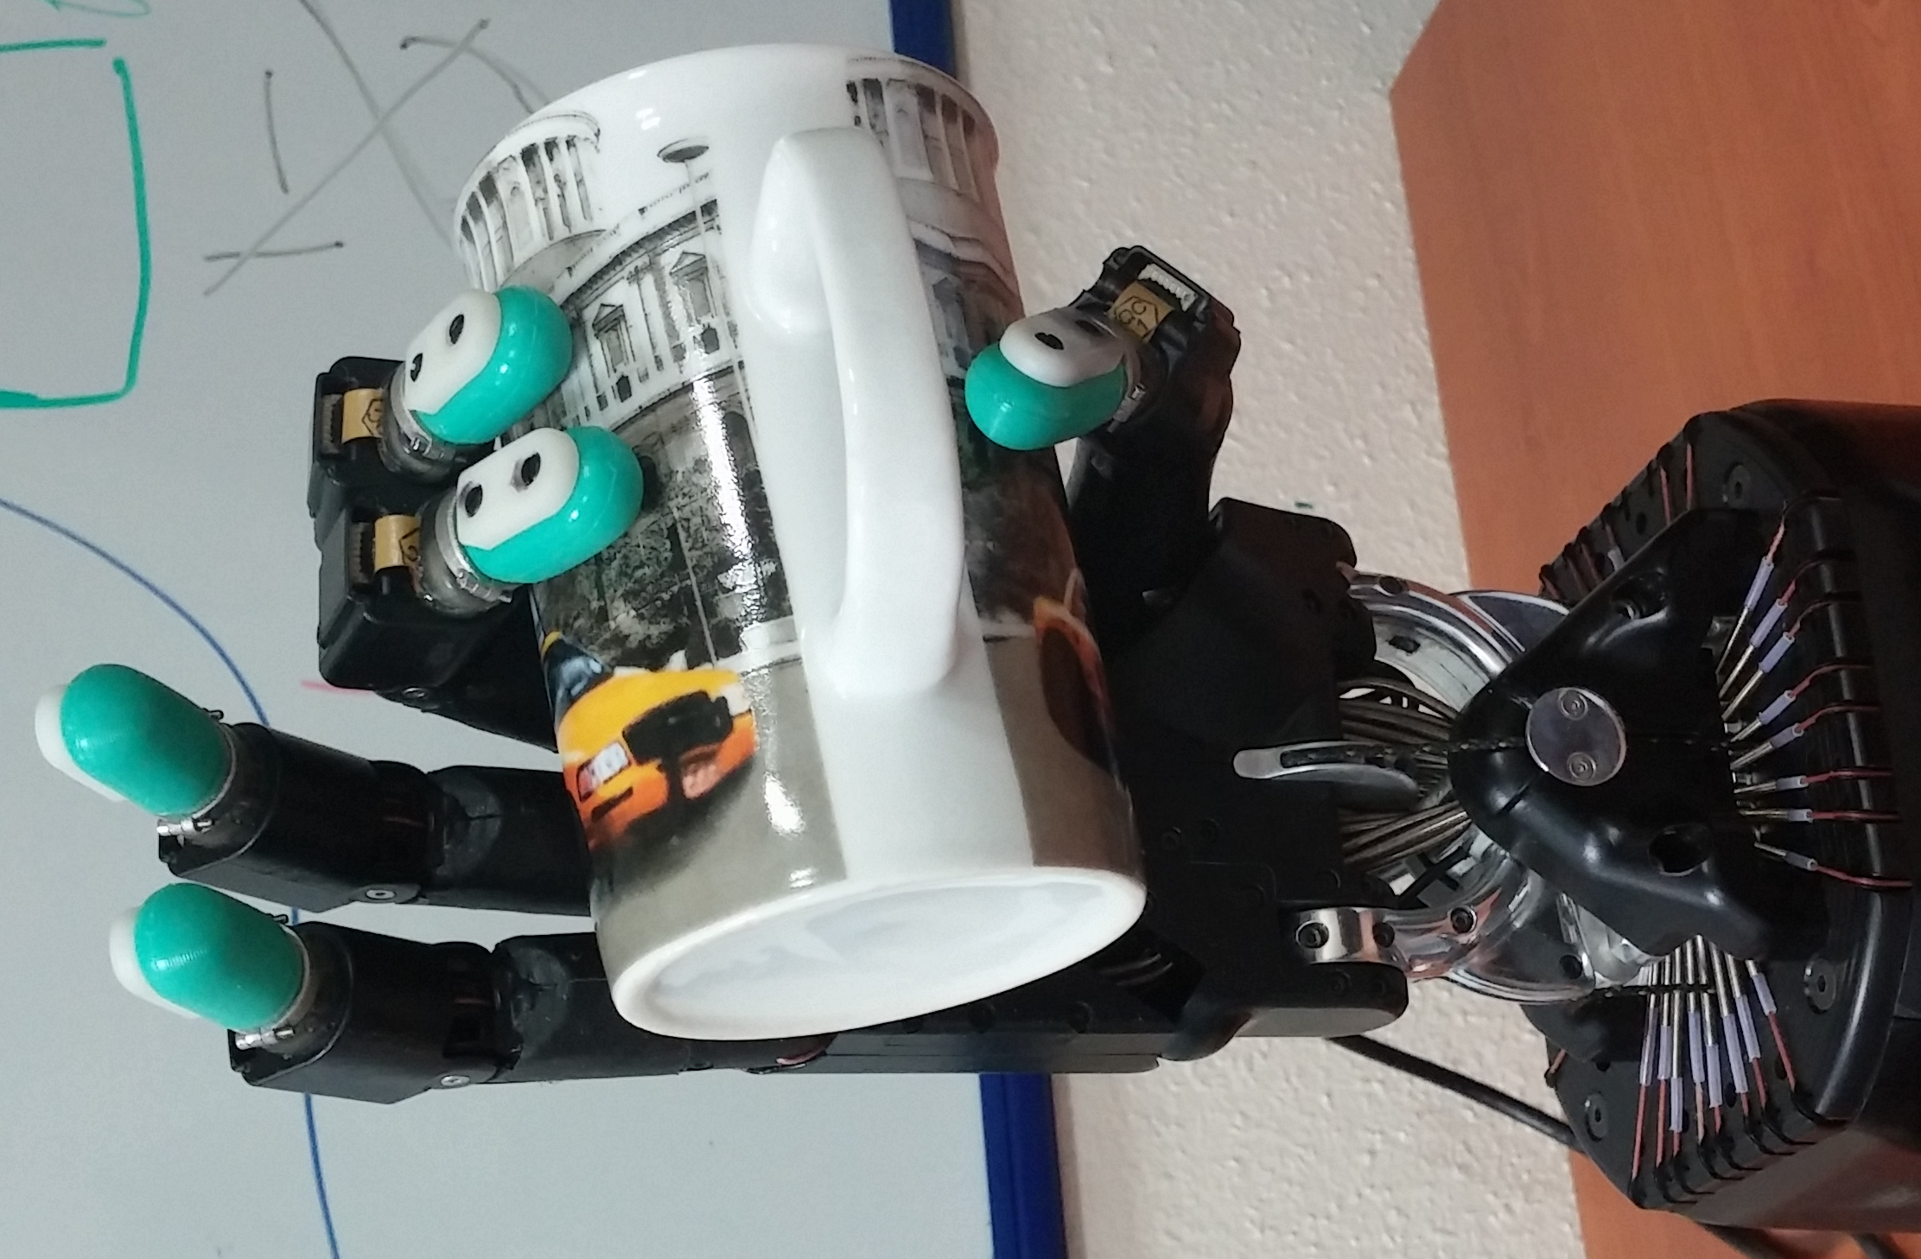
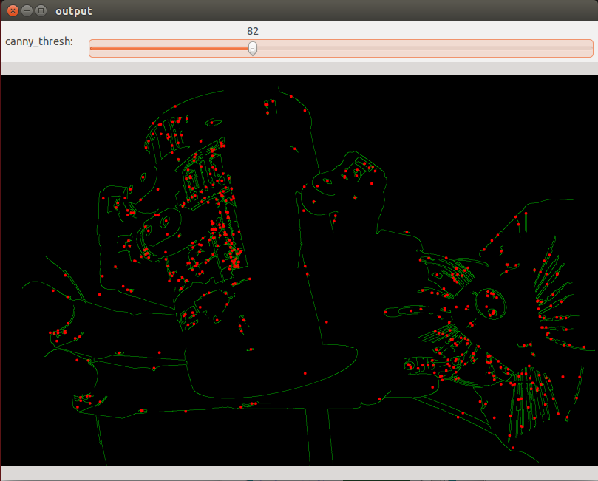
Contour segmentation + moments
Segmenting contours et getting their moments (‘moments.py’):
import cv2
import numpy as np
def thresh_callback(thresh):
edges = cv2.Canny(blur,thresh,thresh*3)
drawing = np.zeros(img.shape,np.uint8)
contours,hierarchy = cv2.findContours(edges,cv2.RETR_TREE,cv2.CHAIN_APPROX_SIMPLE)
for cnt in contours: # For each contour
  moments = cv2.moments(cnt)
if moments['m00']>0: # area of contour
    cx = int(moments['m10']/moments['m00']) #Centroid x
    cy = int(moments['m01']/moments['m00']) #Centroid y
cv2.drawContours(drawing,[cnt],0,(0,255,0),1)
cv2.circle(drawing,(cx,cy),5,(0,0,255),-1)
cv2.imshow('output',drawing)
img = cv2.imread('cam.jpg')
gray = cv2.cvtColor(img,cv2.COLOR_BGR2GRAY)
blur = cv2.GaussianBlur(gray,(5,5),0)
cv2.namedWindow('output',cv2.WINDOW_NORMAL)
thresh = 100
max_thresh = 255
cv2.createTrackbar('canny_thresh:','output',thresh,max_thresh,thresh_callback)
thresh_callback(200)
if cv2.waitKey(0) == 27: #Wait until ESC
cv2.destroyAllWindows()

Slide 17
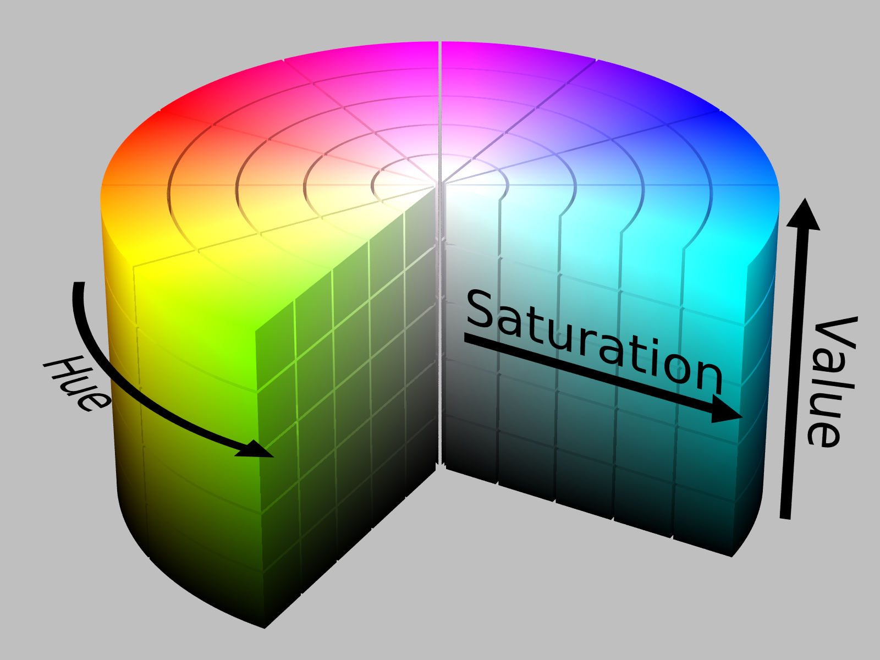
Exercise :
Tracking an object with color
Exercise (Use file ‘camera.py’ or ‘cameraPi.py’ as base) :
  Goal : Segment an object according to its color
  Inputs : Video frames from camera + desired color
  Output : Centroid of the biggest object
  Steps :
      Transform image from BGR to HSV
      Binarize image for detecting color : cv2.inRange
      Find contours of binarized image (cv2.findContours)
      Choose biggest contour (cv2.contourArea), compute centroid (moments.py) and draw it.
  Bonus :
      Choose binarization thresholds with trackbars
      Choose color (H) with the mouse by clicking on it
      Choose thresholds automatically from a ROI
      Draw a bounding box around the object

