Slide 1
Motion Metrics
Meeting 10.05.23

Slide 2

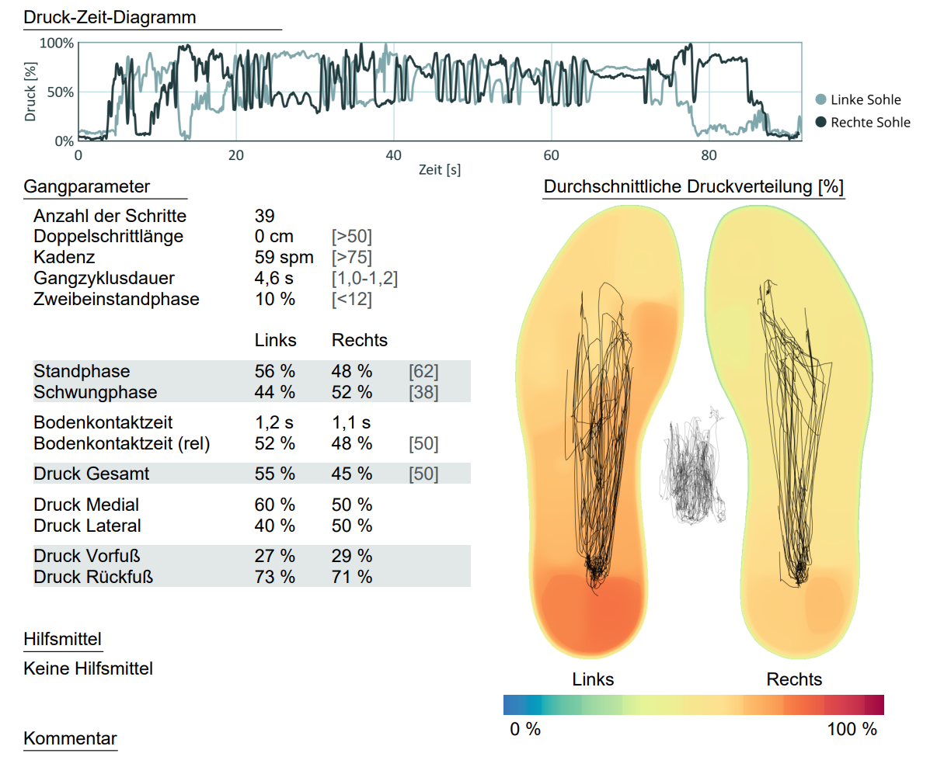
MM
Convert to BIDS
Motion data
Human supervised
Human non-supervised
Primate
Objects
Type:
Position (Marker & Non-marker)
IMU( Acc, Gyro, MAGN)
NGMT free
Build databases
Walking events
IC
FC
Balance params
Area
Time
Existing
Mobilise
IDEA-FAST
ComOn
New
….
MM report $
Develop algorithms
Walking events
Variability
Max. Speed
…
Existing
Human supervised (Minh & Felix)
Human non-supervised (Robbin)
New
….

