Slide 1
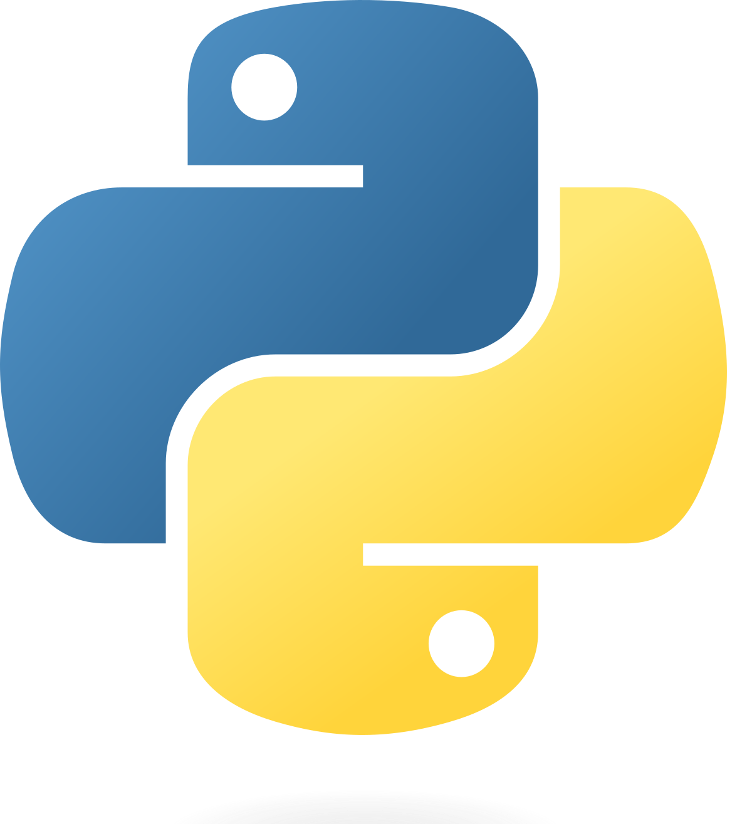
FUNCTIONS IN PYTHON
David Pak

Slide 2
01
What is a Function?

Slide 3

What is a function?
Functions are chunks of instructions/code that serve a singular purpose. Functions are used to make a program less redundant.

Slide 4
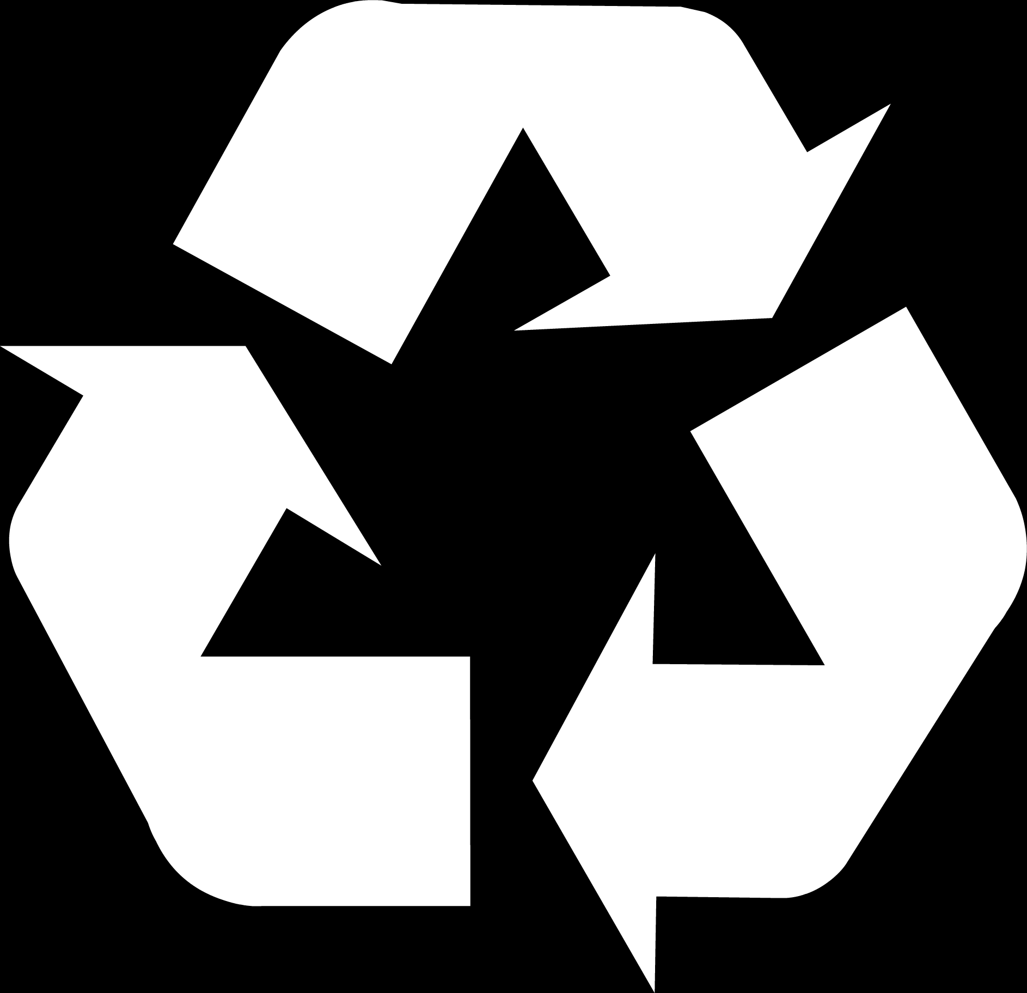
We Make Functions for Two Main Reasons
Code reusability
Don’t have to always rewrite the same code to do the same thing
Organization
Makes the program a lot more neat since there is no more unnecessary code
Code for functions written in separate areas

Slide 5
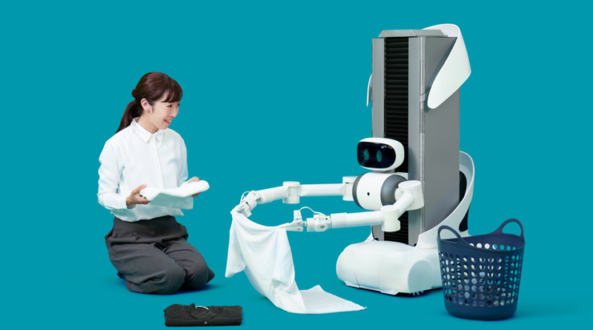
Example:Laundry bot
Imagine if you had a robot that folded your clothes for you.
Very convenient since folding clothes can get very repetitive.
You only have to give the folding instructions to the robot once
Everytime you want to fold clothes, you can just call your robot!

Slide 6
02
How Do We Code Functions?

Slide 7
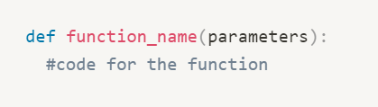
Writing Functions in Python
Every function starts with def
Short for define
Followed by the name of function
Typically related to what the function does
Ends with ():
What goes inside the parentheses?

Slide 8
03
Parameters

Slide 9
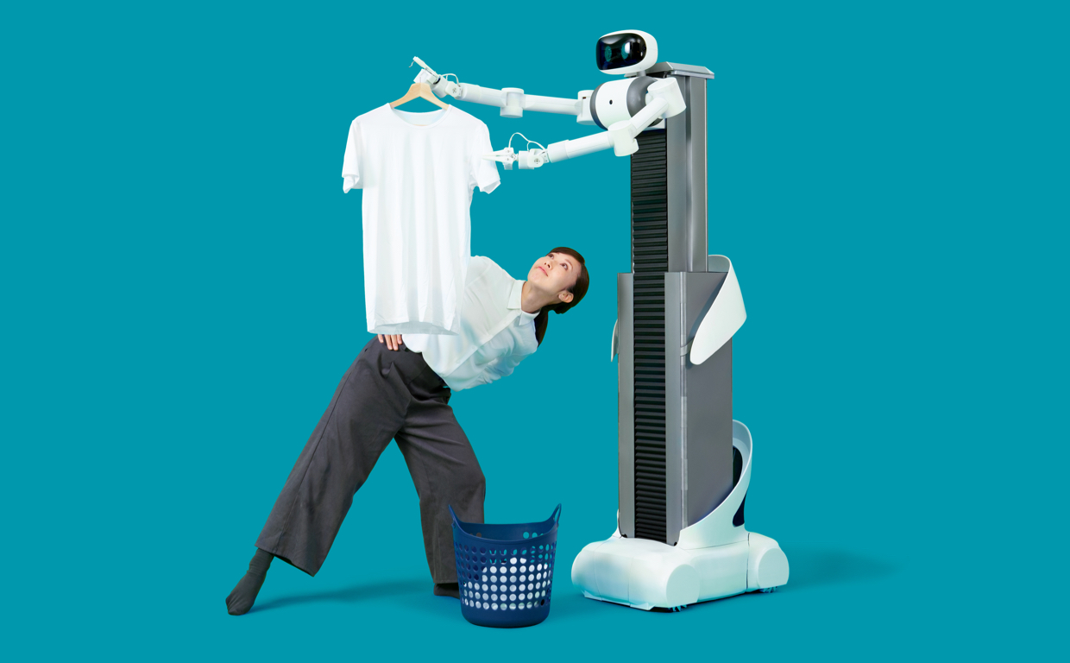
Back to Laundry Bot
The user “passes in” a shirt to the robot
Whenever you call laundry bot to fold your clothes, it needs to get the piece of clothing from you.
This is called a parameter

Slide 10


What Are Parameters
Parameters are the things that need to get inputted into the function
Examples:
Laundry bot needs a piece of clothing
Square root bot needs a number
The values of those variables are specified when you call the function

Slide 11


How Do You Call Functions?
Type the name of the function followed by parentheses
Put the value that you want to perform the function on inside the parentheses

Slide 12
Thanks!
Made by David Pak

