Slide 1
UNIT- 3
Software Design: Overview of the design process, how to characterize a good software design? Layered arrangement of modules, Cohesion and Coupling, approaches to software design. Function- Oriented Software Design: Overview of SA/SD methodology, Structured analysis, Developing the DFD model of a system, Structured Design, Detailed Design, and Design Review. User Interface Design: Characteristics of a good user interface , Basic Concepts, Types of user interfaces, Fundamentals of component based GUI development, and user interface design methodology. Coding and Testing: Coding, Code review, Software documentation, Testing , Black-box testing, White-Box testing, Debugging, Program analysis tools, Integration testing, Testing Object-oriented Programs, Smoke testing, and some general issues associated with testing.

Slide 2
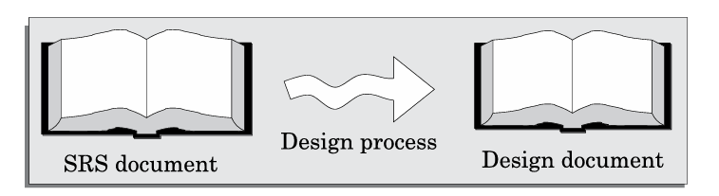
Overview of the Design Process:
The software design phase transforms the SRS document into a design document, which guides coding.
Fig: Design Process

Slide 3
Outcome of the Design Process:
Different modules required: Identify and name modules based on tasks. Control relationships among modules: Define function calls between modules. Interfaces among different modules: Specify data exchanged between modules. Data structures of individual modules: Design data storage for modules. Algorithms for modules: Define processing steps with efficiency considerations.

Slide 4
Classification of Design Activities:
Preliminary (high-level) design: Focuses on the overall system architecture. Divides the system into modules and defines their interactions. Represent using structure charts or UML diagrams.
Detailed design: Define data structures and algorithms for modules, documented in the module specification ( MSPEC).

Slide 5
Do design techniques result in unique solutions?
Designers may create different solutions due to subjective decisions.
Therefore, obtaining a good design would involve trying out several alternatives (or candidate solutions) and picking out the best one.
Analysis versus design
Analysis: Defines requirements without considering implementation, using DFDs or UML.
Design: Transforms analysis into an implementable model, defining system structure and details.

Slide 6
HOW TO CHARACTERISE A GOOD SOFTWARE DESIGN?:
A good software design varies by application type, but generally, it should have:
Correctness: It must meet all system requirements.
Understandability: It should be simple and easy to comprehend.
Efficiency: It should optimize time, cost, and resources.
Maintainability: It should be easy to modify for future changes.

Slide 7
Understandability of a Design: A Major Concern:
The best design is the most understandable. A complex design increases development and maintenance costs.
Key features of an understandable design:
Meaningful and consistent names for components.
Effective use of abstraction (hiding complexity) and decomposition (breaking down into smaller parts).
Examples:
✅ Good Design: A car has separate systems for the engine, braking, and air conditioning. Each part works independently. ❌ Bad Design: A car where the braking system also controls the air conditioning—complex and hard to fix.

Slide 8
Modularity:
A good design should be modular—dividing a problem into independent parts.
Example:
A banking system has separate modules for customer accounts, transactions, and loans. Each works independently but interacts when needed.

Slide 9
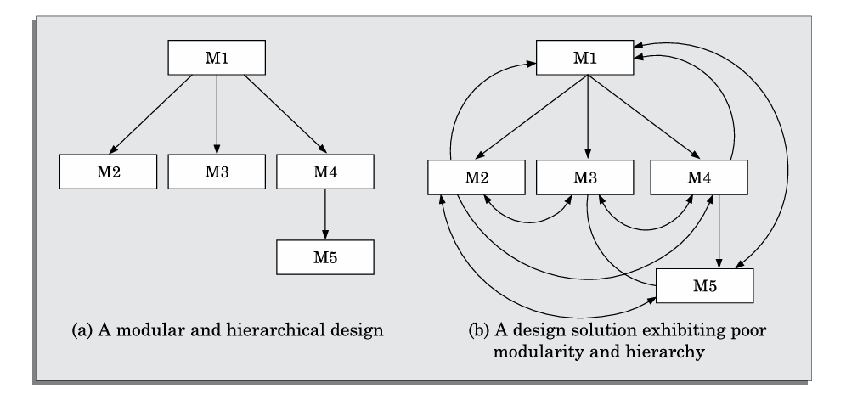
Fig: Two design solutions to the same problem.

Slide 10
A well-modularized system (as in Figure (a)) is easier to manage, scale, and debug.
While a poorly structured system (Figure (b)) increases complexity, making it prone to errors and difficult to maintain.
Good modularity means high cohesion and low coupling!

Slide 11
Layered Design:
A well-structured system should have layers, like:
Presentation Layer (User Interface)
Business Logic Layer (Processing Data)
Database Layer (Storing Data)
Example:
A shopping app has a UI for users, a backend for order processing, and a database for storing purchase history.

Slide 12
Cohesion and Coupling in Software Design:
A good software design has high cohesion (modules focus on one task) and low coupling (minimal dependency between modules).
Cohesion (High is Good ✅)
Definition: Cohesion measures how closely related and focused the functions within a module are.
High Cohesion (Good Design): A module performs a single, well-defined task.
Low Cohesion (Bad Design): A module does too many unrelated tasks, making it difficult to understand and maintain.

Slide 13
Example: ✅ High Cohesion: (Good Design)
A Remote Control is designed only for controlling the TV (power, volume, channels).
A TV handles only display, audio, and input processing.
Each has a single, well-defined function, making the design clean and modular.
❌ Low Cohesion (Bad Design):
A Remote that also functions as a calculator, flashlight, and gaming console—too many unrelated tasks!
A TV that also works as a refrigerator—unrelated features in the same module.

Slide 14
2. Coupling (Low is Good ✅)
Definition: Coupling measures how dependent modules are on each other.
Low Coupling (Good Design): Modules interact minimally and are independent.
High Coupling (Bad Design): Modules depend too much on each other, making changes difficult.

Slide 15
✅ Low Coupling (Good Design):
A TV and a Remote Control communicate only through infrared signals.
The remote doesn’t need to know the internal circuits of the TV.
If the remote breaks, you can replace it without affecting the TV.
❌ High Coupling (Bad Design):
Imagine a TV and Remote connected by wires inside the TV.
If you change the remote, you must open the TV and rewire everything.
If one part fails, the whole system is affected.

Slide 16
Functional Independence
A module should perform a single task with minimal interaction with others.
Benefits:
Error Isolation: Bugs don’t spread across modules.
Scope of reuse: Independent modules can be reused easily.
Understandability: Simplifies system design.

Slide 17
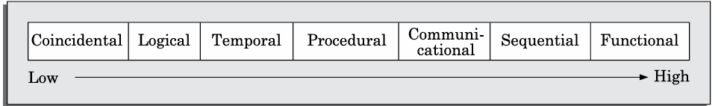
Classification of Cohesiveness:
Cohesion levels (worst to best):
Fig: Classification of cohesion.

Slide 18
Coincidental Cohesion (Worst) ❌
Random and unrelated collection of functions are grouped together.
Example: A "Library Module" that handles book lending, staff leave, and cafeteria orders.
2. Logical Cohesion:
Functions performing similar tasks but with different purposes.
Example: A module containing functions for printing grade sheets, salary slips, and annual reports.

Slide 19
3. Temporal Cohesion
Functions executed together because they run at the same time.
Example: A startup module initializing memory, OS loading, and hardware checks.
4. Procedural Cohesion:
Functions executed sequentially but with different objectives.
Example: A billing system where login, placing orders, and logging out happen in sequence.

Slide 20
5. Communicational Cohesion:
Functions operate on the same data structure.
Example: A Student Module managing student admissions, grades, and attendance using the same database.
6. Sequential Cohesion:
One function’s output is the next function’s input.
Example: In an e-commerce system, "Create Order → Check Availability → Place Order on Vendor."

Slide 21
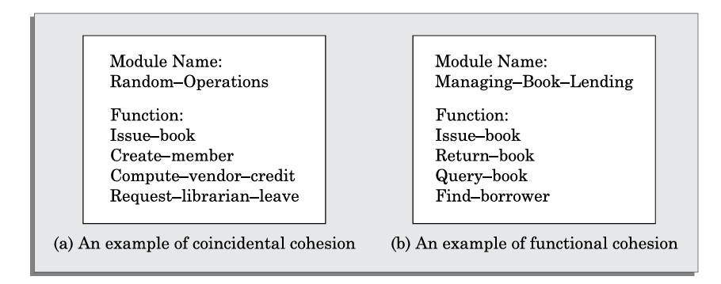
7. Functional Cohesion (Best) ✅
All functions work together for a single, well-defined purpose.
Example: A Payroll Module handling salary calculation, deductions, and payslip generation.
Fig: Examples of cohesion.

Slide 22
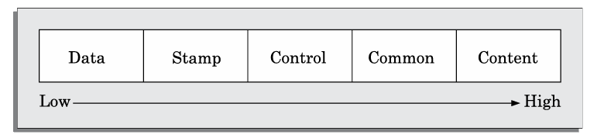
Classification of Coupling:
Coupling measures how dependent two modules are on each other.
Lower coupling is better because it makes the system easier to maintain and scale.
Fig: Classification of coupling.

Slide 23
Types of Coupling (Worst to Best) :
1. Content Coupling (Worst) ❌
One module modifies or jumps into another module’s code directly.
Example: A function in Module A directly edits variables inside Module B.
2. Common Coupling
Modules share global variables, leading to unexpected side effects.
Example: Multiple functions modifying the same global database variable.

Slide 24
3. Control Coupling
One module controls another by passing flags or switches that affect execution.
Example: Module A sends a mode flag to Module B, which changes its behavior.
4. Stamp Coupling
Modules share entire data structures instead of just needed data.
Example: Passing a full student record to a function that only needs the student’s name.

Slide 25
5. Data Coupling (Best) ✅
Modules share only essential data (simple variables).
Example: A function that calculates a student's grade receives only marks as input.

Slide 26
Layered Arrangement of Modules
The control hierarchy organizes program components based on their call relationships.
It defines the order in which modules call each other.
A structure chart (tree-like diagram) is the most common notation used.
Other notations, like Warnier-Orr and Jackson diagrams, exist but are less commonly used today.

Slide 27
Layered Design
In a layered design, modules are arranged in layers based on their call relationships:
A module can only call lower-layer modules.
It cannot call modules in the same or higher layers.
Fig (a) shows a proper layered design, whereas Figure (b) represents a non-layered design where all modules exist in a single layer.
Layered design promotes control abstraction, making the system easier to understand and debug.

Slide 28
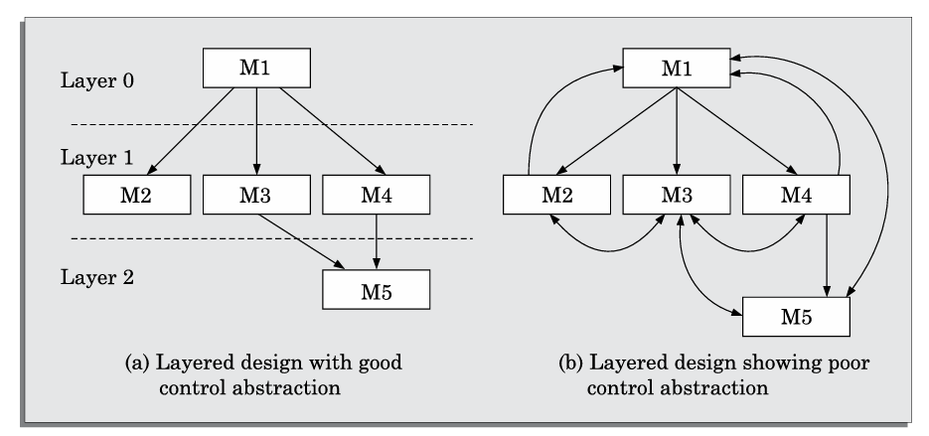
Fig: Examples of good and poor control abstraction.

Slide 29
Significance of Layered Design:
The top-most module acts as a manager, calling lower-level modules.
Intermediate modules provide services to higher layers while performing some tasks.
Lowest-layer modules (worker modules) execute tasks independently without calling any other module.
Layered design makes debugging easier since errors only affect higher-layer modules, reducing troubleshooting time.

Slide 30
Key Concepts:
1. Superordinate and Subordinate Modules:
A superordinate module controls another module.
A subordinate module is controlled by another module.
2. Visibility:
Module M2 is visible to module M1, if M1 directly calls M2.
3.Control Abstraction:
Higher-layer modules should not be visible to lower-layer modules.

Slide 31
4.Depth and Width:
Depth = Number of layers.
Width = Number of modules per layer.
Example: In Figure (a), depth = 3, width = 3.
5. Fan-Out and Fan-In:
Fan-Out: Number of modules directly controlled by a module.
Example: In Figure (a), M1 has a fan-out of 3.
High fan-out (>7) indicates poor cohesion.

Slide 32
Fan-In: Number of modules calling a module.
Example: In Figure (a), M1 has fan-in = 0, M2 = 1, M5 = 2.
High fan-in promotes code reuse and is desirable in a good design.
A layered approach ensures better system organization, easier debugging, and improved maintainability.

Slide 33
Approaches to Software Design –
Software design has two main approaches:
Function-Oriented Design (FOD)
Object-Oriented Design (OOD)

Slide 34
Function-Oriented Design (FOD)
Top-down decomposition: The system starts as a black box, and large functions are broken into smaller ones.
What is a Black Box?
A black box refers to a system or component where we know the inputs and outputs but do not see or understand the internal working.
Example 1: Coffee Machine
Example: A Library Management System may have:
assign-membership-number()
create-member-record()
print-bill()

Slide 35
Centralized system state:
Data is shared globally, and multiple functions access it.
Example:
A fire alarm system stores room alarm status in a global list that functions like ring_alarm() and reset_alarm() access.
Popular Methods:
Structured design by Constantine and Yourdon [1979]
Jackson’s structured design by Jackson [1975]
Warnier-Orr methodology [1977, 1981]
Step-wise refinement by Wirth [1971]
Hatley and Pirbhai’s Methodology [1987]

Slide 36
2. Object-Oriented Design (OOD):
Objects & Methods:
The system is built as a collection of objects (real-world entities). Each object has data (attributes) and functions (methods).
Example: In a Library System, a Member is an object with:
Member_ID (data)
Borrow_Book() (method)

Slide 37
Decentralized data:
Each object manages its own data instead of sharing global data.
Example: In a fire alarm system, each detector, alarm, and sprinkler is a separate object with its own status and location.

Slide 38
Key Concepts:
Encapsulation: Data is private and accessed only through methods.
Abstraction: External entities don’t know how data is stored (like a stack using arrays or linked lists).
Inheritance: Objects can inherit features from a parent class (e.g., a Library_Member can be a Student_Member or Faculty_Member).

Slide 39
FOD vs. OOD
Feature | Function-Oriented Design | Object-Oriented Design
Basic Unit | Functions & Modules | Objects & Classes
Data Handling | Shared Global Data | Private Data in Objects
Design Focus | Processes/Verbs (e.g., update-record()) | Real-World Entities/Nouns (e.g., Member, Book)
Example | Payroll system with get-employee-details() function | Payroll system with Employee object storing details

Slide 40
FOD is simpler for small projects but harder to manage in large systems.
OOD is better for complex systems like AI applications, banking software, and gaming.
Both approaches can be combined – OOD for system design, FOD for internal methods.

Slide 41
Automated Fire - Alarm System – An Example
Imagine a smart fire alarm system in a large building. It has smoke detectors, alarms, and sprinklers that work together to detect and respond to fires.
How It Works?
Smoke Detectors detect smoke in a room.
The system identifies the room location where smoke is detected.
Fire Alarms ring in nearby rooms to alert people.
Sprinklers activate to put out the fire.
A warning message is displayed on the security team’s computer.
After the fire is handled, the firefighter resets the system.

Slide 42
1. Function-Oriented Approach (FOD)
The system is broken into functions like:
Detect_Smoke()
Find_Location()
Activate_Alarm()
Activate_Sprinkler()
Reset_System()
Problem: All functions share global data (e.g., smoke status of rooms), which makes debugging harder.

Slide 43
2. Object-Oriented Approach (OOD) :
The system has objects, each with its own data and methods:
Detector object: senses smoke
Alarm object: rings the alarm
Sprinkler object: activates water spray
Objects only communicate through messages, making the system modular and easier to manage.

Slide 44
Function-Oriented Design Techniques:
Function-oriented design techniques have been widely used for decades and remain popular in software development.
These techniques begin by viewing a system as a black-box that provides high-level functions (e.g., issuing or searching for a book in a Library Automation System).
These functions are progressively decomposed into detailed functions through top-down decomposition.

Slide 45
After decomposition, the identified functions are mapped to modules, forming a module structure that meets good design principles.
Instead of focusing on a single design methodology, this text presents a general approach incorporating essential features from various function-oriented design methodologies, including those by DeMarco & Yourdon, Constantine & Yourdon, Gane & Sarson, and Hatley & Pirbhai.
This approach, known as Structured Analysis/Structured Design (SA/SD) methodology, is used for high-level software design.

Slide 46
Overview of SA/SD Methodology:
SA/SD methodology consists of two key activities:
Structured Analysis (SA) – Transforms the SRS document into a Data Flow Diagram (DFD) model through functional decomposition.
Structured Design (SD) – Converts the DFD model into a structure chart, which represents the high-level design or software architecture.

Slide 47
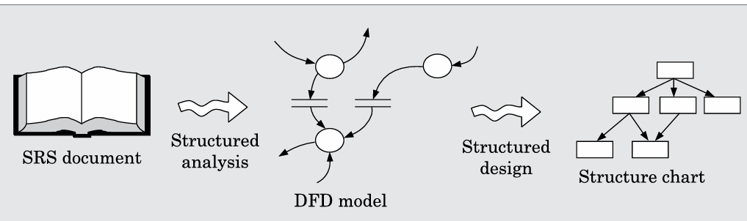
Fig: Structured analysis and structured design methodology.
In structured analysis, functions and data are labeled using user terminology, making the results understandable and reviewable by users.
The detailed design stage follows, where module algorithms and data structures are designed and implemented using a programming language.

Slide 48
STRUCTURED ANALYSIS:
Structured analysis involves breaking down high-level functions into detailed functions while representing data flow graphically.
It follows a top-down decomposition approach and applies the divide and conquer principle.
The Data Flow Diagram (DFD) technique, introduced by Gane & Sarson (1979) and DeMarco & Yourdon (1978), is widely used for representing system processes and data flow.

Slide 49
Data Flow Diagrams (DFDs):
A DFD (Bubble chart) is a hierarchical graphical model representing a system’s processing activities and data flow. It consists of five primary symbols.
Primitive symbols used for constructing DFDs
Function (Process) → Represented by a circle (e.g., "Issue Book" in a Library System).
2. External Entity → Represented by a rectangle (e.g., "Student" or "Librarian").

Slide 50
3. Data Flow → Represented by a directed arrow (e.g., "Book Request" flowing to "Issue Book").
4. Data Store → Represented by two parallel lines (e.g., "Library Database").
5. Output → The output symbol is used when generating a hard copy of data. The notations in this text follow Yourdon’s notation, though other books may use variations, such as Gane and Sarson’s notation, where a data store may appear as a box with one open end.
DFDs ignore control flow and execution sequence, focusing purely on data movement.

Slide 51
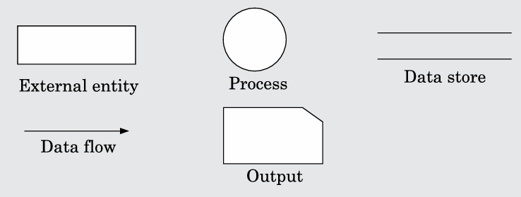
Fig: Symbols used for designing DFDs.

Slide 52
Synchronous and Asynchronous Operations:
Synchronous → If two functions are directly connected, they operate at the same speed.
(e.g., "Read Number" → "Validate Number").
The second function cannot start until it receives input from the first function.
Here, "Validate Number" must wait for "Read Number" to complete before it can process the data.

Slide 53
Asynchronous → If connected through a data store, they operate independently.
One function can store data, and the other function can retrieve it later at its own pace.

Slide 54
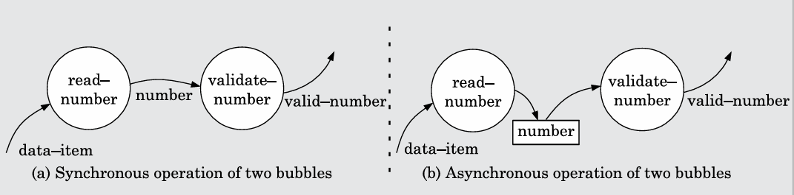
Fig: Synchronous and asynchronous data flow.

Slide 55
Data Dictionary:
A data dictionary lists all data items in a DFD model along with their definitions.
It ensures consistency and aids impact analysis (e.g., determining how changing "Salary" affects "Gross Pay").
Example:
grossPay = regularPay + overtimePay
For large systems, CASE tools automate data dictionary management.

Slide 56
Data Definition Operators:
+ (Composition) → a + b (e.g., "Name + Age" forms "Personal Info").
[ , , ] (Selection) → [a, b] (e.g., "Credit Card or Debit Card" for payment). Represents either a or b.
() (Optional Data) → a + (b) (e.g., "Middle Name" in a name field).
Either a or a+(b) occurs .
{} (Iteration) → {name}5 (e.g., "5 student names") or {name}* ("zero or more names").

Slide 57
= (Equivalence) → a = b + c (e.g., "Total Marks = Theory Marks + Practical Marks").
/* (Commenting)** → Anything between /.../ is a comment.
DFDs and data dictionaries simplify understanding, ensuring consistency in software design.

Slide 58
Developing the DFD Model of a System:
A Data Flow Diagram (DFD) graphically represents how input data is transformed into output data through various levels of detail.
It consists of a hierarchy of DFDs, with each level providing more details than the previous one.

Slide 59
Context Diagram:
The context diagram (Level 0 DFD) is the highest-level and most abstract representation of the system.
It depicts the entire system as a single bubble, labeled with a noun (e.g., "Library Management System").
It also shows external entities interacting with the system and the data flow between them.

Slide 60
Example:
For a supermarket billing system, the context diagram may have the following components:
External Entities: Customers, Suppliers, and Bank
Input Data: Product details, Payment details
Output Data: Bill receipt, Inventory update

Slide 61
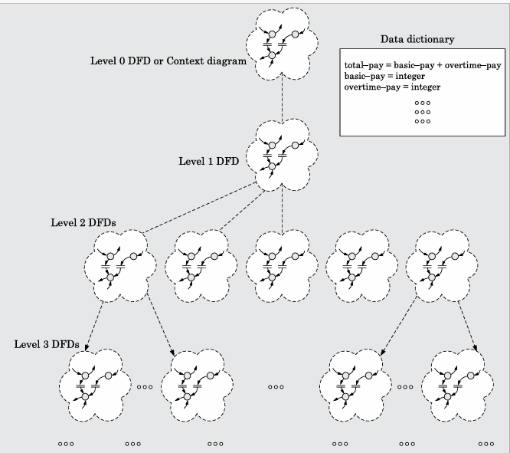
Fig: DFD model of a system consists of a hierarchy of DFDs and a single data dictionary

Slide 62
Level 1 DFD:
The Level 1 DFD provides more detail by decomposing the system into three to seven main functions, represented as bubbles.
Example: For a Library Management System, the Level 1 DFD may include:
Issue Book, Return Book, Search Book, Manage Users
Each function shows the input and output data and interactions with external entities.

Slide 63
Decomposition:
Each bubble at any level is further decomposed into sub functions at lower levels, ensuring that each function is broken down into three to seven sub functions.
Example: The "Issue Book" process in a library system may be decomposed into:
Check User Validity
Verify Book Availability
Record Issue Details

Slide 64
Numbering of Bubbles:
Bubbles in the DFD should be numbered systematically:
Level 0 DFD: Assigned 0
Level 1 Bubbles: Numbered 0.1, 0.2, 0.3, etc.
Level 2 Bubbles: Numbered 0.1.1, 0.1.2, etc.
This numbering helps identify hierarchical relationships in the DFD.

Slide 65
Balancing DFDs:
Each level of a DFD must be balanced, meaning the input and output data flow should match between parent and child bubbles.
Example: In a Hospital Management System, if Level 1 has a function "Patient Registration" that takes patient details as input and outputs a patient ID, then its decomposition (Level 2 DFD) should also show the same data flow in and out. (data flow consistency.)

Slide 66
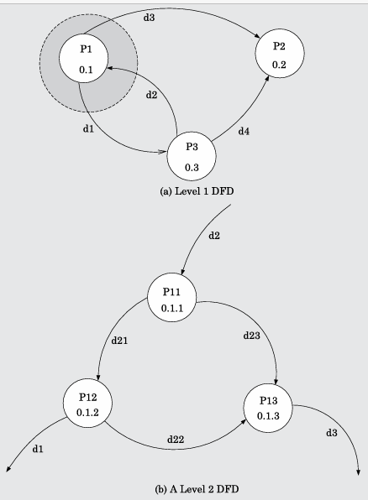
Fig: An example showing balanced decomposition.

Slide 67
How Far to Decompose?:
Decomposition should continue until each function can be expressed as a simple algorithm.
Small systems: Level 1 may be enough
Large systems: May require Level 3 or Level 4
Rarely do DFDs go beyond Level 4.

Slide 68
Common Mistakes in DFD Modeling:
1. More than one bubble in the context diagram.
The context diagram should have only one bubble.
2. Including external entities at lower levels
External entities should only be in the context diagram, not in Level 1 or below

Slide 69
3. Too few or too many bubbles per level
A DFD should have 3 to 7 bubbles per level.
More than 7 bubbles makes it difficult to understand.
4. Including control information
DFDs only represent data flow, not control flow.
5. Direct data flow between data stores or external entities
Incorrect: Data Store A → Data Store B
Correct: Data should flow through a process (bubble)

Slide 70
6. Omitting functionalities from the SRS document.
Every function from the SRS document should be represented.
7. Using unclear or symbolic data names
Incorrect: Naming data items as A, B, C
Correct: Use meaningful names like Customer_Details, Invoice_No
8. Too many data flow arrows
If a bubble has more than 7 data flows, they should be grouped into a higher-level data item.

Slide 71
Example: Instead of showing separate arrows for "First Name", "Last Name", and "DOB", use a single arrow labeled "Customer Details".

Slide 72
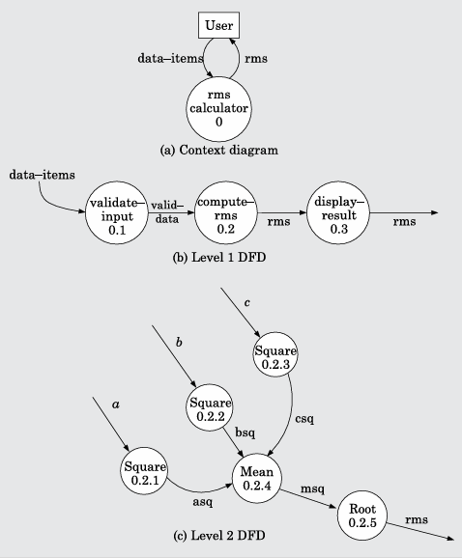
Example 1: RMS Calculation for a Set of Numbers
Eg: Context diagram, level 1, and level 2 DFDs for Example 1
Other Examples Include
tic-tac-toe software
Supermarket Prize Scheme software
trade-house automation system
personal library software

Slide 73
Shortcomings of the DFD model
The DFD (Data Flow Diagram) model has several shortcomings:
1. Imprecision: DFD labels may not fully capture a function's complexity, leading to vague understanding. For example, a label like "find book-position" doesn't explain what happens if the book is missing or if there is incorrect input.
2. Undefined Control Aspects: DFDs don't specify the order in which inputs are processed or outputs are produced, which is crucial for real-time systems.

Slide 74
3. Decomposition Issues: The process of breaking down a system into sub-levels is subjective and depends on the analyst's judgment. Different analysts may create different DFDs for the same problem, making it hard to say which is the best representation.
4. Lack of Guidance: DFDs don't provide clear instructions on how to decompose functions into sub-functions, requiring subjective judgment.

Slide 75
Extending DFD Technique to make it Applicable to Real-time Systems
To apply DFDs to real-time systems, control and event flow aspects must be explicitly represented due to strict timing requirements. The Ward and Mellor technique introduces dashed bubbles for control processes and dashed lines for control flows.
Alternatively, Hatley and Pirbhai separate data processing and control processing into two different diagrams. They use a Control Flow Diagram (CFD) and link it to the DFD with a solid bar reference, which connects the control specification (CSPEC).

Slide 76
CSPEC contains:
A State Transition Diagram (STD), which shows sequential behavior.
A Program Activation Table (PAT), which shows the order of process activations.
This method helps manage complex real-time system designs.

Slide 77
STRUCTURED DESIGN:
Structured design converts the DFD model into a structure chart, which represents the software architecture, including modules, dependencies, and data flow.
The chart focuses on module structure and interaction, not specific procedural details.

Slide 78
Building blocks of a structure chart:
Rectangular boxes represent modules, labeled with their names.
2. Module invocation arrows show which module calls another.
3. Data flow arrows are small arrows appearing alongside the module invocation arrows and represent the transfer of data between modules.

Slide 79
4. Library modules are frequently used and are represented with double edges.
5. Selection is shown with a diamond symbol to represent conditional execution.
6. Repetition is indicated with loops around control flow arrows.

Slide 80
Fig: Examples of properly and poorly layered designs

Slide 81
Flow Chart vs. Structure Chart:
Flow charts represent the control flow in a program, whereas structure charts focus on module dependencies.
Flow charts do not show data exchange or module interactions.
Structure charts suppress the sequential order seen in flow charts.

Slide 82
Transformation of a DFD Model into Structure Chart:
Structured design uses two strategies to transform a DFD into a structure chart:
Transform analysis: Applied single type of data is processed in the same way (e.g., "Process Order").
Transaction analysis: Used when different types of data are processed in different ways. (e.g., different payment methods).

Slide 83
Whether to apply transform analysis or transaction analysis in a DFD:
Transform Analysis: Apply if all input data flows are processed similarly (i.e., they are handled in the same way by the same process/bubble). It's used for simple processing at lower levels of the DFD where a single function can handle all inputs.
Example: A "Process Order" bubble that handles all customer orders similarly—validating, calculating price, and generating an invoice all in the same way.
Transaction Analysis: Apply when input data flows are processed differently, meaning each flow represents a different type of processing or transaction.
Example: A "Process Payment" bubble where different types of payments (credit, debit, cash) are processed differently, requiring separate transactions for each payment type.

Slide 84
Transform Analysis:
This approach identifies the primary modules and their input/output data:
Input: Transforms data from physical to logical form.
Processing: The main functionality.
Output: Transforms data back to physical form.

Slide 85
The structure chart is created by drawing modules for each of these components and placing them under a root module.
This is followed by factoring, which breaks high-level modules into sub modules, including error handling and initialization processes.
Example: If a DFD shows a "Process Order(root)" bubble, transform analysis would break it into modules like "Validate Order" (input), "Process Payment" (processing), and "Generate Receipt" (output).

Slide 86
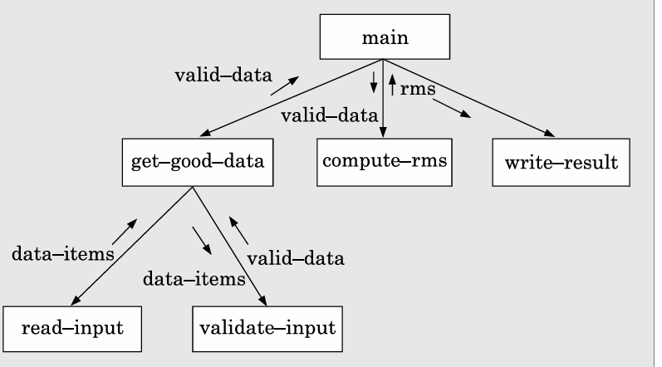
Structure chart for the RMS software:
Fig: Structure chart for Problem RMS Software

Slide 87
DETAILED DESIGN:
In detailed design, the focus is on creating pseudo-code and data structures for the modules in the structure chart.
The design is documented in Module Specifications (MSPEC), which are typically written in structured English.
For non-leaf modules, the MSPEC describes how responsibilities are delegated to lower-level modules.

Slide 88
For leaf-level modules, the MSPEC includes algorithmic steps for processing.
To create the MSPEC, designers refer to the DFD model and the SRS document.
Example: If a module in the structure chart is "Validate Order," the MSPEC will specify the steps for validating customer details, checking inventory, and calculating the total price.

Slide 89
DESIGN REVIEW:
After the design, a review team (including coders, testers, analysts, and maintainers) ensures the design is accurate and feasible. The team checks for:
Traceability: Ensure each DFD bubble is linked to a module in the structure chart.
Correctness: Verify algorithms and data structures are correct.

Slide 90
Maintainability: Assess if the design can be easily updated.
Implementation: Confirm that the design can be efficiently implemented.

Slide 91
User Interface Design:
The user interface (UI) is how users interact with software.
A bad UI can cause confusion and frustration.
For example, if a "Save" button sometimes saves and sometimes deletes, users will be frustrated.
Designing a good UI takes time—sometimes 50% of total software development!
A planned approach avoids extra work. Imagine building a car without planning the dashboard layout—it would be a mess!

Slide 92
Characteristics of a Good User Interface:
1. Speed of Learning – Users should quickly understand how to use the UI without memorizing complex commands.
Use of metaphors and intuitive command names – Interfaces should resemble real-life objects for easy learning. Example: A shopping cart icon in an online store makes it easy to add items.
Consistency – Commands and layouts should be uniform across the application. Example: Google apps have a similar design, making them easy to navigate.

Slide 93
Component-based interface – Using standard UI components helps users feel familiar. Example: Most software uses similar "OK" and "Cancel" buttons in popups.
2. Speed of Use – Commands should be quick to access and execute. Example: Copy-paste shortcuts (Ctrl+C, Ctrl+V) save time instead of using a menu.

Slide 94
3. Speed of Recall – Users should easily remember how to use the interface even after a break. Example: A trash bin icon for deleting files is intuitive.
4. Error Prevention – The UI should reduce mistakes and avoid confusion. Example: A "Confirm Delete" popup prevents accidental file deletion.
5. Aesthetic and Attractive – A visually appealing interface enhances the user experience. Example: Colorful, well-organized buttons in mobile apps make navigation easier.

Slide 95
6. Feedback – The system should inform users about ongoing actions. Example: A loading spinner appears when a webpage is loading.
7. Support for Multiple Skill Levels – The UI should cater to both beginners and advanced users. Example: Beginners can use a menu, while experts use keyboard shortcuts.

Slide 96
8. Error Recovery (Undo Facility) – Users should be able to undo mistakes. Example: The "Undo" button in Microsoft Word allows users to revert changes.
9. User Guidance and On-Line Help – The UI should provide help when needed. Example: A help section in software with a search bar for quick solutions.

Slide 97
BASIC CONCEPTS –
User Guidance and On-line Help:
On-line help system – Provides help whenever needed. A good system gives context-based, user-friendly messages and uses graphics instead of plain text. Example: A tooltip appears when hovering over a button in an application.

Slide 98
Guidance messages – Automatically inform users about next steps, system status, or progress. Different users (beginners vs. advanced) may need different levels of guidance. Example: A wizard guiding users step-by-step in software installation.
Error messages – Should be clear, polite, and helpful. They should suggest how to fix the error and provide links to further help. Example: Instead of “System error,” a good message says, “File not found. Please check the file path.”

Slide 99
Mode-based versus Modeless Interface:
Mode-based interface – Commands depend on the system’s current mode. The user must switch modes to perform different tasks. Example: A text editor with "Insert Mode" and "Command Mode" (like in Vim).
Modeless interface – All commands are available at any time without switching modes. Example: Microsoft Word allows typing, formatting, and saving without changing modes.

Slide 100
3. Graphical User Interface (GUI) versus Text-based User Interface:
GUI Advantages:
Multiple windows allow viewing different information at the same time.
Uses icons and symbols for intuitive interaction (e.g., dragging a file to the trash).
Offers menu-based command selection.
Supports pointing devices like a mouse for easier command execution.

Slide 101
GUI Disadvantages:
Requires special graphics terminals and input devices, which were expensive in the past.
However, modern systems have affordable high-resolution displays, making GUI the standard choice today.

Slide 102
TYPES OF USER INTERFACES – These are of 3 types:
1. Command Language-based Interface
Users type commands to interact with the system.
Efficient and allows composing complex commands but is hard to learn and requires memorization.
Only works with keyboards, no mouse or visual support.
✅ Example: Using dir to list files or rm filename to delete a file in a command prompt. ❌ Drawback: A new user might forget commands or mistype them.

Slide 103
Issues in designing a command language-based interface:
Commands should be short and meaningful.
Allowing users to customize command names can help but makes UI development complex.
Advanced users may benefit from combining commands, but beginners might find it confusing.

Slide 104
2 .Menu-based Interface:
Users select options from a list instead of typing commands.
Easier for beginners since they don’t need to memorize commands.
Not as fast as typing for experienced users.
✅ Example: Right-clicking on a file to see options like "Open," "Rename," or "Delete." ❌ Drawback: If there are too many menu options, finding the right one can be hard.

Slide 105
Techniques to manage large menus:
1. Scrolling menu – When options don’t fit on the screen, users scroll to find them. Example: Choosing a font size in Microsoft Word.
2. Walking menu – Clicking a menu option opens a sub-menu next to it. Example: In Windows, selecting "File" → "Save As" opens a sub-menu.

Slide 106
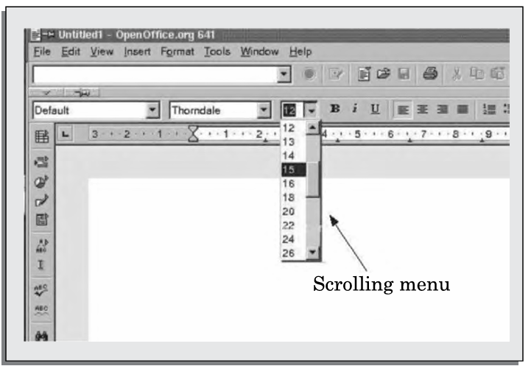
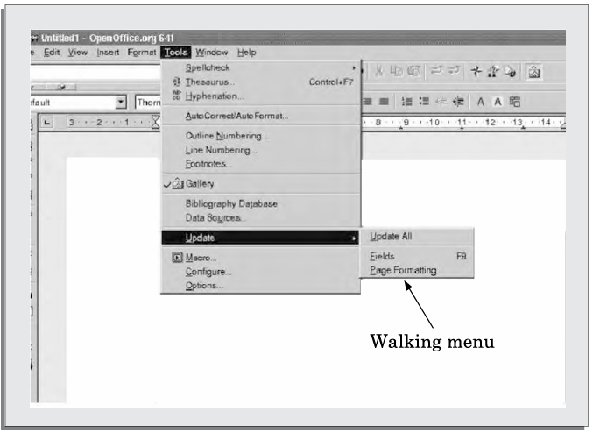
3.Hierarchical menu – Like a tree structure, choosing one option opens a new screen. Example: Navigating phone settings where tapping "Display" leads to more options like "Brightness" and "Font Size."
Fig a: Font size selection using scrolling menu.
Fig b: Example of walking menu

Slide 107
3. Direct Manipulation Interfaces
Uses visual icons instead of text commands.
Easier to understand and language-independent but slow for experienced users.
Hard to perform bulk actions (e.g., deleting many files at once).
✅ Example: Dragging a file to the recycle bin to delete it. ❌ Drawback: Deleting 100 files by dragging each one takes too long, while typing rm *.* in a command line is much faster.
Each interface type has its pros and cons, so modern applications use a mix of all three!

Slide 108
FUNDAMENTALS OF COMPONENT-BASED GUI DEVELOPMENT:
Graphical user interfaces (GUIs) gained prominence in the 1980s, primarily due to advancements in affordable graphics hardware.
Initially, developers crafted GUIs from scratch, handling low-level graphics operations.
Modern GUI development has transitioned to a component-based approach, utilizing predefined elements like menus and dialog boxes, streamlining the design process.

Slide 109
1. Window System
A window is a rectangular screen area acting as a virtual interface for users to perform tasks. It comprises:
Client Area: The primary space where applications render content.
Non-Client Area: Includes window borders, title bars, and controls, managed by the window manager.
The Window Management System (WMS) oversees the allocation and behavior of these windows, ensuring consistent operations such as moving, resizing, and minimizing.

Slide 110
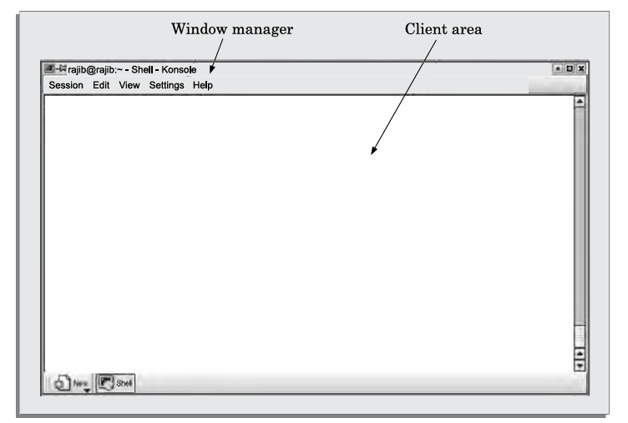
Fig: Window with client and user areas marked.

Slide 111
A WMS consists of two main components:
Window manager: Responsible for the look and behavior of windows.
Window system: Provides low-level services for creating and manipulating windows.

Slide 112
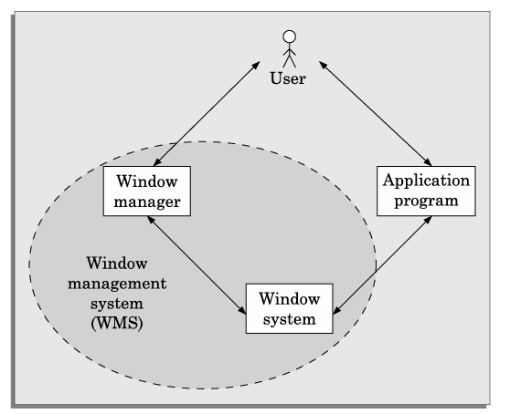
Fig: Window management system

Slide 113
Window Manager and Window System:
The window manager utilizes the window system's services to define how windows behave and appear. Multiple types of window managers can be built on the same window system, offering different features.
The application programmer can either interact with the window manager or directly invoke window system services to develop the user interface.

Slide 114
Visual Programming:
Visual programming is a drag-and-drop style of developing user interfaces, where the programmer can easily design components (like menus and dialog boxes) by placing them visually. This reduces development time significantly and supports the reuse of visual objects.
Popular examples of visual programming languages include Visual Basic and Visual C++, where GUI elements can be designed before writing the underlying application code.

Slide 115
2. Widgets in Component-Based Development:
In component-based GUI development, user interfaces are built using predefined widgets, which are high-level abstractions of window objects. Widgets are reusable, helping programmers build interfaces faster.
Widgets represent different elements of the user interface, such as:
Label widget: Displays a label without interaction.
Container widget: Contains other widgets and moves or resizes them together.
Pop-up menu: Appears temporarily when triggered.

Slide 116
Pull-down menu: A permanent menu activated by moving the cursor.
Dialog boxes: Used for selecting multiple items or entering text.
Push buttons: Trigger actions when clicked.
Radio buttons: Allow selection of a single option from many.
Combo boxes: Display a list of options when interacted with.

Slide 117
3. An Overview of X-Window/MOTIF
The X-window system is popular for developing portable GUIs, as applications developed with X-window are device-independent and can operate over a network.
X/Motif is a widely-used widget set built on top of X-window, which simplifies user interface development by providing predefined components and routines for manipulating these components.

Slide 118
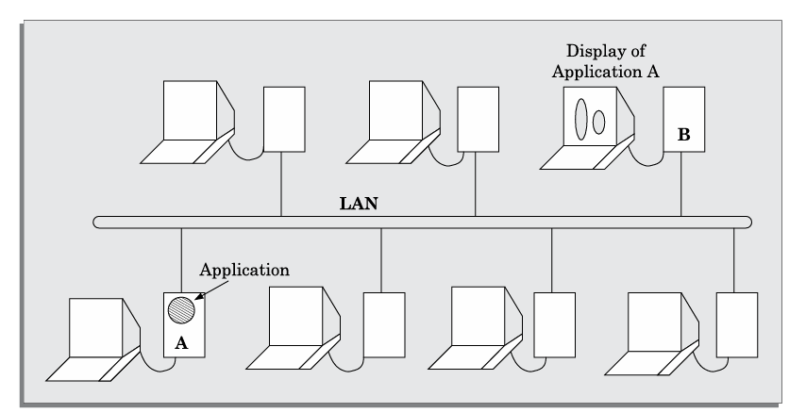
Fig: Network-independent GUI.

Slide 119
The diagram represents the X Windows System (X11) with the Motif graphical user interface, where an application (A) runs on one machine, and its graphical output is displayed remotely on another machine (B) over a LAN.
This setup allows for a client-server model, where the X server handles display rendering while the application logic executes on a separate system.

Slide 120
4. X Architecture
The X architecture consists of several key components:
X server: Runs on hardware attached to the display and manages low-level graphics.
X protocol: Defines the communication format between client applications and the X server.
Xlib: A library of routines that applications use to interact with the X server.
Xtoolkit (Xt): Provides higher-level routines for developing user interfaces, including a set of widgets and intrinsics to manipulate them.

Slide 121
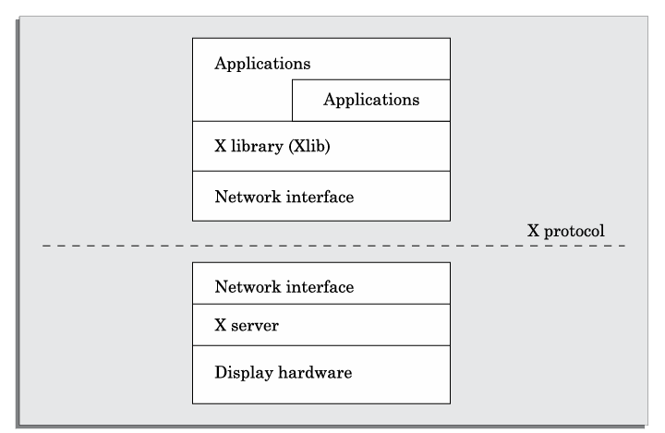
Fig: Architecture of the X System.

Slide 122
This diagram represents the X Window System (X11) architecture, where applications communicate with the X server using the X protocol over a network.
The X client (application) uses Xlib and a network interface to send requests, while the X server processes them and renders the output on the display hardware.

Slide 123
5. Size Measurement of a Component-based GUI
Measuring the size of a component-based GUI is not straightforward using traditional methods like lines of code (LOC) because the interface is made by integrating various predefined components.
An appropriate metric is widget points (wp), which counts the total number of widgets used in an interface. This measurement reflects the complexity of the interface and is independent of the environment in which the interface is implemented.
An alternative way to measure size is by counting the number of screens, but this may not accurately reflect the complexity of the interface.

Slide 124
A USER INTERFACE DESIGN METHODOLOGY:
Currently, there is no rigid step-by-step approach to designing a good user interface (UI).
Instead, designers rely on recommendations and best practices.
Most modern UI design methodologies are user-centered, but this does not mean that users themselves should design the interface. While users understand the tasks they need to perform, they lack expertise in GUI design principles.

Slide 125
Implications of Human Cognition Capabilities on UI Design:
Research in human-computer interaction has shown that human cognitive limitations influence UI design. Key considerations include:
Limited Memory: Users can retain only about seven unrelated items at a time. Designers should minimize memory load by displaying relevant information rather than requiring users to recall it.
Example: An e-commerce website should show the shopping cart contents rather than requiring users to remember what they added.

Slide 126
Frequent Task Closure: Breaking large tasks into smaller subtasks with clear completion feedback helps users feel a sense of progress.
Example: A multi-step online form should indicate when a section is completed before moving to the next.
Recognition vs. Recall: Users should recognize options rather than recall information.
Example: A dropdown list for selecting a country is better than requiring users to type it.

Slide 127
Procedural vs. Object-Oriented Design:
Procedural UI guides users step by step, ideal for well-defined tasks like ATMs.
Object-Oriented UI gives users flexibility, making it suitable for creative applications like design software.
Example: An ATM follows a step-by-step approach, while Photoshop allows users to manipulate multiple objects freely.

Slide 128
A GUI Design Methodology
Based on Frank Ludolph’s work, the UI design process includes the following steps:
Examine the use case model of the software. Interview, discuss, and review the GUI issues with the end-users
Task and object modeling
Metaphor selection
Fundamentals of Software Engineering
Interaction design and rough layout
Detailed presentation and graphics design
GUI construction
Usability evaluation

Slide 129
1. Examining the Use Case Model:
The use case model identifies key tasks users perform with the software. A UI should use metaphors to make interactions intuitive, reducing effort and training costs.
Example: A shopping cart metaphor in e-commerce makes adding and purchasing items easier. Some commonly used metaphors are the following: White board, Shopping cart, Desktop, Editor’s work bench, White page, Yellow page, Office cabinet, Post box ,Bulletin board ,Visitor’s book

Slide 130
2. Task and Object Modelling:
A task is an activity to achieve a goal, broken into subtasks. A task model visually represents this hierarchy. Similarly, an object model defines business objects users interact with.
Example: In a library system, objects include books, journals, and members.
Examples of task goals can be as follows:
Reserve an airline seat
Buy an item
Transfer money from one account to another
Book a cargo for transmission to an address

Slide 131
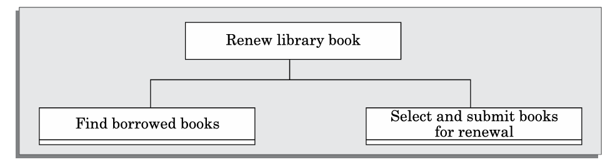
Fig: Decomposition of a task into subtasks

Slide 132
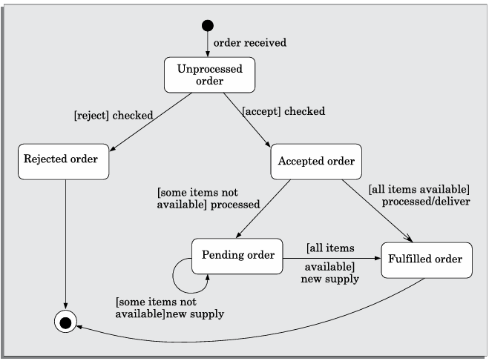
Fig: State chart diagram for an order object.

Slide 133
3. Metaphor Selection:
Metaphors should be simple, familiar, and logically match tasks. If no clear metaphor exists, designers use real-world analogies.
Example: A bulletin board metaphor works for online forums, while a desktop metaphor is used in operating systems.

Slide 134
4. Interaction Design and Rough Layout:
This step maps subtasks to UI elements like buttons, textboxes, and forms, ensuring logical placement.
Example: A login form with username and password fields placed centrally for easy access.

Slide 135
5. Detailed Presentation and Graphics Design:
Each window should represent related objects without clutter. Too many open windows cause confusion, while a single large window forces excessive scrolling.
Example: A dashboard should group related features (e.g., reports, settings, and notifications) efficiently.

Slide 136
6. GUI Construction:
Some windows require modal dialogs, where users must complete an action before proceeding. However, excessive modal dialogs can frustrate users.
Example: A confirmation dialog before deleting a file prevents accidental deletion.

Slide 137
7. User Interface Inspection:
A checklist ensures UI usability:
Visibility of System Status – Users should always know what's happening.
Example: A loading spinner while data is fetching.
Match with the Real World – Use familiar language and concepts.
Example: A trash bin for deleting files.

Slide 138
Undoing Mistakes – Users should easily reverse actions.
Example: Undo button in text editors.
Consistency – UI elements should work the same way across screens.
Example: A "Save" button always in the same location.
Recognition vs. Recall – Users should recognize options instead of recalling them.
Example: Dropdown menus for selecting a country.

Slide 139
Support for Multiple Skill Levels – Provide shortcuts for advanced users.
Example: Keyboard shortcuts in software like Photoshop.
Aesthetic and Minimalist Design – Keep screens clutter-free.
Example: A clean login page with only username, password, and login button.
Help and Error Messages – Provide clear, constructive feedback.

Slide 140
Example: "Invalid email format. Please enter a valid email like example@domain.com.“
Error Prevention – Design to minimize mistakes.
Example: Dropdown lists instead of free-text input for date selection.
By following these principles, UI designers can create intuitive, user-friendly interfaces.

Slide 141
UNIT –III
COMPLETED

