Slide 1
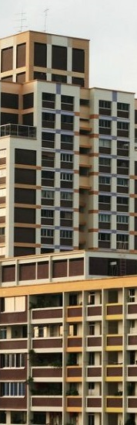
UNDERSTANDING HDB RESALE PRICES 2008 vs 2018
DAVID PANG

Slide 2
datasetS
Dwelling Units under HDB's Management, by Town and Flat Type - https://data.gov.sg/dataset/number-of-residential-units-under-hdb-s-management
Median Resale Prices for Registered Applications by Town and Flat Type - https://data.gov.sg/dataset/median-resale-prices-for-registered-applications-by-town-and-flat-type
Estimated Singapore Resident Population in HDB Flats - https://data.gov.sg/dataset/estimated-resident-population-living-in-hdb-flats Land Area and Dwelling Units by Town - https://data.gov.sg/dataset/land-area-and-dwelling-units-by-town
Resale Flat Prices (Based on Registration Date), From Jan 2017 Onwards - https://data.gov.sg/dataset/resale-flat-prices?resource_id=42ff9cfe-abe5-4b54-beda-c88f9bb438ee

Slide 3
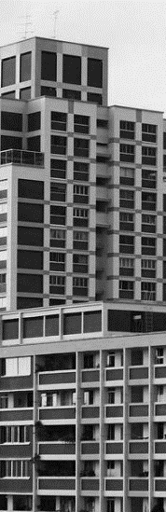
buying 4-room units the dominant choice?

Slide 4
dataset 1
Dwelling Units under HDB's Management, by Town and Flat Type - https://data.gov.sg/dataset/number-of-residential-units-under-hdb-s-management
Data shows number of units sold or rented by type per town per financial year.
All figures are as at 31 Mar of each financial year, from 2008 to 2018.
Data includes sold flats and public rental flats.
With effect from FY 2014, there are no HUDC flats under HDB's management.
Aim: To find out if 4-room units are the dominant purchased flat-type throughout the years.
No. | Name | Title | Type | Description
1 | financial_year | Financial Year | Datetime (Financial Year) - "YYYY" | FY starts on 1 April,ends on 31 March
2 | town_or_estate | Town or Estate | Text (General) | e.g. Bukit Timah and Marine Parade.
3 | flat_type | Flat Type | Text (General) | From FY 2015 onwards, 2-room sold flats include 2-Room Flexi flats.
4 | sold_or_rental | Sold or Rental | Text (General) | -
5 | no_of_dwelling_units | Number of Dwelling Units | Numeric (General) | -

Slide 5
analysis process
load the data from text file with NumPy.loadtxt.
filter the data with ‘sold units’ only and remove ‘rental units’.
create new NumPy array with year, flat type and no. of dwelling units. this is done by summing up all units for each flat type regardless of town area.
include additional array element for HUDC units as 0 from 2014-2019. HUDC units are no longer provided so they need to be created.
create a dictionary: keys are the flat-type. values are the arrays of total units for each year.
plot a matplotlib stacked bar chart of total units for each flat type per year. different colors to represent the different flat-type. intention here is to identify if 4-room units occupy the largest proportion.
plot a matplotlib pie chart of percentage of each flat type in 2008 and 2018 only. intention here is to use the extreme time ends of the dataset. to compare numerically via percentage if 4-room units are still the dominant flat-type.

Slide 6
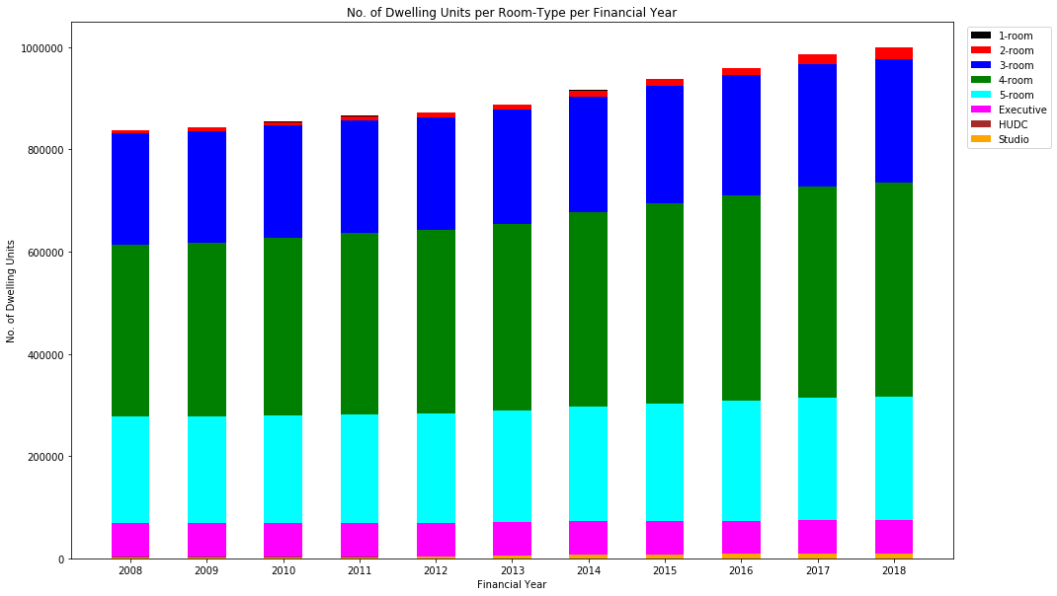
stacked bar chart

Slide 7
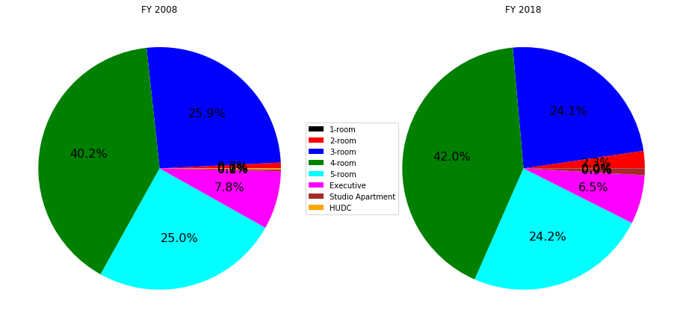
pie chart

Slide 8
RESULTS
4-room units has been the most dominant purchased unit type from FY 2008 to FY 2018. a slight increase from 40.2 to 42.0% within this 10-year difference. it does not matter that we are looking at financial years instead of actual years, since we are interested in the proportion growth of flat-type over these 10 years.
some interesting points: 5-room units dropped slightly. executive units dropped slightly too. 2-room and 3-room units increased instead. a contrast observation as singapore population deemed more affluent now. this may be due to greater number of older generation purchasing smaller flats.
since we’ve affirmed that 4-room units has been the most purchased option, we will only base the further analyses on 4-room units.

Slide 9
how much has resale price changed?

Slide 10
dataset 2
Median Resale Prices for Registered Applications by Town and Flat Type - https://data.gov.sg/dataset/median-resale-prices-for-registered-applications-by-town-and-flat-type
Data shows resale units median price recorded each quarter, sorted by town and flat type.
The data excluded transactions that may not accurately reflect the market price, i.e., resale of part shares, resale between related parties, cases under the Conversion Scheme, resale of terrace flats, converted flats, and HUDC flats.
The figures are rounded to the nearest hundred dollars. "na" indicates no resale transactions in this town and flat type. "-" refers to cases where there are less than 20 resale transactions in this town and flat type. Hence, median prices are not shown as they may not be representative.
Aim: To find out the change of 4-room units median resale price throughout the years, and to find out the % change in 2008 compared to 2018 for each town.
No. | Name | Title | Type | Description
1 | quarter | Quarter | Datetime (Quarter) - "YYYY-[Q]Q" | -
2 | town | Town | Text (General) | -
3 | flat_type | Flat type | Text (General) | -
4 | price | Median Resale Price | Text (General) | "na" : Data not available or not applicable "-" : Data is negligible or not significant

Slide 11
analysis process
load the data from text file with numpy.genfromtxt (to fill nan values) create function to convert quarter acsii values into month datetime64 values.
convert town column strings all to upper case.
filter the data with 4-room units only.
create function that fill 0 values in certain quarters to previous value. this is to avoid line graph dipping to 0.
plot a matplotlib line graph of each quarter against median resale price for each town. the plot is from 2007-Q2 to 2020-Q2. state list of towns that has too few price data points or too many 0 data points. create list of median resale prices for each town in 2008.
plot a matplotlib line graph of the top 3 towns with highest median resale price in 2008. the plot is from 2008 to 2018.
create new numpy array of town and % change of median resale price of 2008 vs 2018. % change is comparing mean median price of 2018 against 2008. plot a sorted horizontal bar chart of % change for each town.

Slide 12
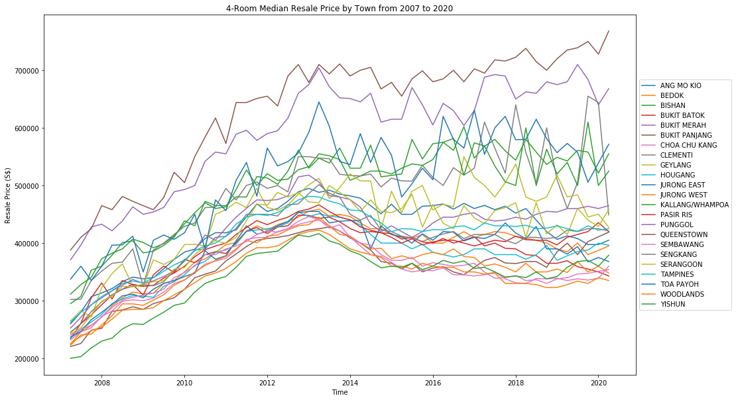
line graph

Slide 13
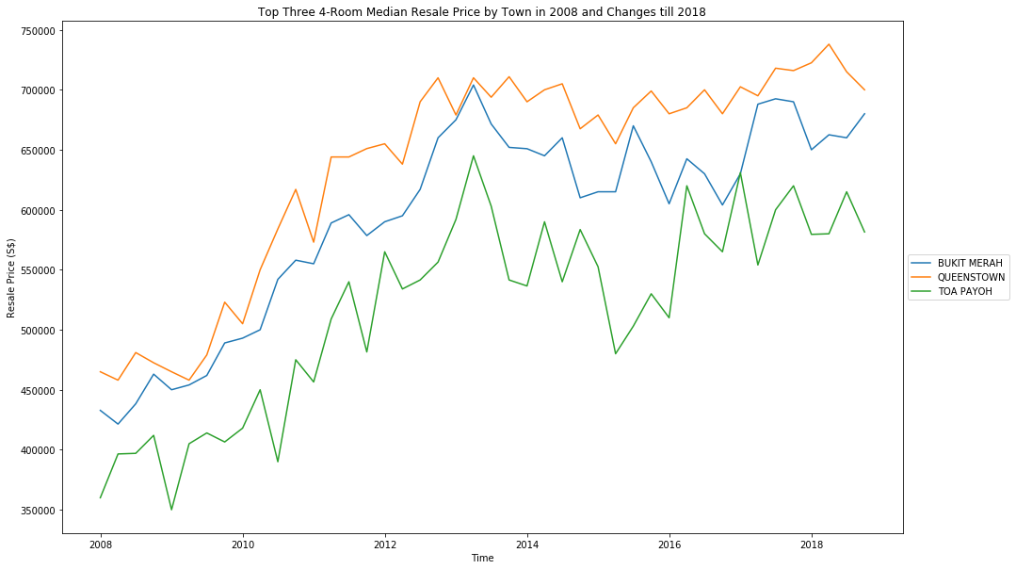
line graph

Slide 14
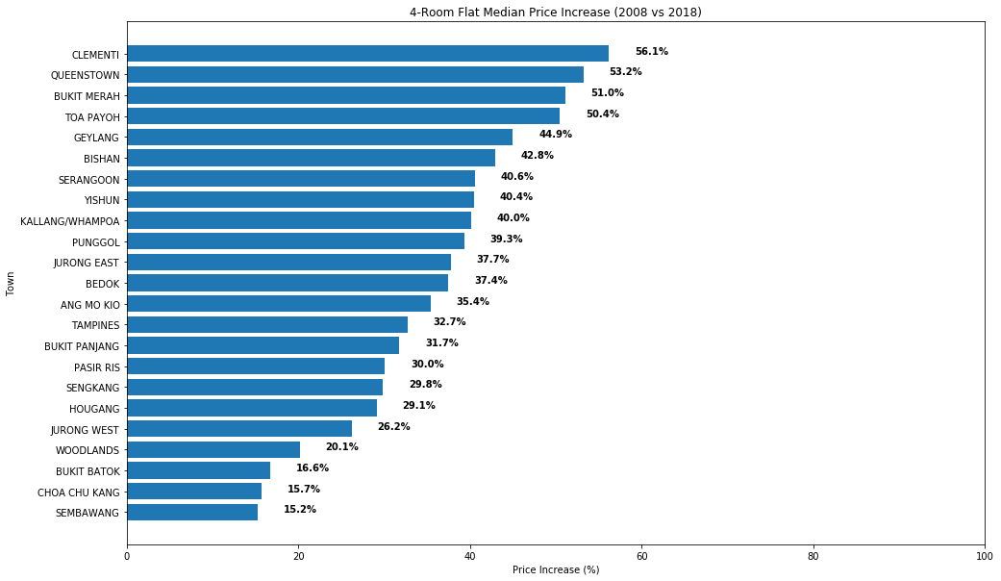
horizontal bar chart

Slide 15
RESULTS
charts shows median resale prices for 4-room flat increase from 2007 to 2020. prices started to hit a new high in 2013 before decreasing and stabilizing since 2016. the decrease coincides with several cooling measures implemented in the same year.
before looking at the % changes between 2008 and 2018 for each town, we’re particularly interested in the changes for the top 3 expensive towns in 2008. they belong to mature estates which is quite expected, and the changes were approximately 50% increase over the 10 years in 2018.
4 towns were excluded, bukit timah, central, central area & marine parade. looking at the remaining 23 towns or estates over these 10 years, centralized mature estates had larger % increases compared to new/fringe estates. this leads to us ponder about the following 2 questions: - is population/pop. density in the town related to the median resale price? - is given median resale price reliable? how about a cross-check with the available transactions data?

Slide 16
relationship between town population & resale median price?

Slide 17
dataset 3 (in conjunction with dataset 2)
Estimated Singapore Resident Population in HDB Flats - https://data.gov.sg/dataset/estimated-resident-population-living-in-hdb-flats Land Area and Dwelling Units by Town - https://data.gov.sg/dataset/land-area-and-dwelling-units-by-town
Singapore Resident Population data shows resident population in HDB flats for each town.
Population figures rounded off to the nearest ’00.
Population figures include residents living in sold or rental units, and they refer to Singaporeans and Permanent Residents only.
Because population data is based on financial year, mean median resale price will be from last 3 quarters of actual year and first quarter of subsequent year from the previous median resale price dataset.
Aim: To find out the relationship between town population and 4-room median resale price
for each town in 2008 and 2018 respectively.
To find out the relationship between town population density and 4-room median resale price for each town in 2008 and 2018 respectively.
No. | Name | Title | Type | Description
1 | financial_year | Financial Year | Datetime (Financial Year) - "YYYY" | Financial year starts on 1 April and ends on 31 March
2 | town_or_estate | Town or Estate | Text (General) | -
3 | population | HDB Resident Population | Numeric (General) | -

Slide 18
analysis process
load the pop data from text file with numpy.loadtxt.
filter the pop data for financial year 2008 and 2018 respectively. filter price data according to year-quarter required instead of using .astype(object).year equals to year directly.
convert all town strings in pop data to upper cases.
do a len check for both price and pop datasets.
do a cross-reference check for both price and pop datasets. this is to ensure if the ordered elements belong to the same town. if they are not in same order, a swap or removal from the pop dataset is required.
create a numpy array with town, price and population for 2008 and 2018 each.
plot a matplotlib scatter plot with 2 subplots, the upper for 2008, lower for 2018. plot each town population against the 4-room mean median resale price. annotate each data points with the respective town names. use np.polyfit to plot the trend line. use np.corrcoef to show the correlation coefficient between the two parameters.
repeat the same procedures for population density against median resale price plots.

Slide 19
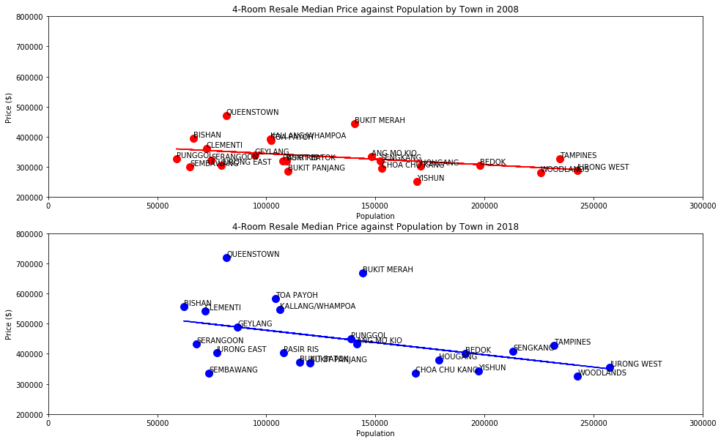

scatter plot (Price v population)

Slide 20
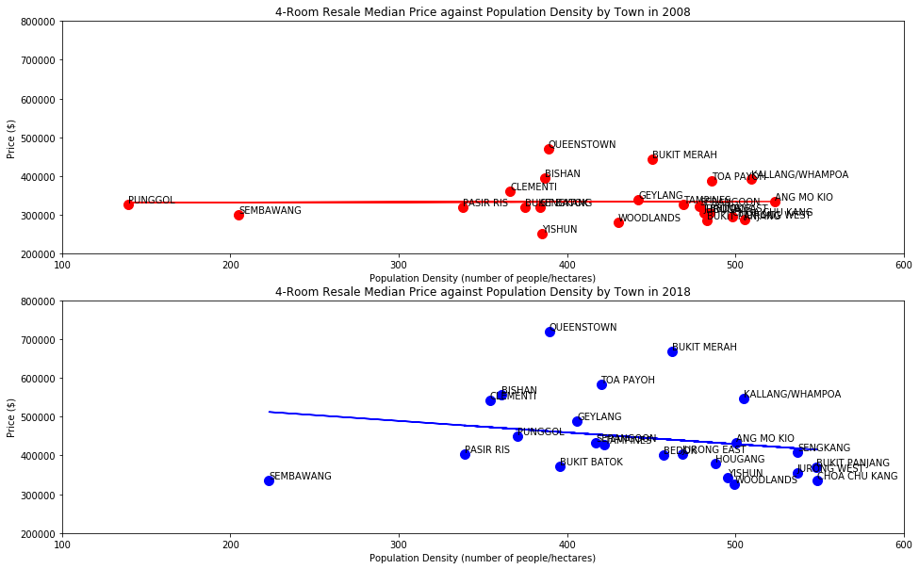

scatter plot (Price v population density)

Slide 21
RESULTS
from the population against median resale price plots in 2008 & 2018, both showed a negative correlation, meaning the higher the town population, the lower the 4-room median resale price. however, the correlation relationship is deemed weak, as the correlation coefficient are both below -0.5.
we can observe strong population growth though in certain new towns in these 10 years, like Sengkang and Punggol, whereas the mature estates showed little or stagnant population growth.
from the population density against median resale price plots, nothing conclusive can be observed. this came rather as a surprise since we would expect a similar negative correlation between the two parameters, if not a stronger relationship. one would have expected that since mature estates are nearer to city center and land allocation is scarce, higher demand for the units in these estates due to convenience and amenities would have jacked up the resale prices.

Slide 22
IS THE GIVEN MEDIAN RESALE PRICE RELIABLE?

Slide 23
dataset 4 (in conjunction with dataset 2)
Resale Flat Prices (Based on Registration Date), From Jan 2017 Onwards - https://data.gov.sg/dataset/resale-flat-prices?resource_id=42ff9cfe-abe5-4b54-beda-c88f9bb438ee
Data shows all individual resale transacted prices from 2017 onwards.
The transactions exclude resale transactions that may not reflect the full market price such as resale between relatives and resale of part shares..
Aim: To compare data obtained median price against given median price in 2018 only. To find out proportion of 4-room transactions for each town in 2018 only.
No. | Name | Title | Type | Description
1 | month | Month | Datetime (Month) - "YYYY-MM" | -
2 | town | Town | Text (General) | -
3 | flat_type | Flat type | Text (General) | -
4 | block | Block | Text (General) | -
5 | street_name | Street name | Text (General) | -
6 | storey_range | Storey range | Text (General) | -
7 | floor_area_sqm | Floor area sqm | Numeric (General) | -
8 | flat_model | Flat model | Text (General) | -
9 | lease_commence_date | Lease commence date | Datetime (Year) - "YYYY" | -
10 | remaining_lease | Remaining lease | Text (General) | Years and Months
11 | resale_price | Resale price | Numeric (General) | -

Slide 24
analysis process
load the transactions data from text file with np.genfromtxt, filling nan values with 0.
filter the data only for the year 2018, and further filter to 4-room only data.
after using np.unique in a for loop on the filtered data ‘town’, len the amount of transactions in each town, and the % of total transactions in singapore by len the entire filtered dataset.
plot a donut plot on the % of transactions for each town in 2018. this is done by using plt.pie but with wedge mark to determine the width & start angle. set the fancy boxes and arrowheads conditions using dictionaries. using pie properties, annotate the ‘town’ & ‘percentage’ at the corresponding locations.
print total number of transactions in 2018. print total number of transactions in each town and their corresponding percentages.
plot a boxplot of all transactions in each town with their resale prices. plot a scatter plot in the same plot with dataset 2, of the given median resale price. this is to identify how skewed each town plot is, and any distinct disparity from the given dataset that was used from dataset 2.
print all town median resale price from transacted data, and percentage difference from the given dataset 2 median resale price.

Slide 25
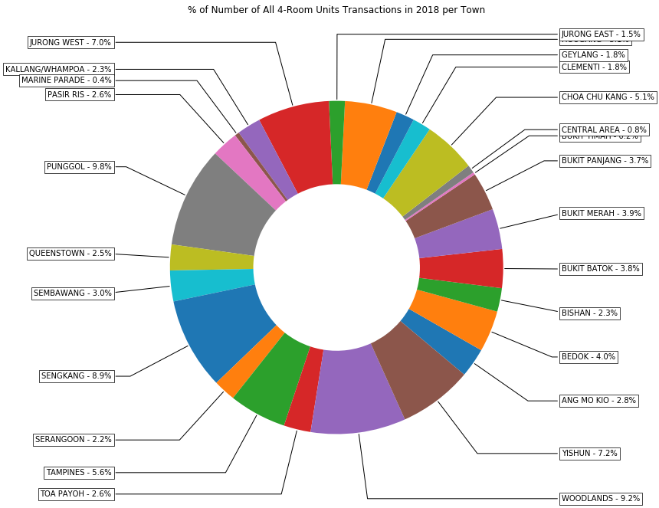
donut plot

Slide 26
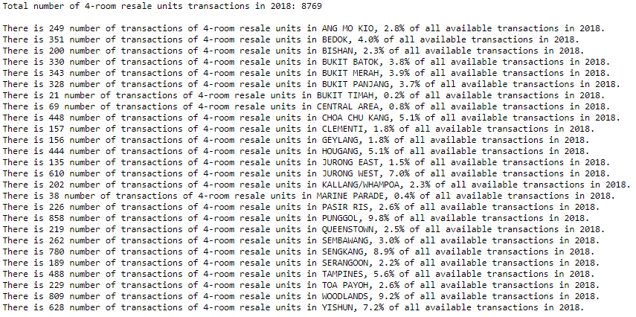
donut plot

Slide 27
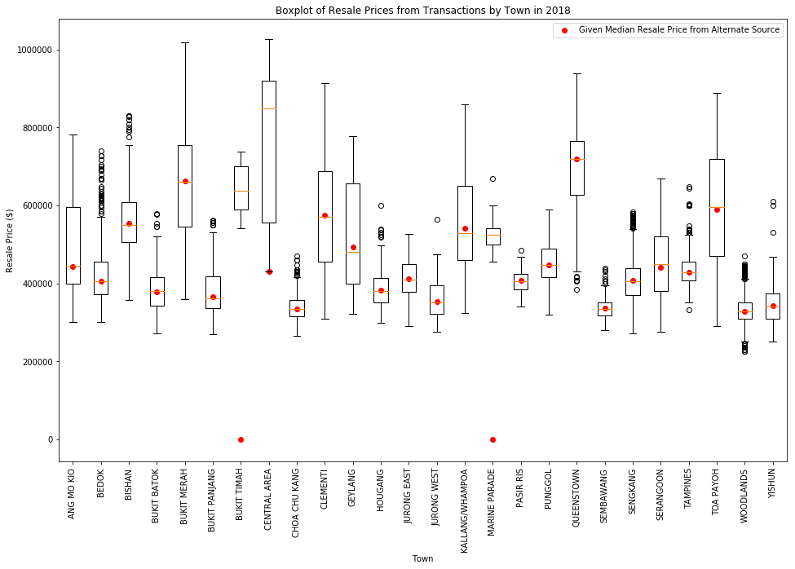
box plot

Slide 28
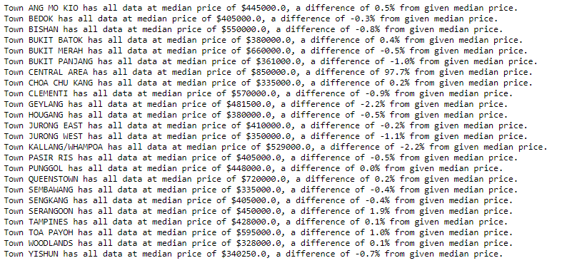
box plot

Slide 29
RESULTS
from the boxplot shown, most towns have either have a normal distribution or are positive skewed. this is also easily recognized by most anomalies occurring at the higher end.
newer towns like Punggol or Sengkang have smaller IQR, whereas mature towns like Bukit Merah or Toa Payoh have visibly higher IQR. mature town have more factors of influence on their resale prices, like accessibility and renovation condition which can dictate more changes.
from the comparison of the boxplot and scatter plot, there are very non-significant differences from the obtained median resale price via the transacted data (dataset 4), and the given median resale price in dataset 2. absolute differences range from 0.1% to 2.2%. this tells us that the given resale prices in dataset 2 are reliable. the towns excluded are bukit timah and marine parade, as there is no data from dataset 2. one distinct difference though, is seen in central area, with a difference of 98%, and after checking it’s due to dataset 2 has listed the area as central, and not central area. central and central area are two different towns/estates.

Slide 30


THANK YOU
+65 9088 6939
davidpangdaowei@gmail.com

