Slide 1

SINGAPORE WEATHER CHANGE
DAVID PANG

Slide 2
DATASETS
1. Surface Air Temperature – Monthly Mean
https://data.gov.sg/dataset/surface-air-temperature-monthly-mean
2. Wet Bulb Temperature, Hourly
https://data.gov.sg/dataset/wet-bulb-temperature-hourly
3. Rainfall – Monthly Total
https://data.gov.sg/dataset/rainfall-monthly-total

Slide 3
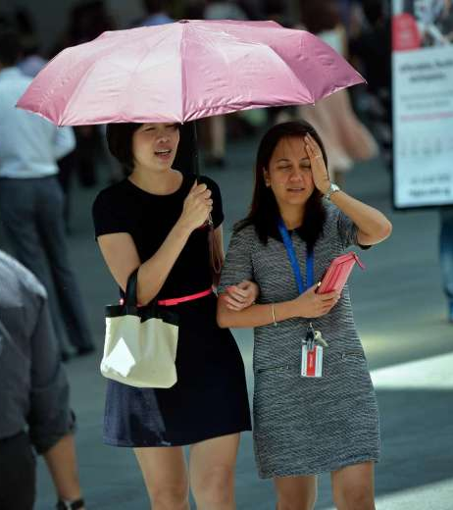
IS SINGAPORE BECOMING HOTTER?

Slide 4
DATASET 1
Surface Air Temperature – Monthly Mean
https://data.gov.sg/dataset/surface-air-temperature-monthly-mean
No. | Name | Title | Type | Unit of Measure | Description
1 | month | Month | Datetime (Month) "YYYY-MM" | - | -
2 | mean_temp | Surface Air Temperature - Monthly Mean | Numeric (General) | Degree Celsius | -
Coverage from 1st January 1982 to 31st December 2020
Source from National Environment Agency
Monthly mean air temperature recorded at the Changi Climate Station

Slide 5
ANALYSIS PROCESS
read csv file using pandas.read_csv
convert the month from string to datetime via pd.to_datetime
groupby the temp in yearly format using mean and then sort_values
plot dataframe with bar chart, annotate with yearly mean values
highlight bars in 2010s red using set_facecolor and edgecolor
create 2 more dataframe for 1980s and 2010s using filter
pd.categorical the months in month name order and pivot the dataframes
using seaborn.heatmap to create heatmaps for 1980s and 2010s

Slide 6
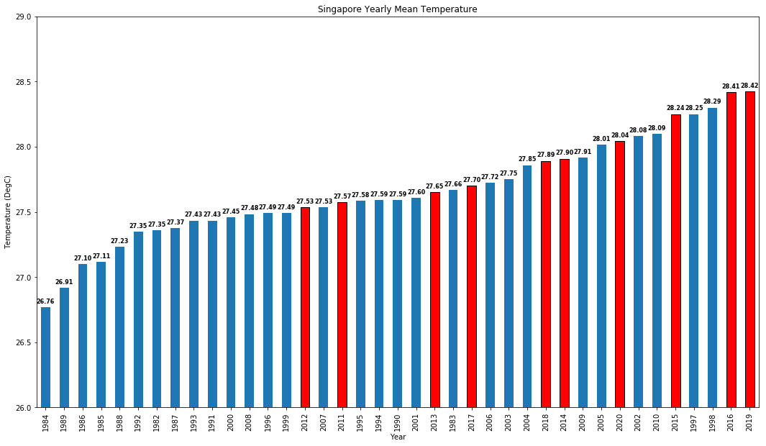
BAR CHART

Slide 7
RESULTS
4 of the top 10 warmest years to date came from the last decade (2010s):
2019 (1st), 2016 (2nd), 2015 (5th), 2020 (8th)
2016 and 2019 were even hotter than 1997 & 1998 when El Nino set in and left record-breaking high temperatures around the world.
in contrast, none of the years in the top 10 coolest years were from the last decade (2010s), as most were from the 1980s and 1990s.

Slide 8
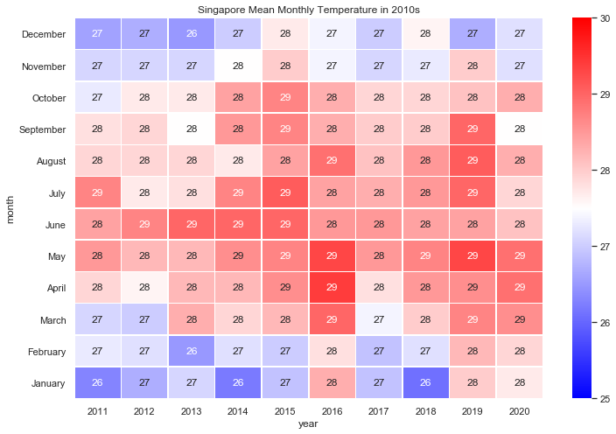
HEATMAP (2010s)

Slide 9
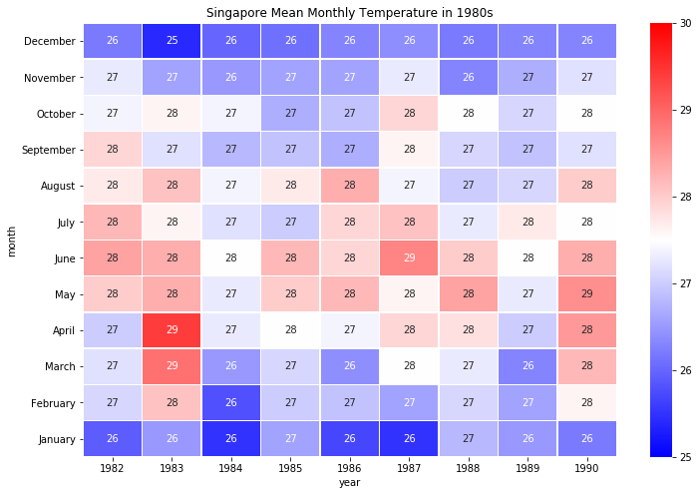
HEATMAP (1990s)

Slide 10
RESULTS
both heatmaps illustrates the monthly mean temperature in each year of the decades (2010s and 1980s respectively). the gist here is to have a distinctive comparison between the mean temperature in each month for both decades.
using 25 to 30 as the vmin and vmax parameters, it’s easier to see that 2010s were indeed much hotter than 1980s, which is shown by the amount of red boxes.
mean monthly temperatures rarely reach 29 degC in the 1980s, whereas it is common in the 2010s. on the other hand, cooler months are getting rare too in the 2010s.

Slide 11

ARE SINGAPORE NIGHTS HOTTER TOO?

Slide 12
DATASET 2
Wet Bulb Temperature, Hourly
https://data.gov.sg/dataset/wet-bulb-temperature-hourly
No. | Name | Title | Type | Unit of Measure | Description
1 | wbt_date | Wbt date | Text (General) | - | -
2 | wbt_time | Time | Numeric (General) | Hour | the hour is from 1 to 24
3 | wet_bulb_temperature | Wet Bulb Temperature-Hourly | Numeric (General) | Degree Celsius | -
Coverage from 1st January 1982 to 31st December 2020
Source from National Environment Agency
Monthly mean air temperature recorded at the Changi Climate Station

Slide 13
ANALYSIS PROCESS
read csv file using pandas.read_csv
filter the dataframe from time starts at 7pm and ends at 6am (night)
groupby the data in year and month using mean
plot all years mean monthly night temp from January to December
change x_axis_label to month name
filter data to coldest year (1984) and recent 3 years to avoid clumped data
plot the 4 years of their mean monthly night temp
change 1984 line as dotted to indicate as a benchmark

Slide 14
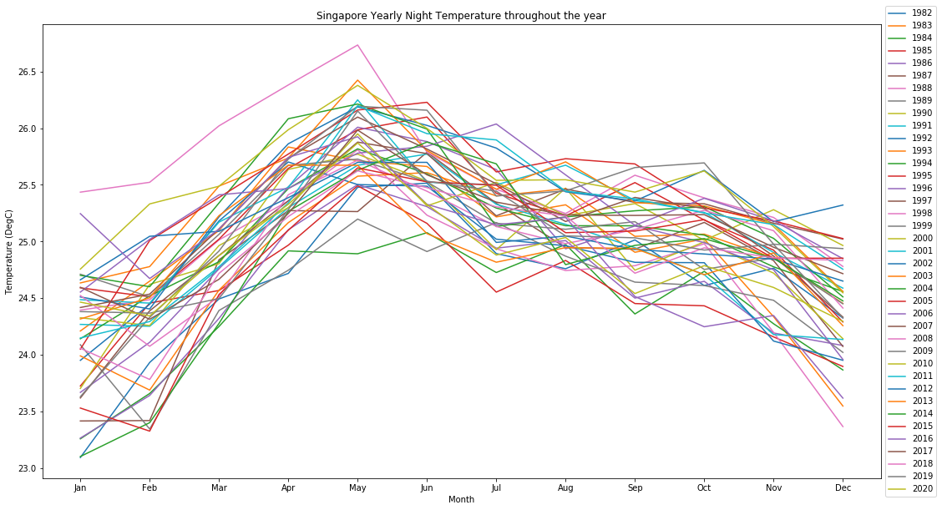
LINE CHART

Slide 15
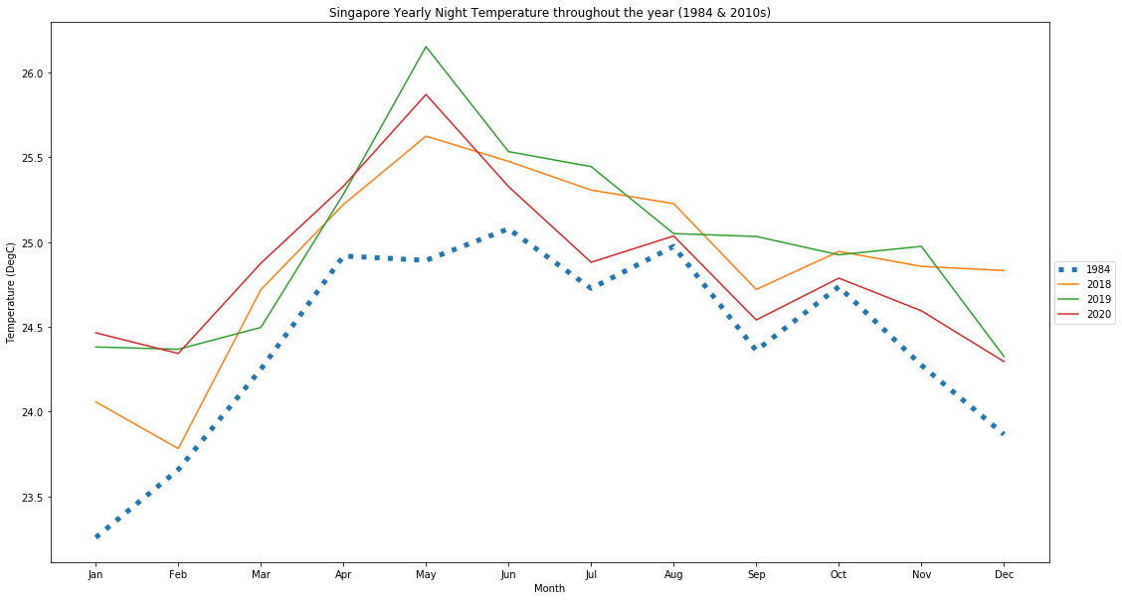
LINE CHART

Slide 16
RESULTS
the mean monthly night temperature is about 2-3 degrees lower than the earlier mean monthly temperature, which is expected since we are only interested in night temperature. (assuming 100% humidity here)
the monthly temperature pattern in the year is also similar to the heatmaps shown earlier, cooler temperatures in nov-jan, and then it rises to its peak around may.
though 1984 may not be the year that has the lowest mean monthly night temperature throughout, we still can observe that the recent years (2018-2020) has much higher temperature than 1984, especially in the hottest month of May, with the greatest difference approximately 1.5 degC.

Slide 17

IS THERE A DIFFERENCE IN RAINFALL BETWEEN THE HOTTEST & COLDEST YEAR?

Slide 18
DATASET 3
Rainfall – Monthly Total
https://data.gov.sg/dataset/rainfall-monthly-total
No. | Name | Title | Type | Unit of Measure | Description
1 | month | Month | Datetime (Month) "YYYY-MM" | - | -
2 | total_rainfall | Monthly Total Rainfall | Numeric (General) | Millimetre | -
Coverage from 1st January 1982 to 31st December 2020
Source from National Environment Agency
Monthly mean rainfall recorded at the Changi Climate Station

Slide 19
ANALYSIS PROCESS
read csv file using pandas.read_csv
plot a histogram of the monthly total rainfall intention here is to observe the common total rainfall expected in Singapore
convert the month into datetime via pd.to_datetime
filter the data into 2 sets, comprising of 1984 and 2019 data
plot a vertical bar chart of the 2 datasets, with each month rainfall side by side
annotate the monthly total rainfall as label to indicate the amount

Slide 20
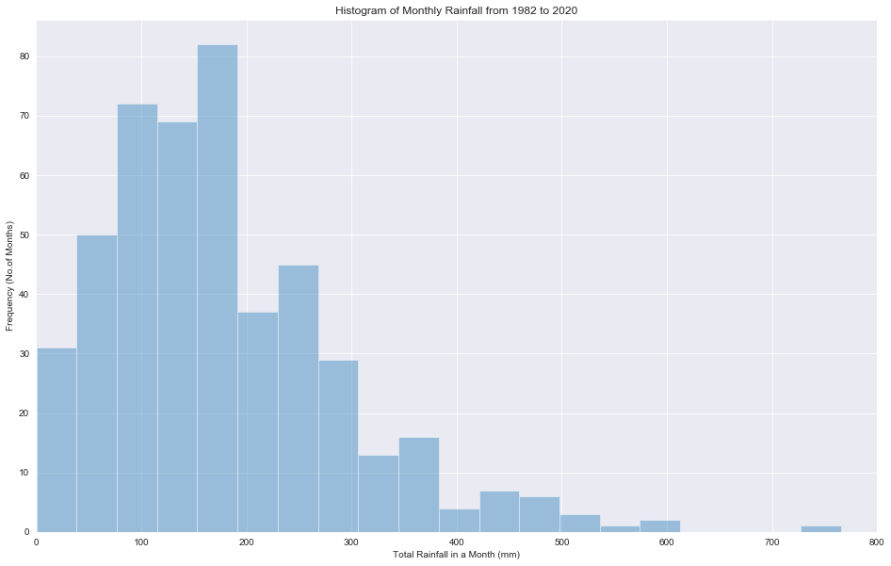
HISTOGRAM

Slide 21
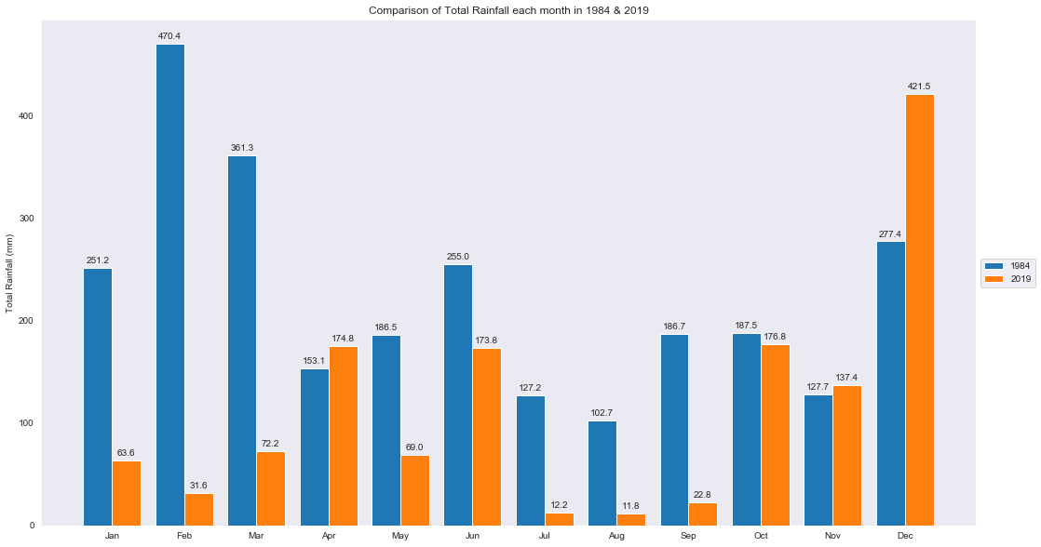
BAR CHART

Slide 22
RESULTS
since rainfall can affect temperature, the monthly rainfall can affect the monthly mean temperature.
from the hottest year in 2019, there are 7 months where the monthly total rainfall is below 80mm, this dry spell can probably be a reason why the temperature in 2019 is much hotter.
most of the months in 1984 have a higher monthly total rainfall than 2019. interestingly Dec 2019 have a much higher monthly total rainfall, which is likely due to localized convergence of monsoon winds and strong daytime heating of land areas.

Slide 23
COMBINING DATASET 1 & DATASET 3
FINDING THE RELATIONSHIP BETWEEN
MONTHLY MEAN AIR TEMPERATURE
MONTHLY TOTAL RAINFALL

Slide 24
ANALYSIS PROCESS
read both csv files using pandas.read_csv
check if both dataframes have same number of rows and data with info()
pd.concat both dataframes using axis=1
using seaborn.lmplot to plot the relationship between monthly total rainfall against monthly mean temperature
include fig_reg = true in seaborn.lmplot to get the fitting curve
import scipy stats and using stats.pearsonr to show correlation coefficient

Slide 25
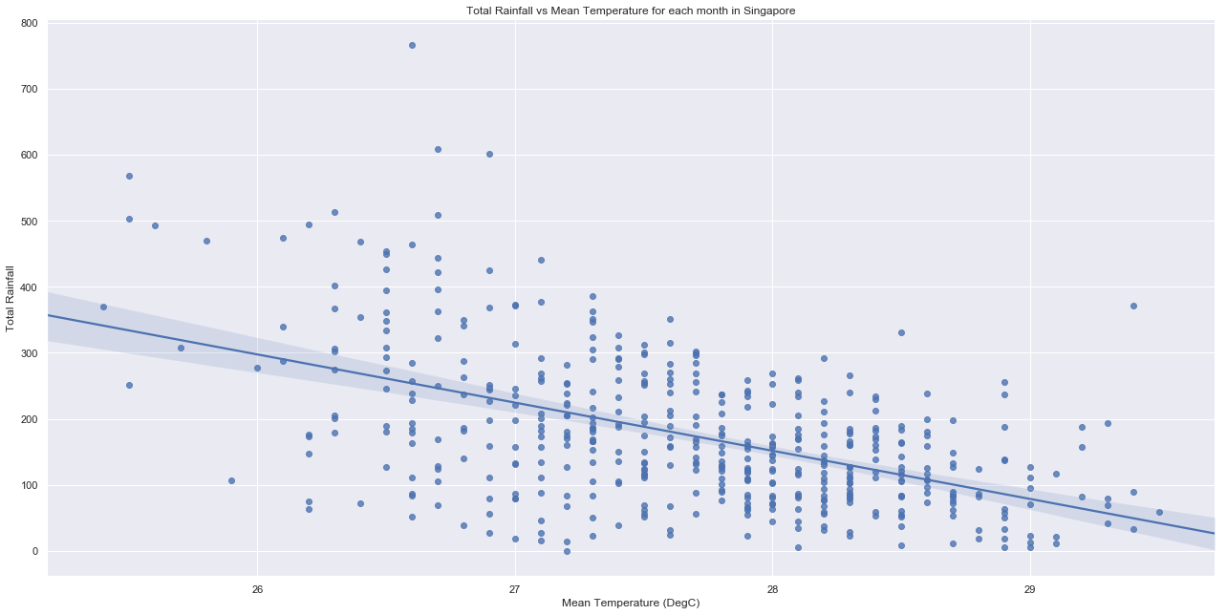
SCATTER PLOT

Slide 26
RESULTS
the correlation coefficient shown is -0.52. this indicates a negative moderation relationship between monthly mean temperature and monthly total rainfall. the higher the rainfall recorded, the lower the temperature we can expect in the same month.
this falls within our expectations, since we can relate that rainfall does cool down the weather.
however I would expect a stronger relationship if we compare the daily temperature against the daily total rainfall. there could be high temperatures in some days of the month, yet high rainfall in some other days, which can make the monthly datasets relationship not so reliable.

Slide 27
USING mySQL & Bokeh

Slide 28
ANALYSIS PROCESS (mySQL)
import mysql.connector
read monthly temp file using pd.read_csv
in mySQL workbench, created database, and created table to contain the data
switching to python, connect to mySQL using mysql.connector.connect
after which add the dataframe into mySQL row by row
the yearmonth is added as varchar while the temp is added as float(10,7)
retrieve data belong to 1984 and 2019 respectively, e.g. “SELECT * FROM datatemp WHERE LEFT(yearmonth, 4) = ‘1984’”

Slide 29
ANALYSIS PROCESS (Bokeh)
import bokeh modules (i.e. io, layouts, models and plotting)
create list of temp values in 1984 & 2019 from the mySQL retrieved data
create a manual list of months in name using pd.date_range
use bokeh.plotting figure to plot the graph we want
create glyphs using the lists and specifying colors and linestyle
create a callback using bokeh.models customJS to write the code for which graphs to show when we use the dropdown list
create a menu for the dropdown list
show the interactive plot and save the output file as html

Slide 30
CONCLUSION
we have observed that Singapore is getting hotter in recent years, the bar chart and heatmaps have illustrated the difference clearly.
there is quite a huge disparity in the temperature difference between the coolest and hottest year (1984 and 2019) 2 degC is actually quite a huge difference!
Singapore mean temperature at night is also getting higher.
the relationship between mean monthly temperature and monthly total rainfall is also established.

Slide 31

THANK YOU!

