Slide 1
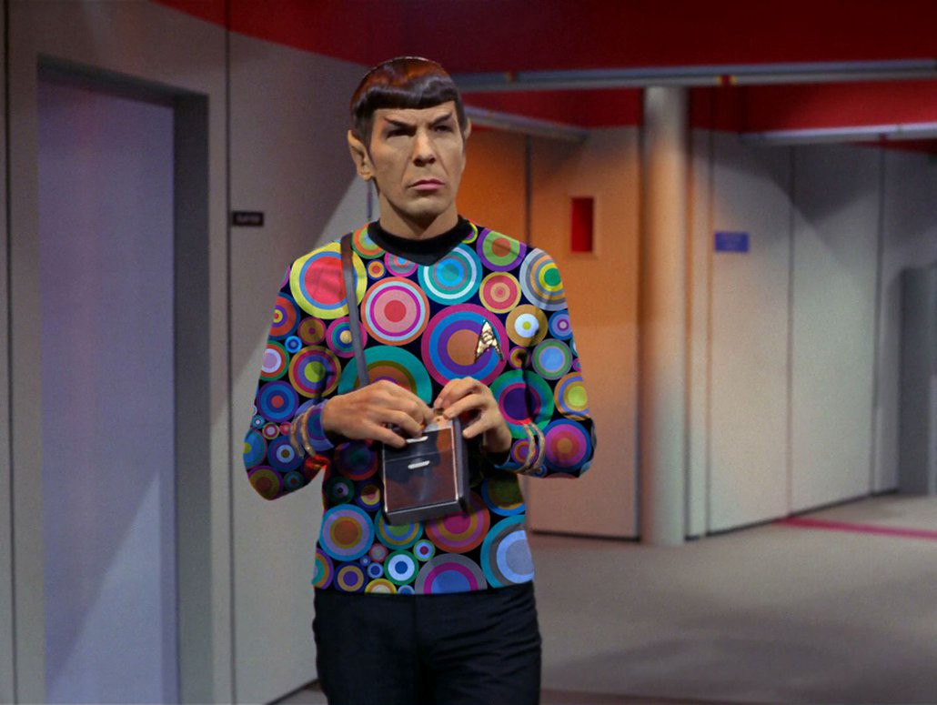
Getting Groovy with Spock
By David Parry

Slide 2
Spock what ?
Highly expressive specification language to test Java and Groovy!
What you want is irrelevant, What you’ve chosen is at hand.
-- Spock 1991 Undiscovered Country

Slide 3
What will be covered?
Specification spock.lang.*
Fixture Methods [setupSpec(), cleanupSpec()] [setup(), cleanup()]
Feature Method Heart of the Specification what you are testing
Blocks setup -> stimulus -> response -> cleanup ➰ where
Conditions plain boolean expressions Groovy Truth
Interactions & Mocks behavior of objects not just checking state i.e. outcome

Slide 4
Fun Facts
uses Groovy as language
data driven testing (DDT)
behavior-driven development (BDD)
sweet reporting
compatible with Gradle and Maven
runs on Java 7+ and Groovy 2.4+
sputnik (Spock + Junit) runs on JUnit runner

Slide 5
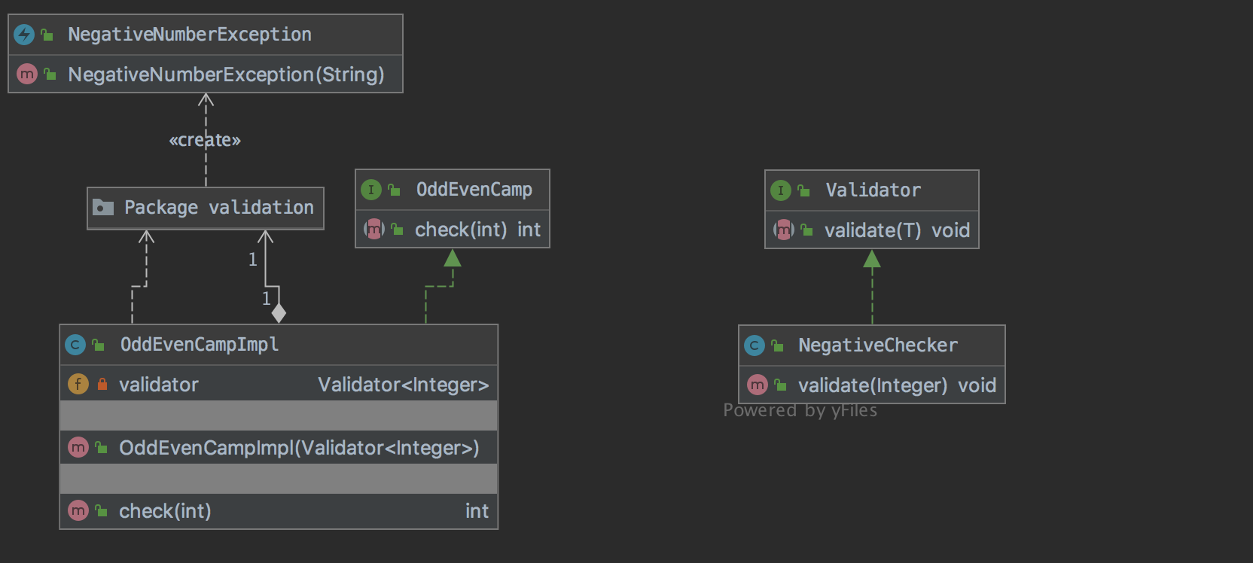
The Ask
Create a method that checks if the integer value is an even or odd number, return 0 for even and 1 for odd.
If number is 0 or negative number throw a runtime exception

Slide 6
Me
twitter: @daviddryparry
web: http://www.davidparry.com
github: https://github.com/davidparry

