Slide 1
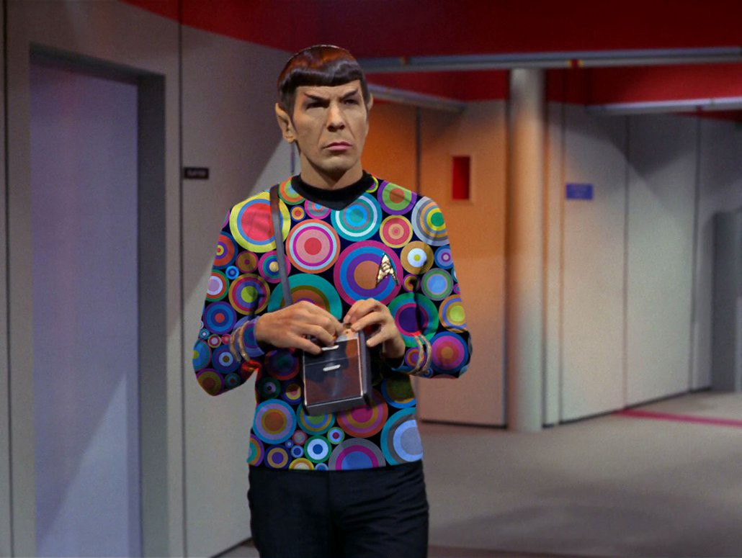
Getting Groovy with Spock
By David Parry

Slide 2
What will be covered?
Specification spock.lang.*
Fixture Methods [setupSpec(), cleanupSpec()] [setup(), cleanup()]
Feature Method Heart of the Specification what you are testing
Blocks setup -> stimulus -> response -> cleanup ➰ where
Conditions plain boolean expressions Groovy Truth
Interactions & Mocks behavior of objects not just checking state i.e. outcome

Slide 3
Fun Facts
uses Groovy as language
data driven testing (DDT)
behavior-driven development (BDD)
sweet reporting
compatible with Gradle and Maven
runs on Java 7+ and Groovy 2.4+
sputnik (Spock + Junit) runs on JUnit runner

Slide 4
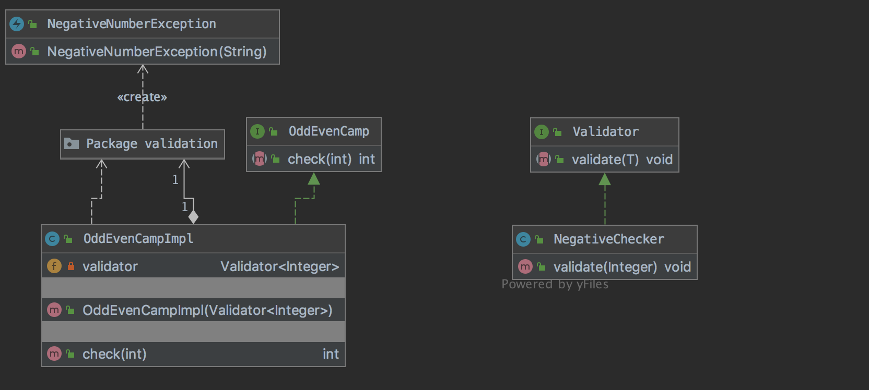
The Ask
Create a method that checks if the integer value is an even or odd number, return 1 for even and 0 for odd.
If number is 0 or negative number throw a runtime exception

Slide 5
Me
twitter: @daviddryparry
web: http://www.davidparry.com

