Slide 1


Slide 2
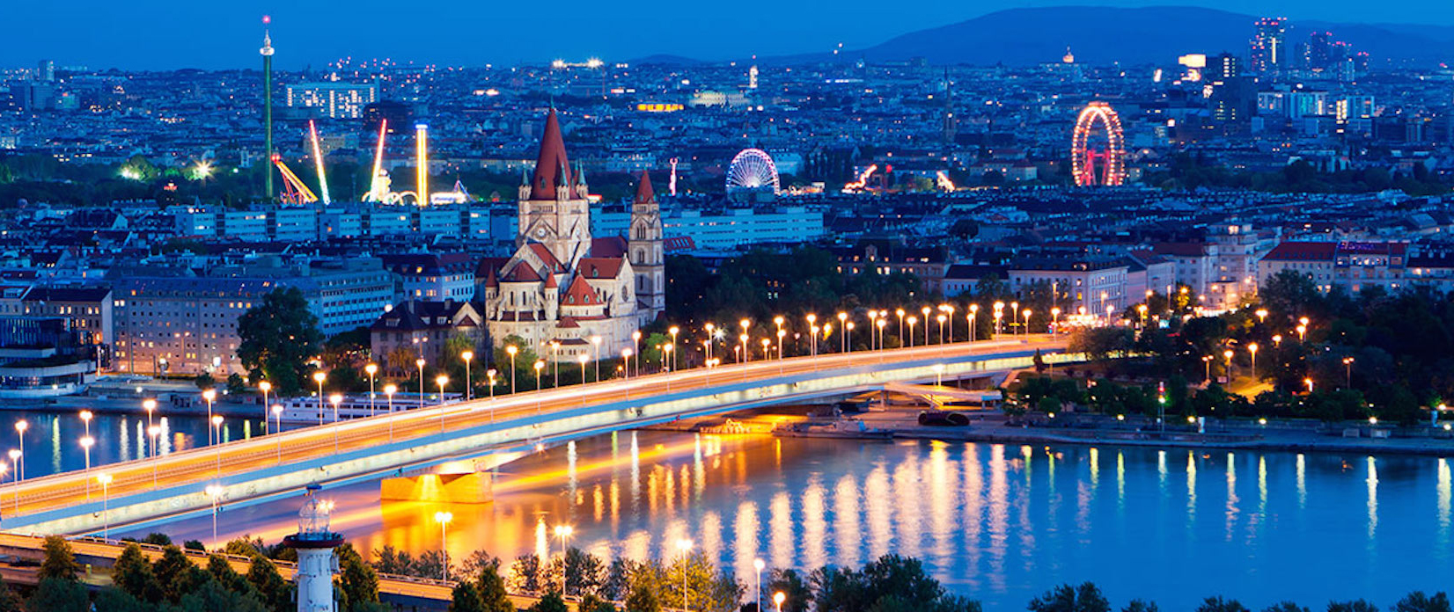
INSO Group 6
Advanced Software Engineering Project

Slide 3
MANAGEMENT TEAM
TOMISLAV TVRDIC
Assistant Technical Architect
DAVID PARAREDA
Technical Architect
ALEXANDRE TANNER
Assistant Team Coordinator
DIEGO MONTAÑO
Test coordinator
ADRIAN TABARA
Team coordinator

Slide 4
WHAT IS CVIENNA?
Open Tour guide
Rely on Open Data (CSV Import)
Bridge information gaps
Filter and save tours based on preferences
Community features

Slide 5
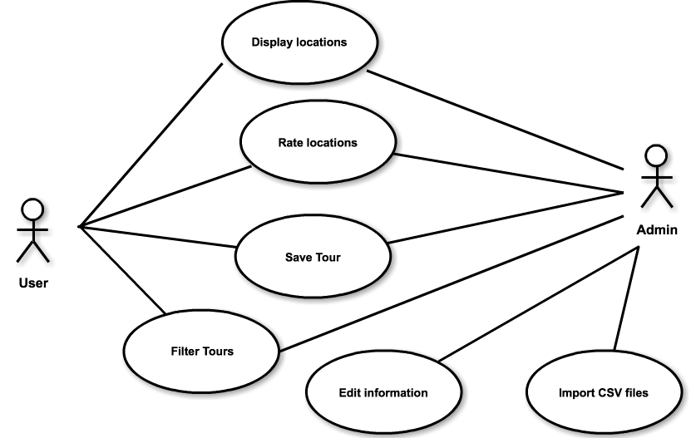
EXAMPLE USER SCENARIO
Wolfgang is visiting Vienna
He has a free day, and wants to visit the city
His preferred budget is around 60 Euros
He inputs preferences, and gets a suggested tour
He can export the tour as PDF
He can rate his favorite spots on the tour

Slide 6
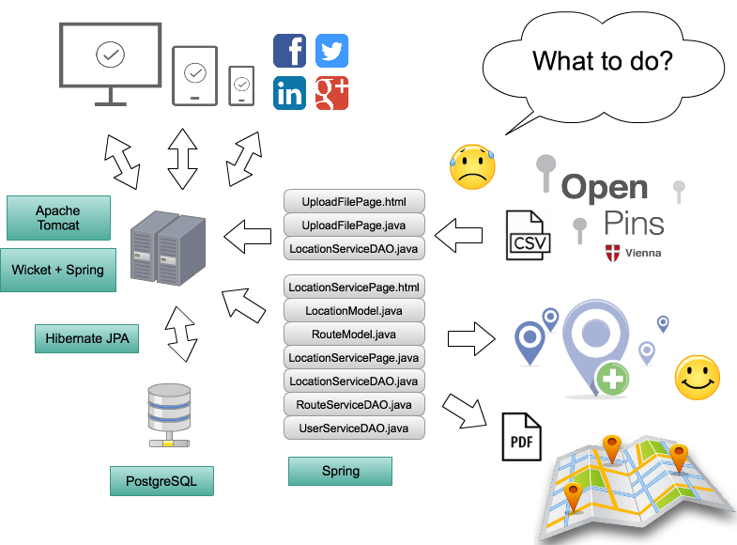
OVERVIEW

Slide 7
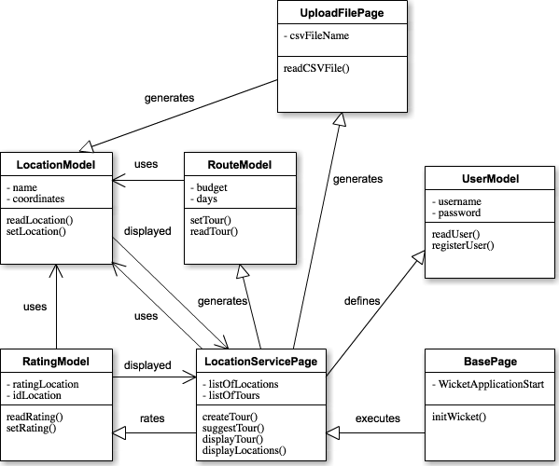
CLASS DIAGRAM

Slide 8
TECHNOLOGIES USED
Coding
Java, jQuery, Ajax, HTML, CSS, XML
IDE
Eclipse with log4j, EGit, Mockito JUnit, jRebel, Jetty Servlet (HTTP requests)
Frameworks
Wicket, Spring, Hibernate
Database: PostgreSQL + pgAdmin
Google Maps API
Bootstrap
Template, Responsive layout
jsPDF + html2canvas: PDF export to save Tours
ChardinJS: Help instructions displayed in the GUI

Slide 9




TECHNOLOGY STACK
Presentation
Wicket: Component-oriented to control and render requests in the GUI.
Business logic
Spring (MVC): Declarative transaction management via @SpringBean.
Data access
Hibernate JPA: Data persistence to DB via @Entity.
PostgreSQL
Open source in the enterprise (Oracle), powerful for Web Applications, focused on data integrity.

Slide 10
WHAT WENT WELL DURING THE PROJECT?
Great internal communication
Whatsapp group for urgent messages and live discussion.
Facebook group for normal discussion.
Dropbox for files.
Clear objectives
Progress easy to track
Weekly feedback and motivation by Tutor was crucial.
Group coding sessions helped productivity and motivation.
SCRUM structure kept us from getting overwhelmed.

Slide 11
WHAT WE LIKED
How open data can be used to provide new services.
Fun to experience a project go from planning to real actual working product.
Possibility to keep developing this project in our free time outside of the ASE context.

Slide 12
PROBLEMS ENCOUNTERED DURING THE PROJECT
Environment issues during the first month, linked to EGit and Apache Tomcat.
Interdependent feature not being ready in time
Tickets have to be moved in the next sprint.
Extra pressure.

Slide 13
LESSONS LEARNED
Communication and planning is important.
Often team meetings help to develop the project.
Test and debug as soon as possible.
Responsibility separations works better.

Slide 14
THANK YOU
QUESTIONS?

