Slide 1
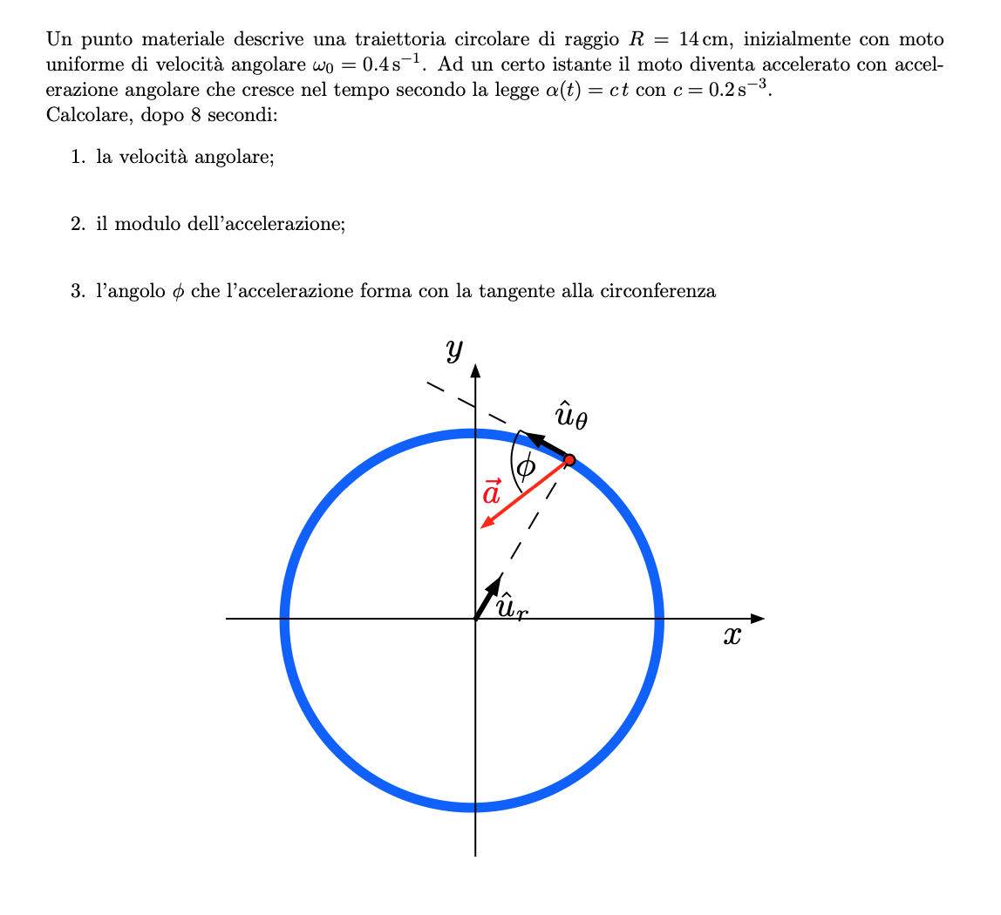

Slide 3
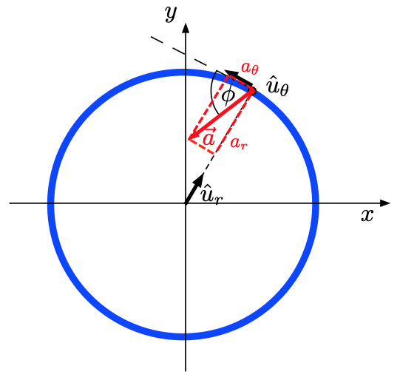

Slide 4
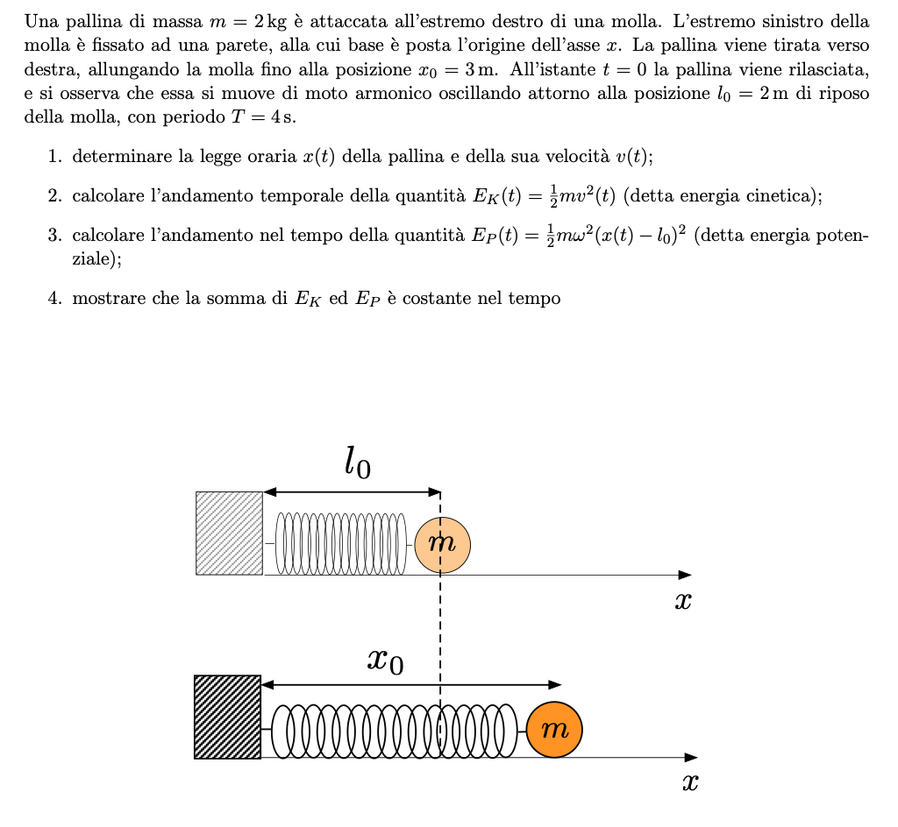

Slide 5
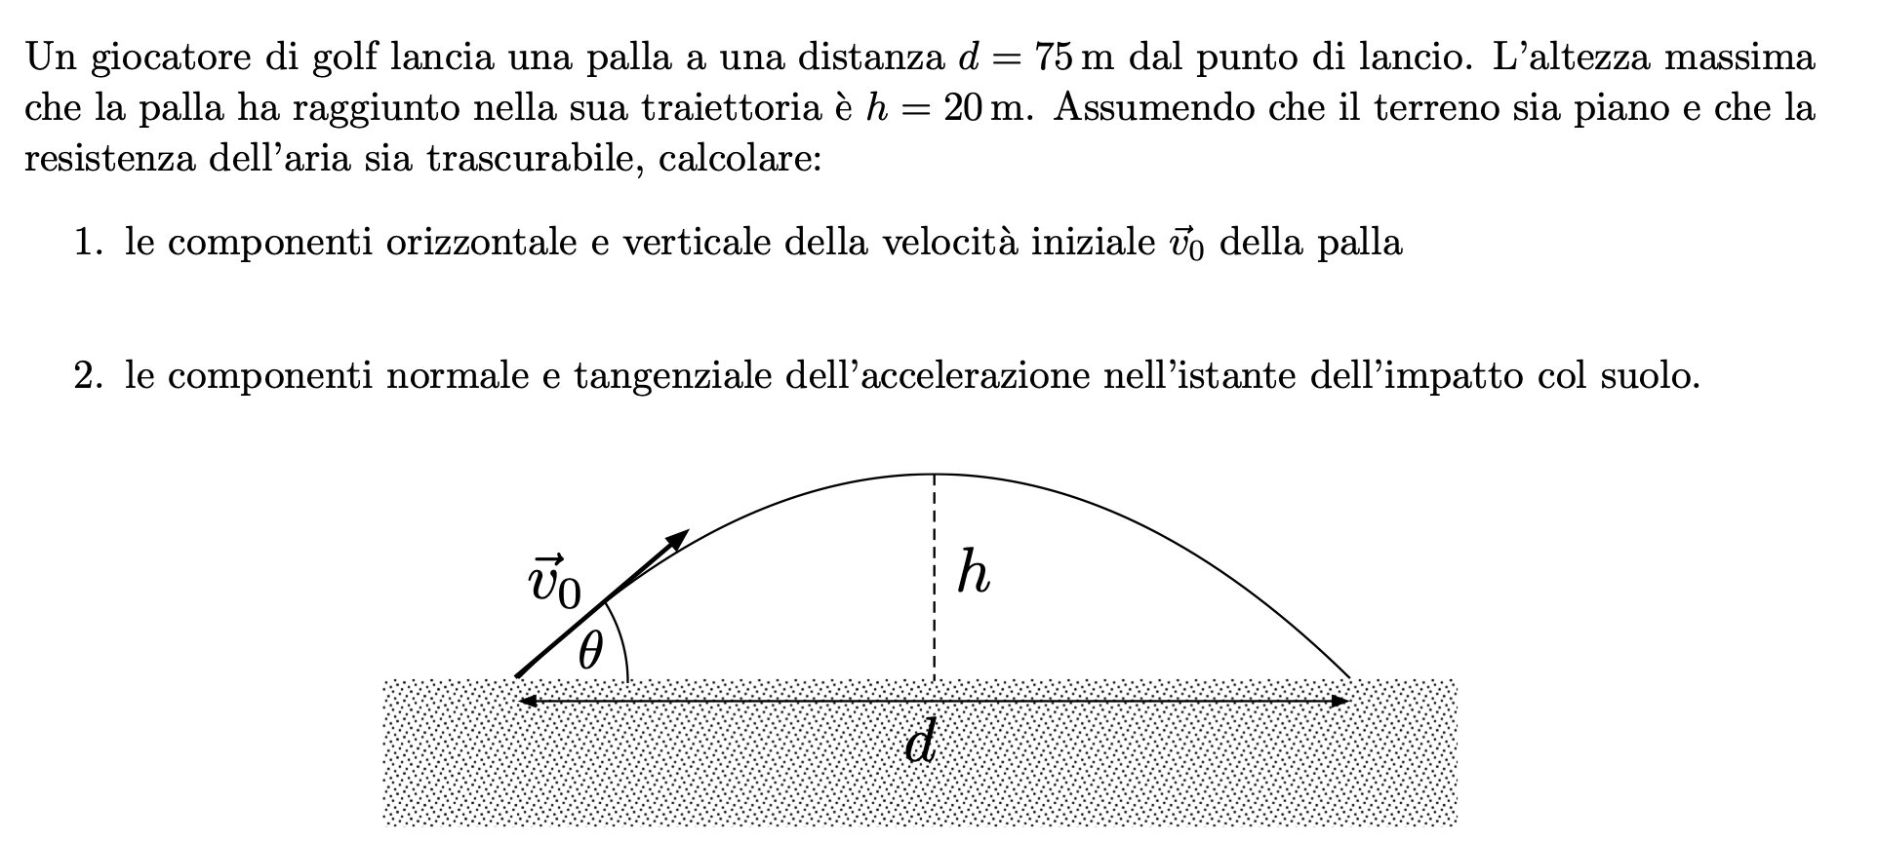

Slide 7
https://teams.microsoft.com/l/meetup-join/19%3ameeting_YmUyYmNhMTUtYTYwOS00N2E2LWI4YTMtYTEyMGNlNTlhZmFk%40thread.v2/0?context=%7b%22Tid%22%3a%22067e7d20-e70f-42c6-ae10-8b07e8c4a003%22%2c%22Oid%22%3a%228e852b7b-6372-4d1b-a51c-a244f1a6cb78%22%7d

Slide 8
