Slide 1
Karaoke Monster
Dave Renne
Andy Baker

Slide 2
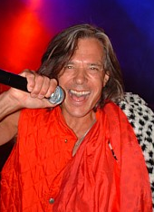
Problem Background
Karaoke Monopoly
  KJs control the karaoke market:
    Old, generic song lists (1000 – 5000 songs, most pre-80s)
    $250 - $800 per night for karaoke services
    The dreaded “creepy KJ” →→→→
What’s out there already
  Professional Services
  Consumer Products
  Karaoke Rental

Slide 3
Proposed Solution
Cut out the middlemen (KJs)
Be your own KJ
Allow customers to make their own karaoke songs and share
Allow ANY song to be made karaoke-ready
Make it CHEAPER and BETTER
… and never have to worry about this guy

Slide 4

Proposed Solution
Karaoke Monster
  Web-based karaoke system
  Upload, add and synch lyrics to any MP3
  Karaoke - any song, any place, any time

Slide 5

Components of a True Solution
Key Functionality Needed:
  Any karaoke enthusiast can create, share and transport synch’d songs
  Legal digital song and lyric sharing
  Intuitive, user-friendly interface
  Automatically delete vocal MP3 layer
  Easy access to song lyrics
  Easy song list management
Notes:
Maybe we have to move away from the MP3 technology eventually?
Have to make it so that Joe Average bar owner can use this with little training…
There are already a number of MP3 vocal deletion technologies – YoGen, for example – none are a flawless solution

Slide 6
Business Opportunity
Informal research among karaoke enthusiasts has been AMAZING
Sell service/product to karaoke bars as a superior, cheaper solution
Potential ways to sell:
  Standalone software
  Server-based subscribers
  Turn-key system
Notes:
WE picked the server-based system because we felt it would allow for the best support and long-term profitability. Selling a service as opposed to a physical product may actually be easier in many bars… Global quiz systems and “Club Keno” are examples of this service-pitching notion.
Not in the model, but we could add revenue by adding advertising partners on the screens and such… or have other bar advertisers use us as a promotional activity they offer!

Slide 7
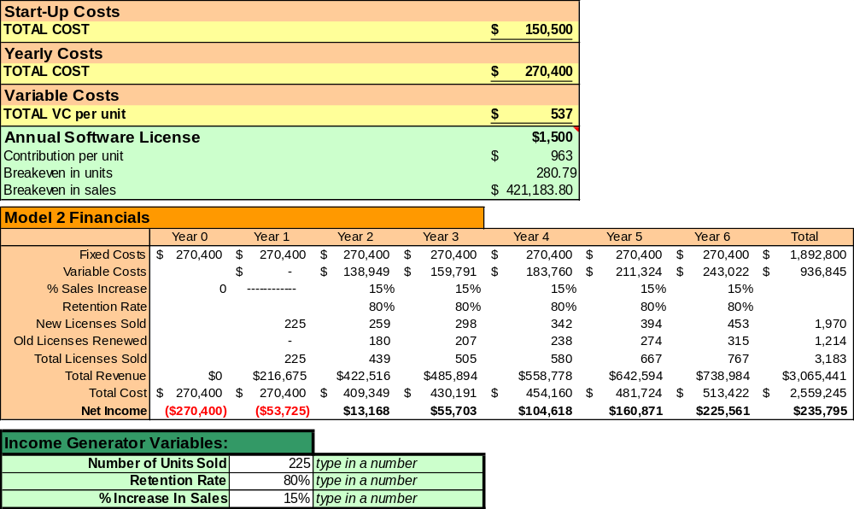
Proposed Business Model

Slide 8
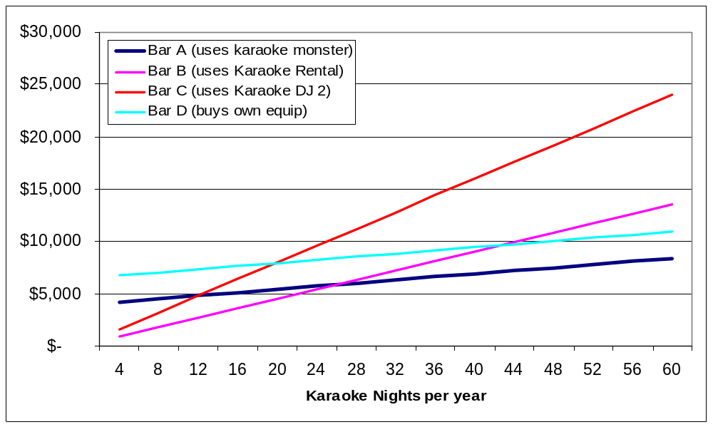
Targeting Karaoke Bars

Slide 9
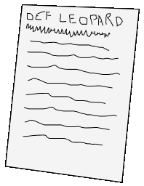
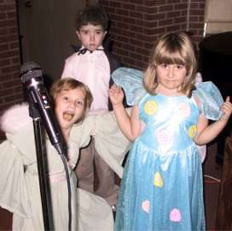

Logical Model Design
Upload MP3 to Server
Search for Lyrics
Sync MP3 & Lyrics
Karaoke!
Notes:
I would like to show the steps the user has to do to create karaoke MP3s on the fly.
BLAH BLAH BLAH…
Basically, it comes down to simplfying the solution…

Slide 10
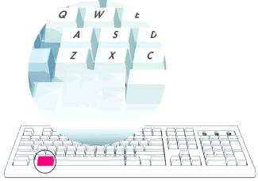


Simplifying the Solution
Keeping time with the lyrics
  Users follow the song with mouse clicks
Hey
Ya……
Hey
Ya…
Hey
Ya…
Hey
ya……..
The system needs to keep an accurate timer between clicks
  Relationship
    Song_Time12 ⬅➔ Song_Text12
Notes:
This creates a relationship between a given single word and and a particular time in the MP3.
BLAH BLAH…
But enough showing how it should work, lets show you how it really DOES work.

Slide 11

DEMO
Notes:
During the Test Karaoke Part-
Andy steers to the FINAL song, and plays it right away.
Dave shows right away how cool the sync is… look, it works!
Andy mentions how you can hear the vocal layer.
Dave then talks about how throguh only HTML the text scrolls through and highlights.
--WE TOTALLY ROCK OUT—
Andy fades out song slowly… Dave begins talking abut dadvanced duration edit.
“Wow, this one was perfect, but obviosly someitmes sync errors can happen. An advanced user to the system can solve any errors by using the advanced sync thingie ma bober”
Then… Andy rolls into the FINAL Karaoke button and what it is supposed to do… this concludes the demo.

Slide 12
Changes before going public
Devise a method to automatically delete the vocal layer
Rewrite a new karaoke player
  Possibly an XML reader inside of flash
Shift away from MP3 technology
  digital-rights management-supported technology
Notes:
We are aware of technologies to process MP3 vocal layers
Just a matter of automating it
There are some inneficiencies in the player itself, being written in entirely client side code, we need to rewrite the player itself to something more visual and accurate
Possibly an XML reader
Since MP3’s are such a hot topic in the legal world, it might be beneficial to support other forms of digital music

Slide 13
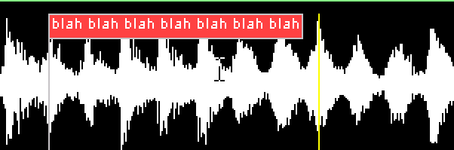
To Do – Features to Add
Trading files on message boards
  Very crucial to create a community of karaoke enthusists
  UserBased Accounts
A visual editing line where users can edit a sync
143
5930
847
Notes:
Having that XML portion supported this will help us build a community by allowing users to trade sync up song files.

Slide 14
Long-term Goals
Get a patent!
Look for a venture capitalist!
Hire some coders!
Life doesn’t end after Innovative Comp.

Slide 15
Questions?
Data Flow Diagram – Test Songs/Record Lyrics
Data Flow Diagram – Sync Songs
Data Flow Diagram – Karaoke Player

Slide 16


Detailed Data Flow
Test Songs/Record Lyrics
MP3 Decoder
Double Click
ASP
Dynamic File
Viewer
DB
Save
Click
Javascript
ASP
Javascript
Pass Values
Across Frame
Using JS GET
Grab File
Name and
run SQL to
Populate
textarea
Read hidden
Artist and
Song Values
And populate
textbox

Slide 17
Detailed Data Flow
Sync Songs
Javascript
MP3 Decoder
Start a new
Timer
Play
ASP
ASP
DB
Loop through each
Word and insert
Into a <SPAN> tag
(generic naming
convention)
Pass hidden
Durations into DB
Save
Click
Sync Button
Javascript
Start a New
Timer
Get current
Word;
Change visual
HTM elements
As they click
Subtract old
Timer with
New timer
Record
Duration into
Hidden value

Slide 18
Detailed Data Flow
Karaoke Player
ASP
ASP
Loop through each
Word and insert
Into a <SPAN> tag
(generic naming
convention)
Output values for
each word into
hidden variables
ADE Opt
Output values for
each word and
each sync
into textbox
DB
Save
Play
Javascript
Javascript
Javascript
MP3 Decoder
Read current word
And its duration
Hold highlight code
With a dynamic
settimeout
Highlight words;
Update hidden
Delay;
Hold code and loop

