Slide 1
Cryptocurrency Market & On-Chain Data
Sourcing, Collecting, Cleaning, & Synthesizing

Slide 2



Sourcing
Bulk downloading from
institutional grade digital asset data providers

Slide 3
CryptoCompare
312 Exchanges
7,739 Assets
359,321 Trading Pairs
Rest API metric categories
300+ exchanges
7,739 digital assets
350,000+ trading pairs
Price
Historical
Blockchain
Lists
Social
News
Order Book
min-api.cryptocompare.com/documentation

Slide 4
Glassnode
Rest API metric categories
Addresses
Blockchain
Derivatives
Distribution
Fees
Indicators
Institutions
Market
Mining
Supply
Transactions
docs.glassnode.com/basic-api/api

Slide 5
CoinMetrics
30 spot & derivatives crypto exchanges
3k+ assets
4k+ pairs
22k+ spot markets
Rest API metric categories
Addresses
Economics
Exchange
Fees & Revenue
Market
Mining
Network Usage
Supply
Transactions
Volume
docs.coinmetrics.io/api/v4

Slide 6
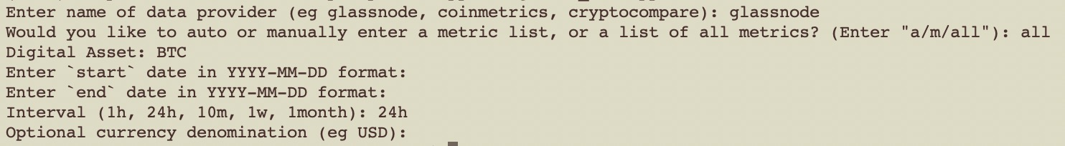
Glassnode Example
Within terminal:
cd into folder containing ‘gather_data.py’ file and run it
You are prompted to
enter ‘glassnode’ as the data provider
Request data
‘a’: Automatically from a preset list of metrics using ‘Auto_Glassnode.py’
‘m’: Manually via a prompt & inputting desired list of metrics using ‘Call_Glassnode.py’
‘all’: All metrics, for all categories on the site are downloaded using ‘All_Glassnode.py’
In this example, we choose ‘all’ and continue to
Choose a Digital Asset (here, BTC)
Enter a ‘start’ date for the timeseries (blank = default date = earliest available)
Enter an ‘end’ date for the timeseries (blank = default date = latest available)
Enter desired unit time interval
Optional denomination of digital asset (blank = default = USD)

Slide 7
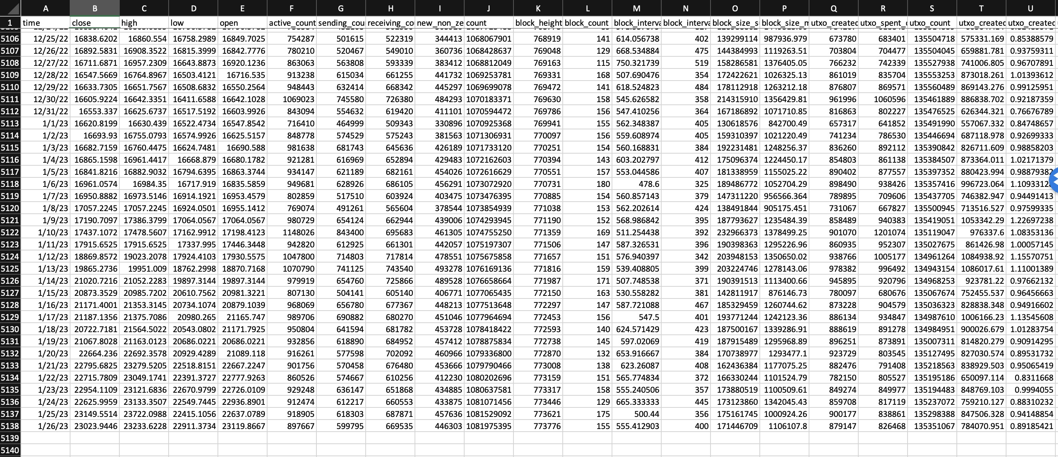
‘All_Glassnode.py’ will call ‘glassnode_data_cat_from_sub_cat.py’ which will
Obtain category names needed for processing API requests from ‘Glassnode_Metrics.xlsx’ file contained within the ‘Glassnode’ folder
Call either ‘Glassnode_OHLC.py’ or ‘Glassnode_Close.py’ depending on whether the requested time-increment interval requested is either ‘24h’, ‘1h’, or something else, respectively
Latter two files will transform any ‘dictionary’ column into separate columns consisting of its separate constituent elements, renaming each using the original dictionary metric-name as a prefix to constituent element column names
Will produce 7 separate CSV files named ‘glassnode_n.csv’ (n=1,…,7) containing requested data inside ‘Data’ folder
Glassnode API limits how many metrics may be requested per call, thus separate CSV files are generated as outputs
Glassnode API limits the number of calls per unit time, thus the inclusion of sleep() method to suspend execution of current thread for a given number of seconds in between subsequent calls.

Slide 8
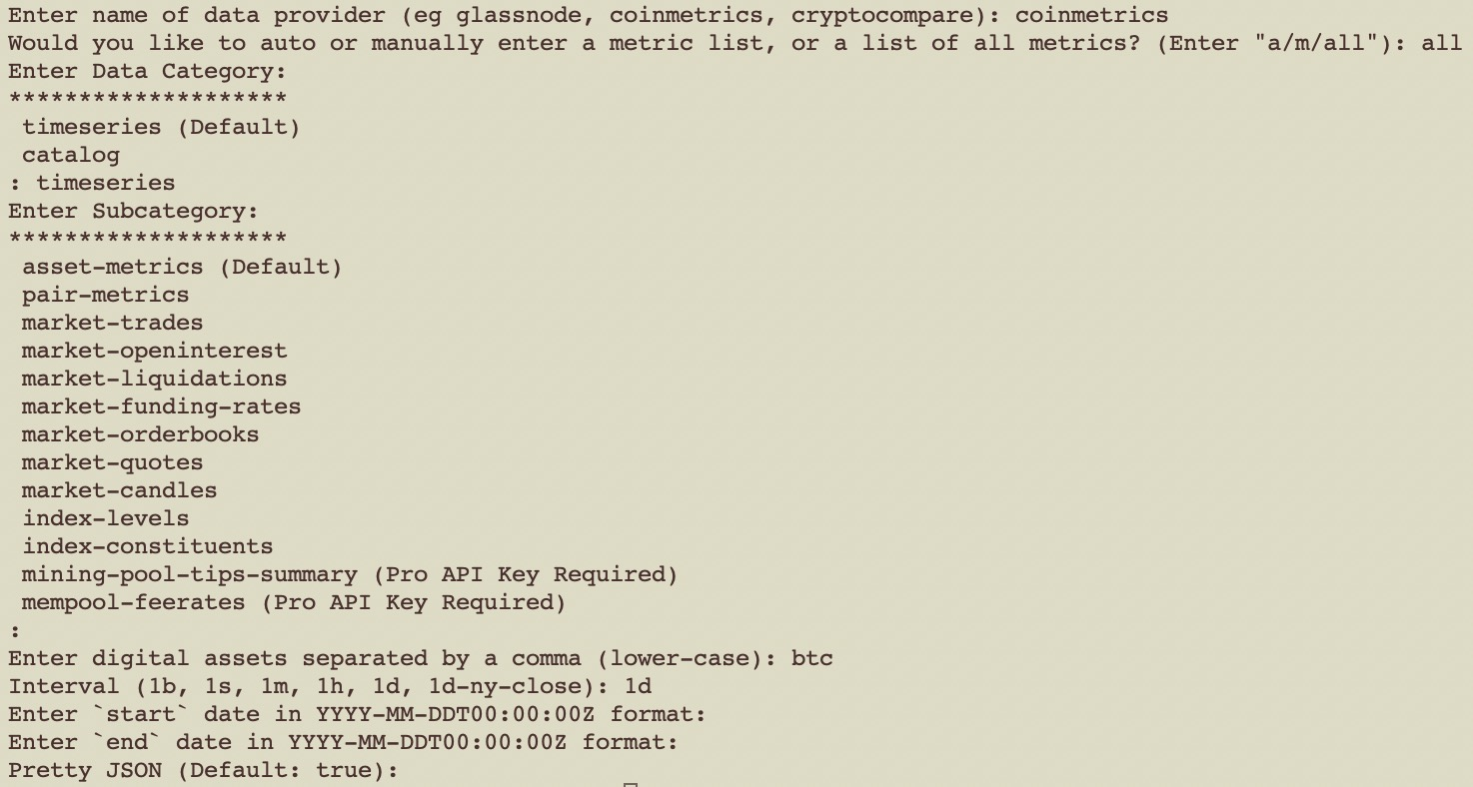
CoinMetrics Example
Similar to Glassnode example

Slide 9
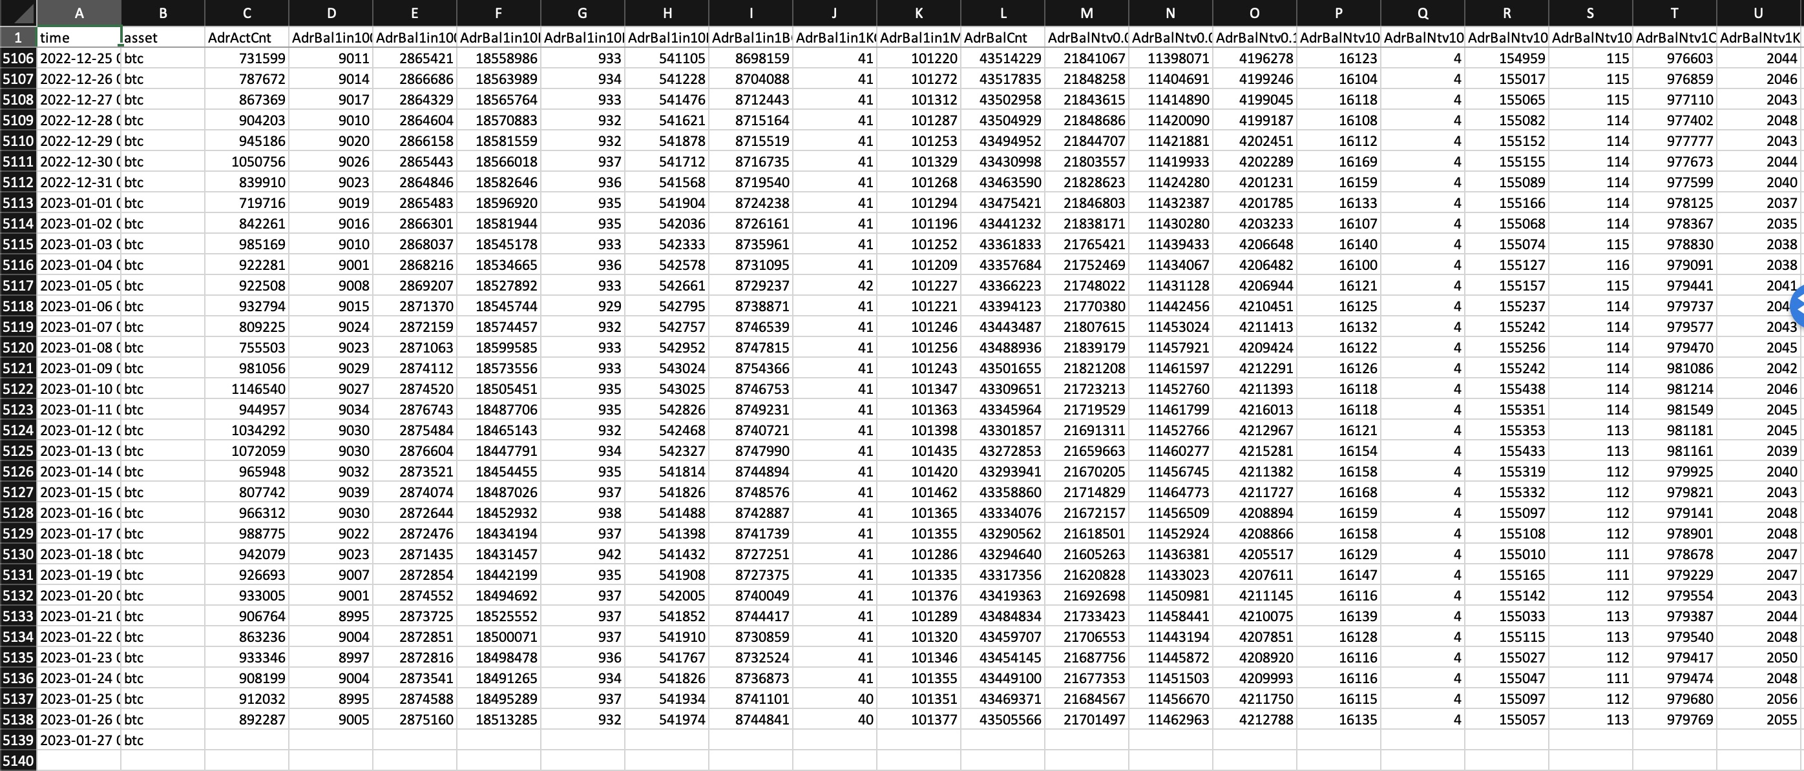
CoinMetrics Example
Will produce ‘coinmetrics.csv’ file (within ‘Data’ folder) containing requested data:

Slide 10
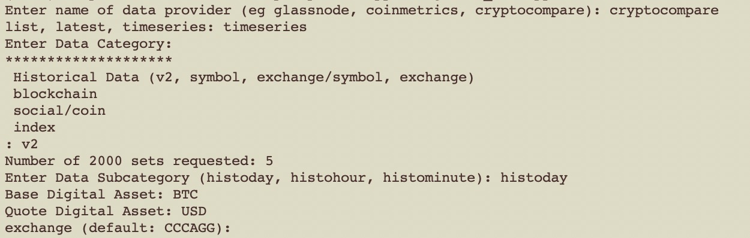
CryptoCompare Example

Slide 11
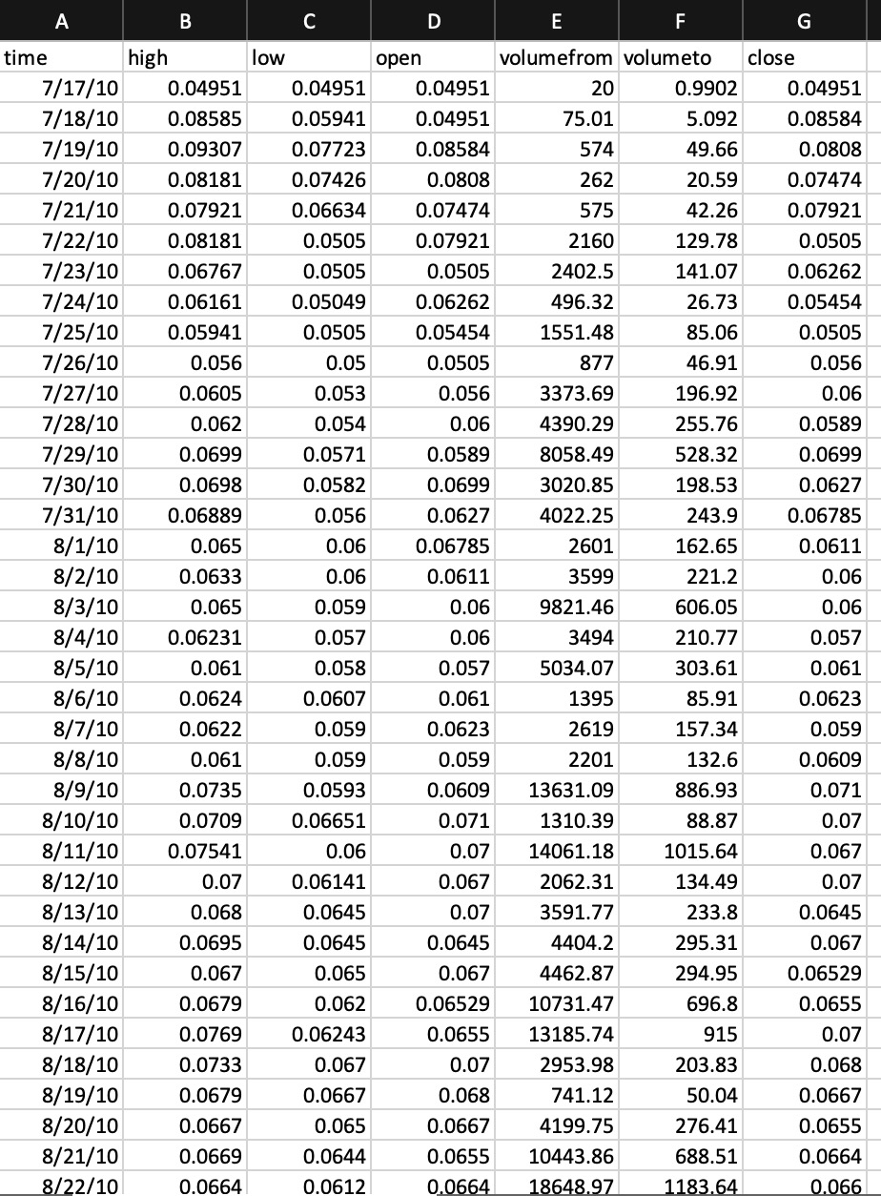
CryptoCompare Example
Will produce a csv file named ‘cc_[category]_[subcategory]_[additional info, eg coin pair: BTC_USD].csv’ and place it within the ‘Data’ folder
e.g.: ‘cc_v2_histoday_BTC_USD.csv’
Not limited to timeseries!

Slide 12
Timeseries Data Cleanup & Analysis
For 24h/1d timeseries data, manually place data into folders contained within the folder named ‘Data’, named according to the coin pair.
E.g. folder names:
BTCUSD
ETHBTC
ETHUSD
For timeseries data other than 24h/1d, manually place data into folders contained within the folder named ‘Data’, named according to the coin pair + chosen time interval.
E.g. folder names:
BTCUSD_hour
BTCUSD_minute

Slide 13
Timeseries Data Cleanup & Analysis
Within ‘Analysis’ folder, whether in a Jupyter Notebook or a .py file, import files named:
‘coin_data.py’ as ‘cd’
‘market_alpha.py’ as ‘ma’
‘formulaic_alpha.py’ as ‘fa’
‘coin_plots.py’ (optional) as ‘cp’
Run ‘process(data_source, coin_pair)’ function from ‘coin_data.py’ which
Takes inputs ‘data_source’ (eg ‘glassnode’, cryptocompare’) and ‘coin_pair’ (eg ‘BTCUSD’, ‘ETHBTC’) and
Returns ‘data’ dataframe which is processed and cleaned
It does this by importing ‘import_coin.py’ and using the latter’s ‘coin’ function to:
Take stated ‘data_source’ and ‘coin_pair’ inputs
Search for, and gather, respective data from ‘Data’ folder
Append complementary data from non-specified sources
eg from CoinMetrics & CryptoCompare if Glassnode is specified, and other permutations

Slide 14
Market & Formulaic Alpha
‘market_data.py’ allows use of ‘market(data, short, medium, long)’ function that
Takes ‘data’ dataframe and accompanying ‘short’, ‘medium’, and ‘long’ numerical values to calculate
traditional TA market alphas, appending these to newly created columns in the ‘data’ dataframe
Requires ‘data’ dataframe contain ‘ohlc’ columns
‘formulaic_alpha.py’ allows use of ‘formulaic(data, returns_dependent=‘N’)’ function that
Takes ‘data’ dataframe and calculates formulaic alphas based on '101 Formulaic Alphas' by Zura Kakushadze’s and appends these to newly created columns in the ‘data’ dataframe
https://arxiv.org/ftp/arxiv/papers/1601/1601.00991.pdf via Stefan Jansen's 'Machine Learning for Algorithmic Trading' book.
https://github.com/stefan-jansen/machine-learning-for-trading/blob/main/24_alpha_factor_library/03_101_formulaic_alphas.ipynb
Requires ‘data’ dataframe to contain ‘ohlc’ columns as well as a ‘volumeto’ column
Optional ‘returns_dependent’ argument will include returns dependent formulaic alpha factors
Default: returns_dependent=‘N’

