Slide 1
Two-stage Model for Automatic Playlist Continuation at Scale
Sara Bardají
David Rosado
2023

Slide 2
Table of contents
01
02
03
04
Introduction
Approach
Brief background
Model architecture
Conclusion
Training and Experiments
Brief recap

Slide 3


Introduction
Problem:
ACM RecSys Challenge 2018
Automatic playlist continuation
Million Playlist Dataset (MPD):
1M playlist
2.2M songs
Idea:
Two stage architecture

Slide 4

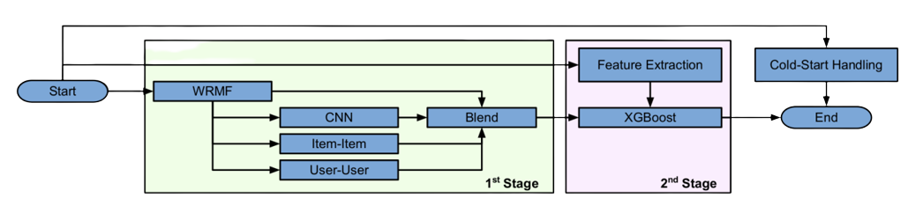
First stage
Objective: Fast candidate retrieval
Weighted Regularized MF:
Latent model for binary/implicit CF
BUT ignores song order
CNN-based latent model:
Considers temporal information
BUT focuses on global patterns
Neighbour-based CF models:
Top capture missed patterns

Slide 5
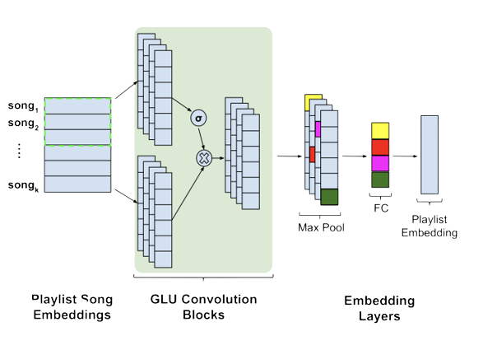
CNN
To model temporal patterns
Trained to predict arbitrary far into the future
Why not use RNN?
Inherently sequential and difficult to parallelize

Slide 6
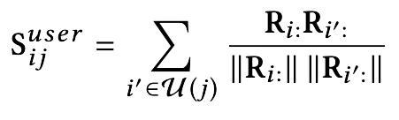
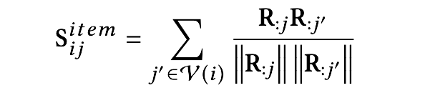
Neighbor-based Models
User - User
for a given playlist-song pair (i, j), compares all playlists where j appears to i
Item-Item
compares j with all songs in playlist i:
Problem: strong bias towards popular items.
Rescale the scores by inverse popularity
where R is the playlist-song matrix
Notes:
The intuition for User-User is that if song j appears in many playlists that are similar to i then the score is high and so j should be included in the recommended list.
If song j is similar to songs already in the i, then the score is high and i should be included in the recommended list

Slide 7
Model Blend
Linear weighted ensemble method:
Standardize the scores
Combine with weights
w₁ = 0.1, w₂ = 0.4, w₃ = 0.3, w₄ = 0.4

Slide 8

Second stage
Goal: re-rank the candidates retrieved by the first stage
More expensive and trade off efficiency for accuracy
Feature Extraction:
Model Architecture
Input from First stage
Playlist Features
Song Features
Playlist-Song Features
Creative Track
20-20 sampling scheme + XGBoost with pairwise ranking loss

Slide 9

Cold Start
Used for playlist in the test set with just playlist names
Build R-name matrix and use the SVD approach

Slide 10
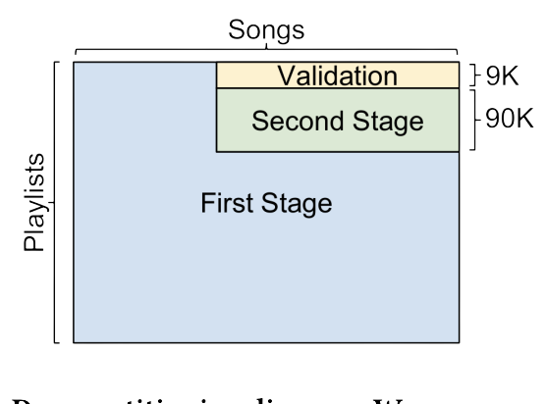
Training
Test set : Ten groups with 1K playlist per group of different structure
Creation of a validation set with the same structure
Creation of a new training set for the second stage

Slide 11
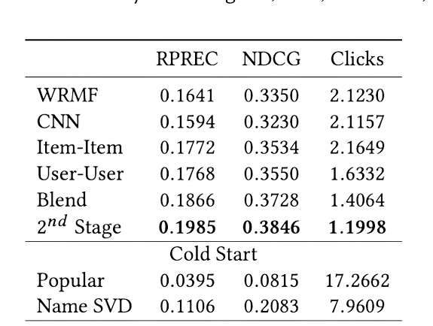
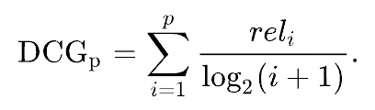
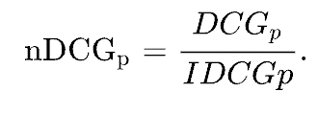
Experiments
Metrics : R-precision, NDCG and Clicks to 500 songs
relevant items in the top R results
R
number of clicks to complete the user playlist
RPREC =
Clicks =

Slide 12
Thanks!

