Slide 1
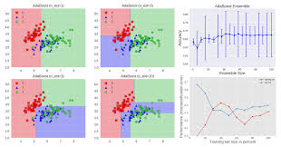
Tanzanian Water Well Dataset
Classification Model

Slide 2
Introduction
The International Water Development Agency has asked me to analyze existing data regarding operating status of water wells in Tanzania.
Task is to create classification models to predict the operating status of water wells based on features whether they are functioning, non-functioning, or functioning but requiring repairs. This is a multi-class classification model.
The dataset contains 59,400 data points and 40 features. Features ranged from entities that installed wells, when wells were installed, location of water wells to the water quality of the wells.

Slide 3
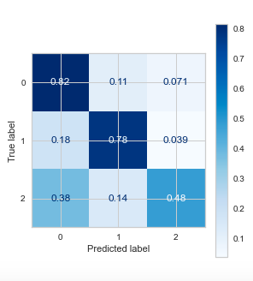
Random Forest and Confusion Matrix
Random Forest is a classification model consisting of many decision trees.
Overall model accuracy: 78%
Model target is multi-class
Confusion Matrix:
82% in predicting functioning wells
78% accuracy non-functioning
48% functioning need repairs

Slide 4
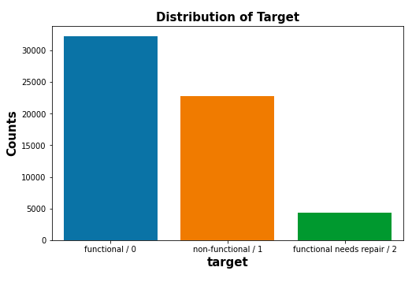
Operating status of the water wells?
Distribution of target/labels
59,400 water wells
54% of the wells are functioning
38% of the wells are non-functioning.
7% are functioning but need repairs.

Slide 5
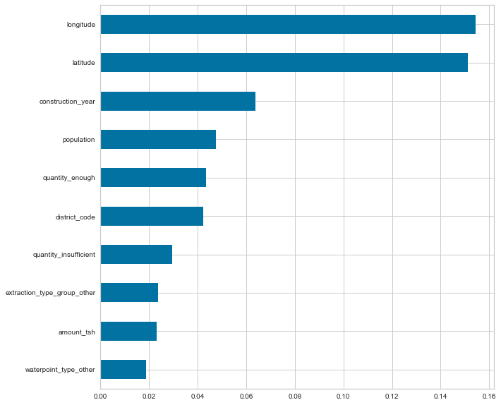
Feature Importance
Ranks factors that had impact on predicting operation status
Latitude and longitude of wells’ locations had biggest effect on predicting the functioning status of wells.
construction_year was important in making predictions.
Quantity category important – quantity_enough and quantity_insufficient.

Slide 6
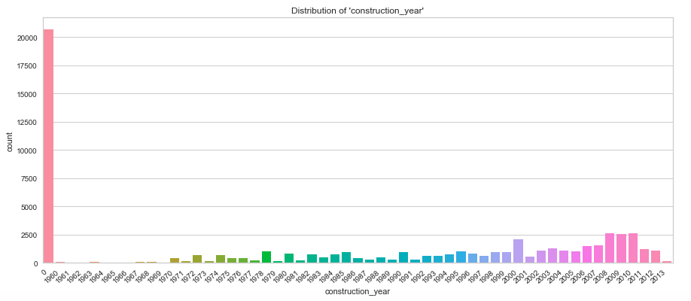
When were the water points built?
Constructed between 1960 and 2013.
35% of feature ‘construction_year’ reported 0 values. Need data for 0 year values for clearer picture of operating of wells.
Most wells built between 2008 to 2011. Years 2000, 2008 to 2011 each represent 4% of feature.

Slide 7
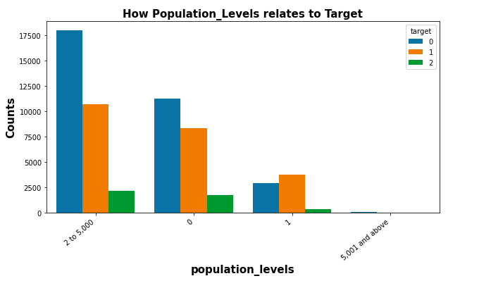
Population and operating status
Feature is population_levels
Population 0:
Around 11,000 wells are functioning
Almost 8,000 non-functioning
Around 2,000 need repairs.
Population 1:
Around 2,600 wells functioning
Around 200 non-functioning
500 need repairs
Population 2 to 5,000:
Around 18,000 functioning
Around 11,000 non-functioning
Around 2,000 functioning need repairs

Slide 8
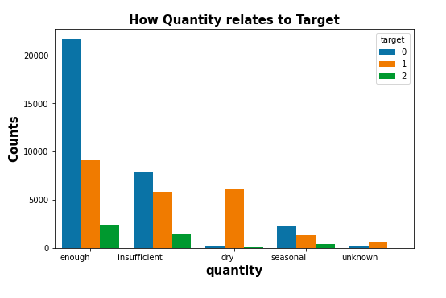
Water ‘quantity’ in wells and operating status
5 categories under ‘quantity’
Enough category is 56% of quantity
Over 20,000 wells are functioning
Around 9,000 non-functioning
Around 2,500 need repairs.
Insufficient is 26% of feature.
Around 8,000 wells functioning
Around 6,000 non-functioning
2,000 need repairs
Dry is 11% of feature.
Around 6,000 non-functioning
Few functioing

Slide 9
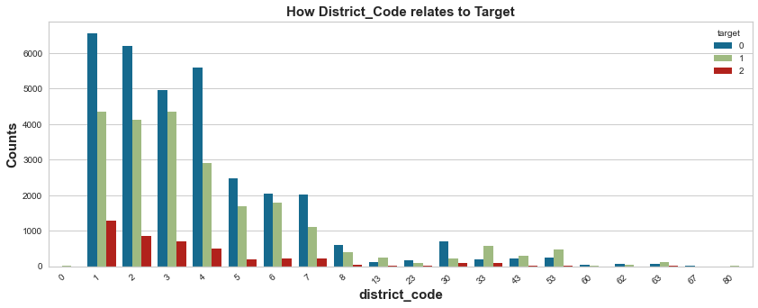
District code and operating status
20 categories under ‘district_code’
District 1 is 20% of feature
Over 6,500 wells are functioning
Around 4,500 non-functioning
Around 1,400 need repairs.
District 2 is 19% of feature.
Around 6,300 wells functioning
Around 4,100 non-functioning
Almost 1,000 need repairs

Slide 10
Recommendations
What needs to be done for accurate status of wells:
Need additional data 2014 to the present.
35% of values for years of construction are 0. Need values for years. Don’t know how old these wells are.
Status of operation of wells:
Important data comes from ‘population_levels’ . Tells of existing of wells and population levels. There are operational wells with 0 population. Why is this occurring, investigate further.
‘quantity_enough’ of water in water_wells. Largest category. 20,000 wells are functioning. Around 9,000 non-functioning. Investigate further where these wells are located and population levels.
‘district_code’ reveals operation status of wells by district. Which districts need help the most. Confirm population level around district that need help the most. Could be that there is relatively low population

Slide 12
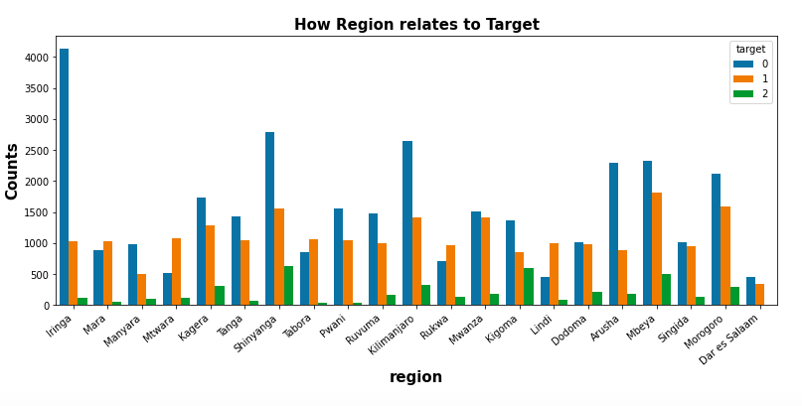
Which regions have water wells.
Iringa has 9% of wells. Shinyanga has 8%, Mbeya 8%, Kilimanjaro 7%
Over 4,000 of Iringa wells are working and 1,000 not working.
Shinyanga has almost 3,000 functioning wells and 1,500 non-functioning
Mbeya has 2,500 functioning wells and 2,000 non-functioning.

Slide 13
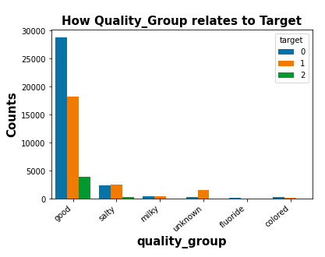
Water quality in wells and operating status
Feature is quality_group
Good category is 86% of quality
Around 29,000 wells are functioning
Almost 18,000 non-functioning
Around 4,000 need repairs.
Salty is 9% of feature.
Around 2,500 wells functioning
Around 2,500 non-functioning
500 need repairs
Milky is 1% of feature.

Slide 14
Follow-up
If I had more time I would continue working on the following matters:
Geographic spatial map
Work on the column showing the amount of water available for the population around the well. This is critical information because it’s not enough to determine whether the well is working or not, another issue is whether the well sufficient to provide meet the community’s water needs.

Slide 15
Closing
Thank you for taking the time to listen to my presentation regarding the water crisis in Tanzania. If you have any questions, please do not hesitate to reach out to me at (917) 348-3454 or email me at torredave@gmail.com.

