Slide 1
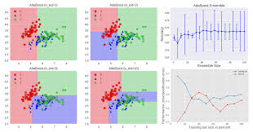
Tanzanian Water Well Dataset
Classification Model

