Slide 1
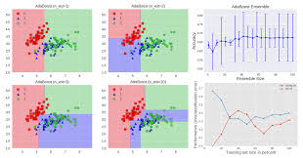
Tanzanian Water Well Dataset
Classification Model

Slide 2
Introduction
The International Water Development Agency has asked me to analyze existing data regarding the ongoing water crisis in the country of Tanzania, specifically involving the water wells.
I will provide the Agency with analysis of the facts and factors which had the most impact on the operating status of the wells and recommendations on which factors in order to increase the level of functioning wells merit continuing, improvement or discontinuing.
I will create classification models to predict the condition of water wells based on features that will be functioning, non-functioning, or functioning but requiring repairs. This is a multi-class classification model.
I worked with a dataset containing 59,400 data points and 40 features. Features contain information ranging from entities that installed wells, when wells were installed, location of water wells to the water quality of the wells.
Dataset covers time period 1960 – 2013.

Slide 3
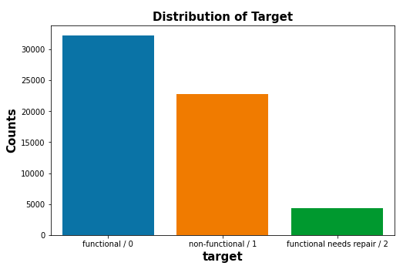
What is the condition of the water points ?
Distribution of target/labels
59,400 water wells
54% of the wells are functioning
38% of the wells are non-functioning.
7% are functioning but need repairs.

Slide 4
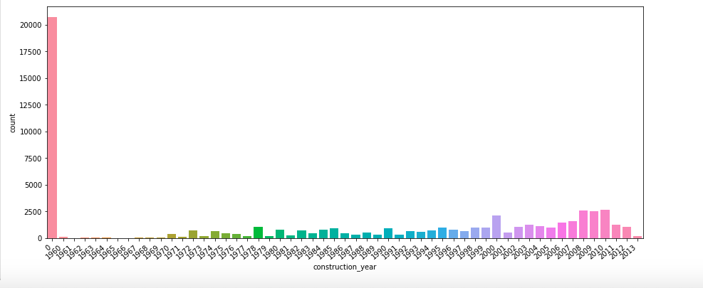
When were the water points built?
Water wells were constructed between 1960 and 2013.
An issue is 35% of feature ‘construction_year’ reported 0 values. Need data of which years 0 represent for clearer picture of how old wells are.
Excluding 0 values, most wells built between 2008 to 2011. Years 2000, 2008, 2009, 2009 each represent 4% of feature.
In 2008, 1800 wells functional, 700 non-functional, 200 need repair.
In 2009, over 1,750 functioning, 700 non-functioning, 175 need repairs.
In 2010, over 2,000 functioning, 550 non-functioning, 170 need repairs.

Slide 5
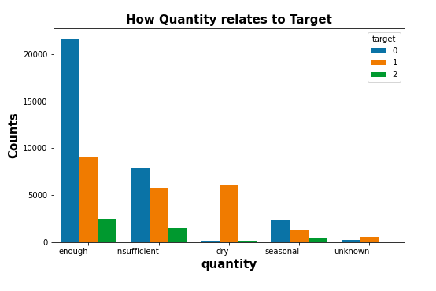
Water ‘quantity’ in wells and operating status
5 categories under ‘quantity’
Enough category is 56% of quantity
Over 20,000 wells are functioning
Around 9,000 non-functioning
Around 2,500 need repairs.
Insufficient is 26% of feature.
Around 8,000 wells functioning
Around 6,000 non-functioning
2,000 need repairs
Dry is 11% of feature.
Around 6,000 non-functioning
Few functioing

Slide 6
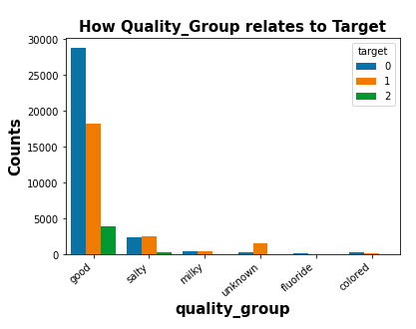
Water quality in wells and operating status
Feature is quality_group
Good category is 86% of quality
Around 29,000 wells are functioning
Almost 18,000 non-functioning
Around 4,000 need repairs.
Salty is 9% of feature.
Around 2,500 wells functioning
Around 2,500 non-functioning
500 need repairs
Milky is 1% of feature.

Slide 7
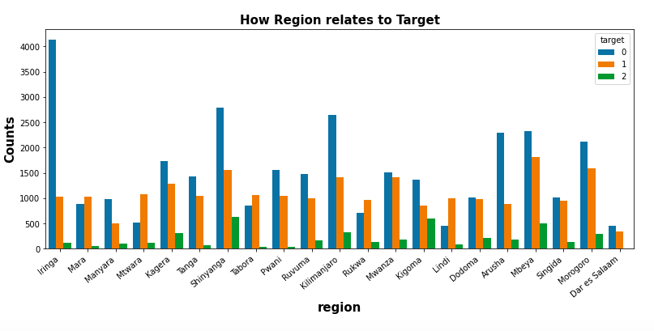
Which regions have water wells.
Iringa has 9% of wells. Shinyanga has 8%, Mbeya 8%, Kilimanjaro 7%
Over 4,000 of Iringa wells are working and 1,000 not working.
Shinyanga has almost 3,000 functioning wells and 1,500 non-functioning
Mbeya has 2,500 functioning wells and 2,000 non-functioning.

Slide 8
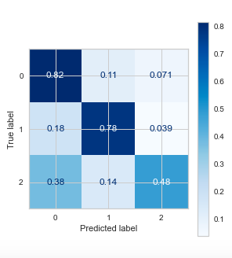
Random Forest and Confusion Matrix
Overall model accuracy: 78%
Confusion Matrix:
82% in predicting functioning wells
78% accuracy in predicting
non-functioning wells

Slide 9
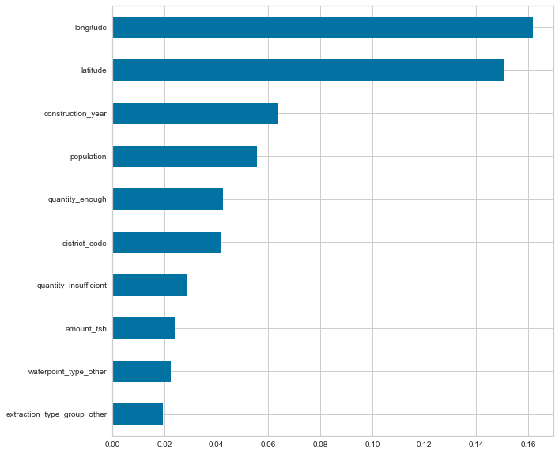
Feature Importance
Latitude and longitude of wells’ locations had biggest effect on predicting the functioning status of wells.
construction_year was important in making predictions.
Quantity category important – quantity_enough and quantity_insufficient.

Slide 10
Recommendations
What needs to be done for accurate status of wells:
Need additional data 2014 to the present.
35% of values for years of construction are 0. Need values for years. Don’t know how old these wells are.
What can be done to improve operation of wells:
There are almost 5,000 wells that function but need repairs. Priority should be to get them repaired to avoid non-functioning.
Largest category of ‘quantity’ of water in wells is ‘enough’. Concentrate on repairing wells in enough category that are non-functioning. Water level is sufficient but wells don’t work. Almost 10,000 wells in this category. Also, immediate attention to wells in category that function but need repairs.
Largest category of ‘quality’ of water in wells is good. Concentrate on repairing wells in good category that are non-functioning. Water level is good but wells don’t work. Almost 20,000 wells are in this category. Also, immediate attention to 4,000 wells in category that function but need repairs.
Regarding regions, what can be learned from Iringa which has the largest number of wells (5294) . Over 4,000 wells are functioning but also the lowest number of non-functioning wells (1,000) compared to other regions. 2nd largest is Shinyenga which has 4,982 wells of which almost 3,000 are functioning and 1,500 aren’t functioning. It wasn’t as simple as checking population because it varies in different parts of the regions. Why were more wells built in these regions as opposed to others? Was it a matter of funding, management, etc.?

Slide 11
Follow-up
If I had more time I would continue working on the following matters:
Geographic spatial map
Work on the column showing the amount of water available for the population around the well. This is critical information because it’s not enough to determine whether the well is working or not, another issue is whether the well sufficient to provide meet the community’s water needs.

Slide 12
Closing
Thank you for taking the time to listen to my presentation regarding the water crisis in Tanzania. If you have any questions, please do not hesitate to reach out to me at (917) 348-3454 or email me at torredave@gmail.com.

