Slide 1
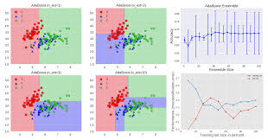
Tanzanian Water Well Dataset
Classification Model

Slide 2
Introduction
The International Water Development Agency has asked me to analyze existing data on the ongoing water crisis in the country of Tanzania, specifically involving the water points.
I will provide the Agency with analysis of the facts and factors which had the most impact on the condition of the wells and recommendations on which factors merit continuing, improvement or discontinuing in an effort to increase the level of functioning wells.
I will create classification models to predict the condition of water wells based on features will be functioning, non-functioning, or functioning but requiring repairs. This is a multi-class classification model.
I worked with a dataset containing 59,400 data points and 40 features. Features contain information such as entities that installed wells, when wells were installed, location of water wells to the water quality of the wells.
Dataset covers time period 1960 – 2013.

Slide 3
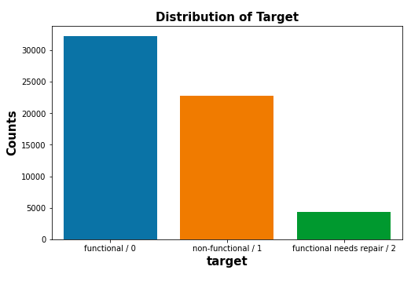
What is the condition of the water points ?
Distribution of target/labels
54% of the wells are functioning
38% of the wells are non-functioning.
7% are functioning but need repairs.

Slide 4
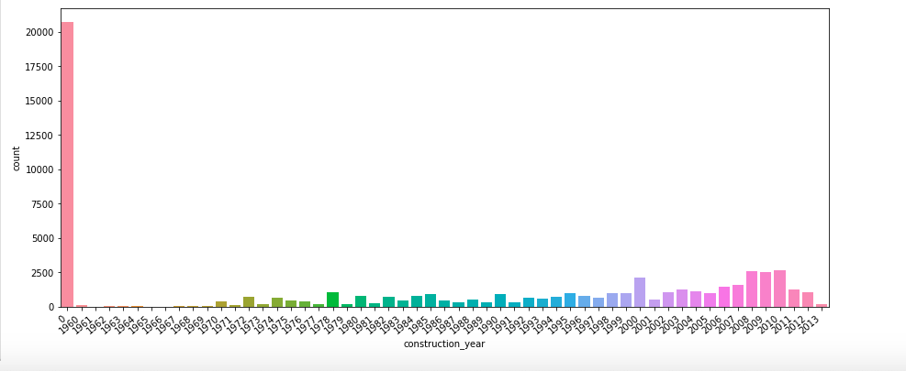
When were the water points built?
Water wells were constructed between 1960 and 2013.
An issue is 35% of features reported 0 values. Need data of which years 0 represent.
Excluding 0 values, most wells built between 2008 to 2011. Years 2000, 2008, 2009, 2009 each represent 4% of category.
In 2008, 1800 wells functional, 700 non-functional, 200 need repair.
In 2009, over 1,750 functioning, 700 non-functioning, 175 need repairs.
In 2010, over 2,000 functioning, 550 non-functioning, 170 need repairs.
Need 0 values for clearer picture of how old wells. are.

Slide 5
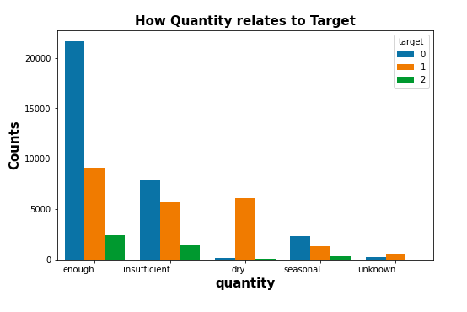
Water quantity in wells and operating status
Enough category is 56% of quantity
Over 20,000 wells are functioning
Almost 10,000 non-functioning
Around 2,500 need repairs.
Insufficient is 26% of feature.
Around 8,000 wells functioning
Around 6,000 non-functioning
2,000 need repairs
Dry is 11% of feature.
Around 6,000 non-functioning

Slide 6
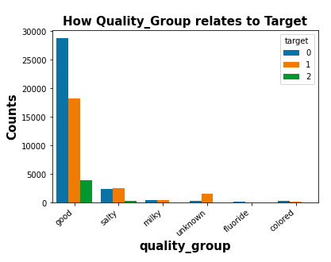
Water quality in wells and operating status
Good category is 86% of quality
Around 29,000 wells are functioning
Almost 18,000 non-functioning
Around 4,000 need repairs.
Salty is 9% of feature.
Around 2,500 wells functioning
Around 2,500 non-functioning
500 need repairs
Milky is 1% of feature.

Slide 7
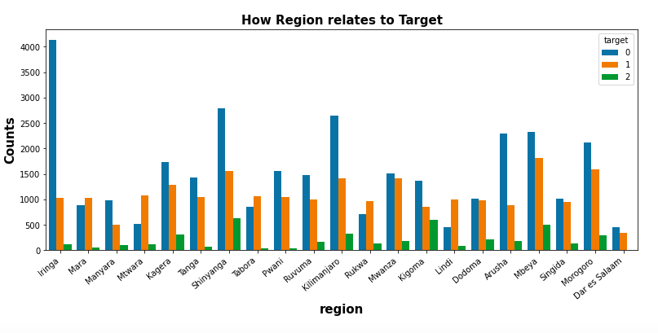
Which regions have water wells.
Iringa has 9% of wells. Shinyanga has 8%, Mbeya 8%, Kilimanjaro 7%
Over 4,000 of Iringa wells are working and 1,000 not working.
Shinyaga has almost 3,000 functioning wells and 1,500 non-functioning
Mbeya has 2,500 functioning wells and 2,000 non-functioning.

Slide 8
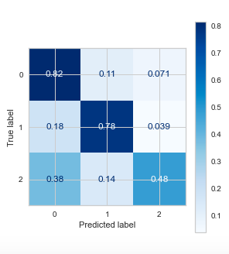
Random Forest and Confusion Matrix
Overall model accuracy: 78%
Confusion Matrix:
82% in predicting functioning wells
78% accuracy in predicting
non-functioning wells

Slide 9
Follow-up
If I had more time I would continue working on the following matters:
Geographic spatial map
Work on the column showing the amount of water available for the population around the well. This is critical information because it’s not enough to determine whether the well is working or not, is the well sufficient to provide meet the community’s water needs.

