Slide 1
Brooklyn Zipcodes
Time Series Forecasting

Slide 2
Background
Top 5 zipcodes to invest in in Brooklyn, NY based on investment time period of 3 years.
Analysis based on data from Zillow.com 4/1/1996 – 4/1/2018
Recommendations based on ROI on average and the low and upper end of time period.
Build model which will forecast the ROI for zipcodes from 4/1/2018 to 2021.

Slide 3
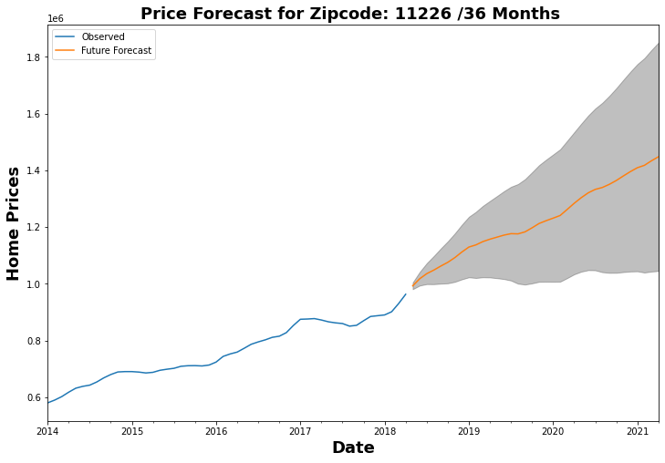
Zipcode: 11226 roi roi_lower roi_upper 0.457944 0.052723 0.863166
Average return 46%
Lower end 6%
Around 2018
Upper end 86%
Around 2021

Slide 4
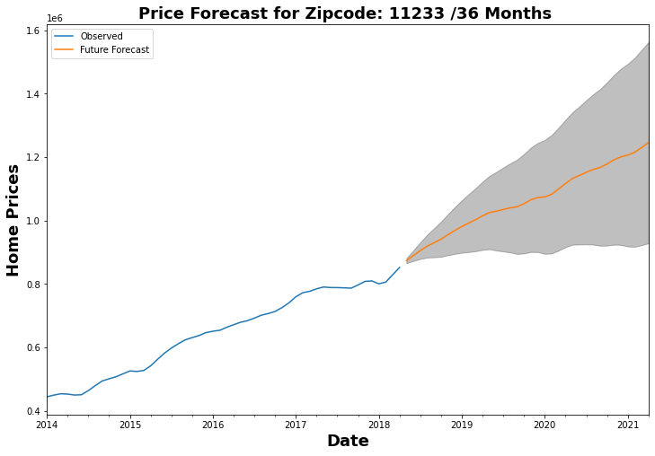
Zipcode: 11233 roi roi_lower roi_upper 0.425923 0.062776 0.78907
Average return 43%
Lower end 6%
Around 2018
Upper end 79%
Around 2021
5th for 1 yr. investment

Slide 5
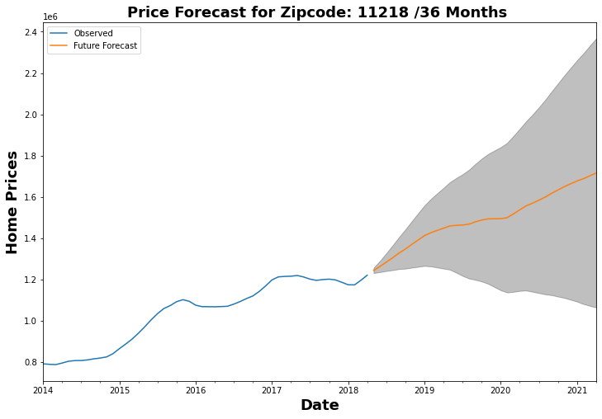
Zipcode: 11218 roi roi_lower roi_upper 0.378893 -0.144644 0.902429
Average return 38%
Lower end -14%
Around 2018
Upper end 90%
Around 2021

Slide 6
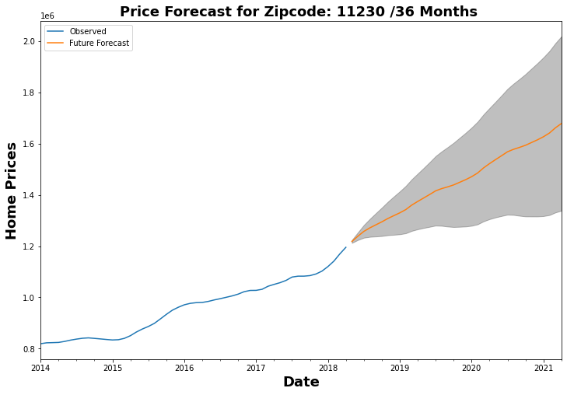
Zipcode: 11230 roi roi_lower roi_upper 0.378108 0.098586 0.657631
Average return 38%
Lower end 9%
Around 2018
Upper end 66%
Around 2021
3rd for 1 investment

Slide 7
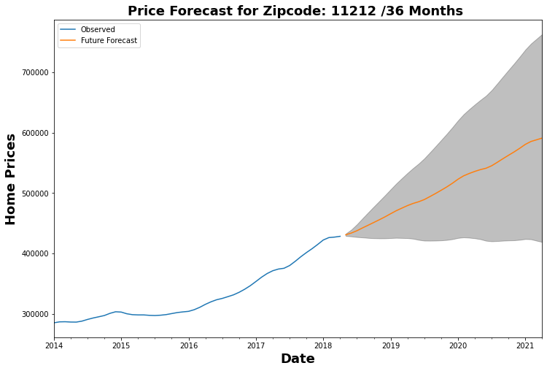
Zipcode: 11212 roi roi_lower roi_upper 0.371624 -0.027713 0.77096
Average return 37%
Lower end -2%
Around 2018
Upper end 77%
Around 2021

Slide 8
Recommendations
Top 5 zipcodes are: 11226, 11233, 11218, 11230, 11212
ROI w/in 1 yr.: 11217, 11238,11230, 11229, 11233
ROI w/in 3 yrs: 11218, 11226, 11233, 11212, 11216

