Slide 1
Introduction
Technical analysis is a trading discipline used to evaluate investments and identify trading opportunities in price trends and patterns from graphs. Technical analysts believe past trading activity and price changes of a stock can be indicators of the security's future price movements.
This notebook will demonstrate how to perform a very basic technical analysis of stock prices using Python code.
The data will consist of the following pharmaceutical companies that are developing a COVID-19 vaccine:
Pfizer (PFE),
Johnson & Johnson (JNJ)
Moderna (MRNA)
Novavax (NVAX)
BioNTech SE (BNTX)
MERCK & Co. (MRK)

Slide 2
Technical Indicators
technical indicators are tools used by investors and traders to gain insights regarding the stock's history, volatility, trends and the direction the price may be headed.
I will use Moving Averages, prices changes and MACD to analyze price trends.
The moving average is also known as the rolling mean or running average. Moving averages smooth out the curve by filtering out the noise in order to highlight components in the data such as trends and seasonality.
MAs used to analyze the past and anticipate future price trends and patterns.

Slide 3
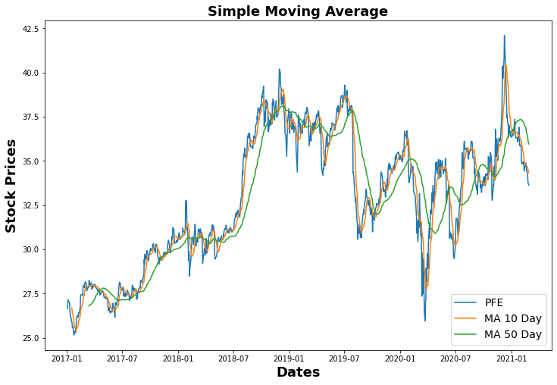
Question 1: Can technical indicators provide an investor or trader with information to make a decision of when to buy and sell stocks?
Simple Moving Average
SMA is used to identify trend direction and to generate potential trading signals.
Graph shows lots of fluctuations and noise in stock price.
What is the SMA showing us? How did stock perform w/o all the noise?
Around 2/18, a spike in price from $30.75 to almost $33.00 and then dropped quickly to almost $28.50
The 10 and 50 day averages around this time period gives a more accurate picture of what the stock price was for that period?
50 day moving average for time period shows that mean price was $30.287786. The average price as $ 32.854801.

Slide 4
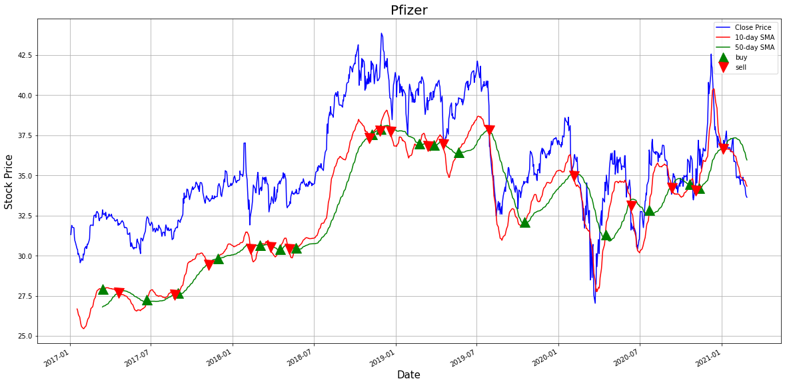
Exponential Moving Average Crossover Strategy
moving average crossover strategy to a price chart allows traders to identify areas where the trend changes the direction creating a potential trading opportunity.
A crossover occurs when a faster moving average (i.e. a shorter period moving average) crosses a slower moving average (i.e. a longer period moving average). In stock trading, this meeting point can be used as a potential indicator to buy or sell an asset.
When the short term moving average crosses above the long term moving average, this indicates a buy signal.
Contrary, when the short term moving average crosses below the long term moving average, it may be a good moment to sell.

