Slide 1

Brooklyn Neighborhoods
Time Series Forecasting

Slide 2
Background
Top 5 zipcodes to invest in in Brooklyn, NY based on investment time period of 3 years.
Analysis based on data from Zillow.com 4/1/1996 – 4/1/2018
Recommendations based on ROI on average and the low and upper forecasting time periods.
Recommendations also based on risk factors
Build statistical models which will forecast the ROI for zipcodes from 4/1/2018 to 2021.

Slide 3
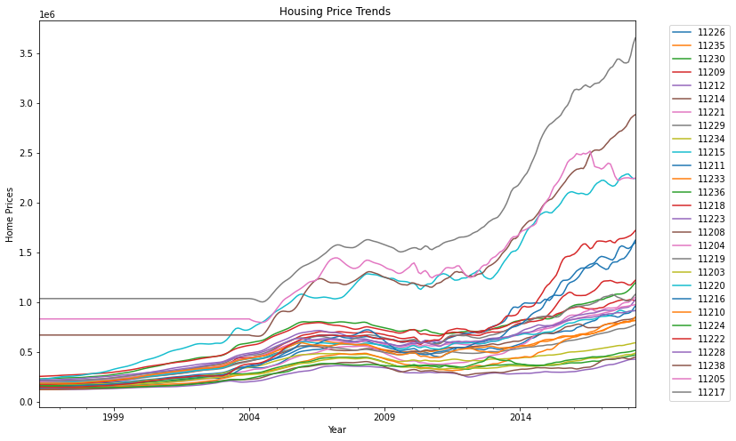
Trends in Housing Prices up to 4-1-2018
Housing market crash in 2008
11217 (gray) 3.5+
High: 3,656,000
Mean: 1,647,587
ROI -3rd yr.
11218 (brown) 3.0
11205 2.25
11215 (acqua) 2.25
11212 428,400
ROI-3rd yr.

Slide 4
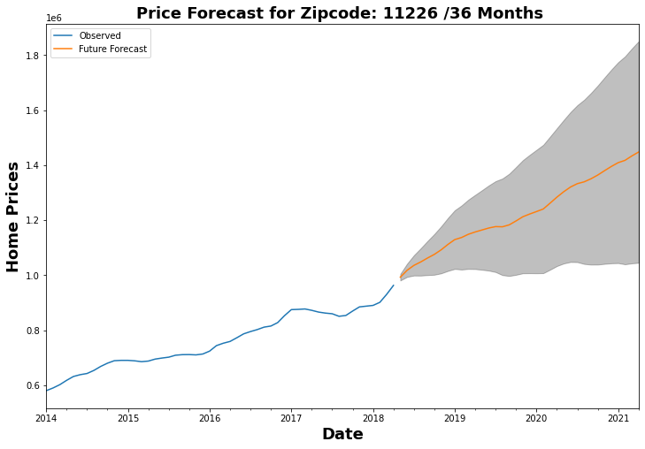
Zipcode: 11226 roi roi_lower roi_upper 0.457944 0.052723 0.863166
Average return 46%
Lower end 6%
Around 2018
Upper end 86%
Around 2021

Slide 5
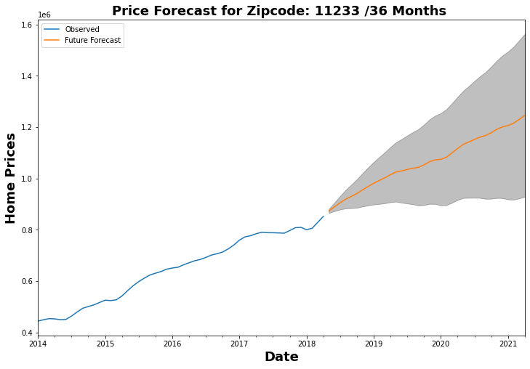
Zipcode: 11233 roi roi_lower roi_upper 0.425923 0.062776 0.78907
Average return 43%
Lower end 6%
Around 2018
Upper end 79%
Around 2021
5th for 1 yr. investment

Slide 6
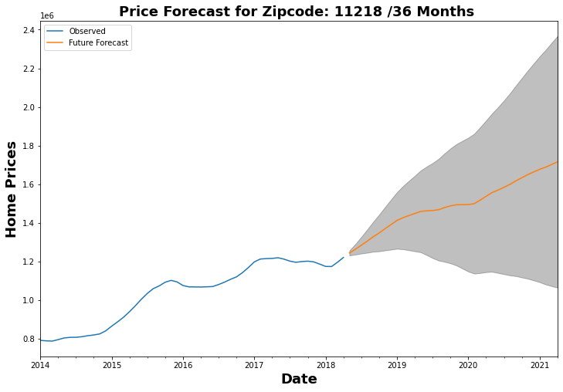
Zipcode: 11218 roi roi_lower roi_upper 0.378893 -0.144644 0.902429
Average return 38%
Lower end -14%
Around 2018
Upper end 90%
Around 2021
1st for 3yr. investment

Slide 7
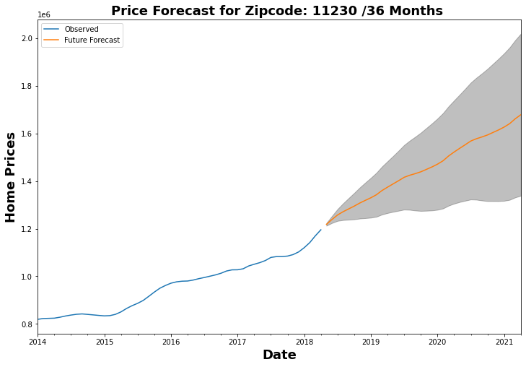
Zipcode: 11230 roi roi_lower roi_upper 0.378108 0.098586 0.657631
Average return 38%
Lower end 9%
Around 2018
Upper end 66%
Around 2021
3rd for 1 investment

Slide 8
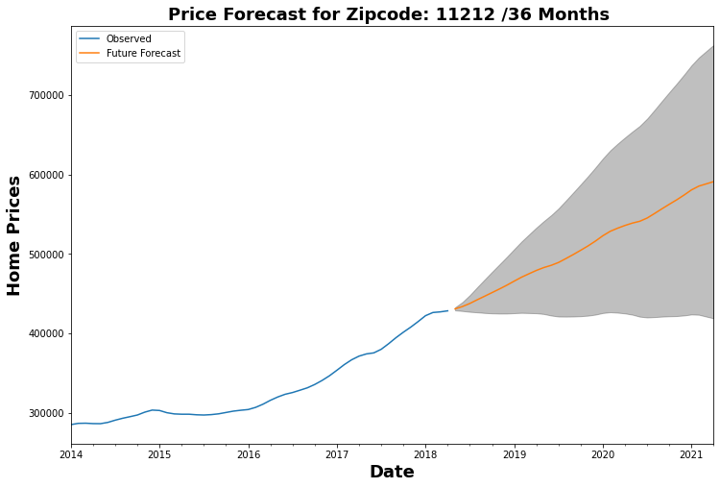
Zipcode: 11212 roi roi_lower roi_upper 0.371624 -0.027713 0.77096
Average return 37%
Lower end -2%
Around 2018
Upper end 77%
Around 2021

Slide 9
Recommendations
Top 5 zipcodes for ROI: 11226 (37%), 11233(43%), 11218(38%), 11230(38%), 11212(37%)
ROI w/in 1 yr. (low): 11217, 11238,11230, 11229, 11233
ROI w/in 3 yrs (upper): 11218, 11226, 11233, 11212, 11216
Winners: 11226, ranked 1st on average & w/in 3 yrs ROI is ranked 2nd w/ROI 86% on upper end
11230: ranked 3rd for 1st year; 11233 ranked for 3rd yr.
Risk Assessment- only data from a uni-variate time series, means only considering the relationship between the average monthly home prices and the date time points. Not considering factors such income, geography etc.

Slide 10
Thank You Thank you for taking the time to listen to my presentation today. Hopefully, you found it helpful. If you have any questions, please don’t hesitate to reach out to me. I can be reached via email or my cell

Slide 11
If I had more time I would work on the following parts to the model:
I would add plotly or dashboard to my model. It needs to be interactive where user can adjust the time period
for forecasting moving a bar.
Need to explore what the risk aspects are to investing in these xipcodes.
Want to create models that consider other features besides average montly sales price.

