Slide 1

Brooklyn Neighborhoods
Time Series Forecasting

Slide 2
Background
Top 5 zipcodes to invest in Brooklyn, NY based on investment time up to 3 years.
Analysis based on data from Zillow.com 4/1/1996 – 4/1/2018
Forecasting period is 4/1/2018 to 4/1/2021

Slide 3
Problem Statement
Investment time period of 1 to 3 years.
Top 5 zipcodes with mean ROI for investment period?
Top 5 zipcodes with ROI on for 1 year?
Top 5 zipcodes with ROI on for 3 years?

Slide 4
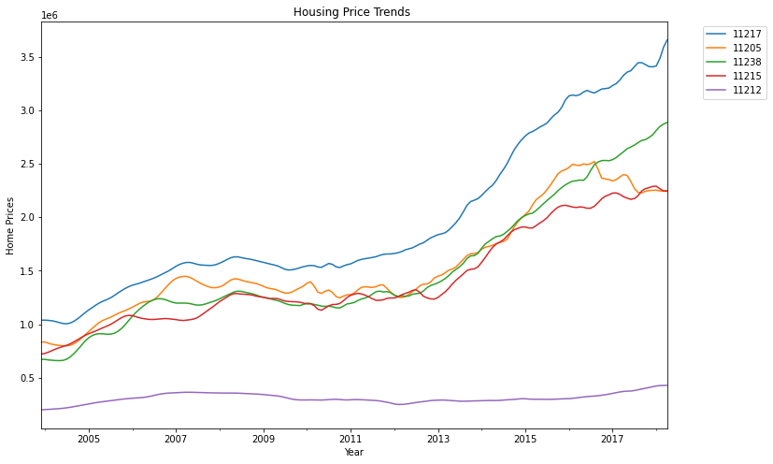
Trends in Housing Prices up to 4-1-2018
Housing market crash in 2008
11217 (blue) $3.66 million
11238 (green) $2.8 million
11215 (green) $2.2 million
11212 (purple) $428,400

Slide 5
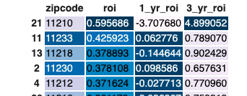
Top 5 Zipcodes w/highest ROI
Top mean ROI:
11210
11233
11218
11230
11212

Slide 6
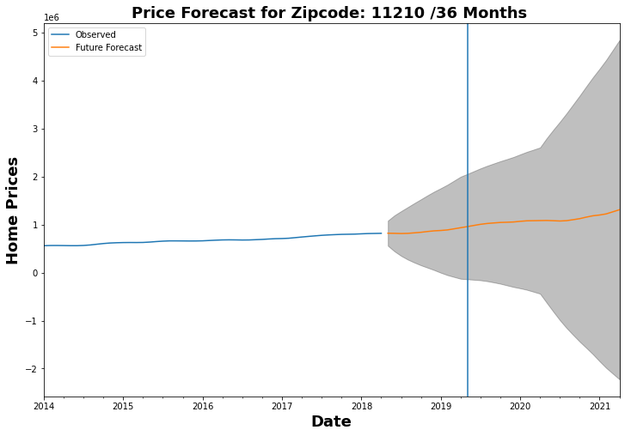
Zipcode: 11210 ROI 1st yr. 3rd yr. 0.595686 -3.70768 4.899052
Mean ROI 59%
1st yr. -370%
3rd yr. 489%

Slide 7
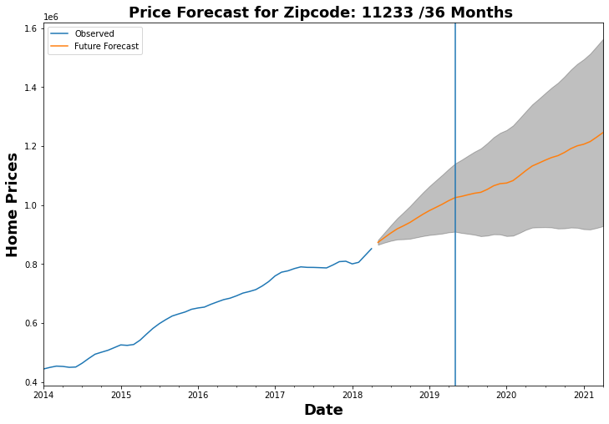
Zipcode: 11233 ROI 1st yr. 3rd yr. 0.425923 0.062776 0.78907
Mean ROI 43%
1st yr. 6.2%
3rd yr. 79%

Slide 8
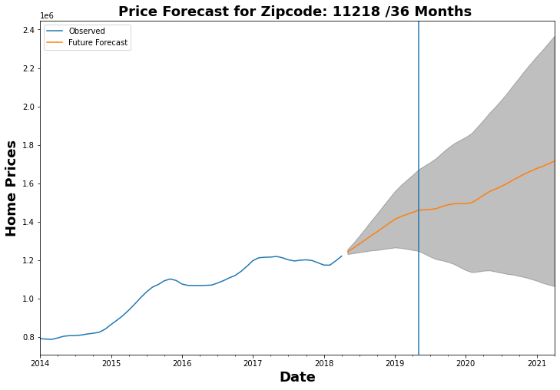
Zipcode: 11218 ROI 1st yr. 3rd yr. 0.378893 -0.144644 0.902429
Mean ROI 38%
1st yr. -14.4%
3rd yr. 90%

Slide 9
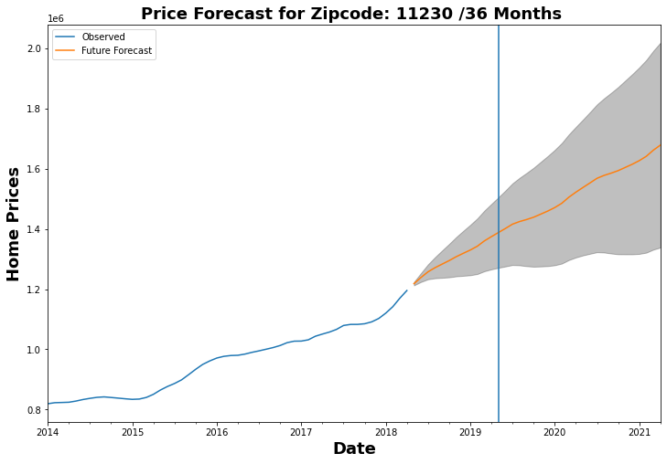
Zipcode: 11230 ROI 1st yr. 3rd yr. 0.378108 0.098586 0.657631
Mean ROI 38%
1st yr. 9%
3rd yr. 66%

Slide 10
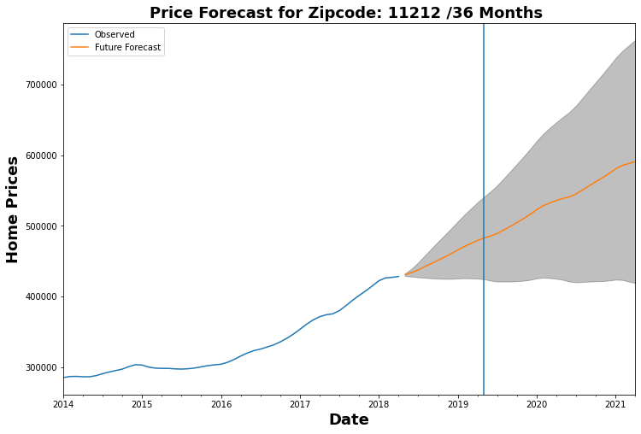
Zipcode: 11212 ROI 1st yr. 3rd yr. 0.371624 -0.027713 0.77096
Average ROI 37%
1st yr. -2.77%
3rd yr. 77%

Slide 11
Recommendations Mean ROI
Top 5 zipcodes with mean ROI:
11210 (60%)
11233 (43%)
11218 (38%)
11230 (38%)
11212 (37%)

Slide 12
Recommendations 1st Year
ROI around 1 yr.:
11238 (19%)
11217 (15%)
11220 (11%)
11230 (9.8%)
11224 (8.7%)

Slide 13
Recommendations 3rd Year
ROI around 3 yrs.:
11210 (489%)
11221 (192%)
11218 (90%)
11233 (79%)
11212 (77%)

Slide 14
Recommendations Winners
Mean ROI 1st yr. 3rd yr.
1.) 11210 (60%) 11210 (489%) 1st
2.) 11233 (42.5%) 11233 (79%) 4th
3.) 11218 (37.8%) 11218 (90%) 3rd
4.) 11230 (37.8%) 11230 (9.8%) 4th
5.) 11212 (37%) 11212 (77%) 5th

Slide 15
Thank You Thank you for taking the time to listen to my presentation today. Hopefully, you found it helpful. If you have any questions, please don’t hesitate to reach out to me. I can be reached via email or my cell

Slide 16
If I had more time I would work on the following parts to the model:
I would add plotly or dashboard to my model. It needs to be interactive where user can adjust the time period
for forecasting moving a bar.
Need to explore what the risk aspects are to investing in these zipcodes.
Want to create models that consider other features besides average monthly sales price.

