Slide 1
Brooklyn Zipcodes
Time Series Forecasting

Slide 2
Background
Top 5 zipcodes to invest in in Brooklyn, NY based on investment time period of 3 years.
Analysis based on data from Zillow.com 4/1/1996 – 4/1/2018
Recommendations based on ROI on average and the low and upper forecasting time periods.
Recommendations also based on risk factors
Build statistical models which will forecast the ROI for zipcodes from 4/1/2018 to 2021.

Slide 3
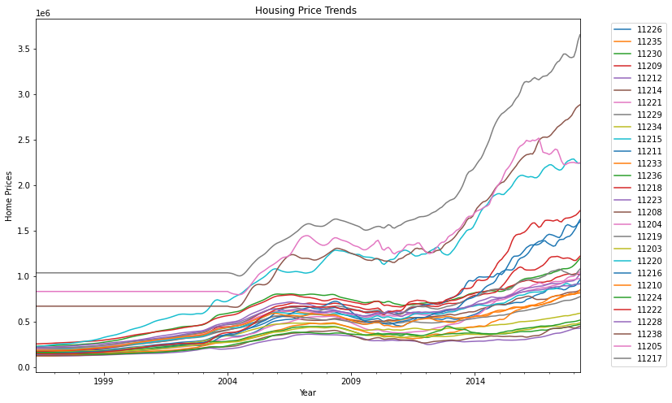
Trends in Housing Prices
Housing market crash in 2008

Slide 4
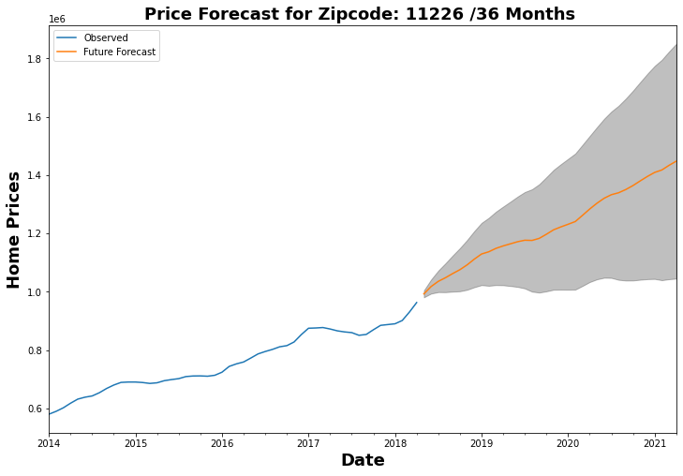
Zipcode: 11226 roi roi_lower roi_upper 0.457944 0.052723 0.863166
Average return 46%
Lower end 6%
Around 2018
Upper end 86%
Around 2021

Slide 5
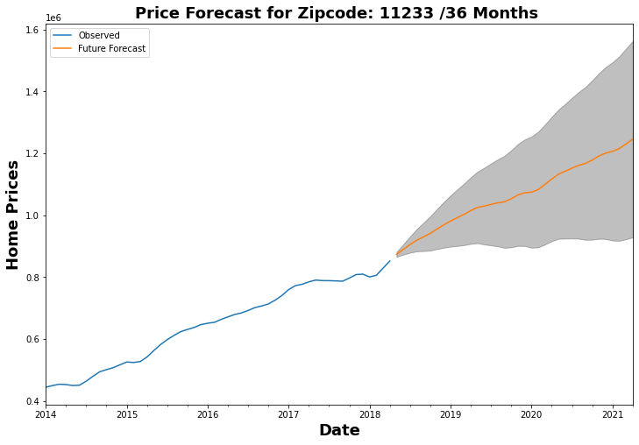
Zipcode: 11233 roi roi_lower roi_upper 0.425923 0.062776 0.78907
Average return 43%
Lower end 6%
Around 2018
Upper end 79%
Around 2021
5th for 1 yr. investment

Slide 6
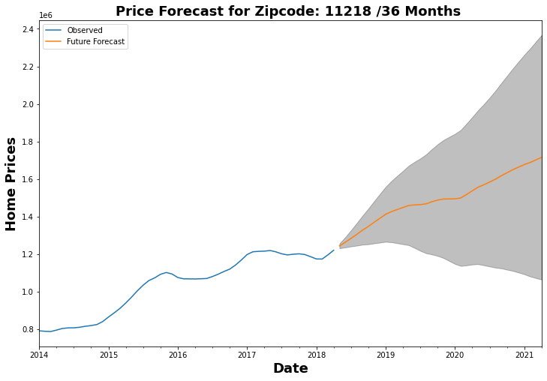
Zipcode: 11218 roi roi_lower roi_upper 0.378893 -0.144644 0.902429
Average return 38%
Lower end -14%
Around 2018
Upper end 90%
Around 2021

Slide 7
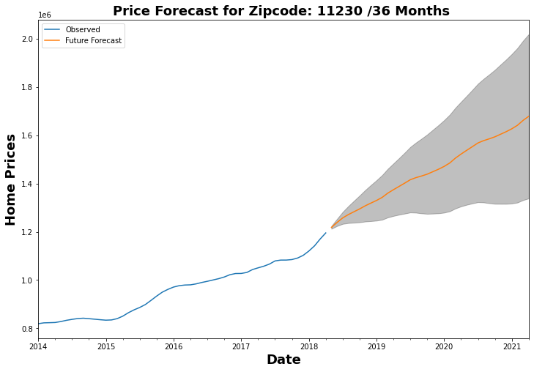
Zipcode: 11230 roi roi_lower roi_upper 0.378108 0.098586 0.657631
Average return 38%
Lower end 9%
Around 2018
Upper end 66%
Around 2021
3rd for 1 investment

Slide 8
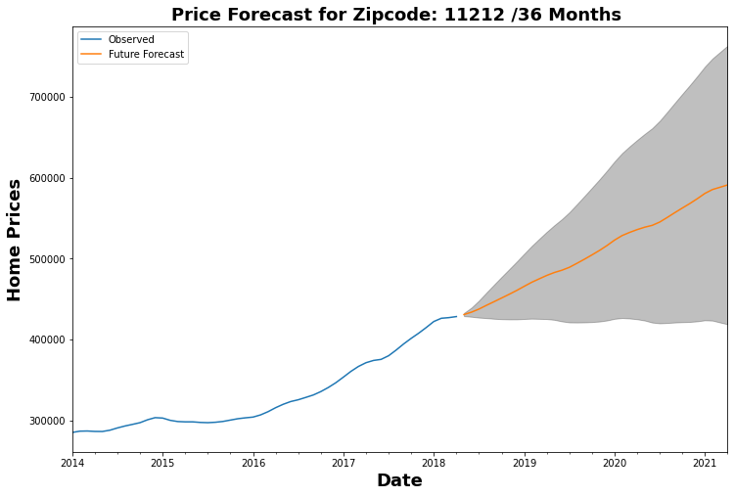
Zipcode: 11212 roi roi_lower roi_upper 0.371624 -0.027713 0.77096
Average return 37%
Lower end -2%
Around 2018
Upper end 77%
Around 2021

Slide 9
Recommendations
Top 5 zipcodes for ROI: 11226, 11233, 11218, 11230, 11212
ROI w/in 1 yr.: 11217, 11238,11230, 11229, 11233
ROI w/in 3 yrs: 11218, 11226, 11233, 11212, 11216
Winners: 11226, ranked 1st on average & w/in 3 yrs ROI is ranked 2nd w/ROI 86% on upper end
Risk Assessment- only data from a uni-variate time series, means only considering the relationship between the y-axis value the x-axis time points. Not considering

