Slide 1

Brooklyn Neighborhoods
Time Series Forecasting

Slide 2
Background
Top 5 zipcodes to invest in Brooklyn, NY based on investment time up to 3 years.
Analysis based on data from Zillow.com 4/1/1996 – 4/1/2018
Forecasting period is 4/1/2018 to 4/1/2021

Slide 3
Problem Statement
Investment time period of 1 to 3 years.
Top 5 zipcodes with mean ROI for investment period?
Top 5 zipcodes with ROI on for 1 year?
Top 5 zipcodes with ROI on for 3 years?

Slide 4
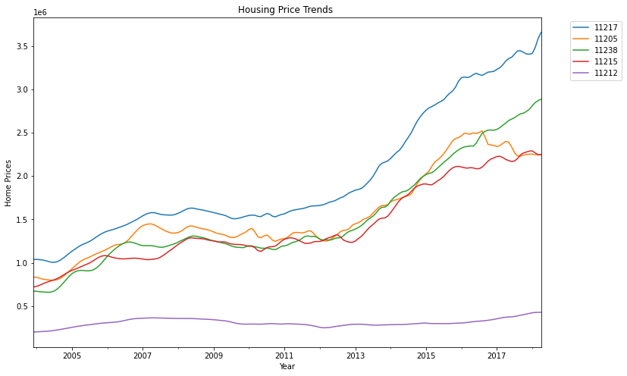
Trends in Housing Prices up to 4-1-2018
Housing market crash in 2008
11217 (blue) $3.66 million
11238 (green) $2.8 million
11215 (green) $2.2 million
11212 (purple) $428,400

Slide 5
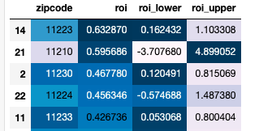
Zipcodes w/Top 5 highest ROIs
Top 5 ROIs:
11223
11210
11230
11224
11233

Slide 6
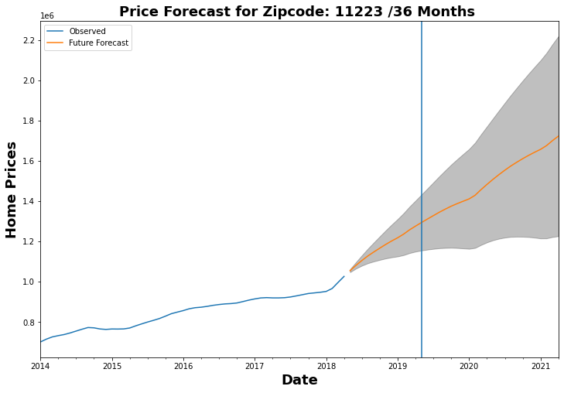
Zipcode: 11223 ROI low high 0.63287 0.162432 1.103308
Model Predicted ROI: 63%
ROI forecast w/ 3yrs period:
range 16% to 110.3%

Slide 7
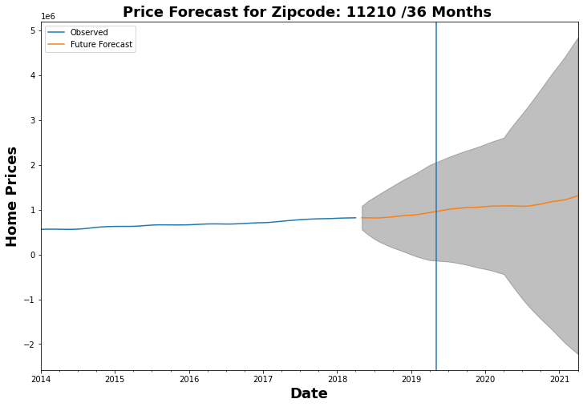
Zipcode: 11210 ROI low high 0.595686 -3.70768 4.899052
Predicted ROI 59%
W/ forecast of 3 yrs. ROI range of -370% to 489%

Slide 8
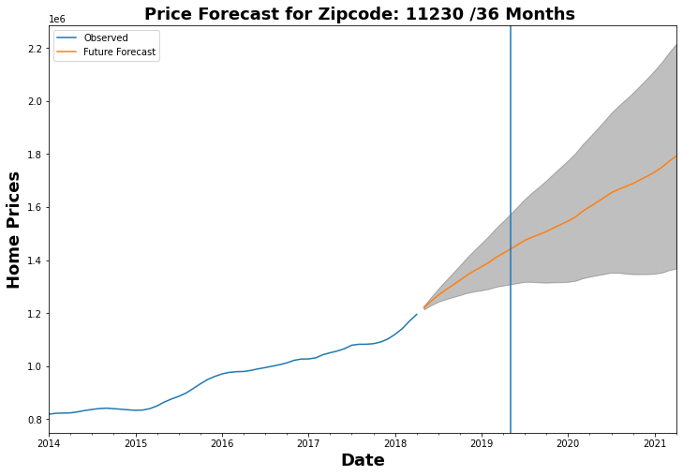
Zipcode: 11230 ROI low high 0.46778 0.120491 0.815069
Predicted ROI 46%
W/ forecast of 3 yrs. ROI range of 12% to 81%

Slide 9
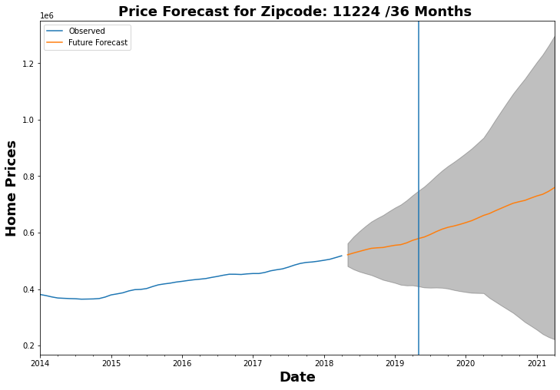
Zipcode: 11224 ROI low high 0.456346 -0.574688 1.48738
Predicted ROI 45%
W/ forecast of 3 yrs. ROI range of -57% to 148%

Slide 10
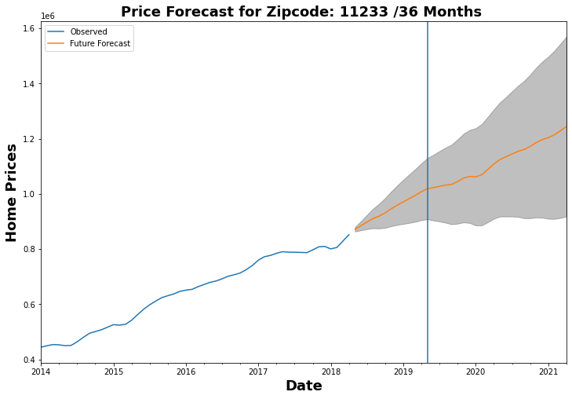
Zipcode: 11233 ROI Low High 0.426736 0.053068 0.800404
Predicted ROI 42%
W/ forecast of 3 yrs. ROI range of 5% to 80%

Slide 11
Recommendations Mean ROI
Zipcodes with Top 5 highest Predicted ROIs:
11223 (63%)
11210 (59%)
11230 (46%)
11224 (45%)
11233 (42%)

Slide 12
Thank You Thank you for taking the time to listen to my presentation today. Hopefully, you found it helpful. If you have any questions, please don’t hesitate to reach out to me. I can be reached via email or my cell

Slide 13
If I had more time I would work on the following parts to the model:
I would add plotly or dashboard to my model. It needs to be interactive where user can adjust the time period
for forecasting moving a bar.
Need to explore what the risk aspects are to investing in these zipcodes.
Want to create models that consider other features besides average monthly sales price.

