Slide 1
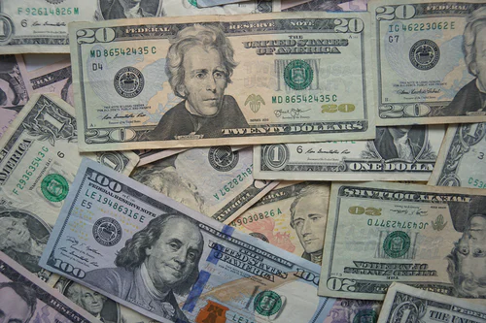
Automating Stock Trading

Slide 2
Introduction
With technology stock trading is becoming highly automated.
Stocks of pharmaceutical companies involved in COVID vaccinations
Data time period: 1/3/17 – 4/30/21
Use Python to analyze past trading activity and price changes of a stock as indicators of security's future price movements.
Create Long Short Term Memory (LSTM )Models to predict future stock prices.
Using technical indicators for market analysis and predictions

Slide 3
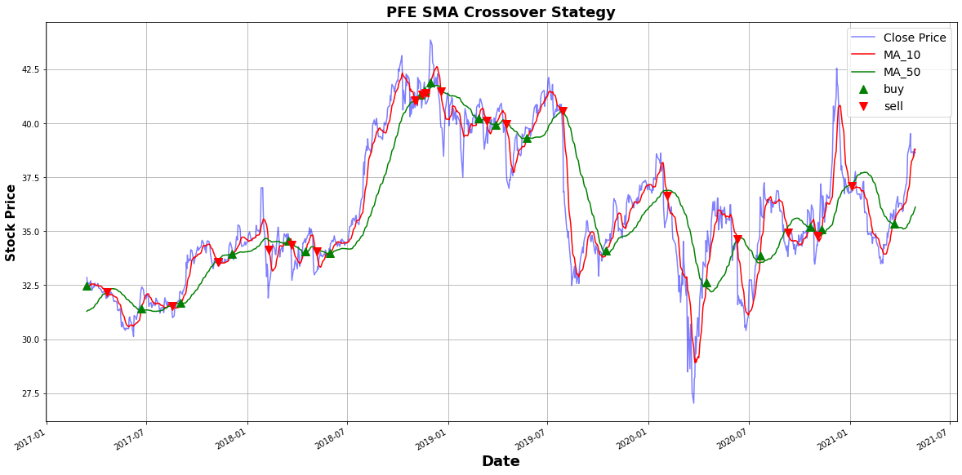
Question 1: Can Python be used to analyze past trading activity and price changes of a stock as indicators of security's future price movements. cv
PFE (Pfizer)
10 and 50 Day Moving Averages
MA crosses the slow one upwards, we buy the asset. When the slow MA crosses the fast one upwards, we sell the asset.

Slide 4
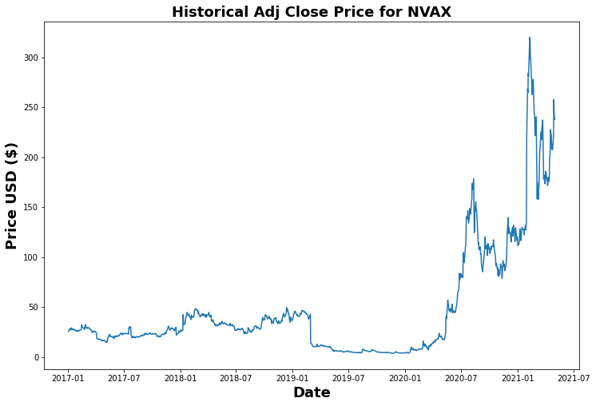
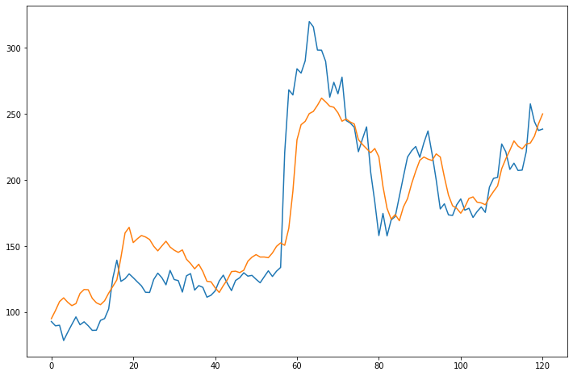
Question 1: How well does the LSTM model perform in forecasting stock prices with 'Adj Close' column and only basic model parameters. NVAX (NOVOVAX) Average stock price $47.55 RMSE: 0.15 High: $319.93, Low $3.69 Model off by $26.10

Slide 5
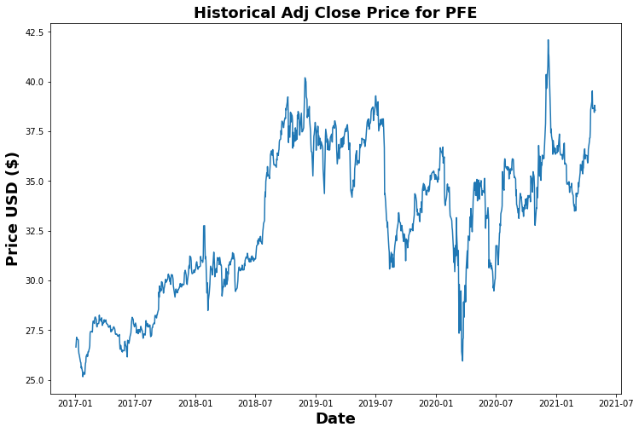
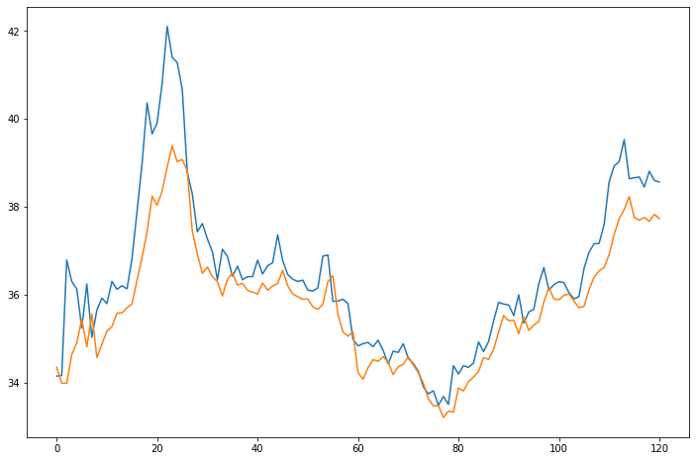
Question 1 (Cont’d) (PFE) Pfizer Average price: 32.999350 RMSE: 0.07 Low: $ 25.159 , High: $42.1019 Off by: 0.94

Slide 6
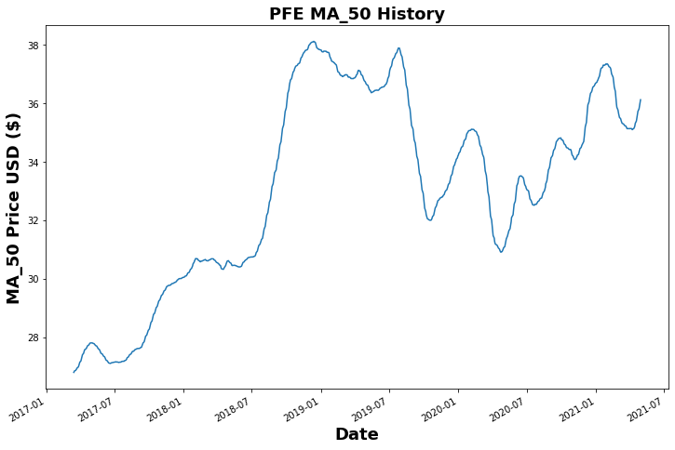
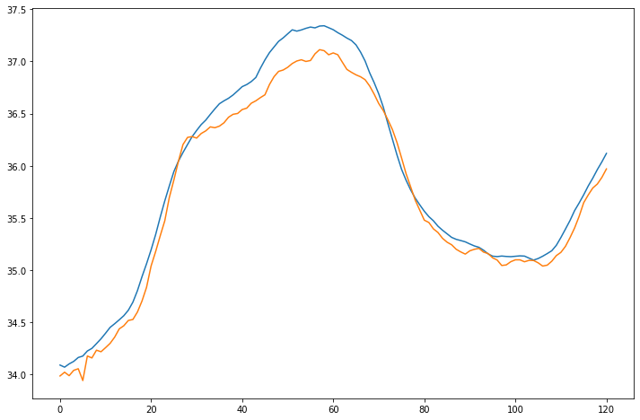
Question 2: How does the LSTM model perform in forecasting stock prices with technical indicator column 'MA_50' and only basic model parameters. Average price: $33.058 RMSE: 0.01 Low: $26.801, High: $38.114 Off by: 0.17

Slide 7
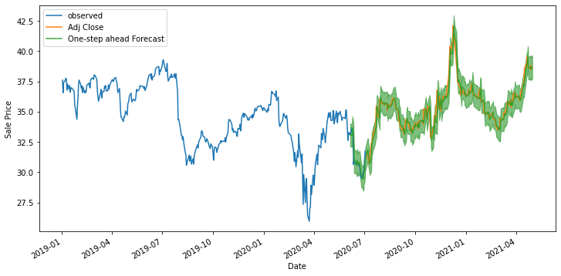
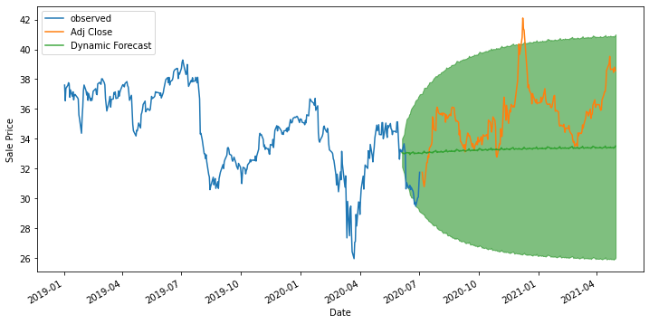
Question 3: How does the SARIMA model perform in forecasting stock prices with column ‘Adj Close' and only basic model parameters. One-Step Ahead Forecasting Dynamic Forecasting Off by 0.53 Mean: $32.99 Off by: 2.91 Green line: around $33/$34

