Slide 1
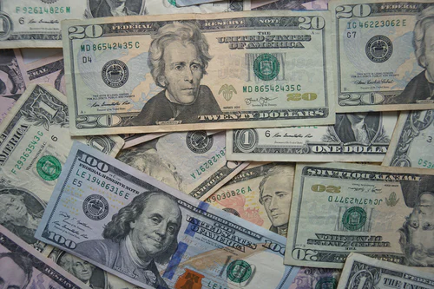
Automating Stock Trading

Slide 2
Introduction
With technology stock trading is becoming highly automated.
Stocks of pharmaceutical companies involved in COVID vaccinations
Data time period: 1/3/17 – 4/30/21
Create Long Short Term Memory (LSTM )Models to predict future stock prices.
Using technical indicators for market analysis and predictions

Slide 3
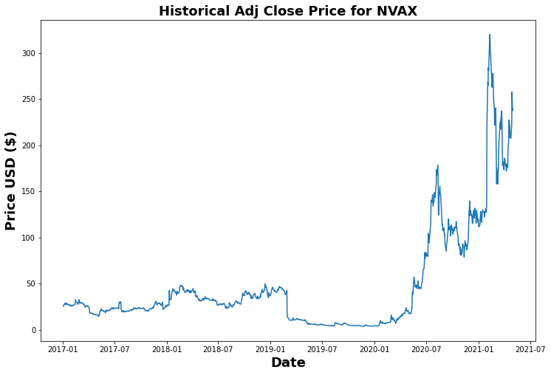
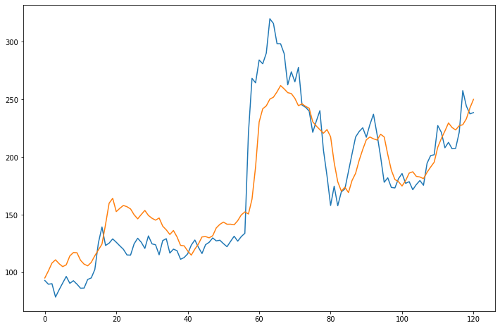
Question 1: How well does the LSTM model perform in forecasting stock prices with 'Adj Close' column and only basic model parameters. NVAX (NOVOVAX) Average stock price $47.55 RMSE: 0.15 High: $319.93, Low $3.69 Model off by $26.10

Slide 4
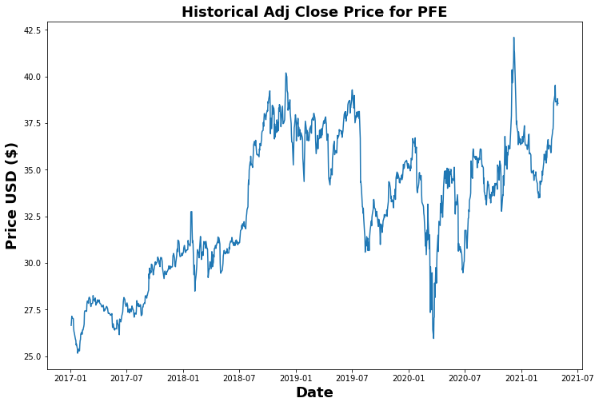
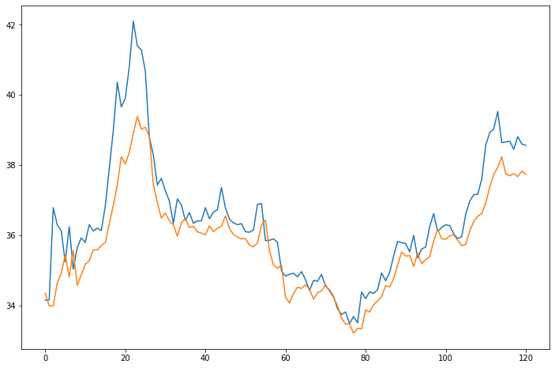
Question 1 (Cont’d) (PFE) Pfizer Average price: 32.999350 RMSE: 0.07 Low: $ 25.159 , High: $42.1019 Off by: 0.94

Slide 5
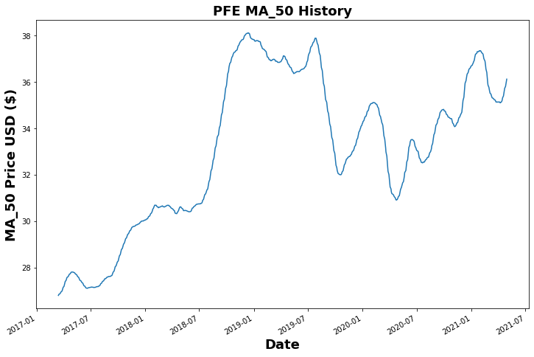
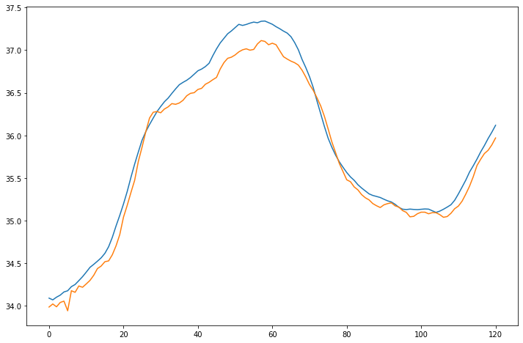
Question 2: How does the LSTM model perform in forecasting stock prices with technical indicator column 'MA_50' and only basic model parameters. Average price: $33.058 RMSE: 0.01 Low: $26.801, High: $38.114 Off by: 0.17

Slide 6
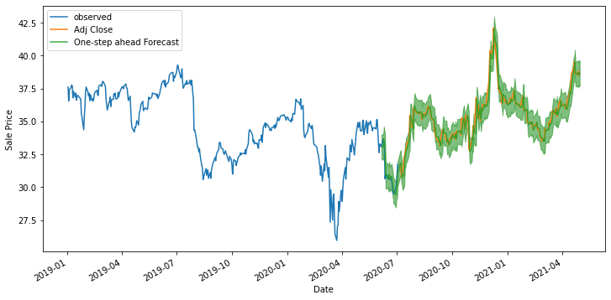
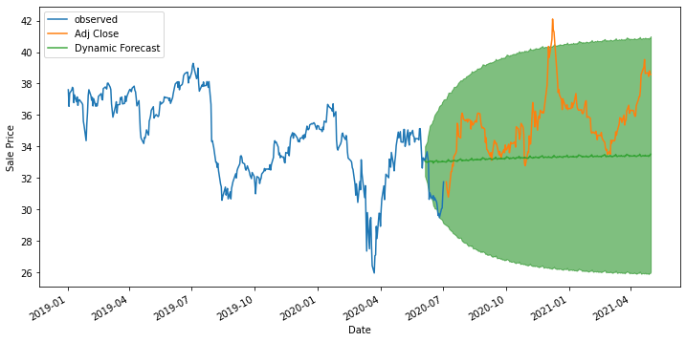
Question 3: How does the SARIMA model perform in forecasting stock prices with column ‘Adj Close' and only basic model parameters. One-Step Ahead Forecasting Dynamic Forecasting Off by 0.53 Mean: $32.99 Off by: 2.91 Green line: around $33/$34

