Slide 1


Automating Stock Analysis and Price Forecasting

Slide 2
Introduction
stock trading is becoming highly automated and user friendly
Stocks of pharmaceutical companies producing COVID vaccinations
Dataset time period: 1/3/17 – 4/30/21
Use Python to create models and plots for past trading activity and price forecasting.
Long Short Term Memory (LSTM ) and ARIMA Models to predict future stock prices.
Using technical indicators for market analysis and predictions

Slide 3
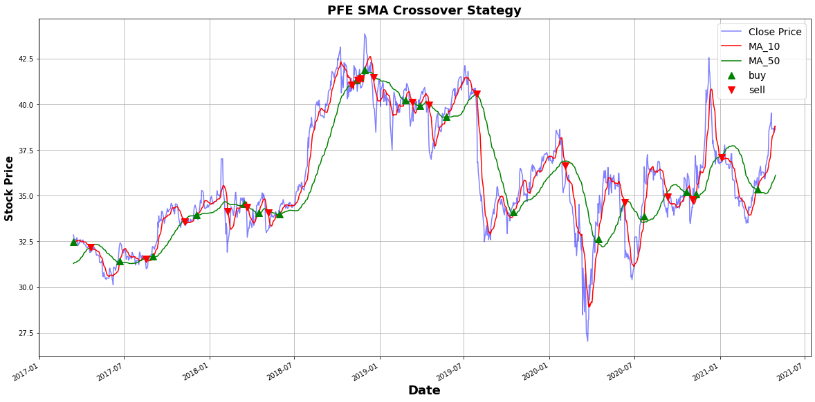
Question 1: Can basic plots be used for analysis of past trading activity, price changes and security's future price movements?
PFE (Pfizer)
10 and 50 Day Moving Averages
10_MA crosses 50_MA upwards, we buy the asset. When the 50_MA crosses the 10_MA upwards, we sell the asset.

Slide 4
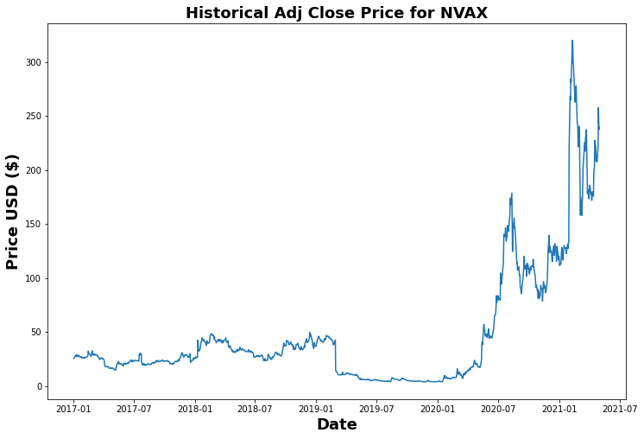
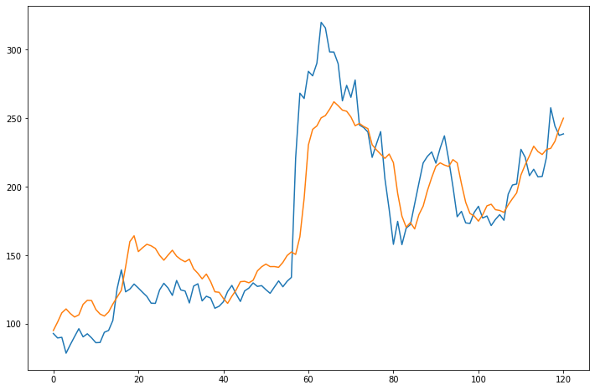
Question 2: How well does the LSTM model perform in forecasting stock prices with 'Adj Close' column and only basic model parameters. NVAX (NOVOVAX) Average stock price $47.55 RMSE: 0.15 High: $319.93, Low $3.69 Model off by $26.10

Slide 5
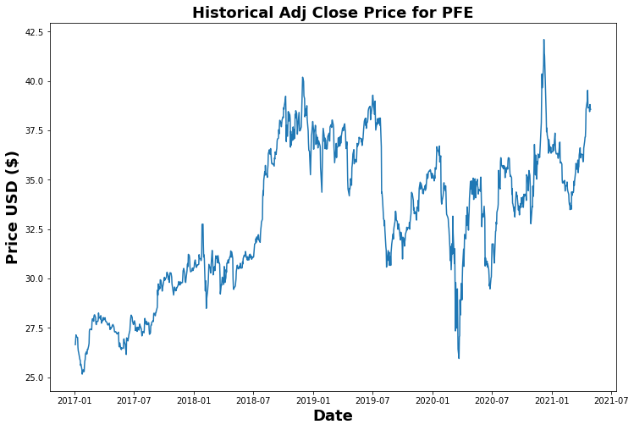
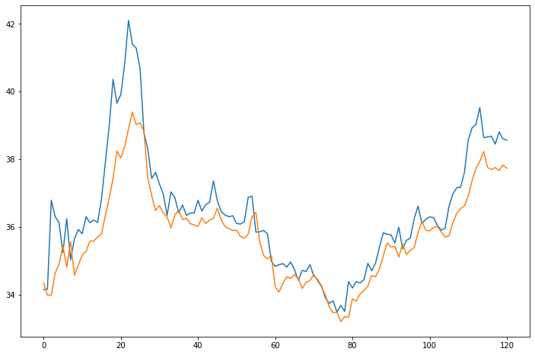
Question 1 (Cont’d) (PFE) Pfizer Average price: 32.999350 RMSE: 0.07 Low: $ 25.159 , High: $42.1019 Off by: 0.94

Slide 6
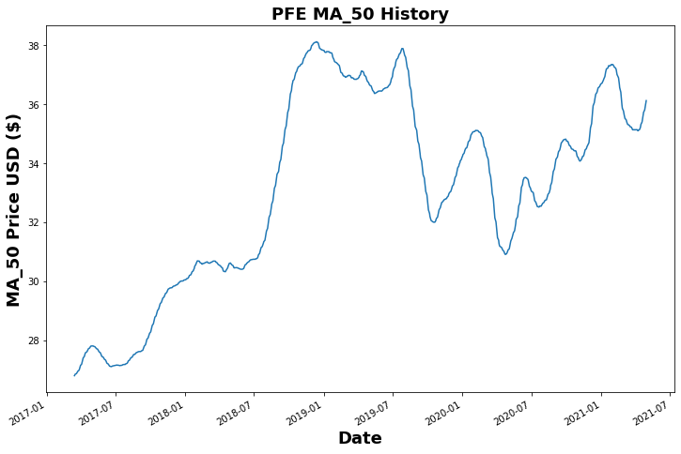
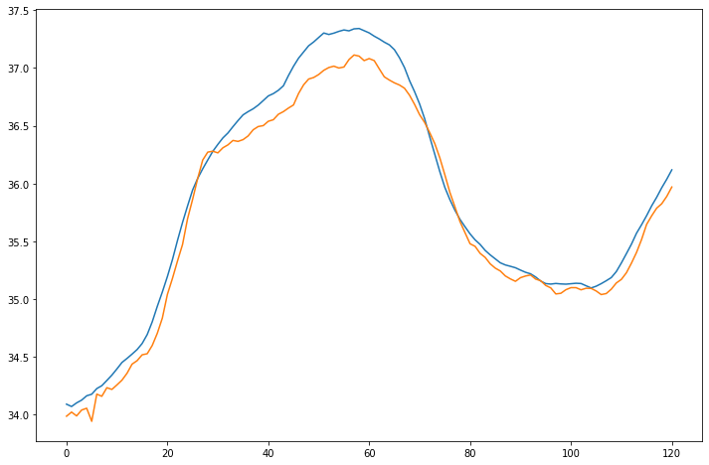
Question 2: How does the LSTM model perform in forecasting stock prices with technical indicator column 'MA_50' and only basic model parameters. Average price: $33.058 RMSE: 0.01 Low: $26.801, High: $38.114 Off by: 0.17

Slide 7
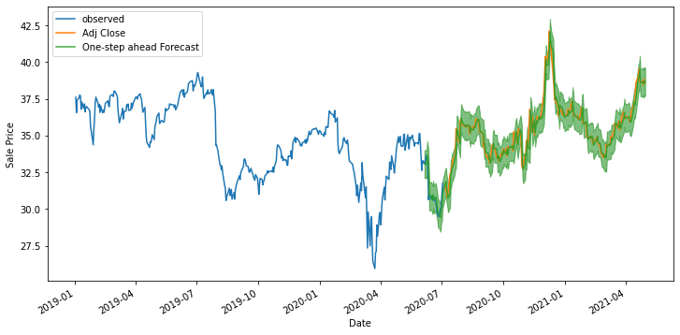
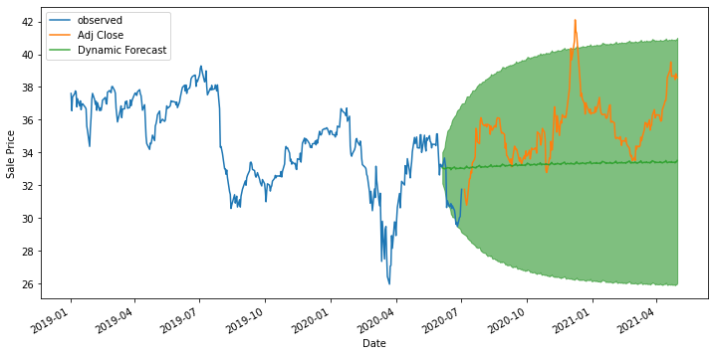
Question 3: How does the SARIMA model perform in forecasting stock prices with column ‘Adj Close' and only basic model parameters. One-Step Ahead Forecasting Dynamic Forecasting Off by 0.53 Mean: $32.99 Off by: 2.91 Green line: around $33/$34

