Slide 1


Automating Stock Analysis and Price Forecasting

Slide 2
Introduction
Market analysis software that user friendly for non-technical
Stocks of pharmaceutical companies producing COVID vaccinations
Dataset time period: 1/3/17 – 4/30/21
Goal: can advanced trading tools like technical indicators and models be utilized by non-technical users with solid results
Use Python to create models and plots for past trading activity and price forecasting.
Long Short Term Memory (LSTM ) and ARIMA Models to predict future stock prices.
Using technical indicators for market analysis and predictions

Slide 3
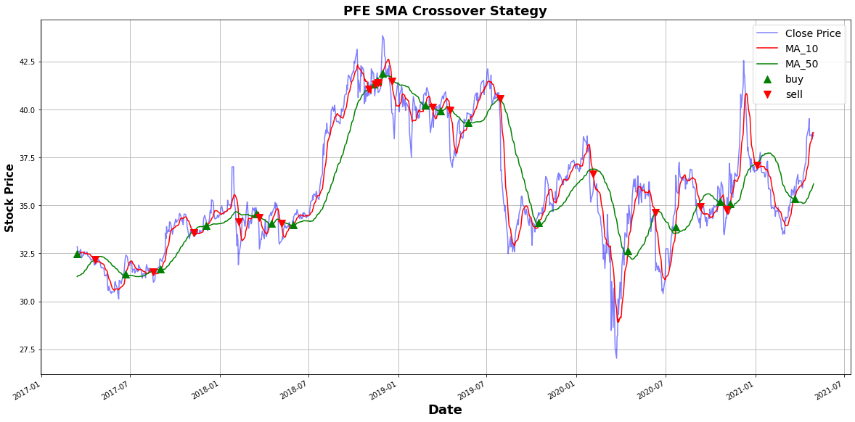
Question 1: Can the trading tools like technical indicators be simplified so users can perform analysis of security’s past trading activity, price changes and future price movements?
PFE (Pfizer)
10 and 50 Day Moving Averages
10_MA crosses 50_MA upwards, we buy the asset. When the 50_MA crosses the 10_MA upwards, we sell the asset.

Slide 4
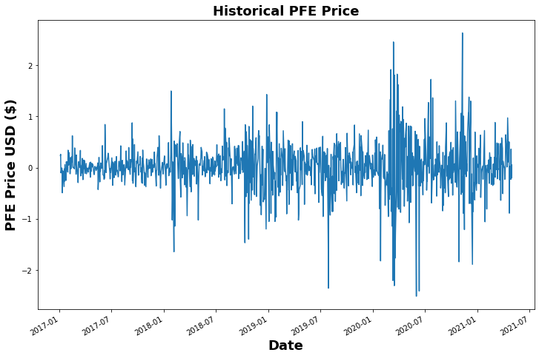
Question 1: Price Change is technical indicator
PFE
How much has price changed over time
Volatility?
Mean: 0.314
Min: 0.000
Max: 2.63

Slide 5
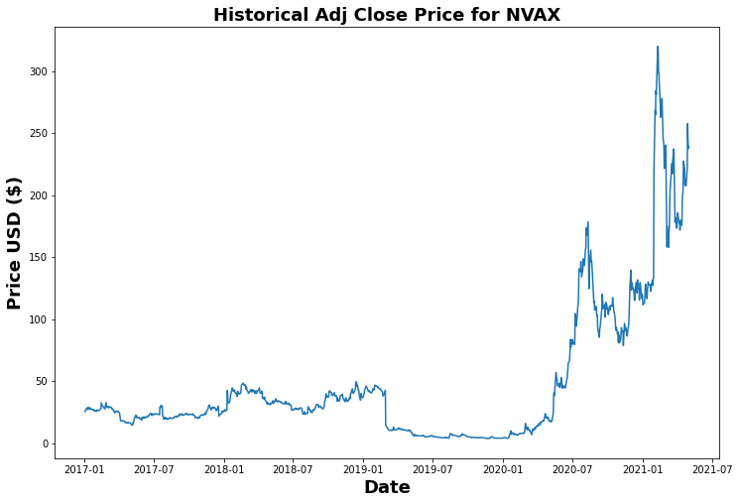
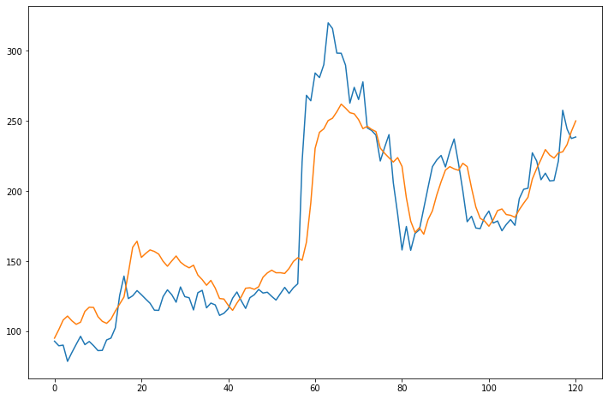
Question 2: How well does the LSTM model perform in forecasting stock prices with 'Adj Close' column and only basic model parameters. NVAX (NOVOVAX) Average stock price $47.55 RMSE: 0.15 High: $319.93, Low $3.69 Model off by $26.10

Slide 6
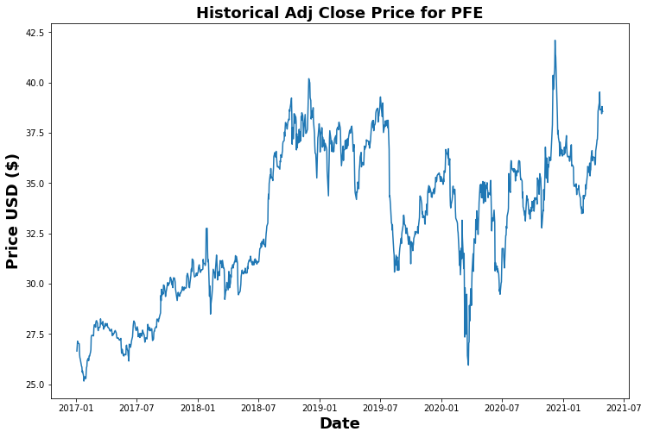
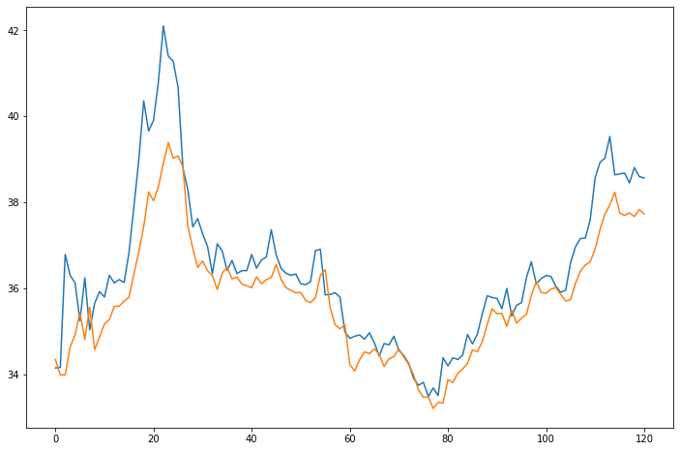
Question 2 (Cont’d) (PFE) Pfizer Average price: 32.999350 RMSE: 0.07 Low: $ 25.159 , High: $42.1019 Off by: 0.94

Slide 7
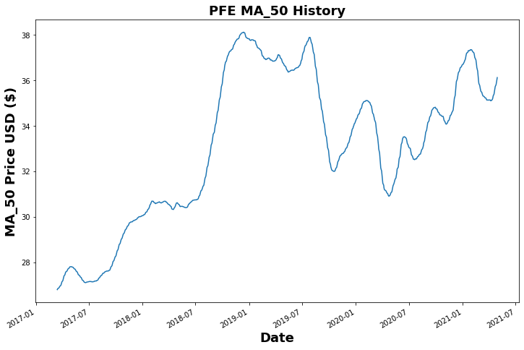
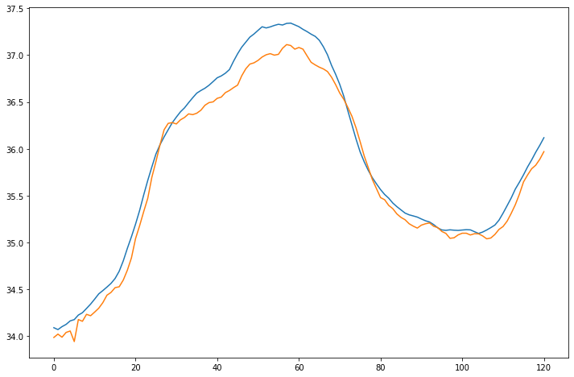
Question 2: How does the LSTM model perform in forecasting stock prices with technical indicator column 'MA_50' and only basic model parameters. Average price: $33.058 RMSE: 0.01 Low: $26.801, High: $38.114 Off by: 0.17

Slide 8
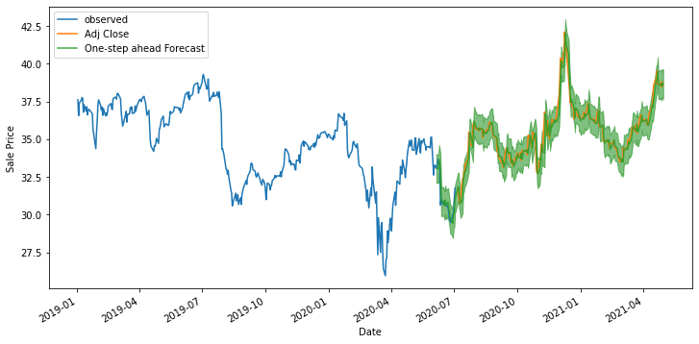
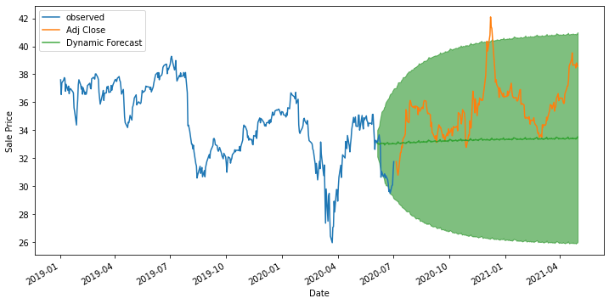
Question 3: How does the ARIMA model perform in forecasting stock prices with column ‘Adj Close' and only basic model parameters. One-Step Ahead Forecasting Dynamic Forecasting Off by 0.53 Mean: $32.99 Off by: 2.91 Green line: around $33/$34

Slide 9
Findings
Technical indicators can be used by non-technical user to analyze stock history and future price trends with good results, ie moving averages gives user realistic view of how stock has performed. Also shows user where stock should have been bought and sold.
LSTM models performed well. With volatile stock model off by $26.10. Model metric for NVAX was 0.15. Non-volatile stock off by 0.94.
ARIMA models performed well. One-step ahead off by 0.53. Dynamic Forecasting off 2.91.

Slide 10
Recommendations
Pursue building platform which enables users with only the symbol of stock to apply technical indicators for historical stock analysis and price trends.
The plots can be easily understoood with users having very little knowledge of stock trading and analysis. Future Software will need to provide basic instruction on how the technical indicators can be used.
Create software for LSTM and ARIMA algorithms at a basic level which can be utilized by users for market analysis and price forecasting

Slide 11
Closing
Thank you for coming today. If you have any questions, please do not hesitate to reach out to me.

Slide 12
If I had more time I would add more layers to deep learning models and change the parameters to the ARIMA models and contrast the results. Basic parameters, layers v. more complicated.

