Slide 1
SECURITY ENGINEERING — HANDS-ON LAB
Automated Sign-In Risk
Detection & Response
Microsoft Entra ID → Microsoft Sentinel → Logic Apps
David Rufino Botte | Senior Desktop Engineer
github.com/davidrufinobotte/entra-sentinel-detection-lab

Slide 2
HOW IT WORKS
End-to-end pipeline: log to alert
Entra ID
Sign-In Logs
→
Log Analytics
Workspace
→
Sentinel
Detection Rule
→
Incident
Created
→
Logic App
Playbook
→
Email
Alert
A risky sign-in is logged, ingested into Sentinel, evaluated by a scheduled detection rule, and — if it matches — automatically opens an incident and triggers an emailed alert.

Slide 3
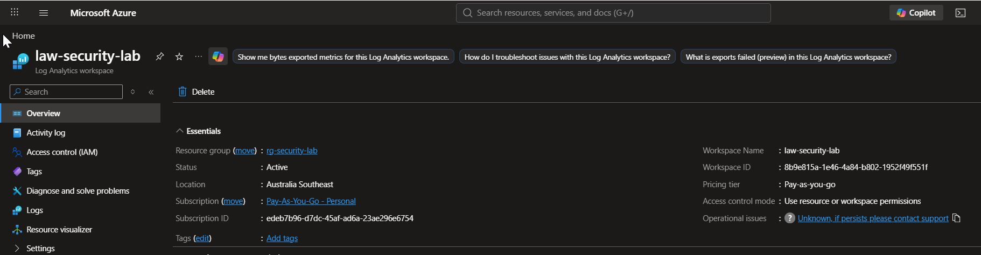
01
FOUNDATION
Log Analytics Workspace
Created law-security-lab as the central log repository for the lab
Pay-As-You-Go subscription, Australia Southeast region
Base layer every downstream Sentinel component reads from

Slide 4
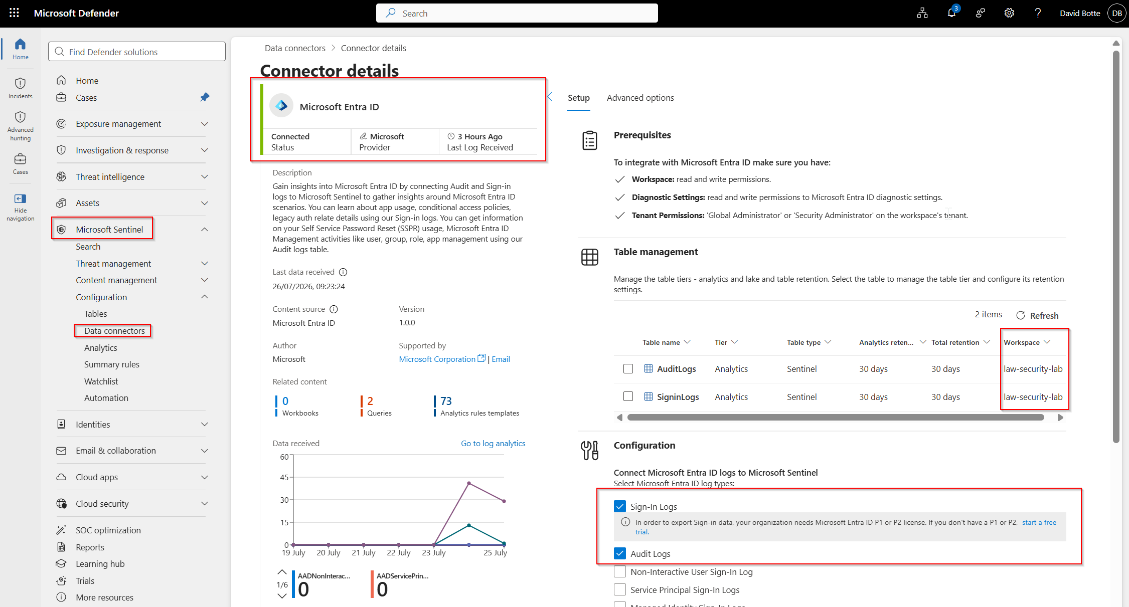
02
DATA SOURCE
Connecting Identity Signals
Connected the Microsoft Entra ID data connector (Sign-In + Audit logs)
Fixed a real issue: the connector was missing until the Entra ID solution was installed from the Sentinel Content Hub
Confirms troubleshooting ability, not just following steps

Slide 5
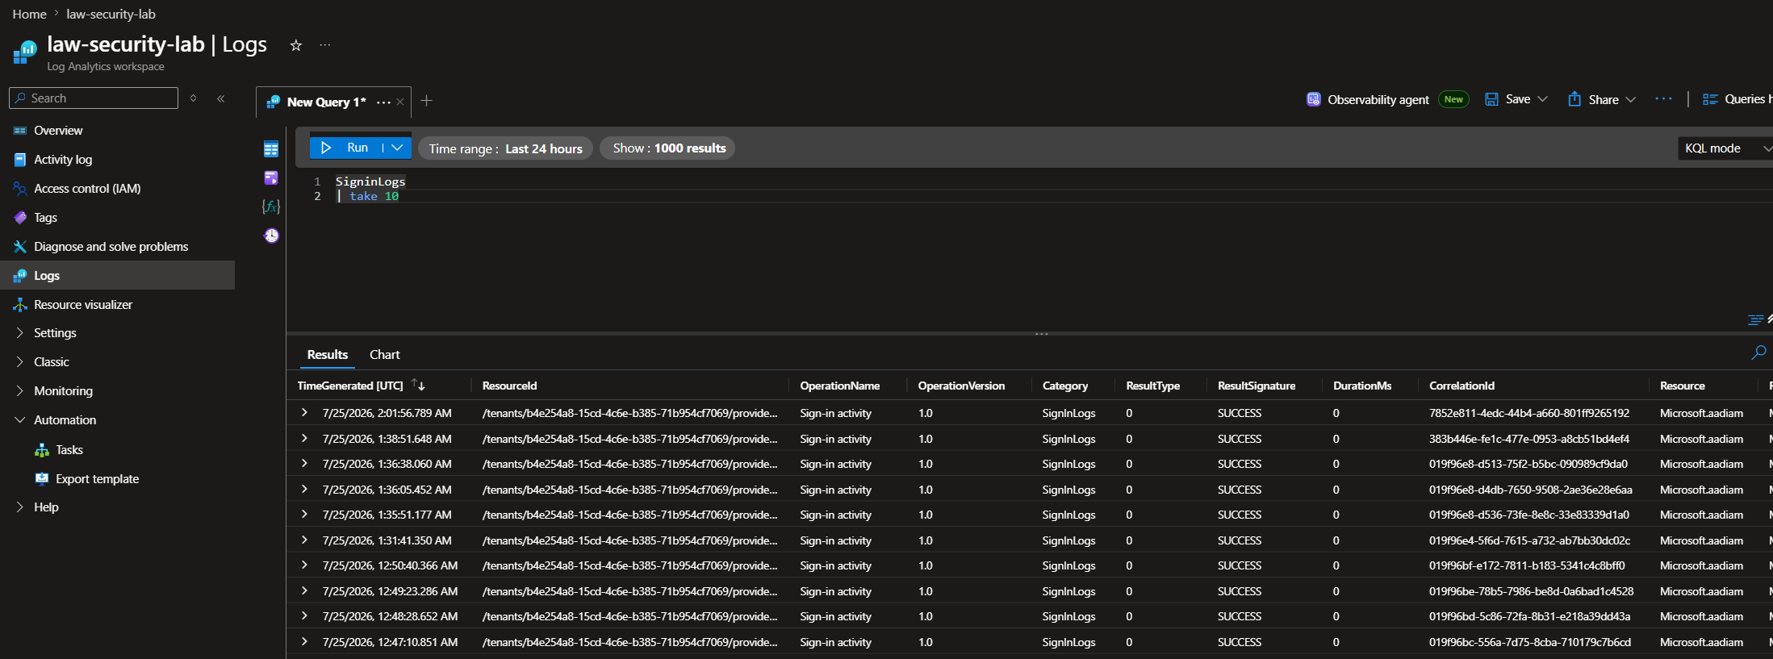
03
VALIDATION
Confirming Data Ingestion
Ran a KQL query (SigninLogs | take 10) before building any detection logic
Verified logs were flowing end-to-end from Entra ID into the workspace
Build on confirmed data, not assumptions

Slide 6
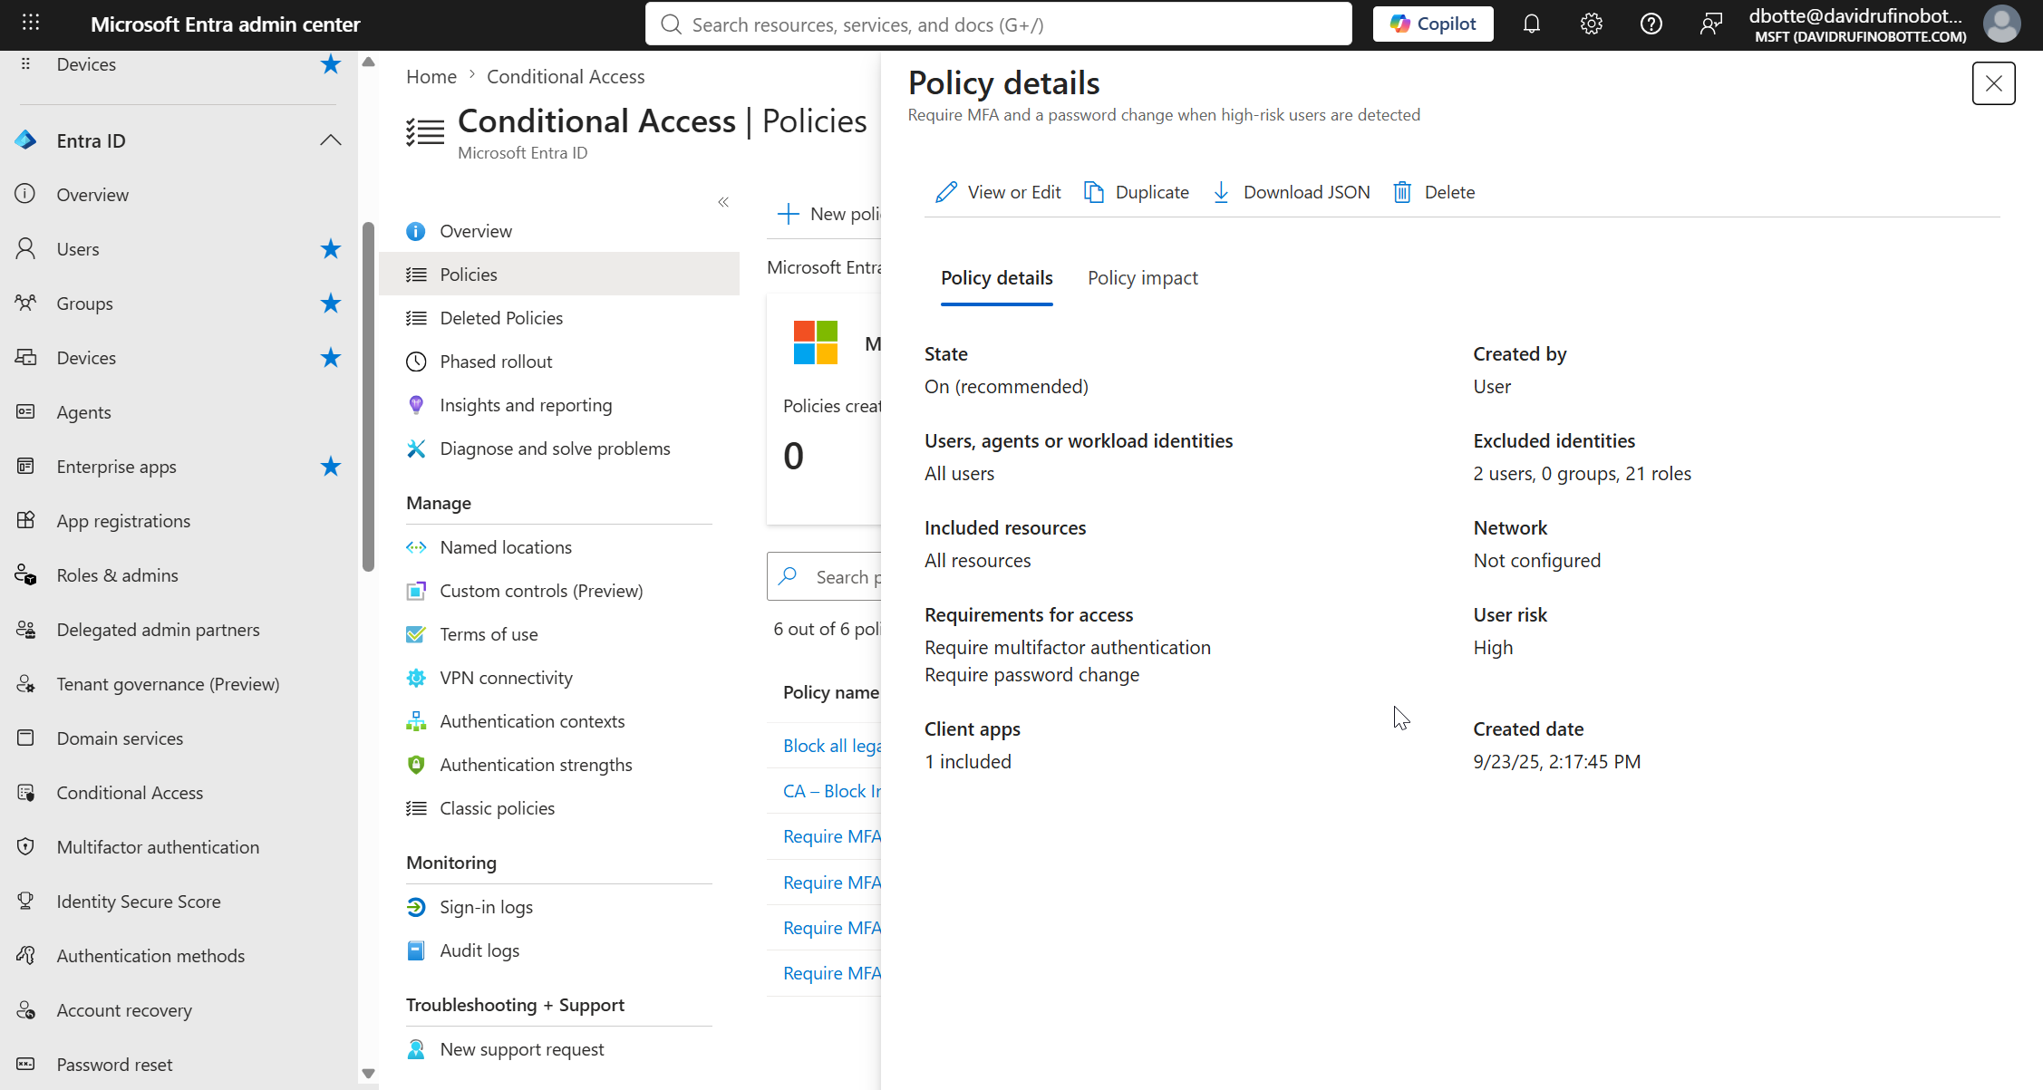
04
GOVERNANCE
Reusing Existing Controls
Audited existing Conditional Access policies before creating a new one
Found and reused a policy already enforcing MFA on risky sign-ins
Avoids policy sprawl — a real security engineering judgment call

Slide 7
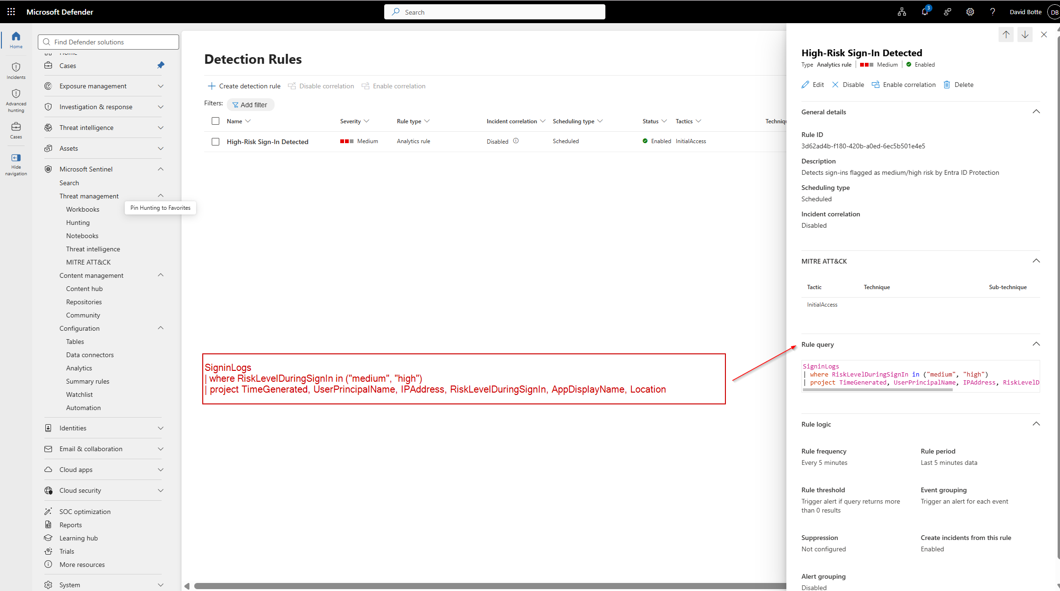
05
DETECTION
Building the Analytics Rule
Scheduled KQL rule 'High-Risk Sign-In Detected', running every 5 minutes (5 minutes just because is test enviroment)
Filters on RiskLevelDuringSignIn (medium / high) from Entra ID Protection
Mapped to MITRE ATT&CK — Initial Access

Slide 8
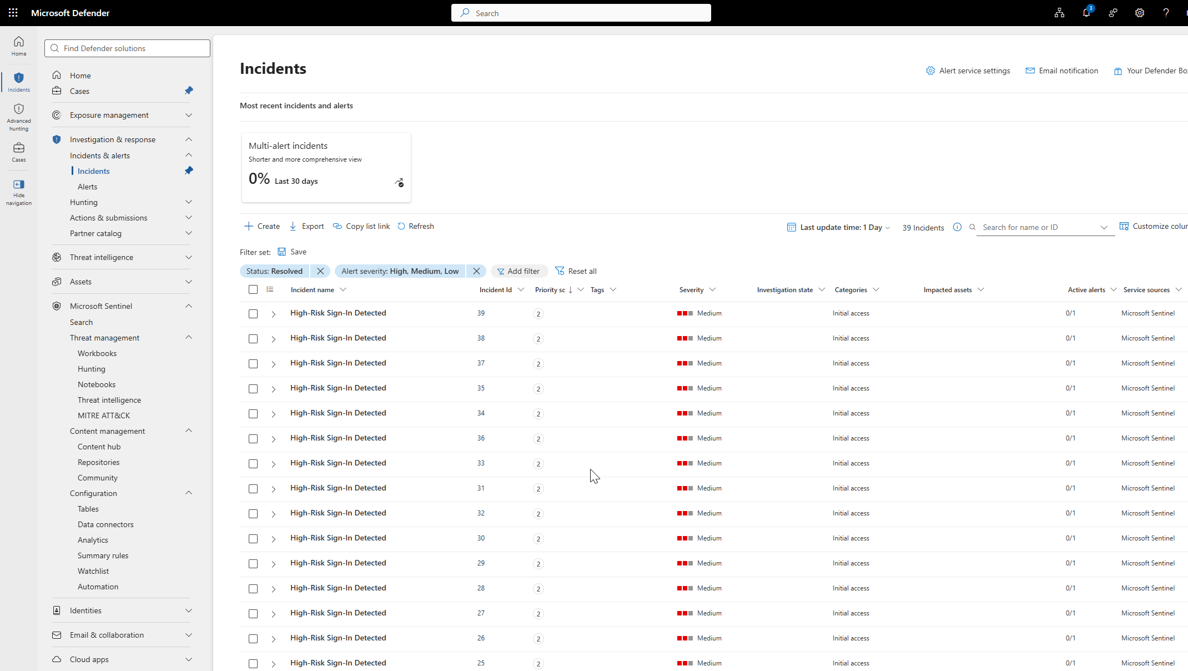
06
RESULTS
Detections at Scale
The rule generated 39 incidents from real sign-in activity
Confirms the detection logic works against live data, not just theory
Each incident automatically linked back to its source alert

Slide 9
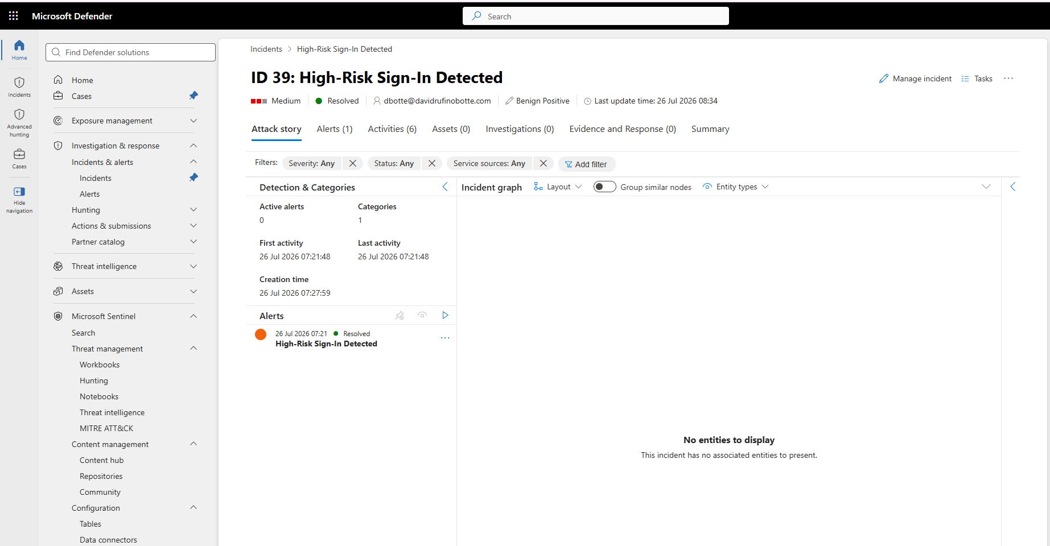
07
TRIAGE
Incident Review & Closure
Reviewed and closed incidents individually with correct classification
Classified as Benign Positive — the detection was correct; the activity was a controlled test
Standard SOC discipline, not blanket dismissal

Slide 10
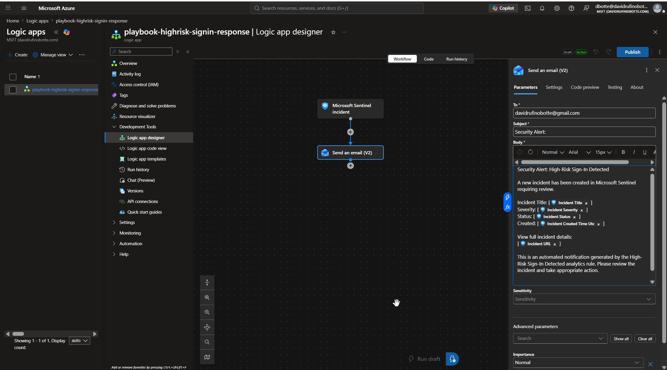
08
AUTOMATION
Automated Response Playbook
Logic App triggered directly by 'Microsoft Sentinel incident'
Sends a structured alert with incident title, severity, status and link
Consumption plan used deliberately, to avoid fixed hosting cost

Slide 11
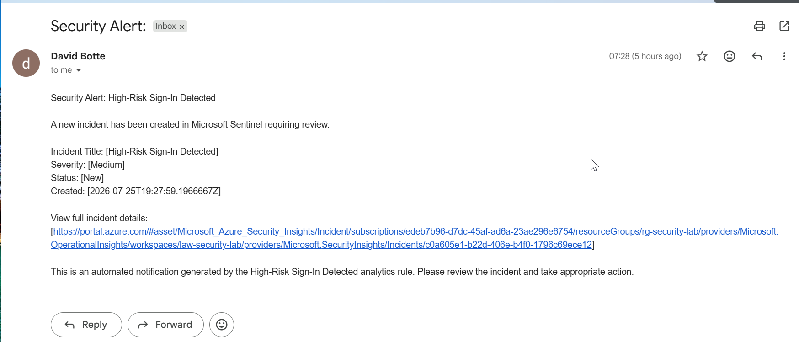
09
OUTCOME
Closing the Loop
Alert delivered by email within minutes of incident creation
Full pipeline proven: sign-in log → detection → incident → automated notification
No manual step between detection and alert delivery

Slide 12
WHAT THIS DEMONSTRATES
Skills applied in this lab
Identity Security
SIEM Engineering
Entra ID, Conditional Access, risk-based sign-in policy
Microsoft Sentinel, KQL detection rules, MITRE ATT&CK mapping
Security Automation
SOC Discipline
Logic Apps / SOAR-style automated incident response
Incident triage, classification, and closure — not just detection
Troubleshooting
Cost & Governance Awareness
Diagnosed and resolved real platform issues (missing connector, permissions, cross-tenant setup)
Reused existing controls; chose consumption pricing to avoid unnecessary cost
David Rufino Botte
github.com/davidrufinobotte/entra-sentinel-detection-lab

