Slide 1
SECURITY ENGINEERING — HANDS-ON LAB
CrowdStrike Falcon API
Detection & Triage
Sensor → API Client → Real Detection → Automated Triage
David Rufino Botte | Senior Desktop Engineer
github.com/davidrufinobotte/security-engineering-labs

Slide 2
HOW IT WORKS
From endpoint sensor to automated triage
Falcon
Sensor
→
Simulated
Attack
(Atomic Red Team)
→
Falcon
Detects
→
Alerts API
(Read)
→
Python
Script
→
Alerts API
(Write)
Triage
A safe, authorized simulated attack triggers real Falcon detections. A Python script reads them via API, then writes back a status update and comment — closing the loop from detection to response.

Slide 3
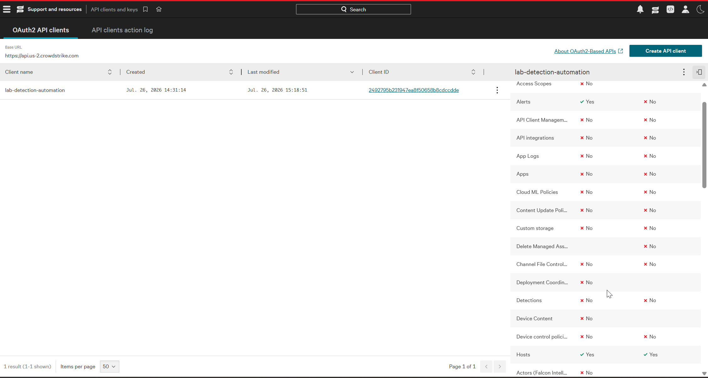
01
ACCESS SETUP
A Least-Privilege API Client
Created a dedicated OAuth2 API client (lab-detection-automation)
Scoped to exactly what the project needs: Alerts and Hosts — nothing else
Same least-privilege principle applied earlier in the Entra ID + Sentinel lab

Slide 4
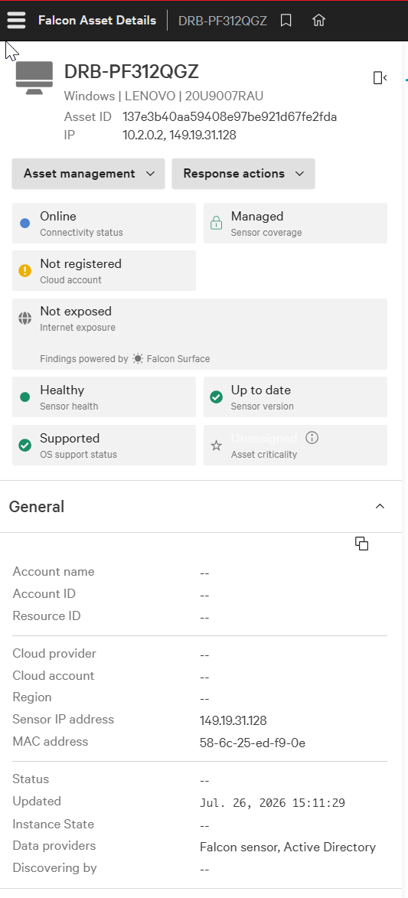
02
FOUNDATION
Sensor Deployed & Reporting
Falcon sensor installed on a dedicated test laptop
Confirmed online, managed, healthy, and up to date within minutes
This is the data source everything downstream depends on

Slide 5
03
REAL PROBLEM #1
Hit a Decommissioned API
First script used FalconPy's classic Detects service class — the industry-standard starting point
CrowdStrike retired this API entirely; the request failed with a clear 404

Slide 6
04
REAL PROBLEM #2
Migrated API, Wrong Scope
Rewrote the script against the current Alerts API — but the client's old scope name didn't carry over
403 access denied — fixed by granting the correct Alerts: Read scope

Slide 7
05
VALIDATION
Confirmed Working — Before Any Data
With auth and scope fixed, the script ran cleanly and correctly reported zero alerts
Proves the pipeline works end to end before relying on it to catch something real

Slide 8
GENERATING A REAL SIGNAL
Why EICAR didn't work — and what did
EICAR: no detection.
Falcon is a behavior-based EDR — a static test file sitting on disk, never executed, simply doesn't trigger it. Expected, not a misconfiguration.
Atomic Red Team: real detection.
Ran MITRE technique T1053.005 (Scheduled Task persistence) — a safe, reversible simulation of real attacker behavior, with automatic cleanup after.

Slide 9
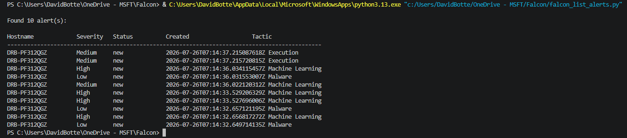
06
RESULT
10 Alerts, Multiple Detection Layers
One safe technique triggered detections across Execution, Machine Learning, and Malware categories — confirming several of Falcon's engines are active, not just one signature check

Slide 10
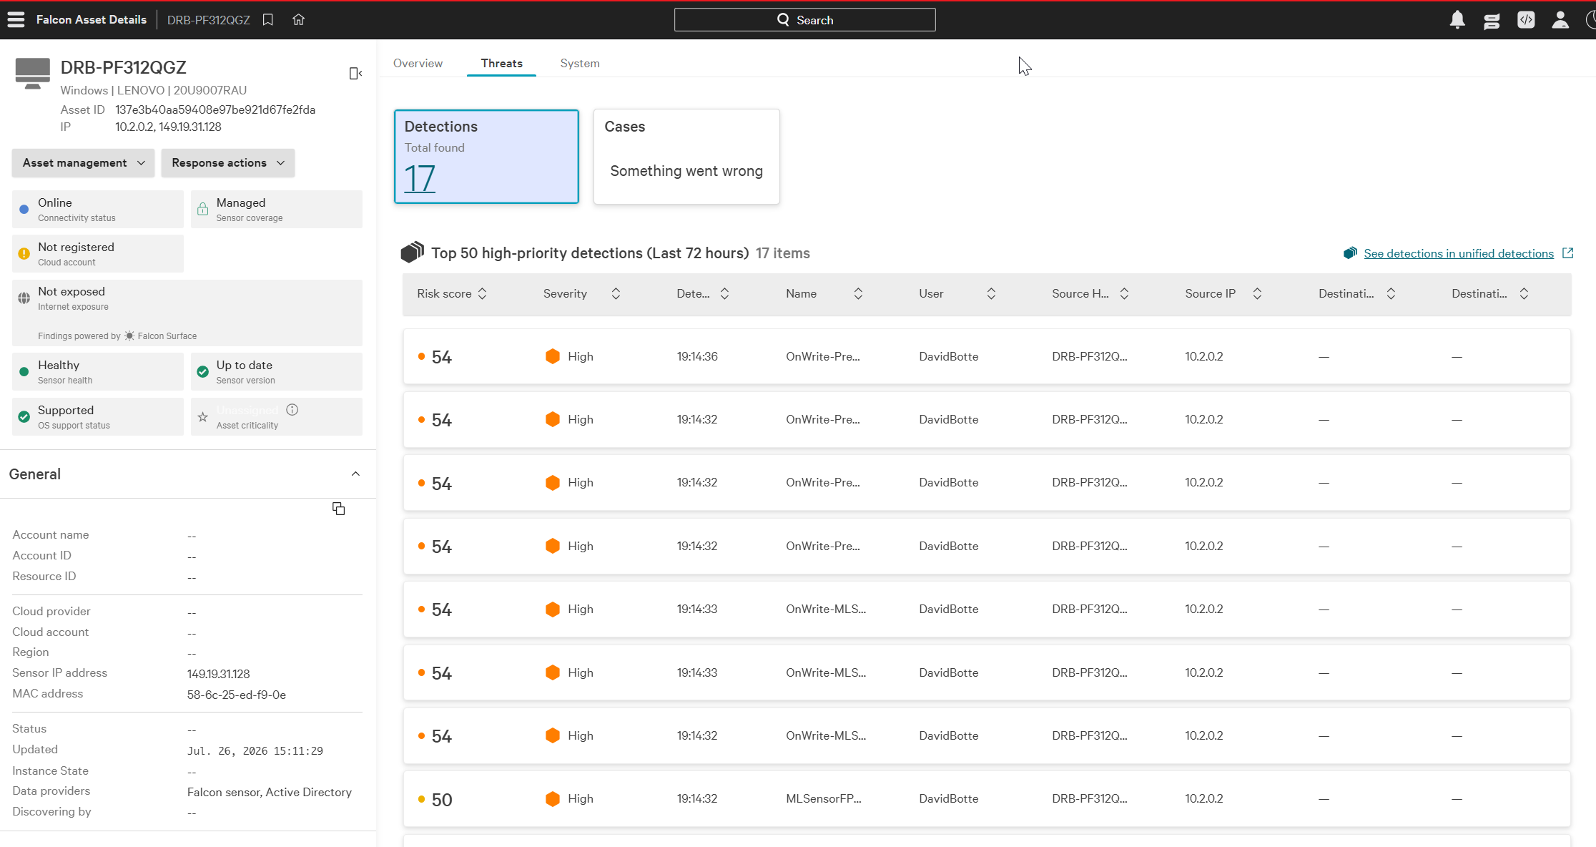
07
CROSS-CHECK
Confirmed in the Console Too
Cross-checked the API results against the Falcon console directly on the host
17 total detections found — the API view and the console view agree
Good practice: never trust a script's output alone when a source of truth is one click away

Slide 11
08
REAL PROBLEMS #3 & #4
Closing the Loop Took Two More Fixes
Extended the script to update and close alerts via API — not just read them
Wrong parameter name (ids vs. composite_ids)
Wrong status value — fixed using the exact values from the API's own error message

Slide 12
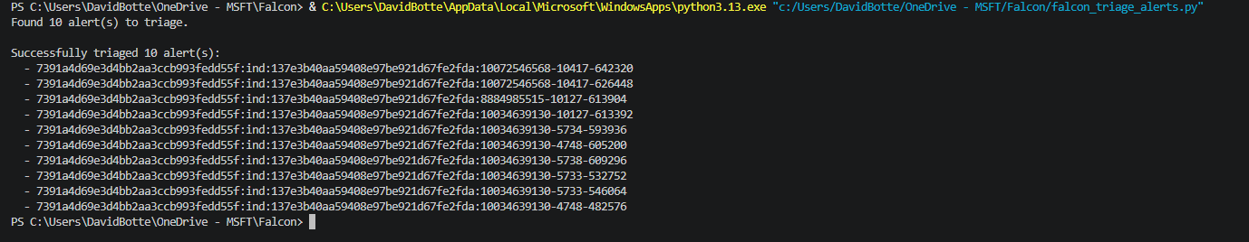
09
OUTCOME
Automated Triage, Confirmed
All 10 alerts closed via API with a status update and an audit comment explaining the authorized test — the same closing discipline used in the Sentinel lab, done here through code
API client updated with write access, scoped only to what triage required

Slide 13
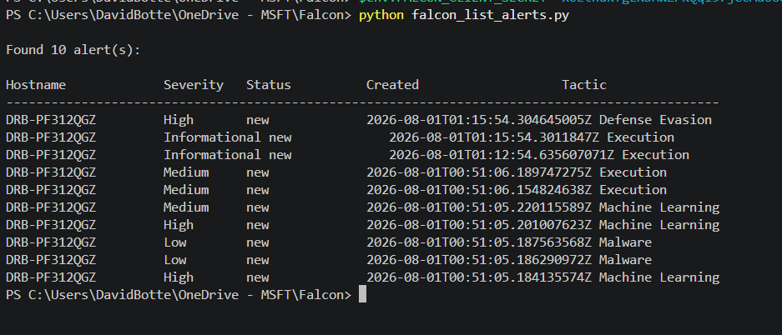
10
GOING FURTHER
Testing Across Multiple Tactics
Ran two more Atomic Red Team techniques, covering different MITRE tactics than the original test
T1082 (Discovery): ran cleanly, no alert — expected, since a native systeminfo command alone isn't distinct enough to flag
T1112 (Defense Evasion): blocked by Falcon's prevention layer AND still generated a High severity alert — prevention and detection working together, not just one or the other

Slide 14
WHAT THIS DEMONSTRATES
Skills applied in this lab
EDR & API Integration
Adversary Simulation
CrowdStrike Falcon, FalconPy SDK, OAuth2 authentication
MITRE ATT&CK technique execution via Atomic Red Team
Real API Debugging
Automated Triage & Response
Diagnosed and fixed 4 distinct real errors, not scripted ones
Closed the loop: read, triaged, and contained hosts via API — with safety-first dry-run design
Least Privilege
Verification Discipline
Scoped API client access to exactly what each task needed
Cross-checked script output against the console directly
David Rufino Botte
github.com/davidrufinobotte/security-engineering-labs

