Slide 1
Solving the Sudoku problem with spiking neural networks
David Samu
09/10/2017

Slide 2
Contents
Solving Sudoku puzzles (forward pass / inference)
Generating Sudoku puzzles (backward pass / spontaneous state settling)
Sampling from compatible solutions (solving the under-defined problem)
Learning the connectivity by examples

Slide 3
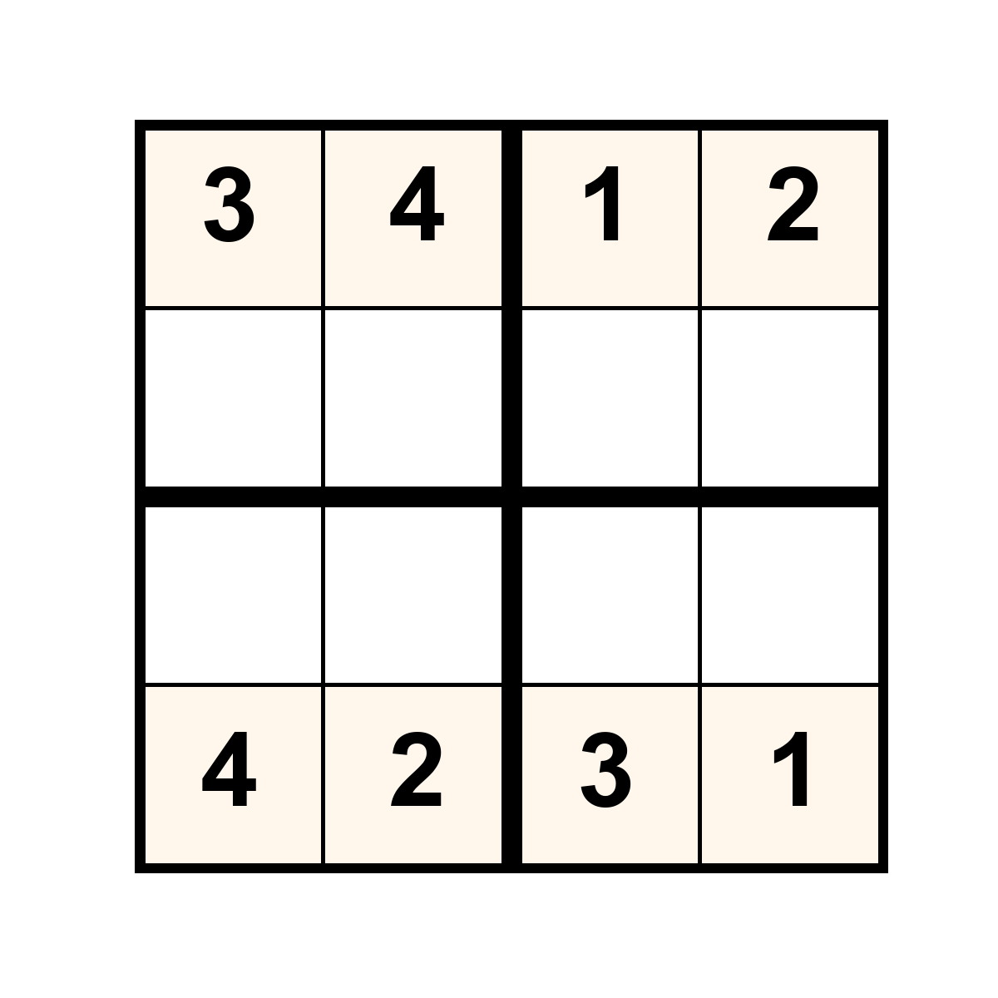
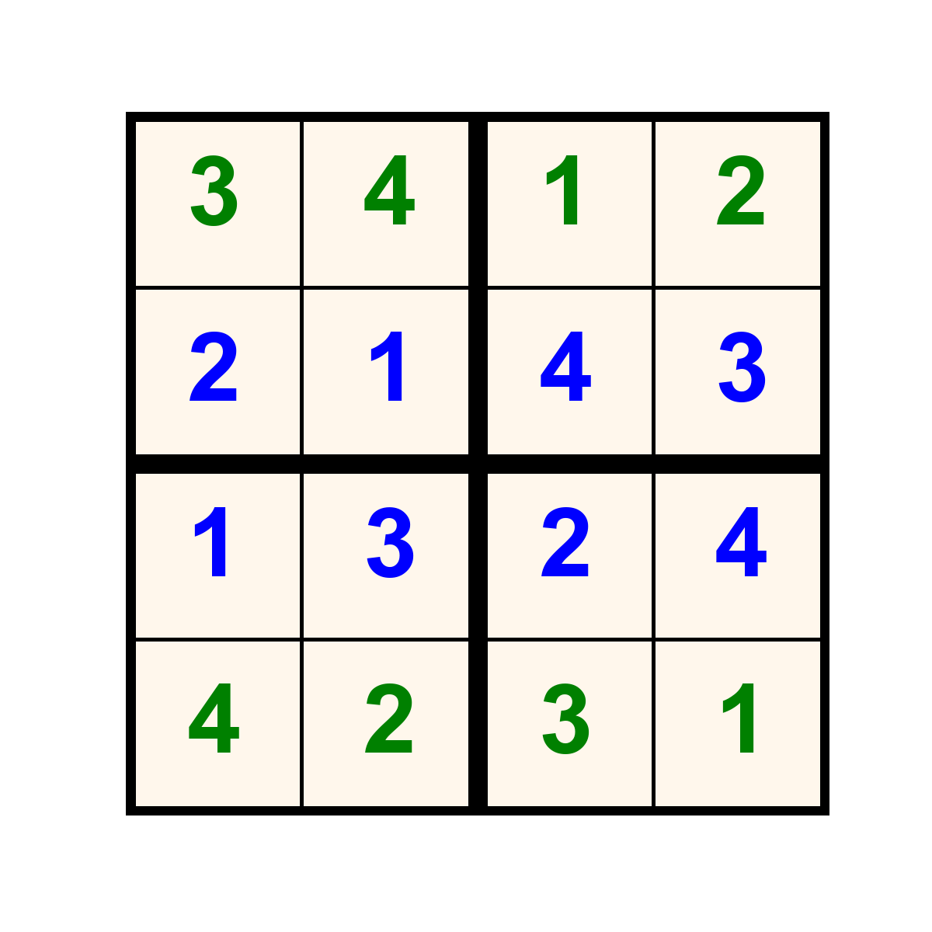
Example puzzles

Slide 4
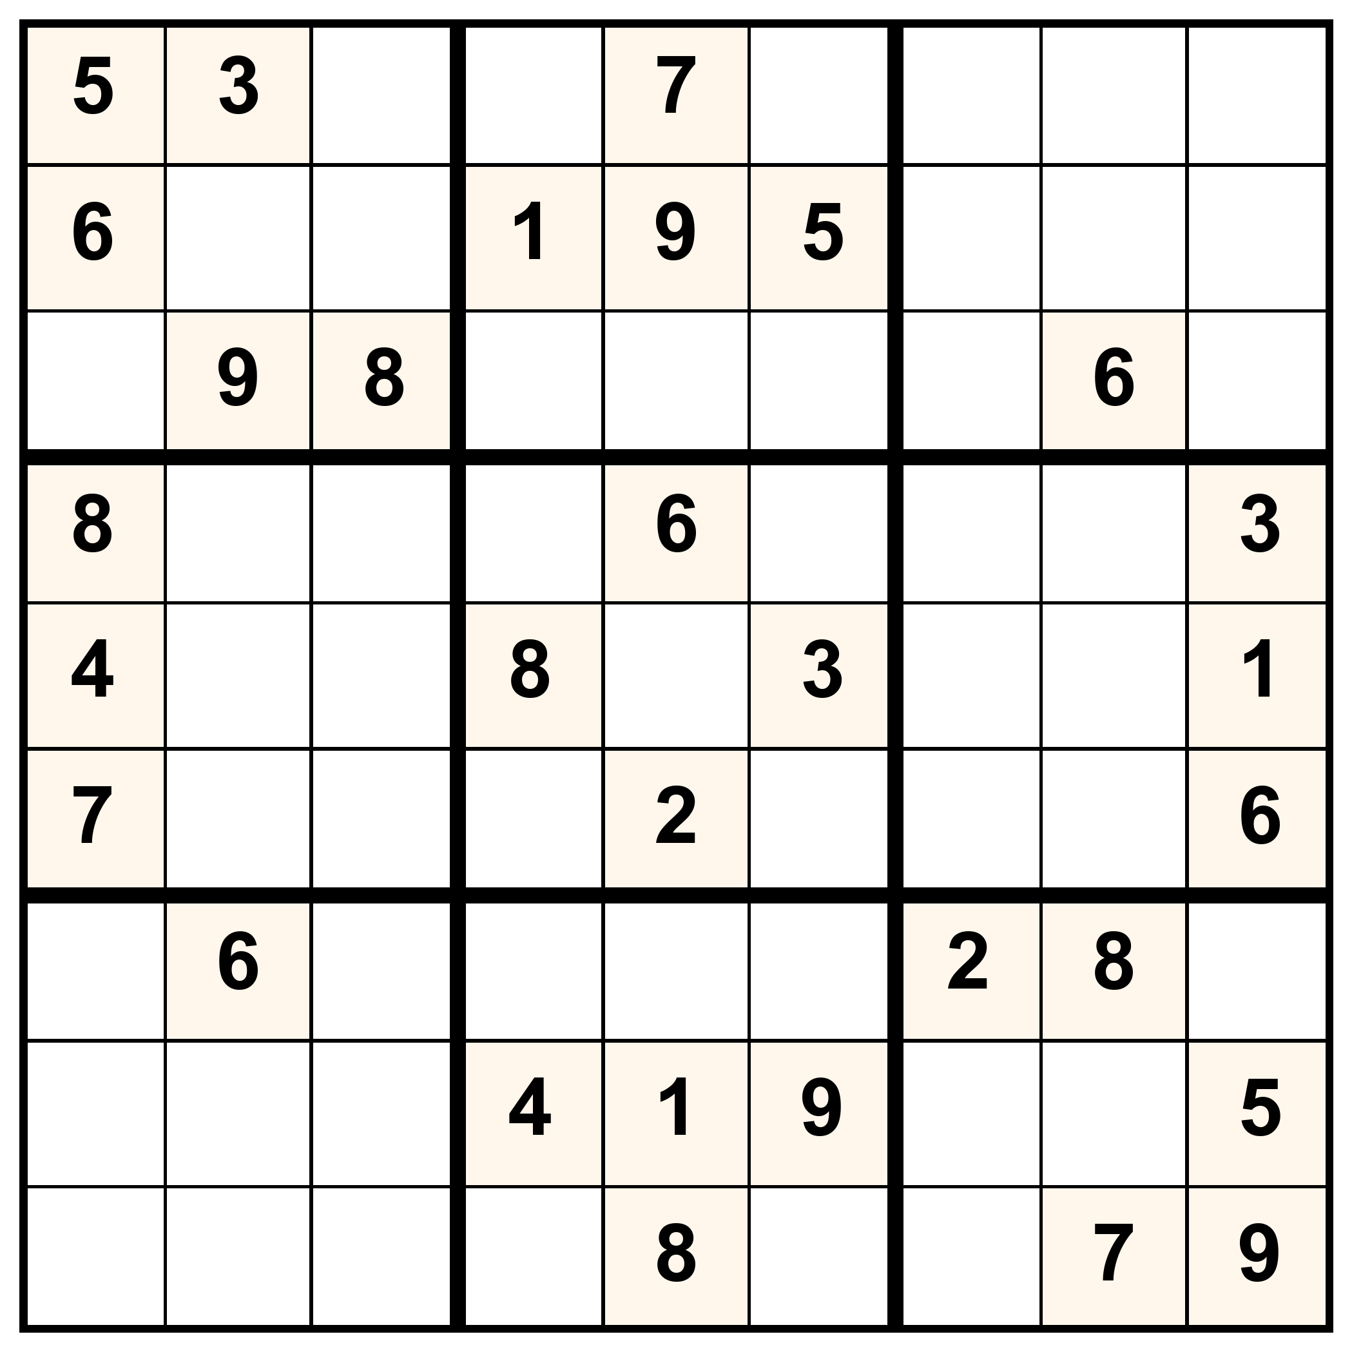
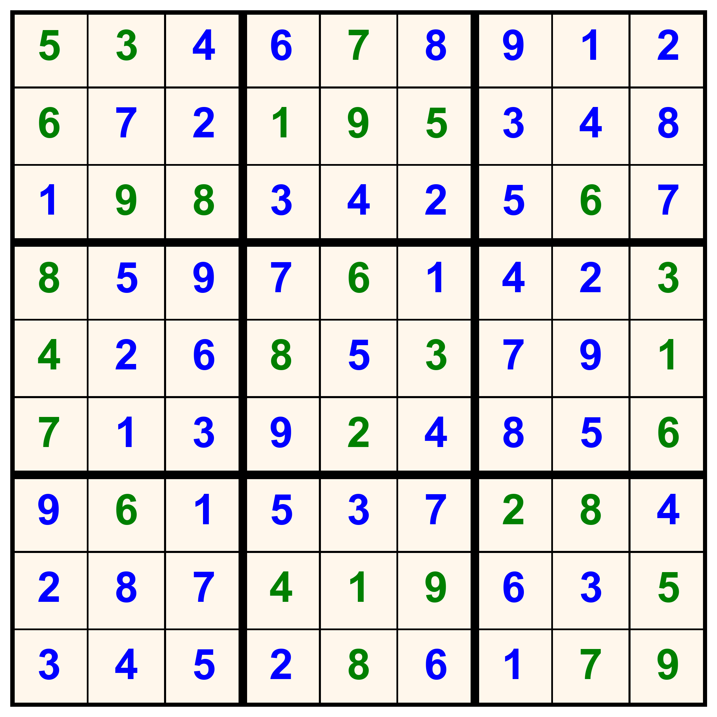
Example puzzles

Slide 5
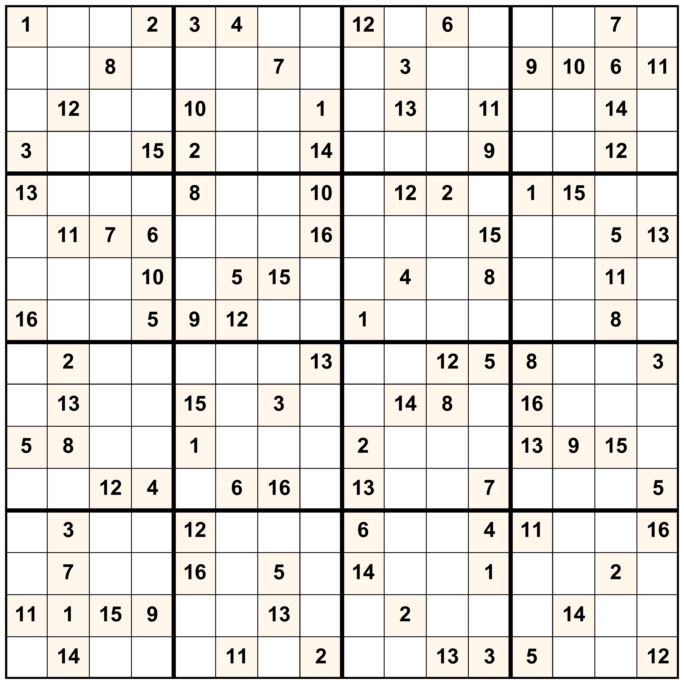
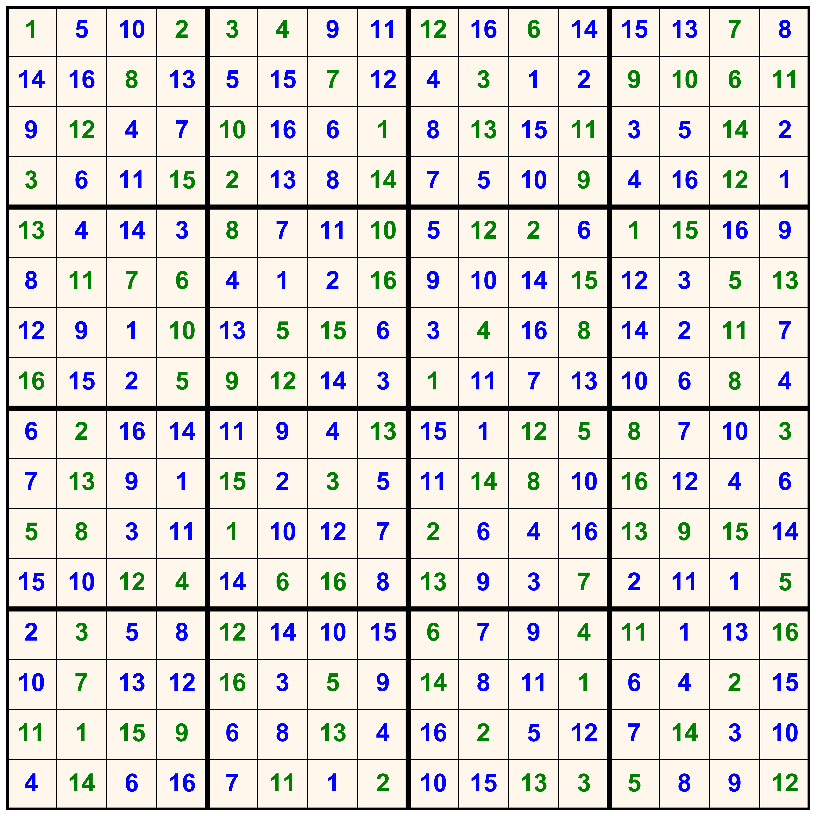
Example puzzles

Slide 6
The (mechanistic) model
Spiking neural network
Units: I&F neurons, each representing a number
  e.g. in an N-by-N table, a number between 1 and N
Network structure: N x N x N units, organized in a 3-D grid
Connectivity: encodes the rules of Sudoku via WTA circuits (all-to-all inhibition) at
  each position of the table (only one value is possible at each position)
  each row, column and subsquare among units encoding the same number (numbers cannot repeat along rows, etc)
Input: delivered as Poisson processes
Output: active unit at each table cell (decoded by rate or spiking coding)
Critical parameters: input strength – to – lateral inhibition ratio

Slide 7
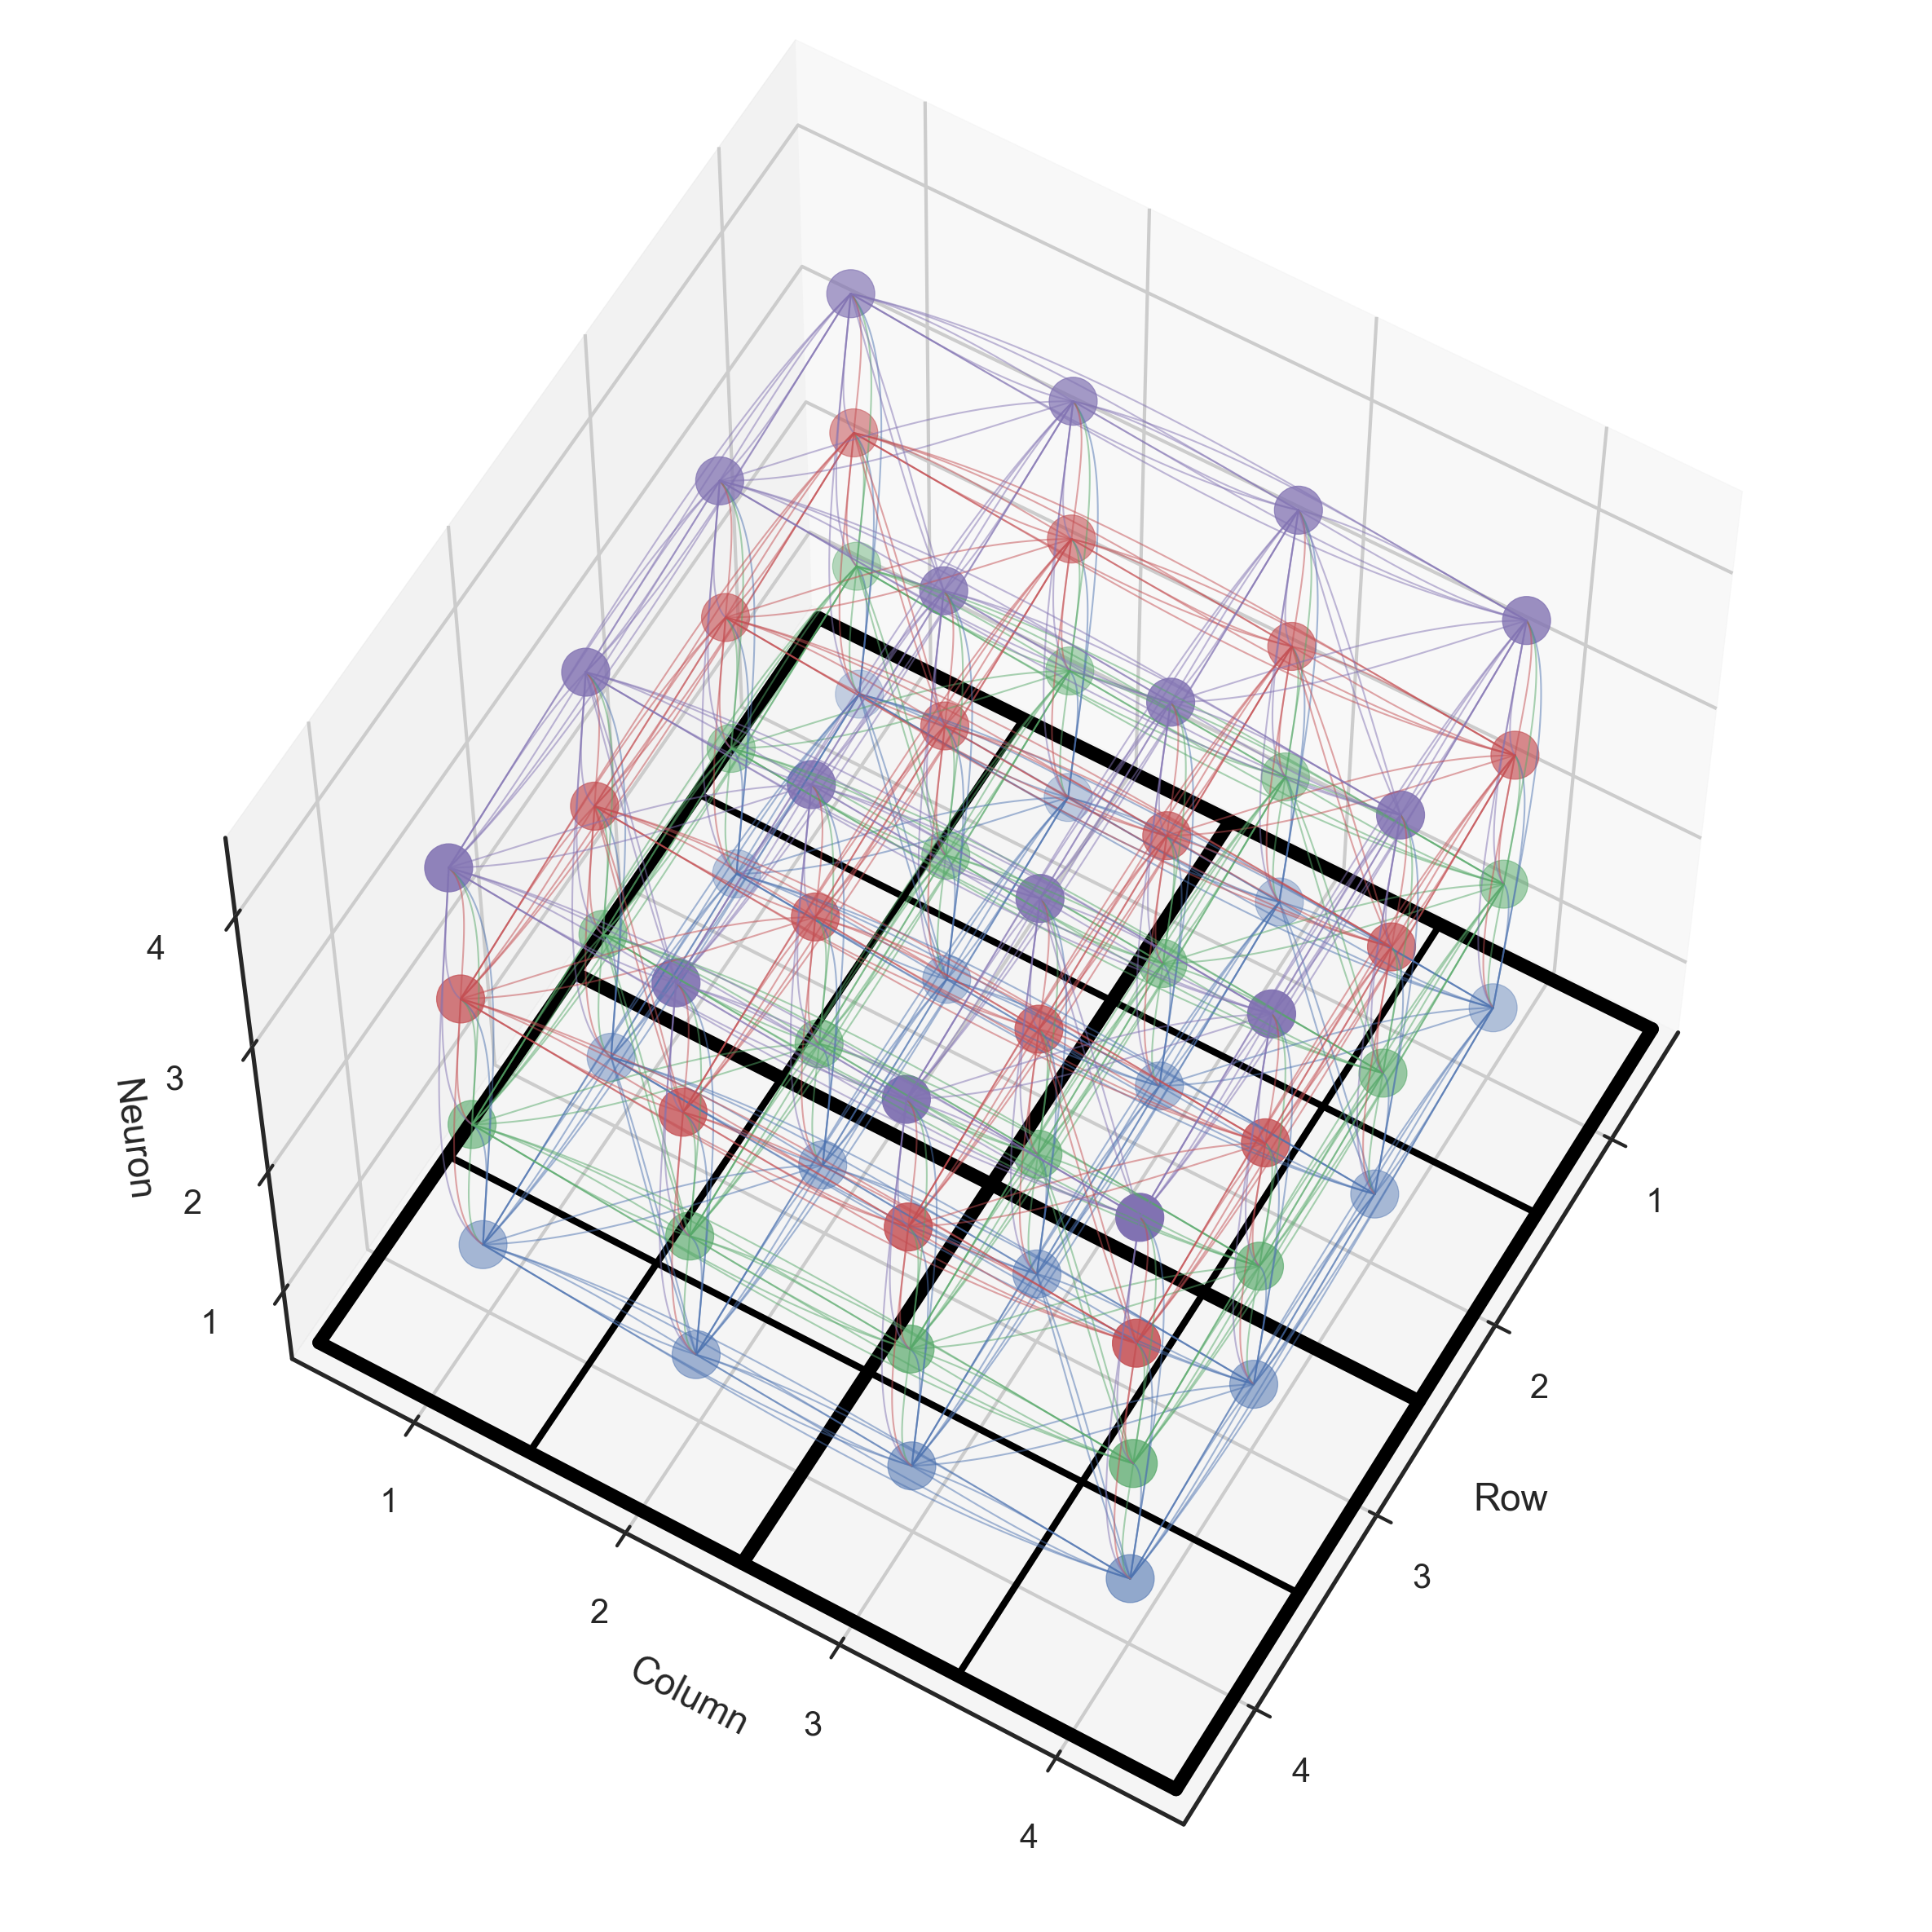
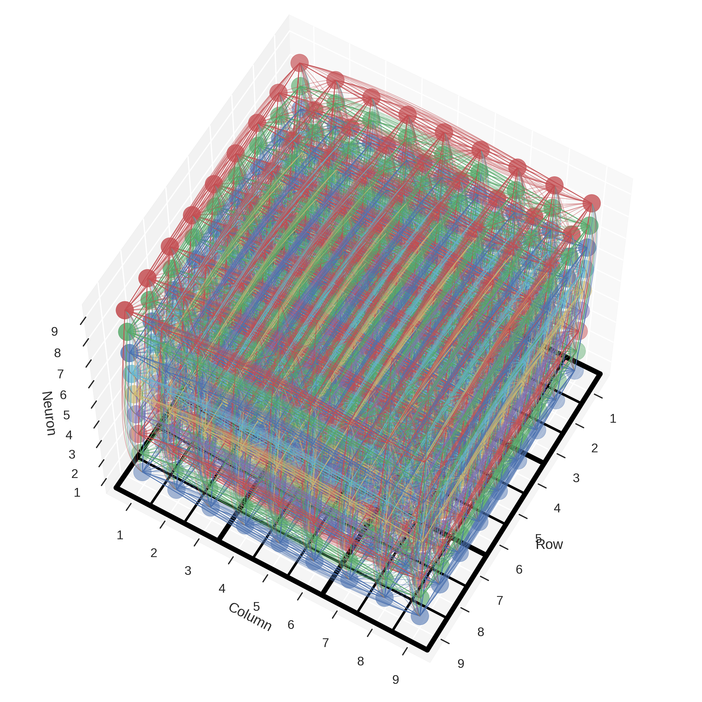
Network connectivity

Slide 8
Perception – Sudoku model correspondence
puzzle: available incomplete/ambiguous sensory information
  received as input
solution: complete state of the world
  represented in the activity of units
solving the puzzle: inferring the complete state of the world
  arrived at by the network through inference
multiple solutions of an underdefined problem: alternative, but “correct” interpretations of the sensory information (Necker cube)
  the network randomly transitions between the corresponding states, according to the neural sampling hypothesis
rules of Sudoku: relationships among features or causes of sensory data
  encoded by network connectivity

Slide 9
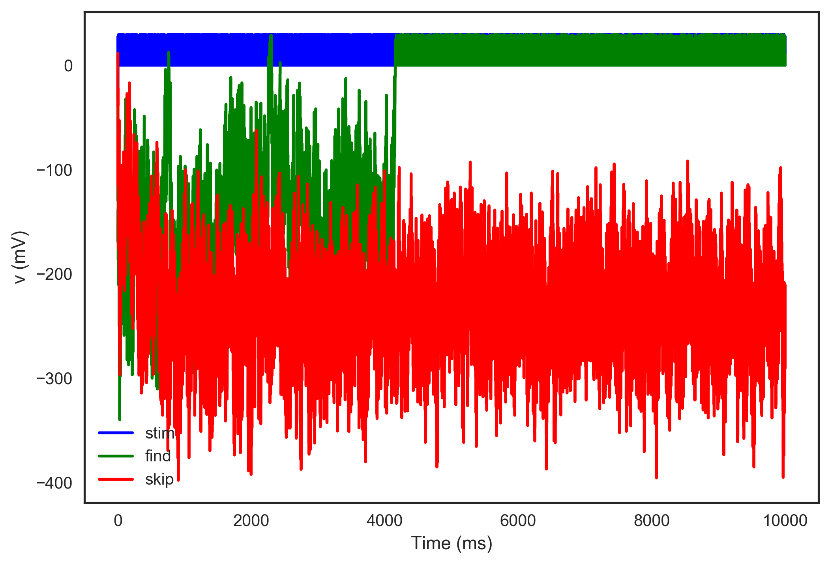
Solving the puzzle
Example voltage traces

Slide 10
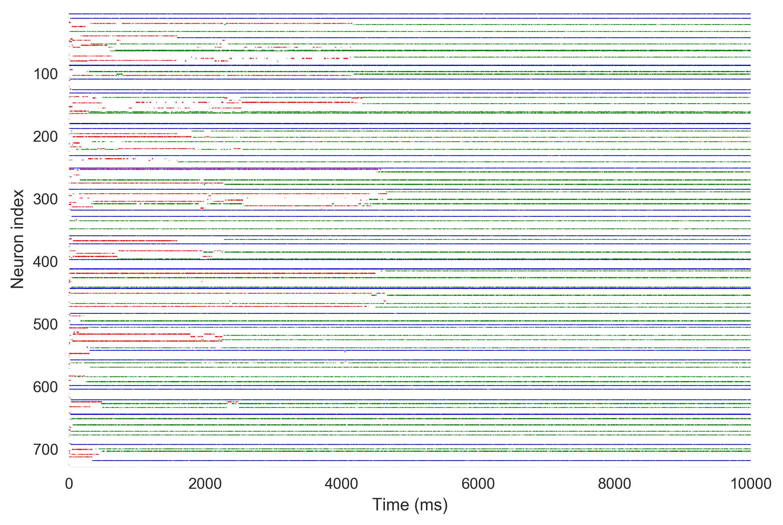
Raster plot

Slide 11
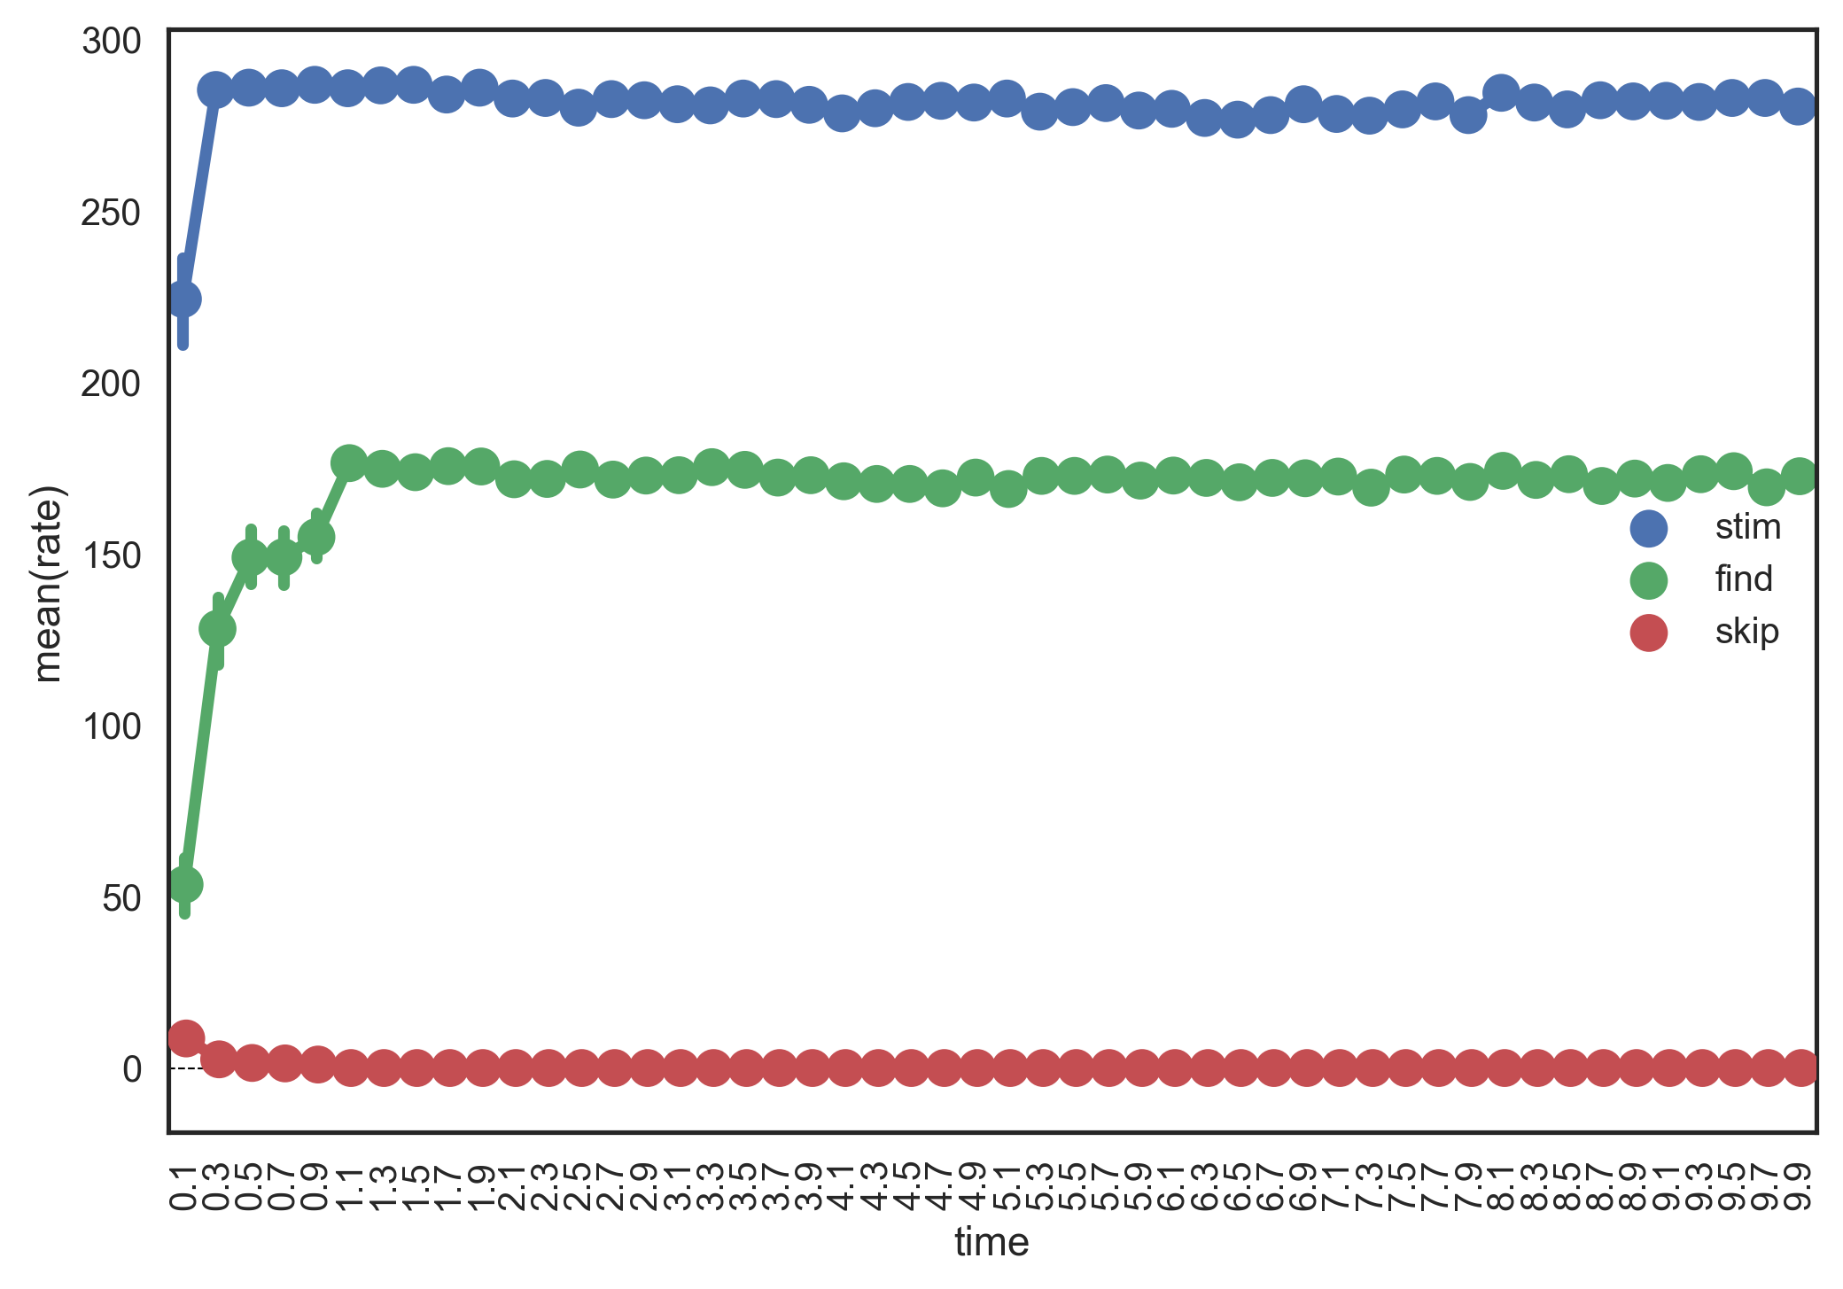
Mean rates per group

Slide 12
Generating new configurations
Equivalent to: Dreaming valid/coherent states of the world (correct puzzles)
  in the probabilistic context: probable states, given the distribution of the data
  incorrect Sudoku tables are improbable/impossible states, therefor shouldn’t be generated (sampled from)
Starting from random initial network states, 100 / 100 tables generated were correct Sudoku configurations.

Slide 13
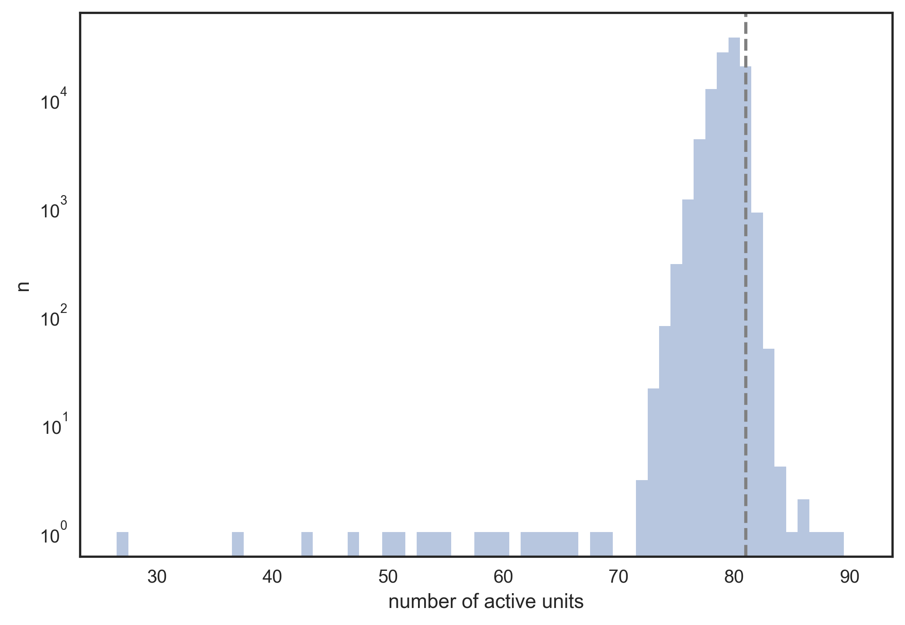
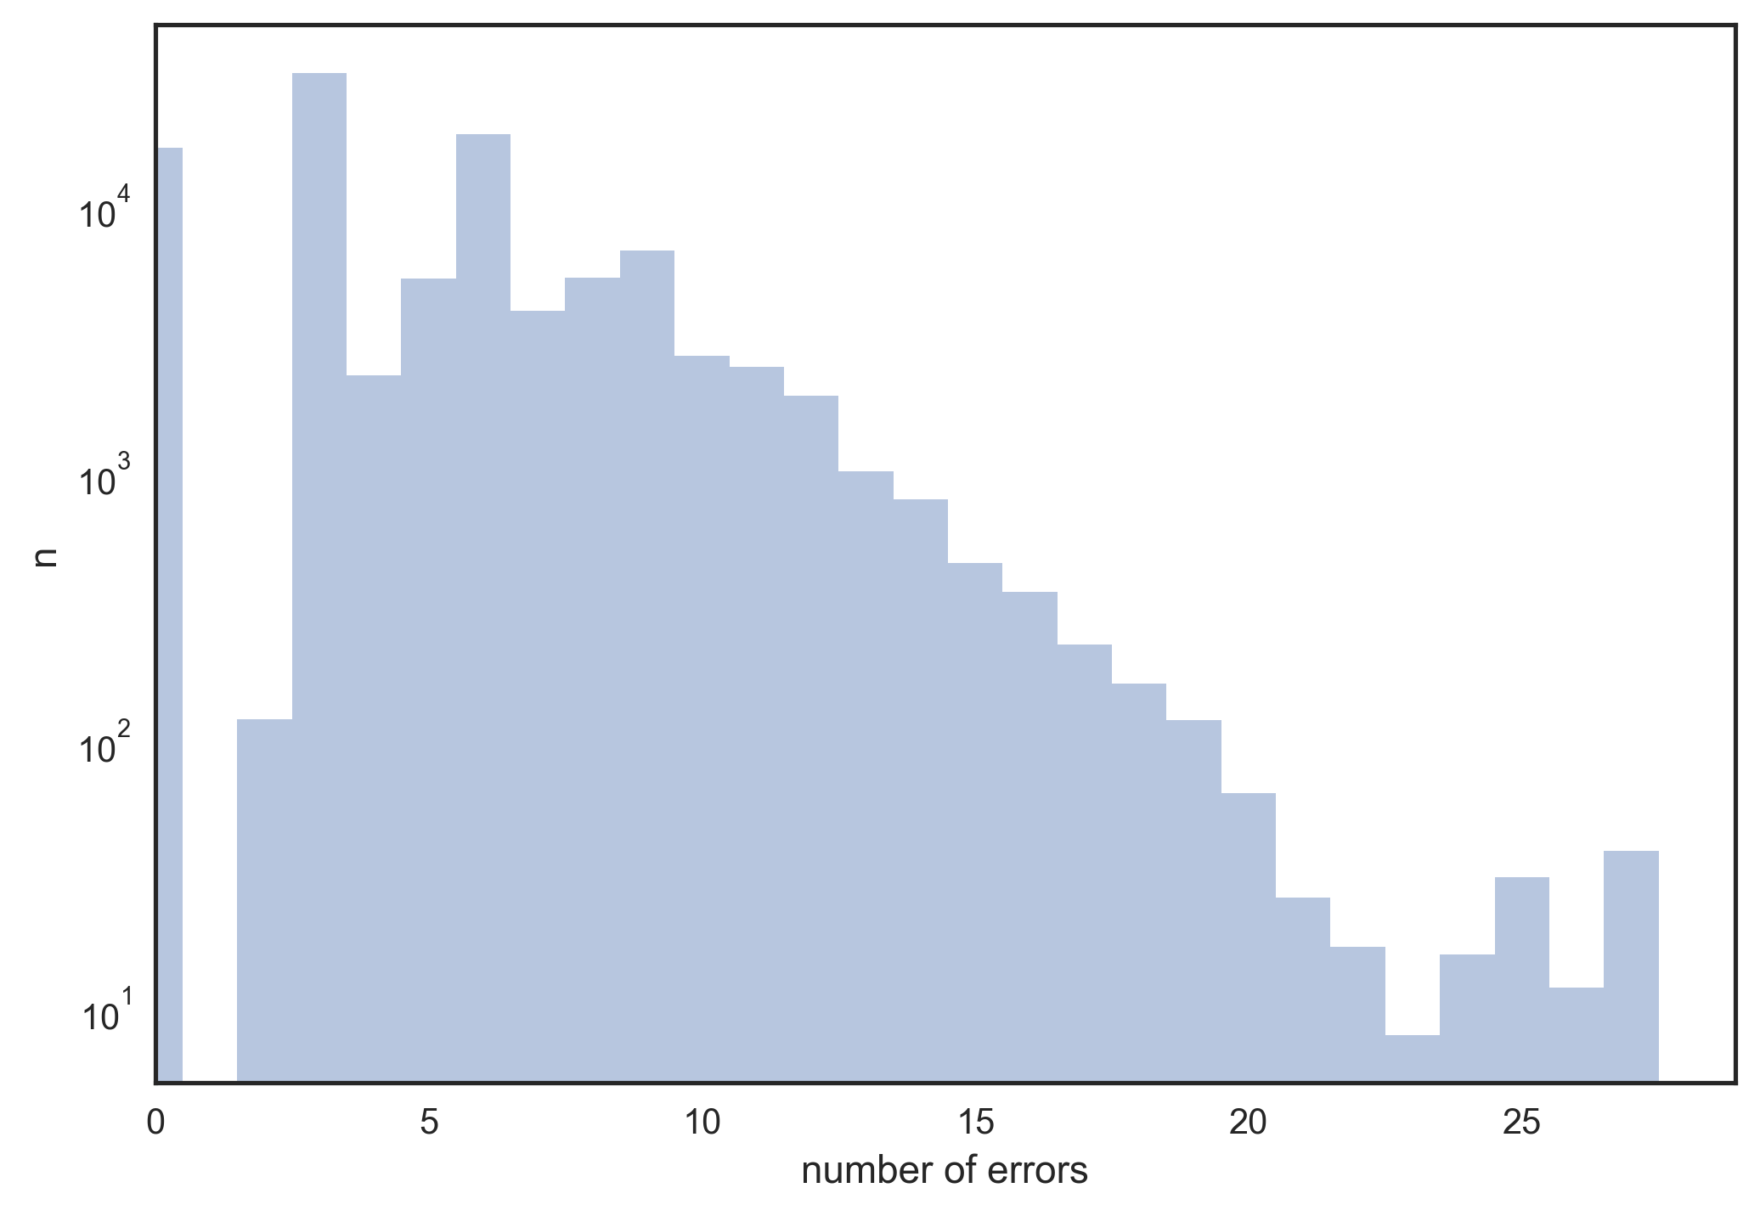
Sampling from alternative solutions in a heavily underdefined puzzle

Slide 14
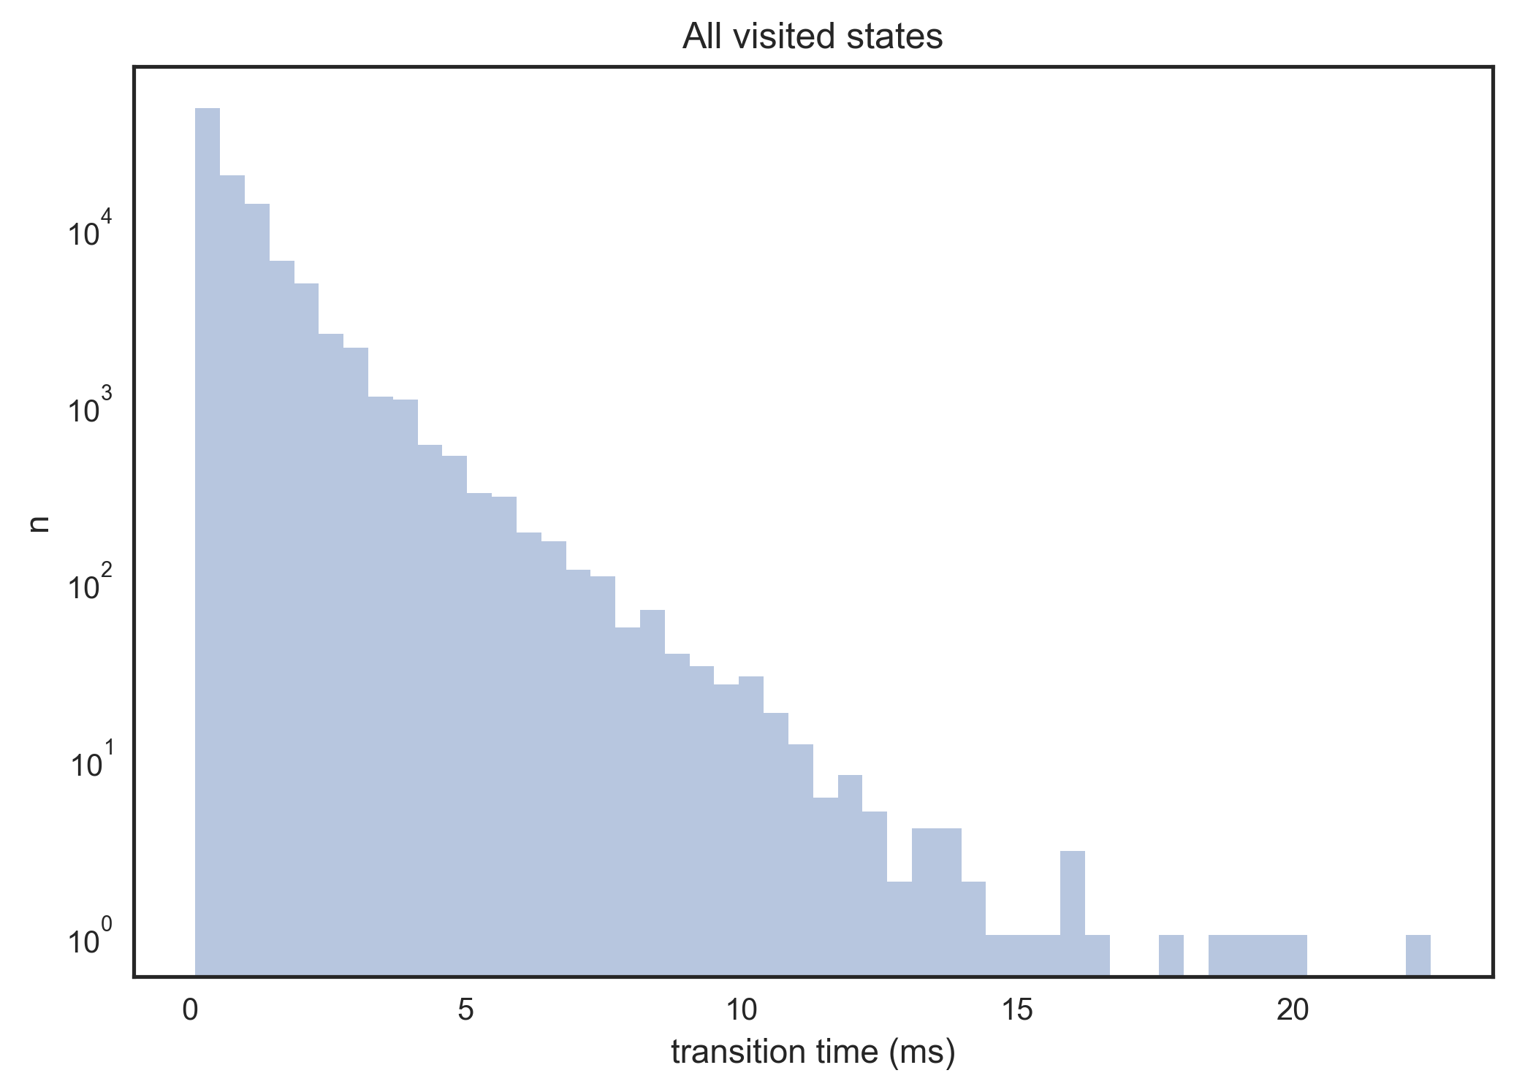
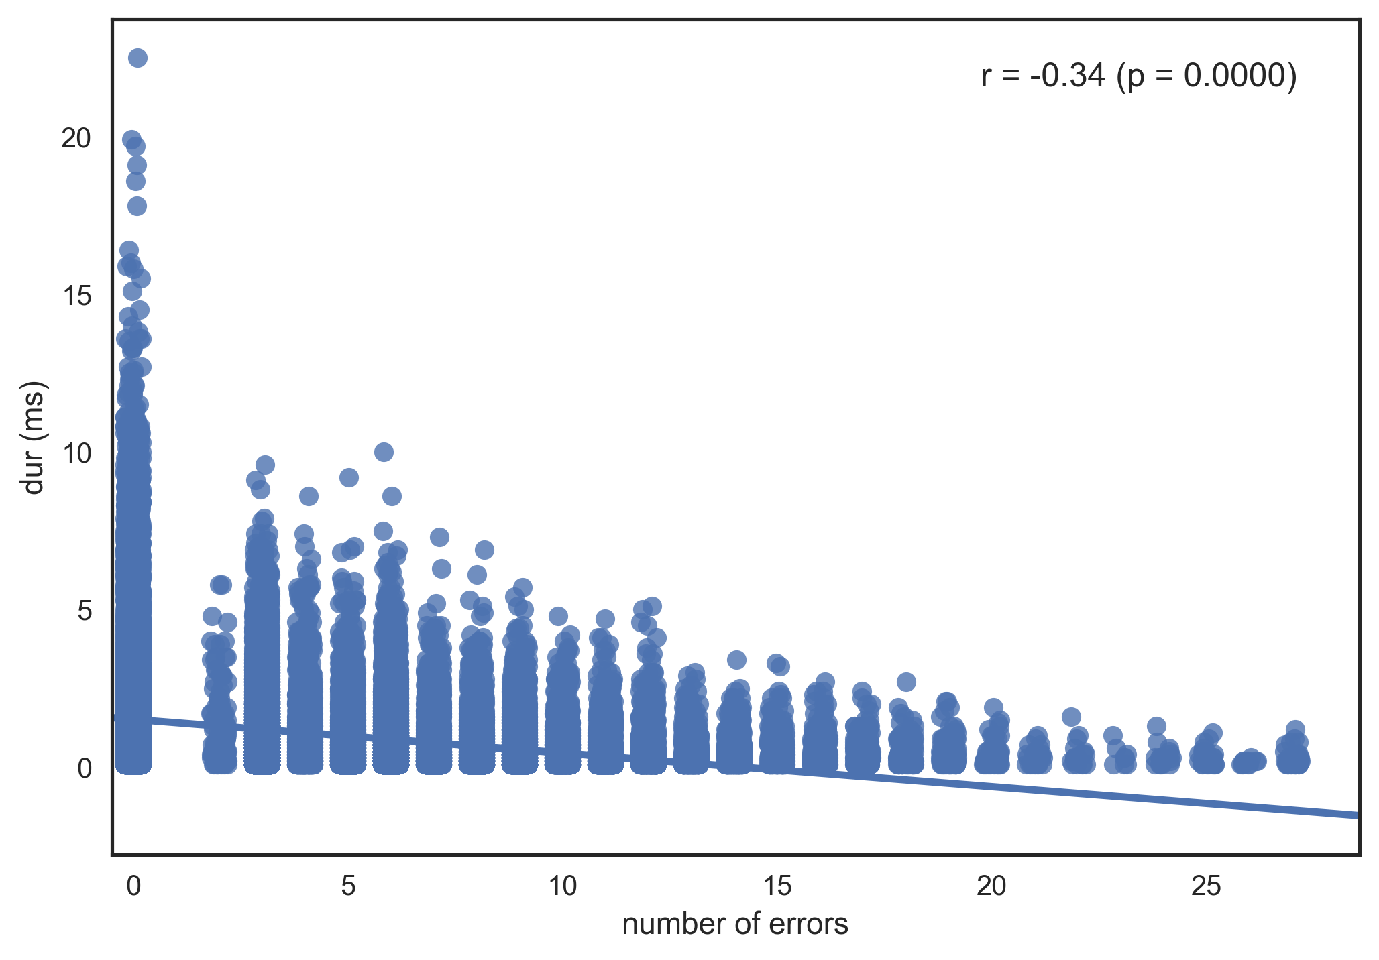
Sampling from alternative solutions in a heavily underdefined puzzle

Slide 15
Learning the weights
‘Supervised’ learning: presenting correct solutions as input and let the evoked activity adjust the weights by STDP
Reinforcement learning? Provide positive reward signal when the network happens upon a correct solution in spontaneous activity.

