Slide 1



Creativity beyond reality
July 2015
Innovation and Robotics

Slide 2
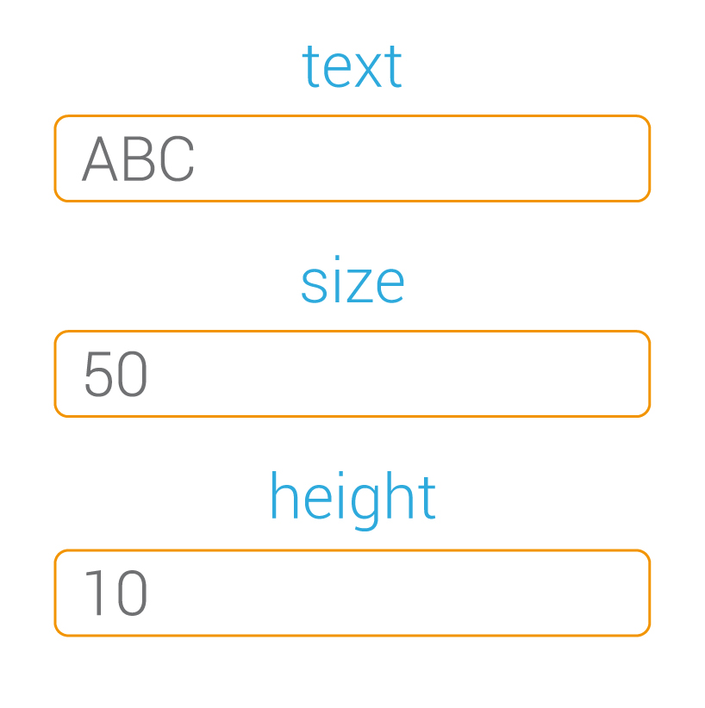


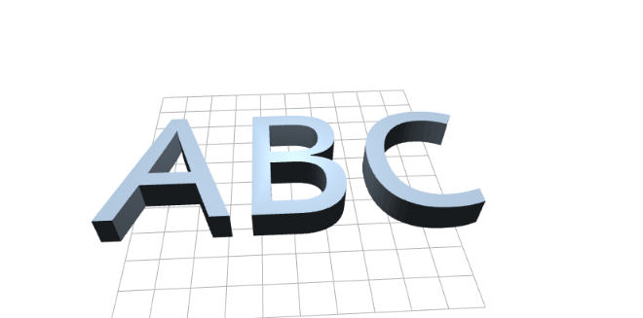

What is a machine?
It is a piece of open software
It has input/output parameters
It can create anything
3D models, electronics, documents, ...

Slide 3

Machine definition
Description
I/O parameters
Int, Float, Boolean, String, List, ...
Engine
FreeCAD, ...

Slide 4


What is ?
A server that can execute machines based on
open source tools through a nice web interface
A repository of machines and objects
that belongs to the Technological Heritage
An open project to allow everyone
to contribute

Slide 5

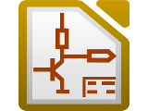

Roadmap
Add new input / output parameters
Upload files, other machines, ...
Include more engines
FreeCAD, Blender, KiCAD, LaTeX, make, ...
Allow one click install with Docker
...

Slide 6



