Slide 1
Overview
Gait recognition by 3D modelfitting.
Previous work has used 2D algorithms only.
This is the first piece of research that used a 3D dataset.
Data obtained from subjects walking through Southampton Biometric Tunnel.

Slide 2
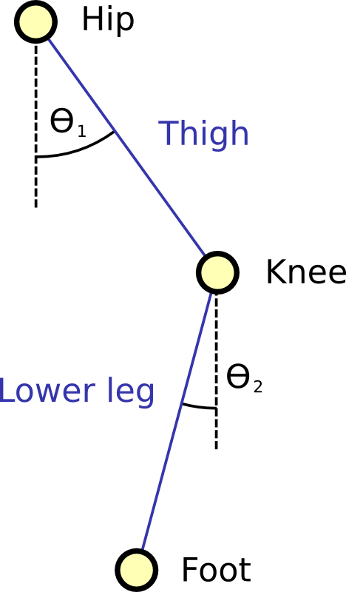
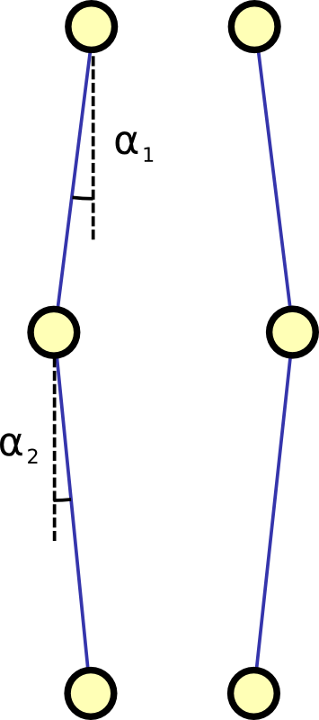
Project goals
Create a model of the human legs.
Fit this model to each frame in a video.
Analyse the change of model parameters over time to produce a gait signature.
Compare the gait signature with those of other subjects to produce a classification.

Slide 3
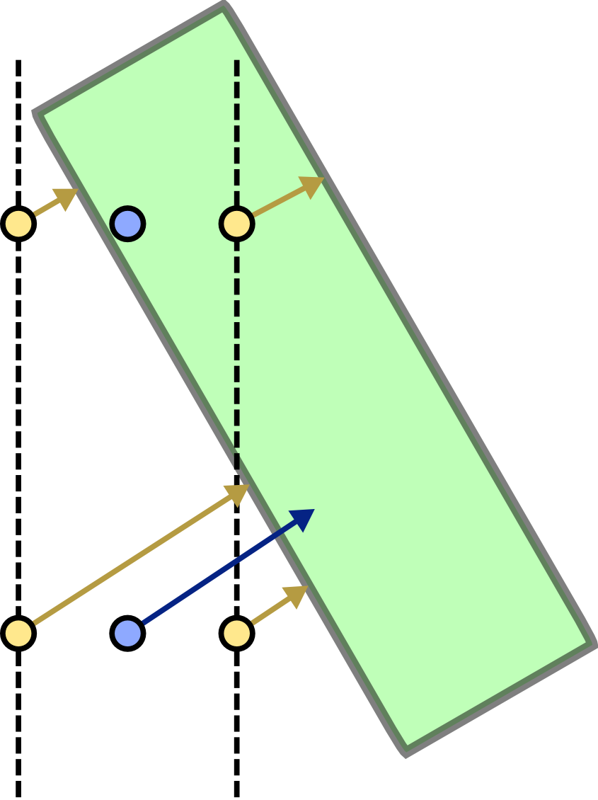
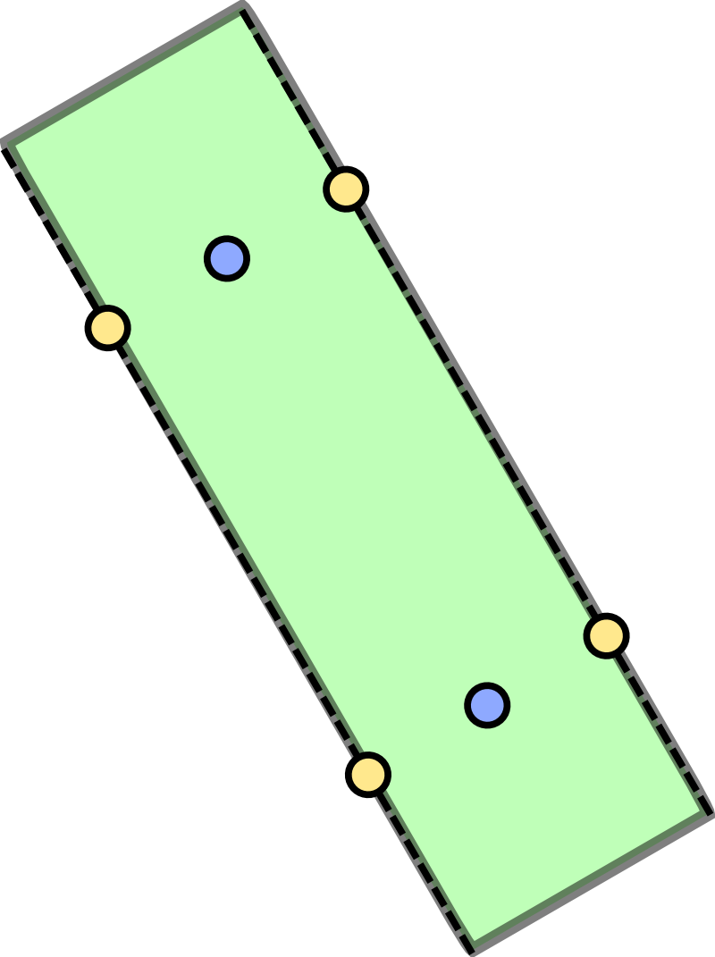
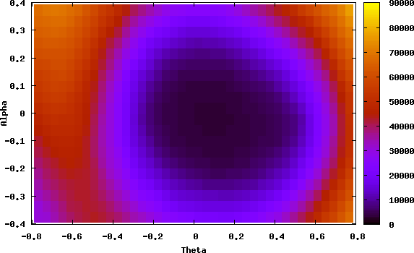
Project goals
Create a model of the human legs.
Fit this model to each frame in a video.
Analyse the change of model parameters over time to produce a gait signature.
Compare the gait signature with those of other subjects to produce a classification.

Slide 4
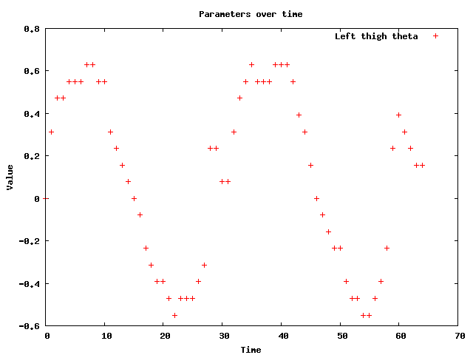
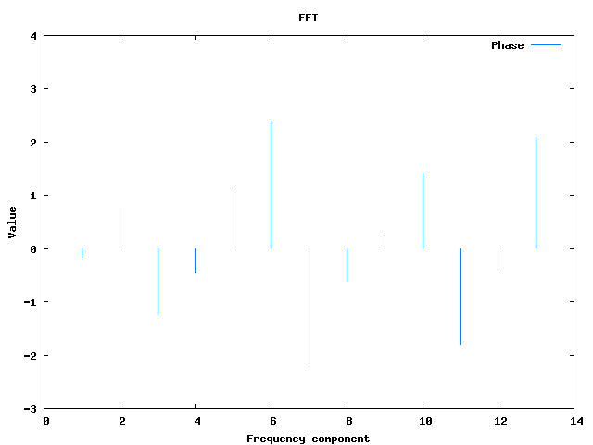
Project goals
Create a model of the human legs.
Fit this model to each frame in a video.
Analyse the change of model parameters over time to produce a gait signature.
Compare the gait signature with those of other subjects to produce a classification.

Slide 5
Project goals
Create a model of the human legs.
Fit this model to each frame in a video.
Analyse the change of model parameters over time to produce a gait signature.
Compare the gait signature with those of other subjects to produce a classification.

Slide 6
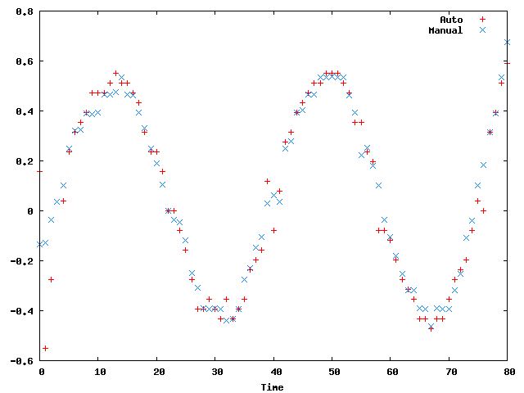
Accuracy of modelfitting
Manual fitting produced by visually adjusting parameters.
Compared with automatic fittings from a variety of algorithms.

Slide 7
Accuracy of modelfitting

