Slide 1
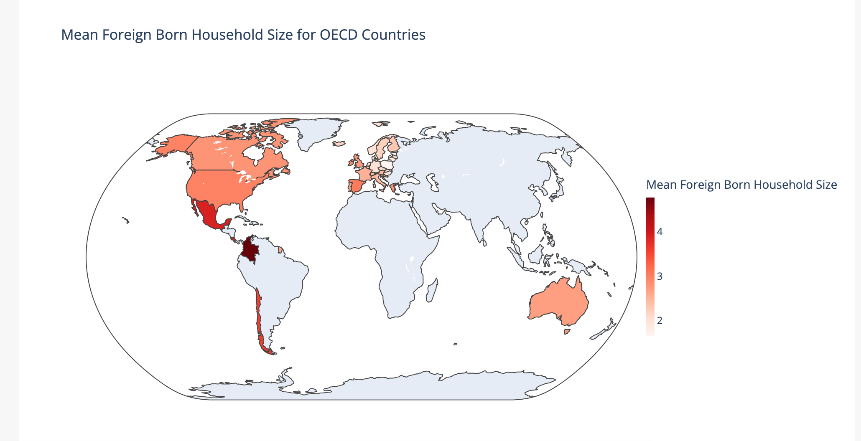
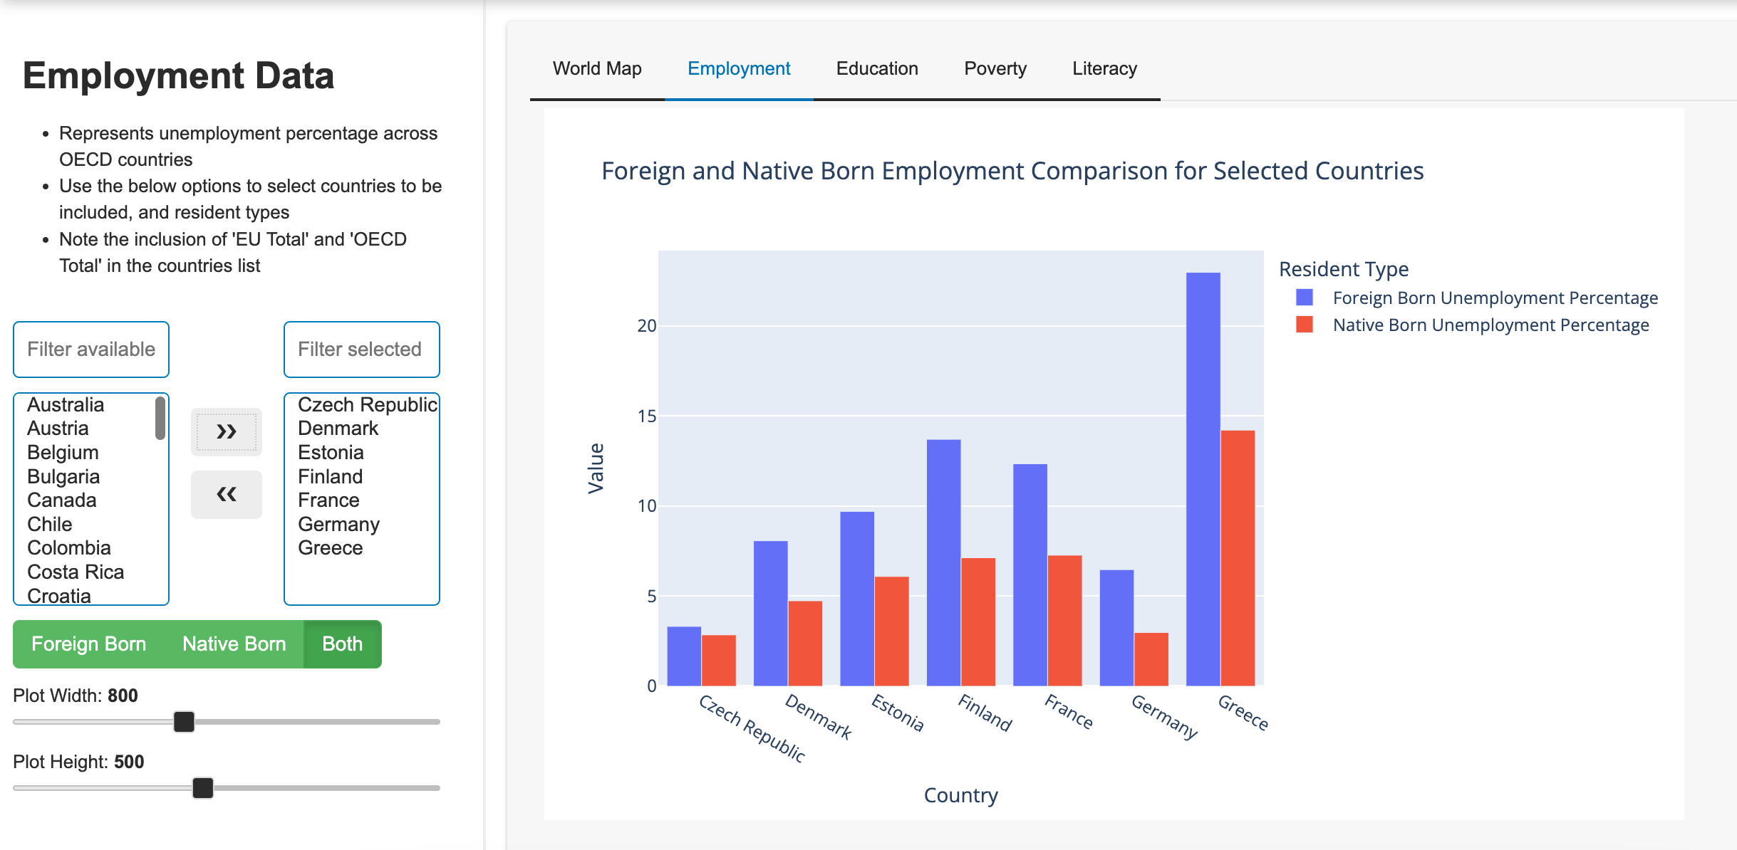
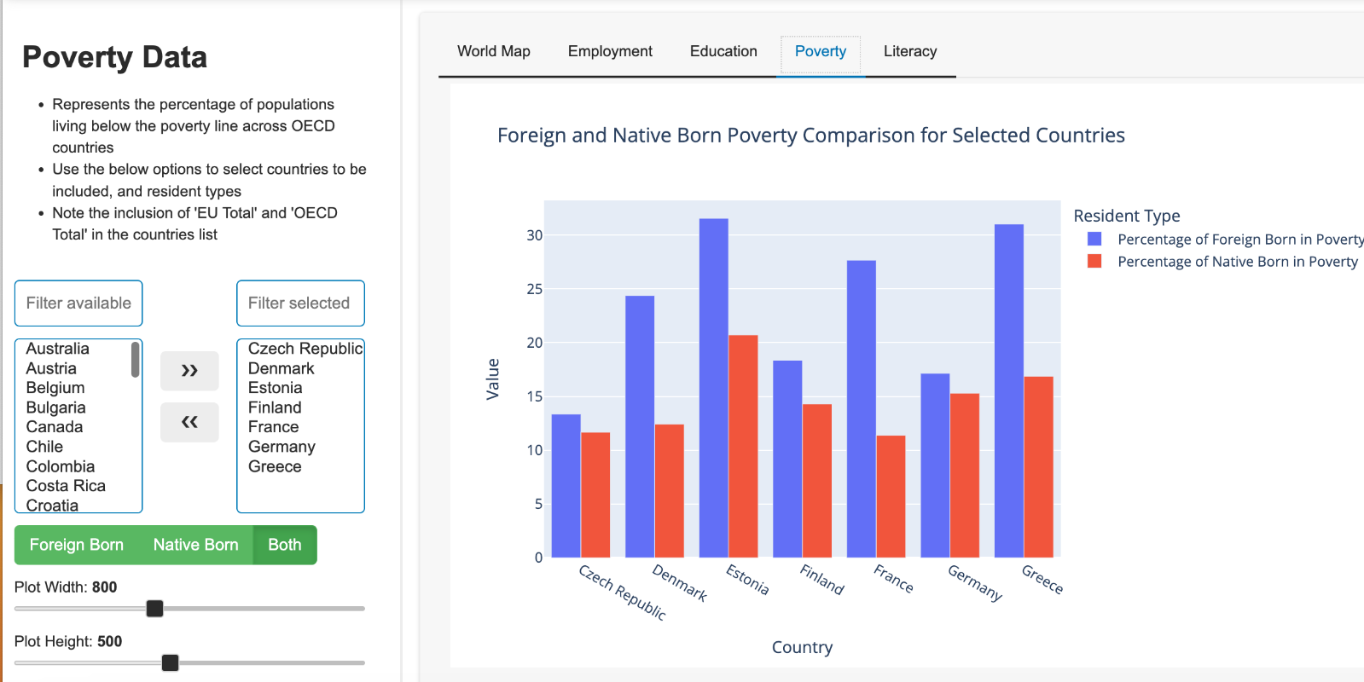
Immigrant Equality in OECD Countries David Scales Northeastern University
Data Introduction
The Organization for Economic Co-operation and Development is a coalition containing 38 member states, including the U.S., Mexico, Australia, and a majority of the EU.
The organization conducts many efforts into producing publicly available data regarding global trade, economics, health, and in this case, immigration.
This dashboard aims to use this data to enable the user to compare various statistics regarding the lives of foreign-born vs. native-born populations in OECD countries
Home Page
The dashboard’s main page features an interactive globe demonstrating various features of foreign-born populations across OECD countries, from the percentage of a population’s whole, to mean household size
Data Exploration
This dashboard utilizes several strategies to make it seamless to view and compare relevant data.
The dashboard contains four tabs, each representing a category of data. A sidebar allows countries from the OECD, as well as foreign-born/native-born/both to be selected for comparison. These selections are carried through tabs, as shown in the image on the right

