Slide 1
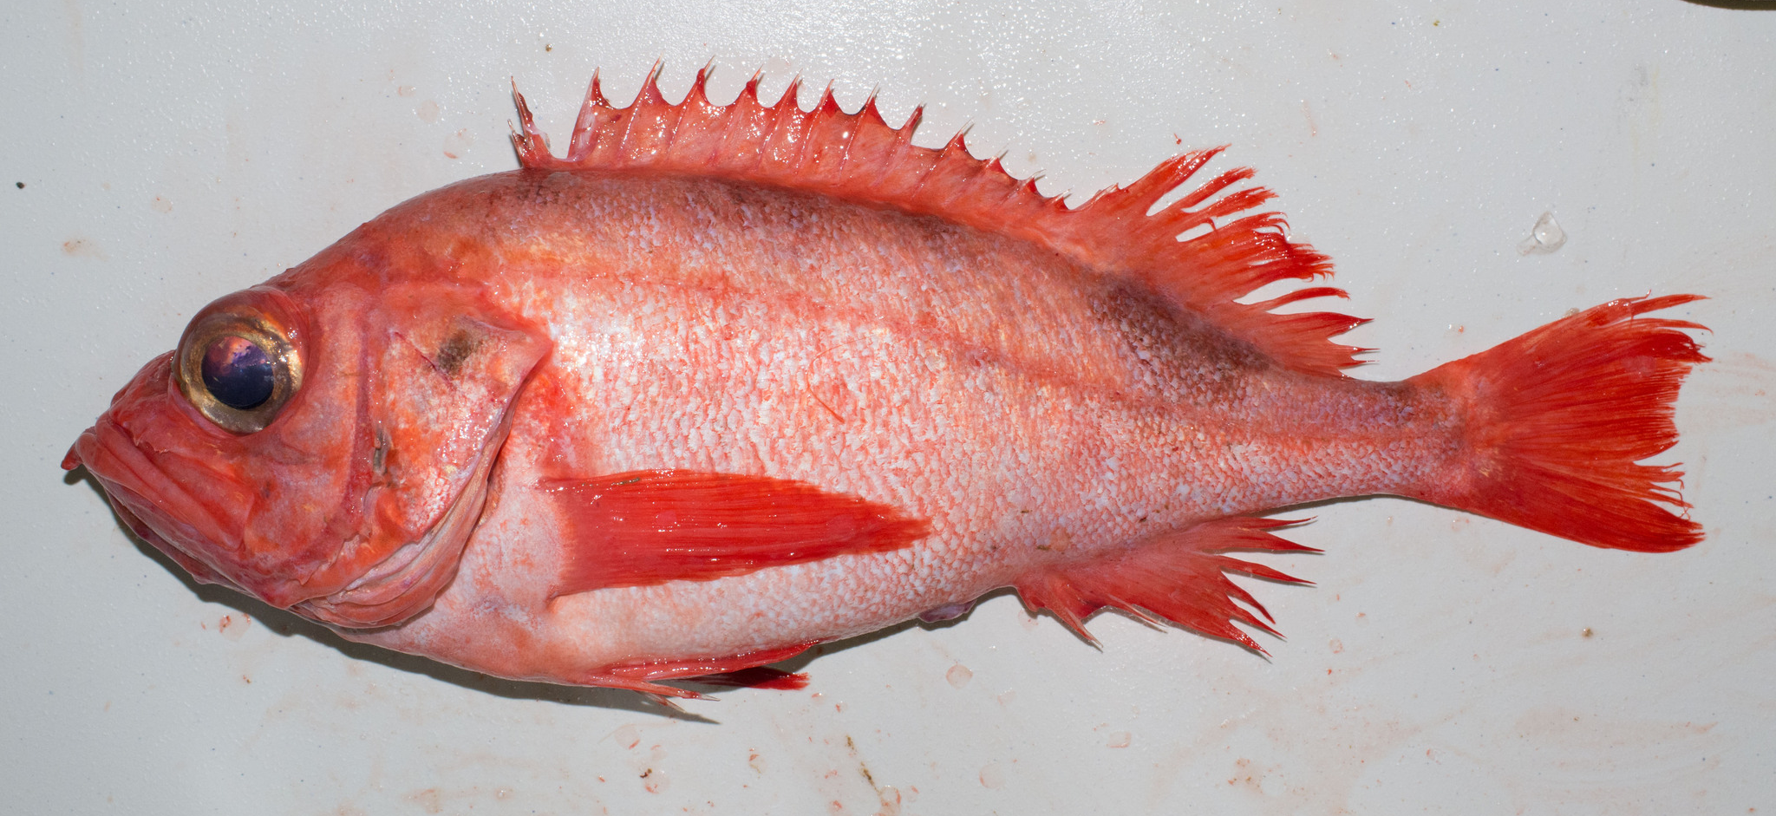
Taxonomic names – understanding sources and authorities
C. Nozères (2013)
Claude Nozères, DFO-Quebec Region, 2022-12-13

Slide 2
Sources and Authorities
Taxonomic Concepts - context
Taxonomic Authorities - opinion
Taxonomic Frameworks - linkages

Slide 3
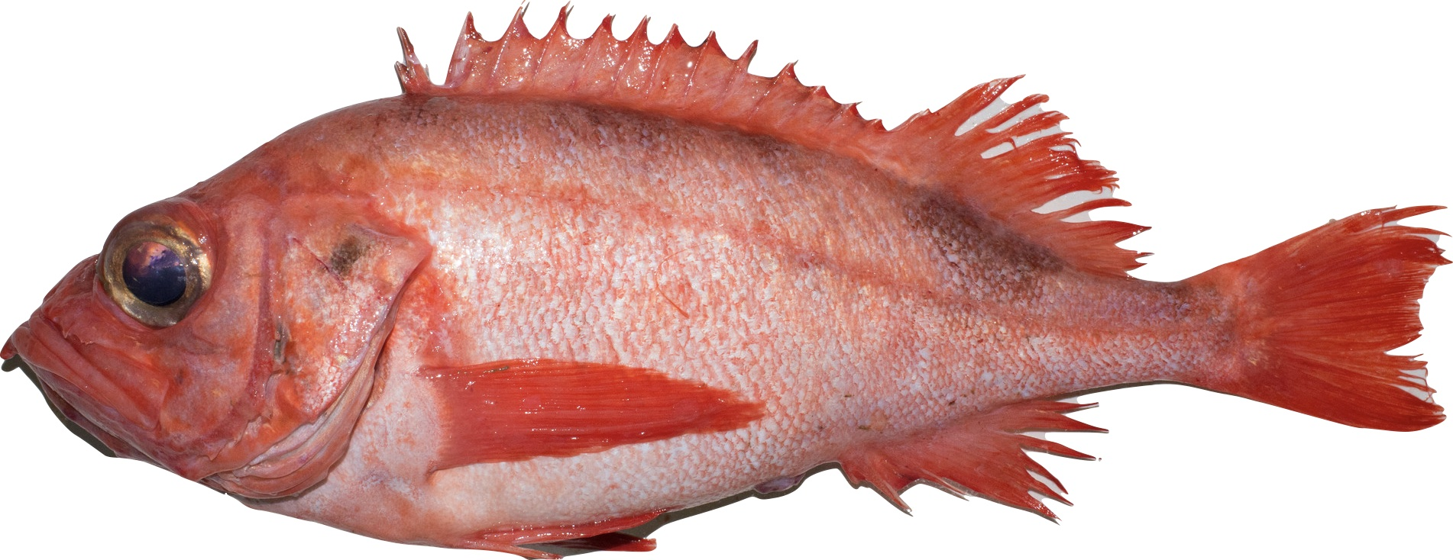
Taxonomic Concepts
A name of an organism at a time and place
use an Authority to give it weight (valid/official)
value could depend on history and geography
Sebastes sp.
Gulf of St. Lawrence, ca. 1950 = Sebastes marinus
Gulf of St. Lawrence, ca. 1990 = Sebastes fasciatus, Sebastes mentella, Sebastes norvegicus
qualifier: often mentella, some fasciatus, usually not the name for captures of norvegicus (synonym = marinus)
qualifier: called redfish in Atlantic, but rockfish in Pacific
qualifier: possible to name species proportions in capture modelling, but not the name for an individual fish

Slide 4
Standards associated with names
Biodiversity Information Standards https://www.tdwg.org/
DarwinCore: defines fields for context, e.g.,
scientificName: name according to an authority
scientificNameID: international identifier of an authority
verbatimIdentification: name as recorded by a source
identificationRemarks: notes on name from a source
taxonomicRemarks: notes on name from an authority
Annual conference (last one in Oct. 2022)
discuss new tools, use cases, data quality--and taxonomy
Published in journal https://biss.pensoft.net/
Like Authorities , there are several Standards; DarwinCore is a major one for biodiversity

Slide 5
Taxonomic Authorities
Reference Sources that present opinions on names
Primary: initial authority, usually more academic
e.g., Eschmeyer’s Catalogue of Fishes https://www.calacademy.org/scientists/projects/eschmeyers-catalog-of-fishes
Secondary: may be an authority and have opinion, but not necessarily the root source of a name
e.g., FishBase to WoRMS
note: Fishbase is considered ‘primary’ to WoRMS, and WoRMS is considered ‘primary’ to several, like OBIS, iNaturalist, and DFO

Slide 6
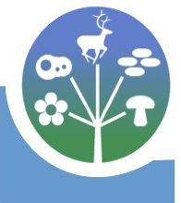

Authorities: WoRMS with DFO
In 2000s, a DFO taxonomic working group began standardizing name lists to match with ITIS (Integrated Taxonomic Information System)
was mostly for agriculture in USA (plants and insects)
needed for trade (reference for commercial species)
By 2010, the marine authority adopted by DFO was WoRMS (World Register of Marine Species)
this has a regional subset: CaRMS (Canadian Register of Marine Species), for checklists and photos
managed by Mary Kennedy (DFO-BIO, retired 2015), also Claude Nozères (mainly as a contact person)
https://www.marinespecies.org/CaRMS/index.php

Slide 7
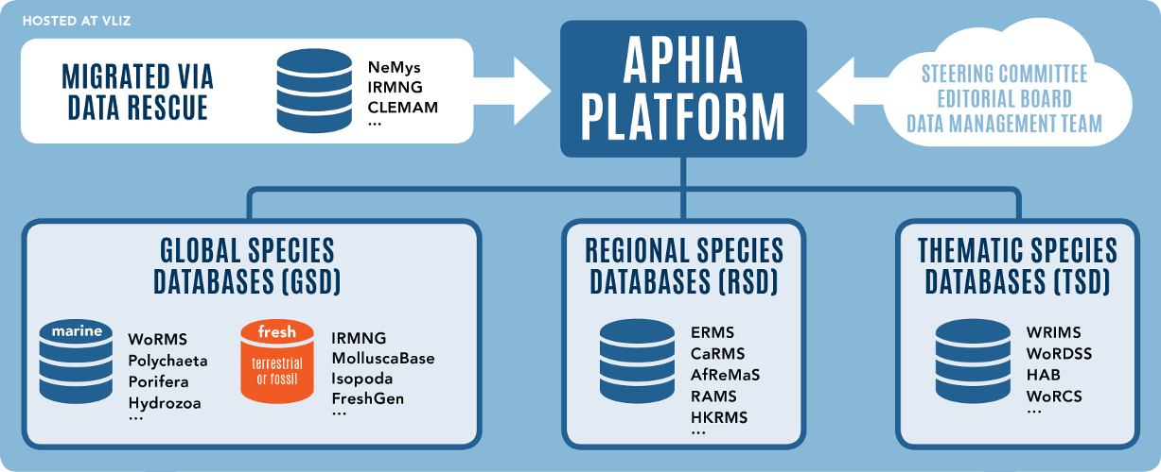
WoRMS structure
https://www.marinespecies.org/about.php
Had several projects and needs. Instead of building separately, chose to make a ‘global
base’ that combines several root sources, and displays subsets by geography or subject.

Slide 8
WoRMS - Names
Lists known versions of taxonomic names
if missing, will be added when given a reference
Every spelling or taxonomic variation has a taxon page and unique sequential number (AphiaID)
every version/page is linked to all others
1 name will be preferred (‘valid’) over others
spelling changes and revisions make synonyms (’invalid’)
sometimes ‘alternate representations’ are shown
Could automatically use valid name (as does OBIS), or known synonyms (are linked to valid name)

Slide 9
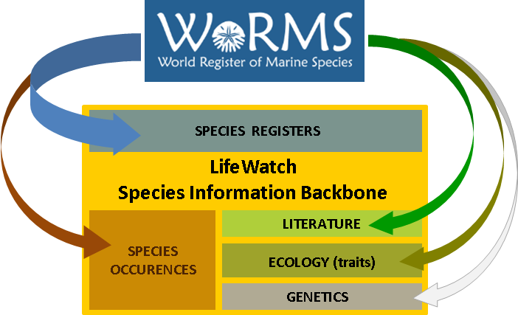
WoRMS: names and beyond
15 years on: history news capsules explaining more
https://lifewatch.be/en/2022-news-WoRMS-15th-anniversary

Slide 10
WoRMS in 2022
https://www.marinespecies.org/aphia.php?p=stats
Data Management Team (5)
Steering Committee (12)
Editors (317)
Names: 766,910

Slide 11
Taxonomic Frameworks
from iNaturalist: information about ‘what me mean’ by a particular taxon https://www.inaturalist.org/pages/taxon_frameworks
thus, how a branch of their taxonomy links to that of another, such as from WoRMS, ITIS, or Catalogue of Life
may be a match (one-to-one)
or a deviation (including external—not in a source)

Slide 12
Frameworks in application
How names are linked from an authority to a user
OBIS = WoRMS current names are source for records
DFO = WoRMS is source for most names
iNaturalist = WoRMS is a source of marine names
GBIF = WoRMS is a source among others (e.g., ITIS)
BIIGLE (images) = WoRMS is the source for taxonomy if wanted for annotations
BOLDsystems (genetics) = WoRMS names have links

Slide 13
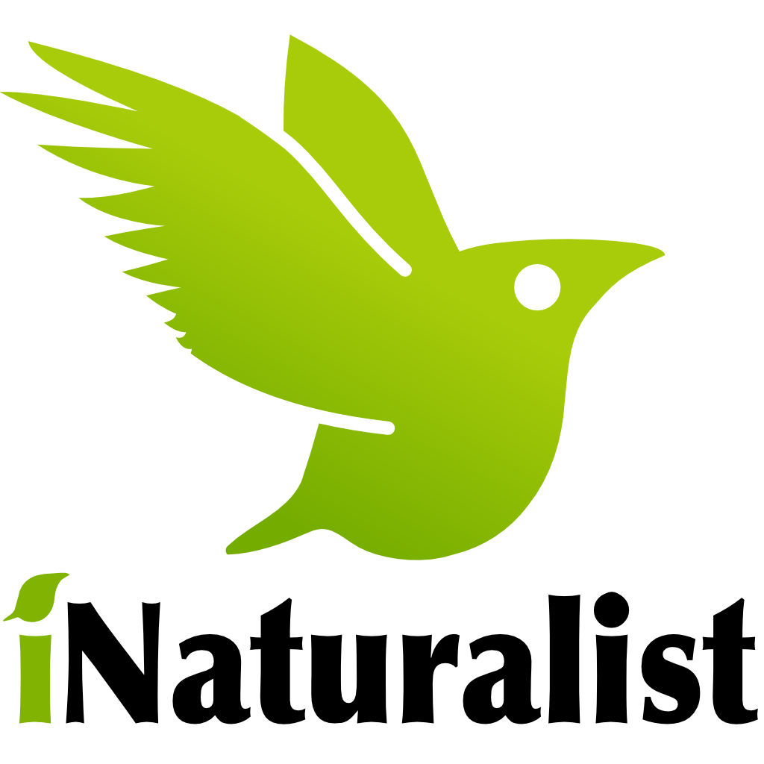
iNaturalist in 2022
Users from groups with curators and managers maintain taxonomic framework for records that are always changing with names and relationships
Do not ‘care’ about names (unless you want to)
21 groups of iNaturalist Network (e.g., iNaturalist Canada, managed by Canadian Wildlife Federation)
32 M observations with 46 M identifications
262 K species
Year in Review 2022: https://www.inaturalist.org/stats/2022

Slide 14
Sources & Names: a taxon
Published revision in a coral (concept)
https://ssbbulletin.org/index.php/bssb/article/view/8735
Revised record in WoRMS (authority)
https://www.marinespecies.org/aphia.php?p=taxdetails&id=1608733
Leads to taxon swap by iNat. curators (framework)
https://inaturalist.ca/taxon_changes?taxon_id=1430593
Changes notify users -> updates DFO record
https://inaturalist.ca/observations/15001570

Slide 15
Sources & Names: Quebec Region
Dashed lines: external and interlinked
Solid ovals: most match, are separate

