Slide 1

Space Block - Roll the block
Checkpoint de IA

Slide 2
Specification of the work
In the puzzle game Space Block - Roll the Block, the player's objective is to maneuver a block through a maze-like environment to a particular target area. Each cell in the 2D grid, on which the game is played, indicates a possible space for a block to occupy. The block can only move horizontally or vertically, and it must steer clear of obstructions in its route like walls and other blocks.
Finding the quickest series of moves that will let the player to arrive at the desired grid spot is the goal of the optimization issue in Space Block - Roll the Block. The objective is to complete each level with the fewest movements possible while avoiding hazards and keeping the block inside the grid's confines.
The search can be guided by various heuristics and evaluation functions, and a variety of search algorithms, including A*, breadth-first search, and depth-first search, can be used to address this optimization problem. The goal is to choose the best option that minimizes the number of moves necessary while guaranteeing that the block arrives at the desired spot without running afoul of any barriers or straying beyond of the allowed area.

Slide 3
Related work FALTA FAZER AINDA
References to works found in a bibliographic search (articles, web pages, source code, etc.)
Comparison with related works (similarities, differences, advantages, disadvantages, etc.)

Slide 4
Formulation of the problem
State representation: In the game Space Block - Roll the Block, the state can be shown as a series of cells, with each cell containing information on whether it is empty, contains a block, or is blocking the way. This grade can be represented as a bidimensional matrix where each cell is a 0 (empty cell), 1 (block), or 2 (obstacle).
Initial state: The initial configuration of the blocks in a grade is known as the initial state. He can change from level to level, with various arrangements of blocks and obstacles. The initial state can be depicted as a bidimensional matrix in which each cell contains the value 0 (vacant cell), 1 (blocked cell), or 2 (obstacle). Test goal: The test goal is to ascertain whether the block arrived at its intended position in the grade. This is done by determining whether the cell that contains the block of DNA has the same coordinates as the cell that will carry it. The level is deemed to be complete if the block arrived at its intended location.
Operators: In the video game Space Block - Roll the Block, the operators are the actions that can be taken to move the block along the gradient. The following operators may be defined as move the block up,down,left and right with a cost
In Space Block - Roll the Block, the evaluation function can be described as the number of blocks that are not in their final positions. The heuristic function can be used to direct the search algorithm by calculating the number of movements required to reach the desired state. The value of the heuristic will decrease as blocks get closer to their final positions, and the search algorithm will be closer to finding the best solution.

Slide 5
Implementation work FALTA ACABAR
Programming language used is python in Visual Studio Code
Arrays for create arena,block’s position
Sets e gets blocks’s positions,player score and name
Bugs?? ISSUES??

Slide 6
Conclusion ISTO ESTA UMA MERDA EU SEI
We already done a arena and block,created a scored and a name of player but we need to create the rules of the game also need to implement breadth-first search, and depth-first search so we have a lot of work to do.

Slide 7

Classes do JOgo
Block
Board
Square

Slide 8

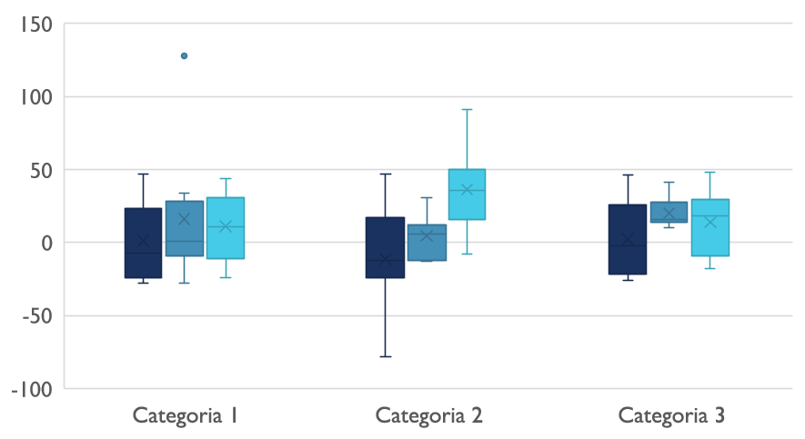
Pesquisa

Slide 9
Formulação do Problema – Search Problem

Slide 10
Detalhes de Implementação

Slide 11
Requisitos Tecnológicos
Rede
Satélite
Ligação

Slide 12

Obrigado
David Ferreira up202006302
Luísa Salvador up202006471
Mariana Teixeira up201905705

