Slide 1

Space Block - Roll the block
Checkpoint 2 de IA

Slide 2
game
The goal of the puzzle game "Space Block Roll the Block" is to move a block from a beginning position to a goal point(Golden block) on a game board while avoiding numerous obstacules(Black blocks).
The block can be moved vertically or horizontally one square at a time on the game board, which is made up of a grid of squares. To determine the optimal path for the block through the barriers and toward the objective, the player must use reasoning and strategy.
The game typically progresses through multiple levels of increasing difficulty, with more complex puzzles and obstacles introduced as the player advances. Some versions of the game may also feature power-ups or other bonus items that can help the player overcome challenges.

Slide 3
A*
A* is a heuristic search algorithm that is frequently employed in graph path-finding issues. Although it is comparable to the breadth search algorithm (BFS), A* only expands the node that is deemed to be the most promising based on a heuristic function.
To identify which node should be extended, A* employs two functions. The overall cost of the path from the starting node to the current node is represented by the first function, called the current cost function. The second is a heuristic function that calculates the approximate cost of the shortest route between the current node and the target node. If the heuristic function never overestimates the real cost of the path to the objective, then it is an acceptable heuristic.

Slide 4
BFS
The BFS (Broad Search) search method searches all nodes of a network in breadth, that is, it first looks at all of a node's direct neighbors before moving on to the node's next level neighbors. Before moving on to the next level, BFS starts at the graph's root and investigates every node that is nearby at the same level.
In a weighted network, BFS is helpful for determining the shortest path, and in an unweighted graph, it can be used to determine whether a path connects two nodes. It can be used recursively or iteratively.

Slide 5
Heuristics
O A* is an improvement over BFS since it takes into account heuristic function when deciding which node to expand, which typically results in a more effective search and a shorter path. The A* is extensively used in computer and robotic games where finding paths is a significant issue.
To determine the distance between two people on a graph, we use the Manhattan distance tool. Manhattan's distance is the sum of the absolute differences between the coordinates x e and two of us. It is a common distance measurement used in graph search algorithms like the A* (A-star) to find the shortest path between two points.

Slide 6
Evaluation Fucntions
Number of moves: There is a counter that each step the block will take has a cost of 1 goal for having that value as small as possible
Our block is not allowed to touch the black blocks
The block can be lying down or standing up

Slide 7
results

Slide 8
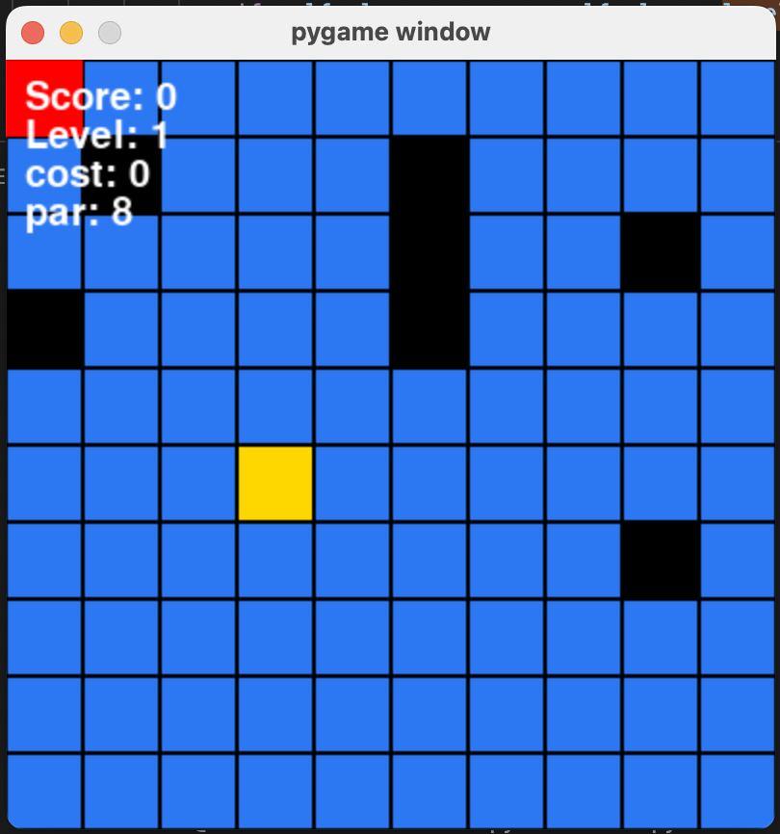
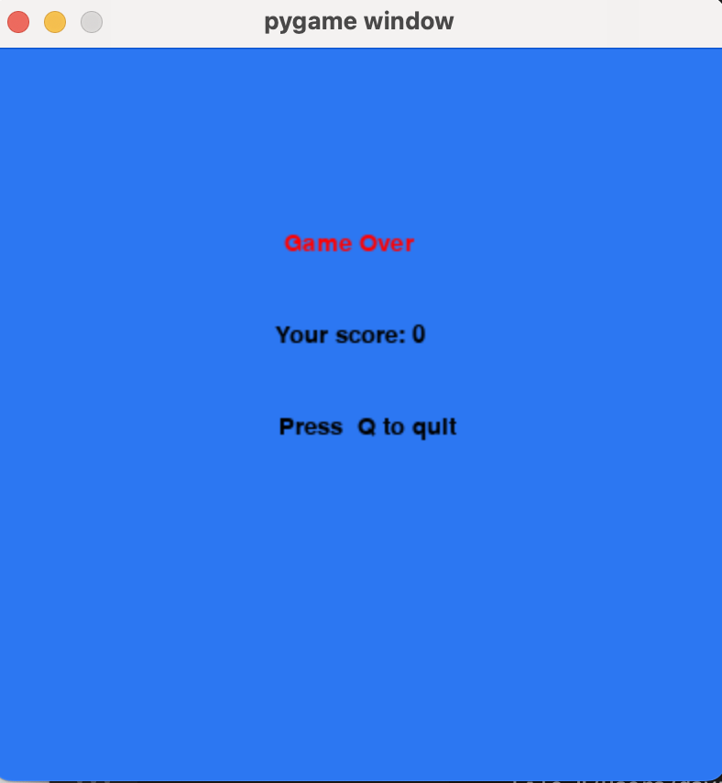
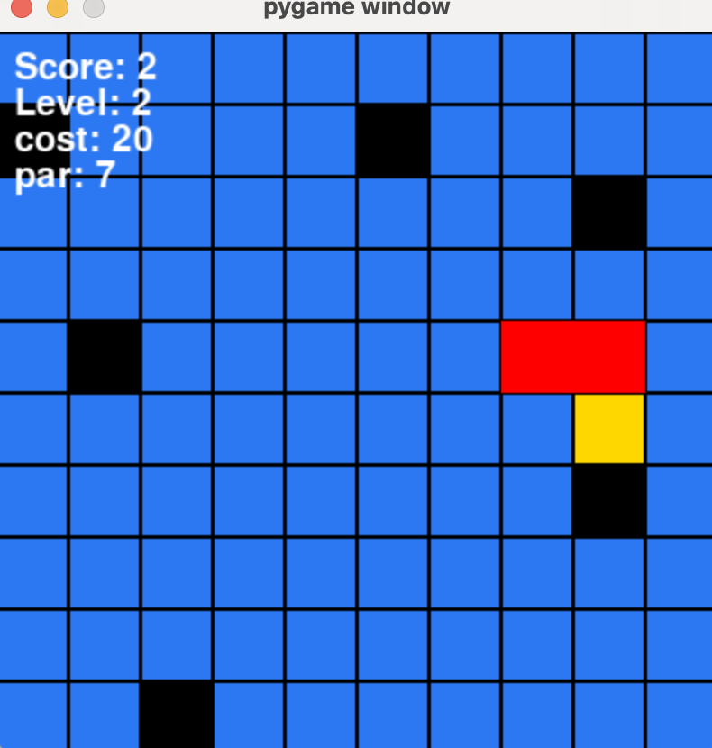
Images of the game

Slide 9
References
https://favtutor.com/blogs/breadth-first-search-python
https://www.pythonpool.com/a-star-algorithm-python/
https://www.statology.org/manhattan-distance-python/

Slide 10

Obrigado
David Ferreira up202006302
Luísa Salvador up202006471
Mariana Teixeira up201905705

