Slide 1
Quantum Walks
David Shaw
Notes:
Hey everyone, I’ll be talking to you about quantum walks. My goal is to extend the analysis of a classical random walk into the quantum realm, and showcase the mathematical concepts that drive quantum computing and algorithms.

Slide 2
Random Walks
A path of random steps in a mathematical space
Fundamentally described by a position and a set of transition probabilities
Some random number generator dictates the walker’s next step
Forms the backbone of many probabilistic simulation models
Notes:
3. We will be referring to this as a coin – since the simplest example of this is the flip of a coin.
4. Markov Chains and MCMC are famous examples

Slide 3
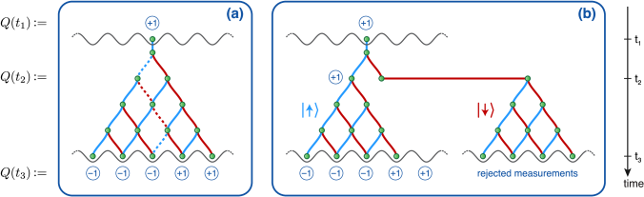
Quantum Walk
Quantum analogue to a random walk
Walker is described by a wavefunction
Linear combination of allowed positions (eigenstates)
Each eigenstate has an associated probability corresponding to its eigenvalue

Slide 4
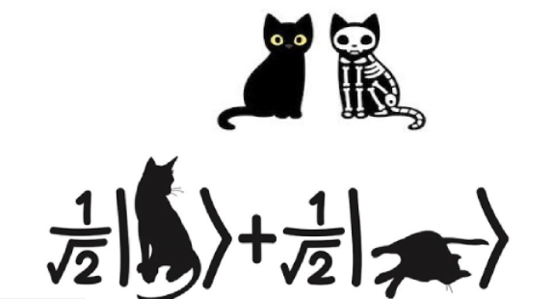
How do quantum systems differ from classical systems?
Uncertainty
exact state of the system is unknown (until measurement)
Mathematically, states and transitions are represented by vectors and operators
Composite systems are entangled
System state is a linear superposition of the allowed state vectors
Each vector has an associated amplitude, squaring the amplitude provides a probability
System is collapsed to a single state vector upon measurement
Notes:
point 1 - While this uncertainty is inconsequential in regular computers, it can’t be ignored in a quantum circuit
point 4 – This is super important! This is the basis of quantum mechanics. In case you haven’t heard of Schrodinger’s cat, it’s a famous thought experiment that’s basically the ELI5 version of QM. The idea is that a “quantum cat” in a closed box is in a linear superposition of two states- one where the cat is alive, and one where the cat is dead. Peeking at the box will obviously reveal the cat as either dead or alive, but before looking it is ”both”.
point 7 – our coin is now entangled with the system of the walker, not independent

Slide 5
Applications
Quantum walks have potential to speed up many computation algorithms
Faster graph traversal
Quantum MCMC: a quantum walk approaches its stationary distribution faster than a classical walk
Verify matrix multiplication
Exponential time algorithms -> polynomial time
Potential to better model quantum physical systems
Notes:
Quantum algorithms work by building circuits of qubits. Many quantum algorithms then utilize a quantum walk model to “traverse” this circuit.

Slide 6
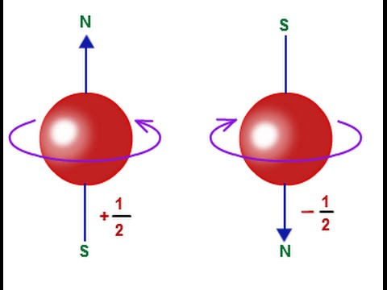
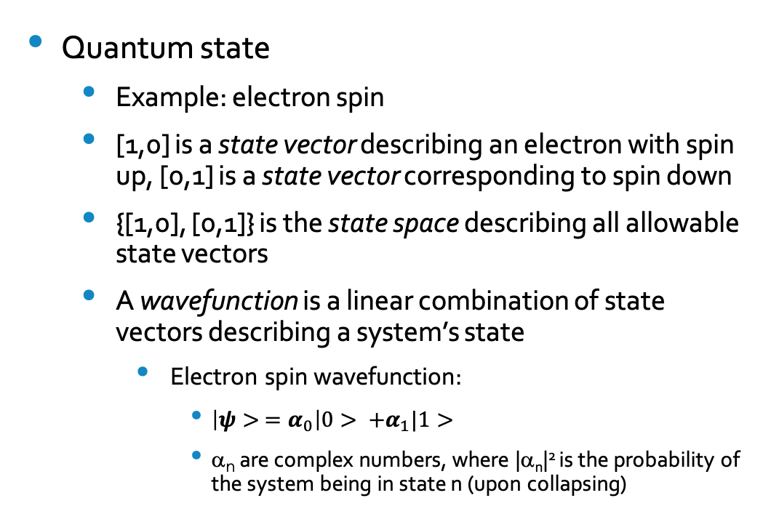
Basics of Quantum Mechanics
Quantum state
Example: electron spin
[1,0] is a state vector describing an electron with spin up, [0,1] is a state vector corresponding to spin down
{[1,0], [0,1]} is the state space describing all allowable state vectors
A wavefunction is a linear combination of state vectors describing a system’s state
Electron spin wavefunction:
$\left|ψ> =α_{0}\right|0> +α_{1}|1>$
α_{n} are complex numbers, where |α_{n}|² is the probability of the system being in state n (upon collapsing)
Notes:
We’ll be looking at one of the simplest QM systems there is – the spin of an electron. Spin is a little bit tricky to describe, but it’s essentially a representation of angular momentum.
What’s important is that there are 2 allowed states, up and down. Represent this mathmatically with vectors.
Our state space is simply the set of these two state vectors
Remember earlier, we discussed that QM systems are represented by linear combinations of allowed state vectors. This is our wavefunction for the electron:
psi is the wavefunction, then we have 0=spin up and 1=spin down. The weird signs are referred to as “kets” in QM notation.
We also have the two coefficients, giving us probability.

Slide 7
Motivating example
We’ll be quantizing the simplest example of a random walk – a discrete time 1-dimension walker on a line
The walker takes a step forward at each time step with probability p, and a step backwards with probability 1-p
Classical model parameters
Position: given by an integer {-n,n} where n is the number of time steps taken
Coin: a boolean realization from a probability distribution
Quantum model parameters
Position: given by a vector |n>, a unit vector where the n-th entry is 1 and 0 otherwise
Coin: a unit vector in a 2-dimension Hilbert space
Notes:
Classical: we bound the position since we can’t see the walker at position 15 after 10 time steps
QM: coin: we spent so much time talking about electron spin in the previous slide because it’s a great analogue to a coin.

Slide 8
References
Portugal, Renato. Quantum Walks and Search Algorithms (Quantum Science and Technology), 2013
J Kempe (2003) Quantum random walks: An introductory overview, Contemporary Physics
Balu, Radhakrishnan; Liu, Chaobin; Venegas-Andraca, Salvador E. (2017) Probability distributions for Markov chains based quantum walks
https://robwel.ch/2014/03/visualising-quantum-random-walks-in-python/
https://susan-stepney.blogspot.com/2014/02/mathjax.html
https://upload.wikimedia.org/wikipedia/commons/9/9b/Random_Walk_Simulator.gif

