Slide 1
Password Generator Device
David Im and Alper Karslioglu

Slide 2
Overview
Create a password generator that will communicate with the login server to increase security
Server randomly generates a password from a word bank and encrypts it
Server then sends the encrypted password to the generator device
Device decrypts the password and displays it for the user to gain access into the system
Device can also ping the server to generate a new password

Slide 3

Specs
Device
Raspberry Pi 3 Model B running Raspbian
Monitor
Simple mouse to regenerate password
Software language: Python
Server
Host Device is a Windows 10 machine
Software: C++
Source: Raspberry PI

Slide 4
Encryption Algorithm
Stream Cipher using a preset key that both device and host keeps
This makes encryption and decryption the same algorithm
Pseudo Code
for(int i goes through each bit of the inputText){
if(index is at end of the key){
index = 0;
}
//XOR for each bit
inputText.at(i) = inputText.at(i) ^ key.at(index);
++index;
}
}

Slide 5

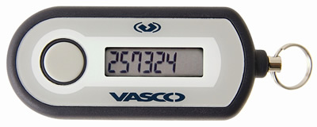
Usage
Simulates increasing security with two factor authentication
Two factor because its both something the user knows (password) and something user has (password device)
Idea based on real commercial devices that generate random passwords as shown
Source: Blizzard
Source: CU Boulder Office of Information Technology

