Slide 1
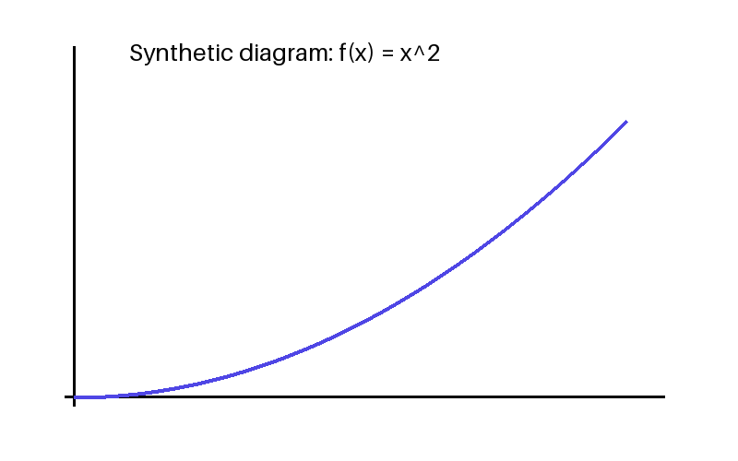
Conditional probability
P(A|B)=P(A intersection B)/P(B)
Assume P(B)>0.

