Slide 1
Document Auto-Classification & Semantic Search
Offline, single-GPU Windows desktop application for hierarchical document classification and multilingual semantic search
Project: docclassify
Stack: Python 3.11+ · PySide6 · SQLite + LanceDB · BGE-M3 · Qwen2.5-7B (local LLM)
Prepared as a technical architecture reference

Slide 2
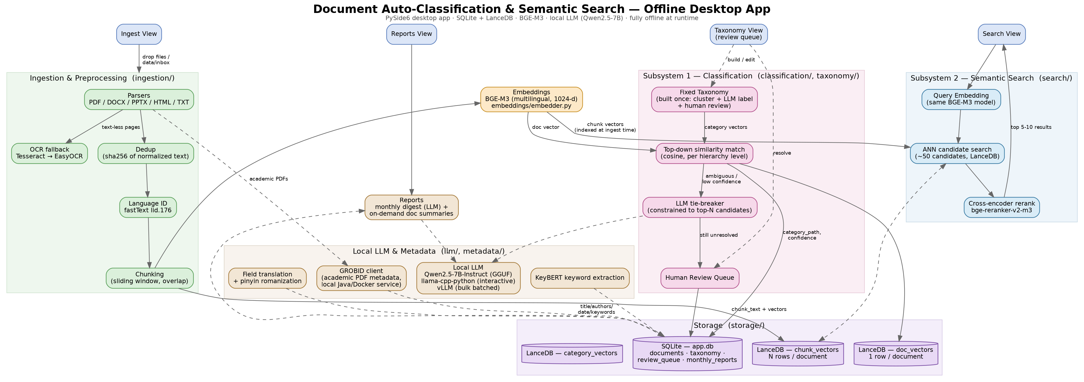
System Architecture

Slide 3
Shared Pipeline & Two Subsystems
Shared Ingestion
Classification
Semantic Search
Parse PDF / DOCX / PPTX / HTML / TXT
OCR fallback: Tesseract → EasyOCR
Language ID per chunk (fastText)
Sliding-window chunking with overlap
SHA-256 content dedup
Embed with BGE-M3 (1024-d, multilingual)
Fixed taxonomy, built once via clustering + LLM labeling + human review
Top-down cosine similarity match, level by level
LLM tie-breaker (constrained to top-N) on low confidence
Unresolved cases go to a human review queue
Result stored in SQLite (category_path, confidence, status)
Query embedded with the same BGE-M3 model (cross-lingual alignment)
Wide ANN candidate search (~50) over chunk_vectors in LanceDB
Cross-encoder rerank (bge-reranker-v2-m3)
Top 5-10 results returned to the UI
Optional category / language filters pushed down to LanceDB

