Slide 1
Getting Started with Transformers for Language Modeling
Dave Turner (Research Software Engineer – PNI)
Notes:
Play video at start: https://mediacentral.princeton.edu/media/t/1_ozqnt442

Slide 2
Goals
Introduction to NLP and language modeling
Introduction to transformer models
Hugging Face on RC clusters
Pipelines

Slide 3
What is natural language processing (NLP)?
NLP is a field of linguistics and machine learning focused on understanding everything related to human language.
Classifying whole sentences: Getting the sentiment of a review, detecting if an email is spam, determining if a sentence is grammatically correct or whether two sentences are logically related or not
Classifying each word in a sentence: Identifying the grammatical components of a sentence (noun, verb, adjective), or the named entities (person, location, organization)
Generating text content: Completing a prompt with auto-generated text, filling in the blanks in a text with masked words
Extracting an answer from a text: Given a question and a context, extracting the answer to the question based on the information provided in the context
Generating a new sentence from an input text: Translating a text into another language, summarizing a text
https://huggingface.co/course/chapter1/2?fw=pt

Slide 4
Why is it hard?
Computers don’t process information in the same way as humans
Lexical Ambiguity: words that can be used as adjectives, nouns, and verbs.
Semantic Ambiguity: this refers to sentences that have different meanings in different contexts.
Syntactic Ambiguity: the confusion is created because of the two meanings of the sentence given above. “saw” or the “boy” could be modified by the phrase ‘with my binoculars’ to establish a clearer meaning.
Spelling Errors: Humans can easily solve spelling errors.
Sarcasm: Cues such as ‘yeah right, ‘whatever, etc. could be interpreted differently in several contexts.
Colloquialisms and Slang: Colloquialisms do not have a dictionary definition when used in formal language and the meanings of such words will vary based on the geographical location.
At the limit, this is a general intelligence problem (AGI)
https://www.folio3.ai/blog/why-natural-language-processing-is-difficult/

Slide 5
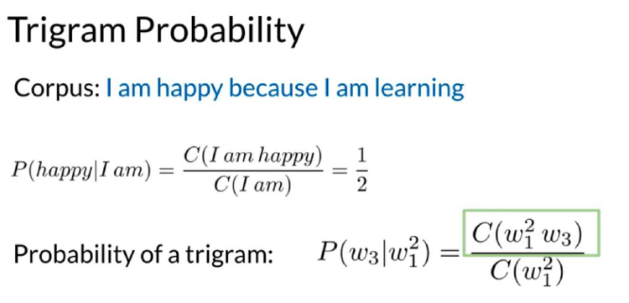
What is a language model?
A language model learns the probability of word (or token) occurrences based on examples of text.
For example, a classic NLP example of a trigram (3-word) probabilistic language model:
The probability formula for 3-grams or trigrams. C means counts, w stands for word, upper index means n-gram, lower index is simple word order index. Courtesy of deeplearning.ai. Source.

Slide 6
Neural Language Models
Classical probabilistic language models compute word co-occurrence statistics directly from the text.
As n in n-gram increases this scales very poorly. Two main problems:
Too many n-grams! This is the context problem. We can’t represent context efficiently.
Related to this is a sparsity problem, most n-grams never even occur!
The neural network approach to language modeling can be described using the three following model properties, taken from “A Neural Probabilistic Language Model“, 2003.
Associate each word in the vocabulary with a distributed word feature vector.
Express the joint probability function of word sequences in terms of the feature vectors of these words in the sequence.
Learn simultaneously the word feature vector and the parameters of the probability function.

Slide 7
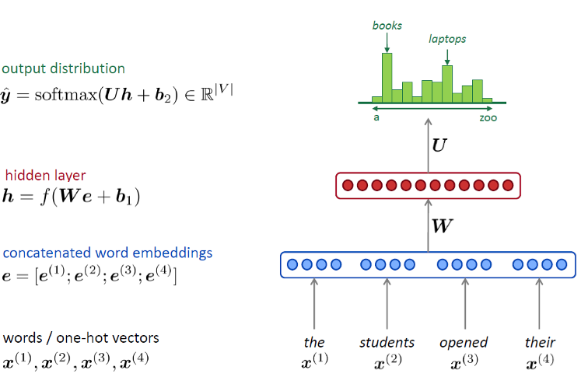
A fixed window language model
Embeddings eliminate the sparsity problem. Source

Slide 8
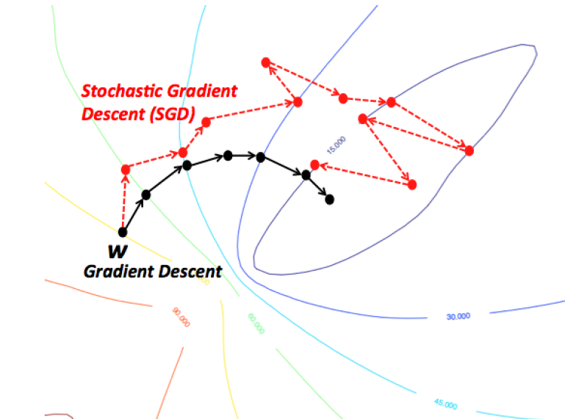
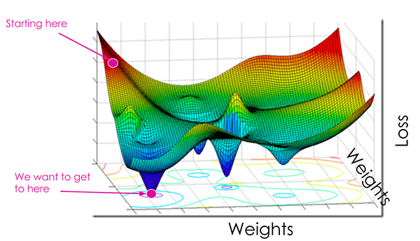
Learn via stochastic gradient descent

Slide 9
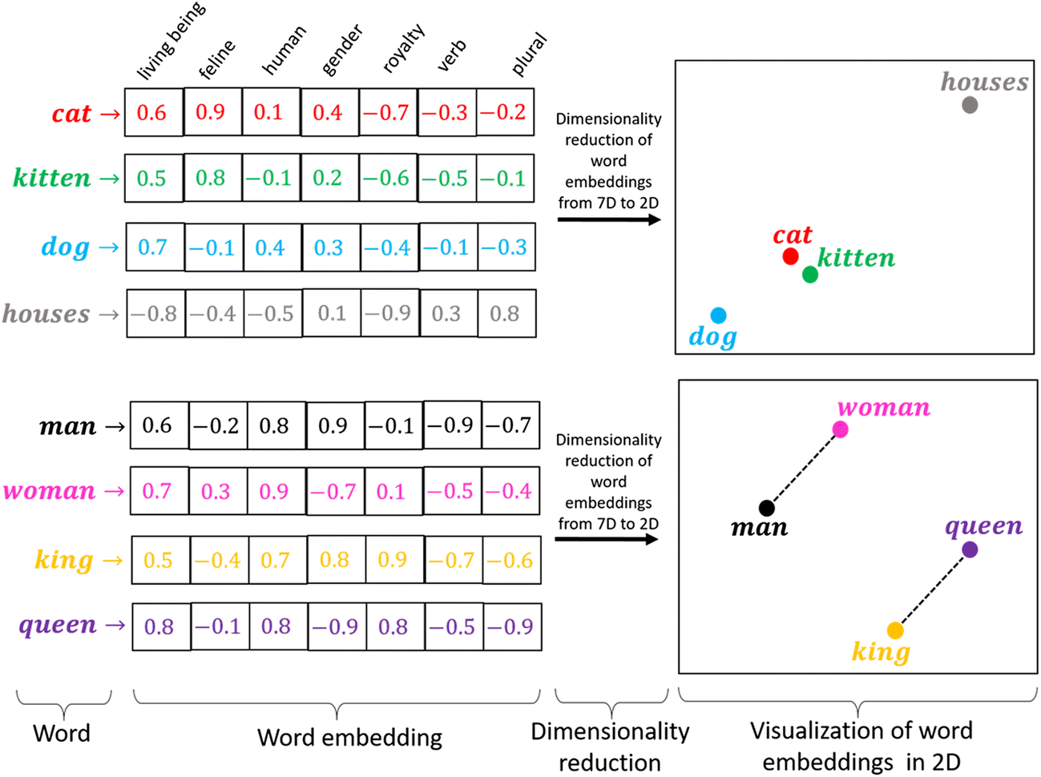
Word Vectors\Embedding Example
Source

Slide 10
How to deal with context?
The sparsity problem is mitigated by representing words as dense high-dimensional learned vectors.
The models that learn these vectors are still trained on tasks with small contexts (a few words) because they are fully connected networks. They are not even deep neural networks!
Most of the progress over the last decade in NLP has been focused on addressing this context issue¹ more efficiently for longer contexts.
Until around 2017 the dominant approach was sequence to sequence models called recurrent neural networks (LSTM, GRU, etc.) or convolutional neural networks (CNN). Often augmented with attention mechanisms.

Slide 11
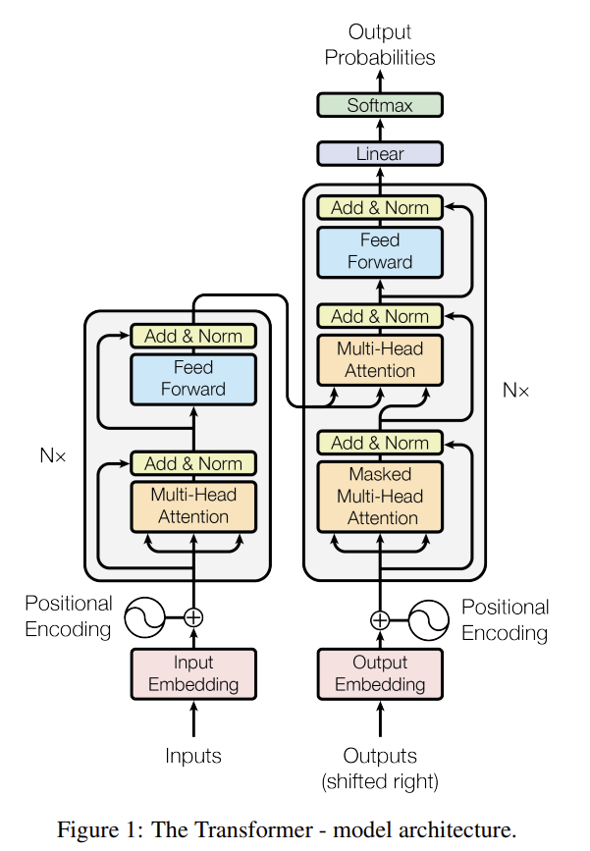
NLP since 2017
The introduction of the transformer architecture by Vaswani et al. Attention Is All You Need (2017) (Google Research)
More parallelizable
Scalable to large datasets
Combined with pre-training to enable transfer learning
Better handling of long sequences (though still limited)

Slide 12
Transformer Model Highlights
June 2018: GPT, the first pretrained Transformer model, used for fine-tuning on various NLP tasks and obtained state-of-the-art results
October 2018: BERT, another large pretrained model, this one designed to produce better summaries of sentences (more on this later)
February 2019: GPT-2, an improved (and bigger) version of GPT that was not immediately publicly released due to ethical concerns
October 2019: DistilBERT, a distilled version of BERT that is 60% faster, 40% lighter in memory, and still retains 97% of BERT’s performance
October 2019: BART and T5, two large pretrained models using the same architecture as the original Transformer model (the first to do so)
May 2020, GPT-3, an even bigger version of GPT-2 that can perform well on a variety of tasks without the need for fine-tuning (called zero-shot learning)
April 2022, PaLM, Pathways Language Model by Google Research, scaling to 540 Billion parameters for state-of-the-art performance
July 2022, BLOOM-175B, BigScience research workshop released BigScience Large Open-science Open-access Multilingual Language Model, an autoregressive language model based on the GPT-3 architecture.

Slide 13
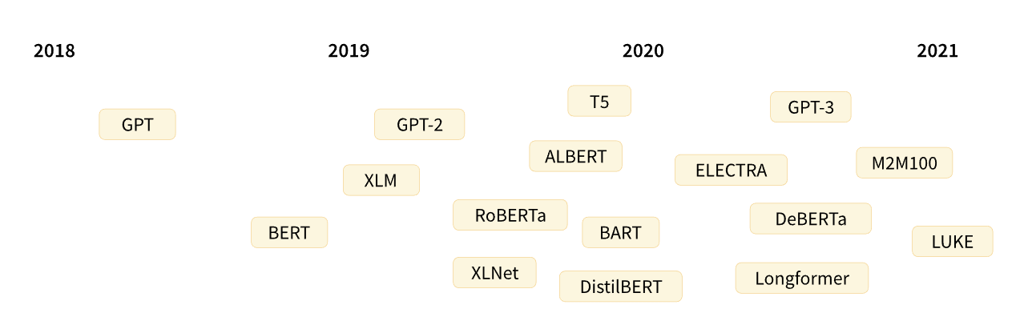
Transformer Model Highlights

Slide 14
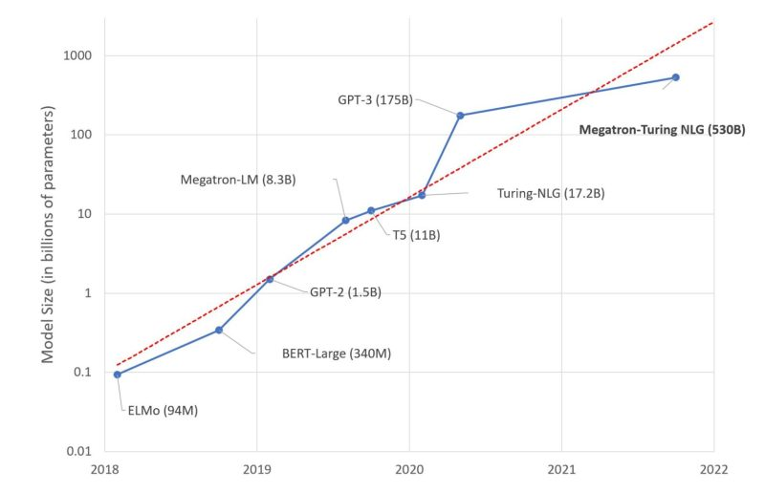
Model Size
https://huggingface.co/blog/large-language-models

Slide 15
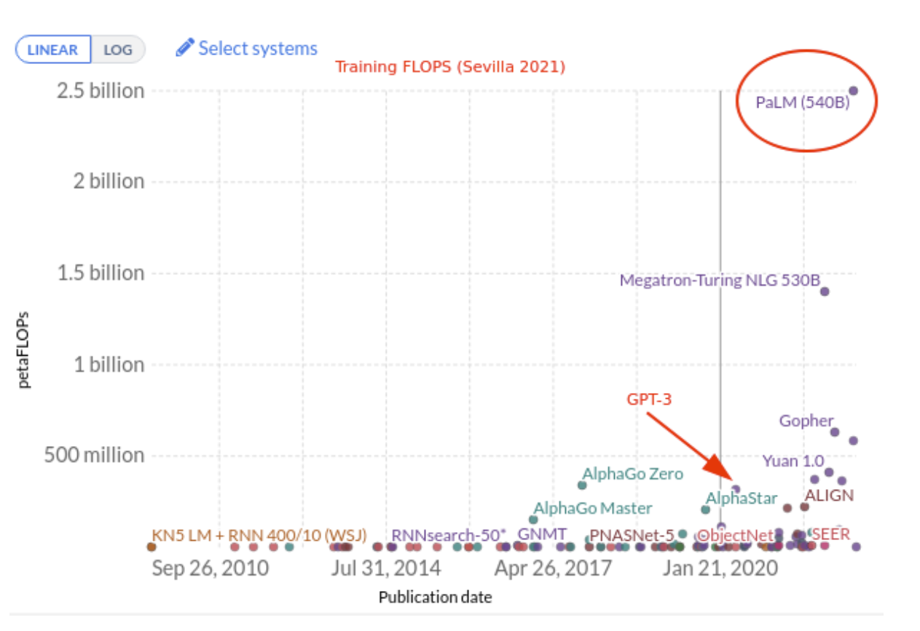
Compute
PaLM has 540B parameters = 3x bigger than GPT-3 175B parameters
Likely the most expensive model ~$10M (2.5 yottaFLOPS) vs GPT-3 ~$5M
PaLM and GPT-3 are fascinating, but likely not economical now
PaLM is not publicly available, GPT-3 has a paid API
https://vaclavkosar.com/ml/googles-pathways-language-model-and-chain-of-thought

Slide 16
Use Smaller Models
When evaluating models, you should pick the smallest one that can deliver the accuracy you need. This will make inference faster and require less resources (storage\compute).
For most NLP tasks smaller models can achieve good enough performance.
Use fine tuning to improve performance on your task
Current (2022) exceptions
Few or zero shot learning
Need state of the art

Slide 17
Model Types
This list is far from comprehensive and is just meant to highlight a few of the different kinds of Transformer models. Broadly, they can be grouped into three categories:

Slide 18
Model Types
This list is far from comprehensive and is just meant to highlight a few of the different kinds of Transformer models. Broadly, they can be grouped into three categories:
GPT-like (also called auto-regressive Transformer models)
These models are best suited for tasks involving text generation.

Slide 19
Model Types
This list is far from comprehensive and is just meant to highlight a few of the different kinds of Transformer models. Broadly, they can be grouped into three categories:
GPT-like (also called auto-regressive Transformer models)
These models are best suited for tasks involving text generation.
BERT-like (also called auto-encoding Transformer models)
best suited for tasks requiring an understanding of the full sentence, such as sentence classification, named entity recognition (and more generally word classification), and extractive question answering.

Slide 20
Model Types
This list is far from comprehensive and is just meant to highlight a few of the different kinds of Transformer models. Broadly, they can be grouped into three categories:
GPT-like (also called auto-regressive Transformer models)
These models are best suited for tasks involving text generation.
BERT-like (also called auto-encoding Transformer models)
best suited for tasks requiring an understanding of the full sentence, such as sentence classification, named entity recognition (and more generally word classification), and extractive question answering.
BART/T5-like (also called sequence-to-sequence Transformer models)
best suited for tasks revolving around generating new sentences depending on a given input, such as summarization, translation, or generative question answering.

Slide 21
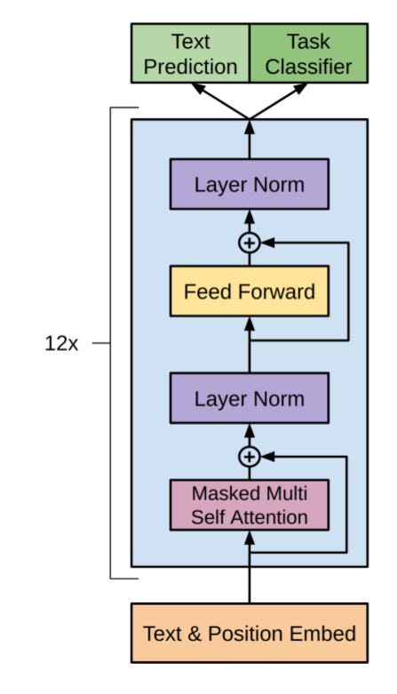
Example Transformer: GPT
Radford, Alec, et al. "Improving language understanding by generative pre-training." (2018).

Slide 22
Example Transformer: GPT
Radford, Alec, et al. "Improving language understanding by generative pre-training." (2018).

Slide 23
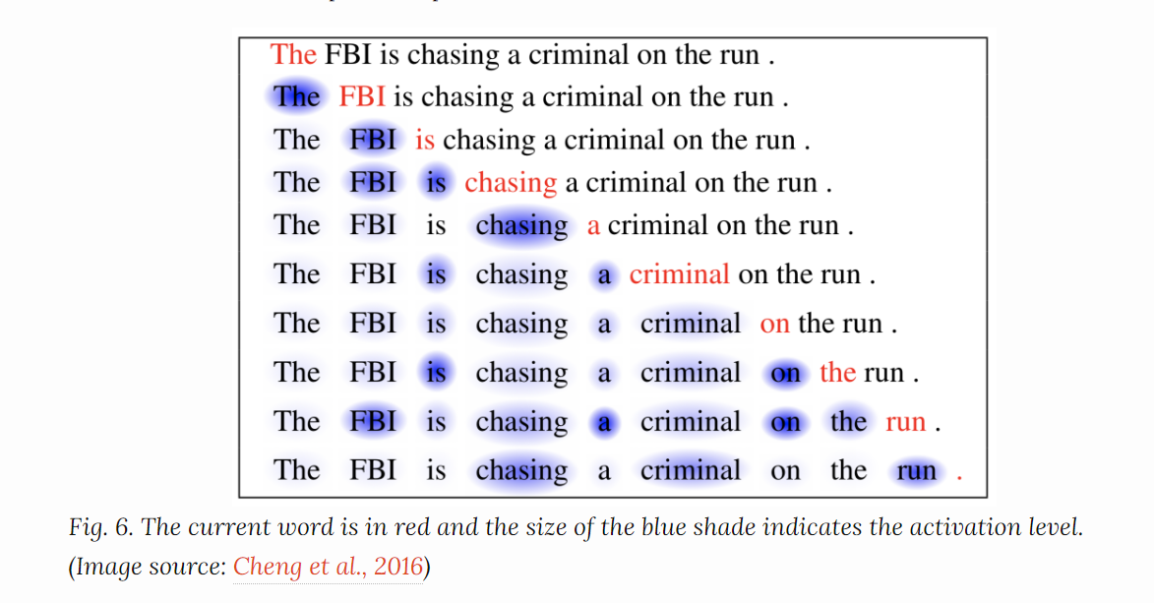
Self-attention: high level intuition
Cheng et al. 2016

Slide 24
Self-attention
Make word embedding change depending on context, that is, transform N individual word embeddings into N contextual embeddings
For example: the phrase “Bank of a river”; the embeddings for “bank” and “river” should be very different in this context from their typical context.
“A self-attention module works by comparing every word in the sentence to every other word in the sentence, including itself, and reweighting the word embeddings of each word to include contextual relevance.”
Source

Slide 25
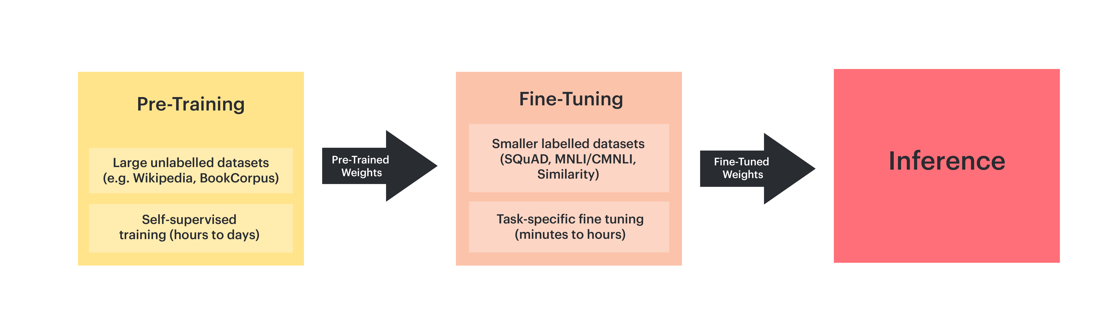
Pre-training vs Fine-tuning
GPT was the first pre-trained transformer, this has become very common
Large training datasets enable transfer learning
Basically, all state-of-the-art results were beaten by transformer models pre-trained on massive language datasets and finetuned on smaller task related dataset.
Source

Slide 26

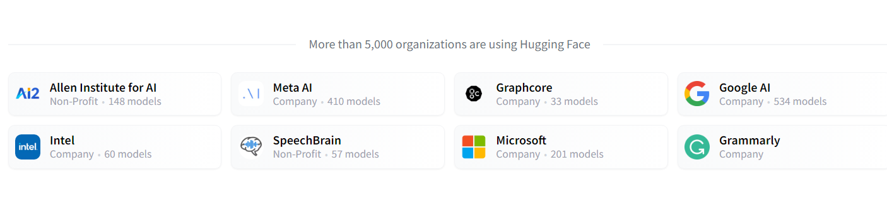
Hugging Face
Build, train and deploy state of the art models powered by the reference open source in machine learning.
transformers: Transformers: State-of-the-art Machine Learning for PyTorch, TensorFlow, and JAX.
datasets: The largest hub of ready-to-use datasets for ML models with fast, easy-to-use and efficient data manipulation tools.
tokenizers: Provides an implementation of today's most used tokenizers, with a focus on performance and versatility.
accelerate: A simple way to train and use PyTorch models with multi-GPU, TPU, mixed-precision

Slide 27
Follow along with Google Colab
https://tinyurl.com/hugfacetutorial

Slide 28
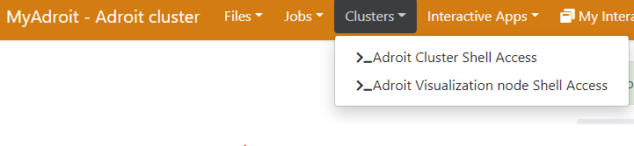
Setup on Princeton HPC Resources
Login into adroit.princeton.edu
SSH via terminal or use https://myadroit.princeton.edu/
Download tutorial materials and extract:
git clone https://github.com/davidt0x/hf_tutorial.git
cd hf_tutorial
./setup_python_env.sh

Slide 29
setup_python_env.sh
#!/bin/bash
# Load the anaconda module. This gives us access to a modern version of python. We can
# use it to create a virtual environment that contains the specific version of python
# we want and the specific packages we need for our projects.
module load anaconda3/2022.5
# Create the anaconda virtual environment. You could also use standard python venv here
# if you prefer.
conda create -n hf python=3.9 -y
# Activate the environment
. activate hf
# Install dependencies for this tutorial, this line (without the transformers and
# datasets package) is taken directly from PyTorch documentation, see
# https://pytorch.org/get-started/locally/. This can also be installed with conda
# as well but there seems to be issues with torch 1.13 conda packages at the moment.
pip3 install torch torchvision torchaudio transformers[sentencepiece] datasets --extra-index-url https://download.pytorch.org/whl/cu116
# Also install the hugging face command line interface, useful for inspect your
# cache and deleting things.
pip3 install huggingface_hub[cli]

Slide 30
Cache datasets\models on scratch
If you are using transformers on adroit. Setting your hugging face cache directory to scratch storage is best. The default location is your home directory ~/.cache/huggingface, but storage is limited here. To change, add this line to your ~/.bashrc:
export HF_HOME=/scratch/network/<NetID>/.cache/huggingface/
If you have used hugging face already and have datasets and models downloaded, just move it:
mkdir /scratch/network/<NetID>/.cache
mv ~/.cache/huggingface /scratch/network/<NetID>/.cache/
If you are using transformers on della-gpu, the same should be true but we should use /scratch/gpfs instead of /scratch/network

Slide 31
Downloading models and datasets
Princeton research computing clusters are comprised of head nodes and worker nodes.
Head or login nodes are for setting up jobs, writing code, transferring files. Limited testing of codes.
Worker nodes are for running your jobs and must be requested through SLURM scheduler. These nodes do not have access to the web!
Hugging face is clever and will try to download models and datasets for you. These downloads will fail if they are run from the worker nodes. These downloads are typically triggered by calls to following hugging face methods:
.from_pretrained(…)
pipeline(…)
load_dataset(…)

Slide 32
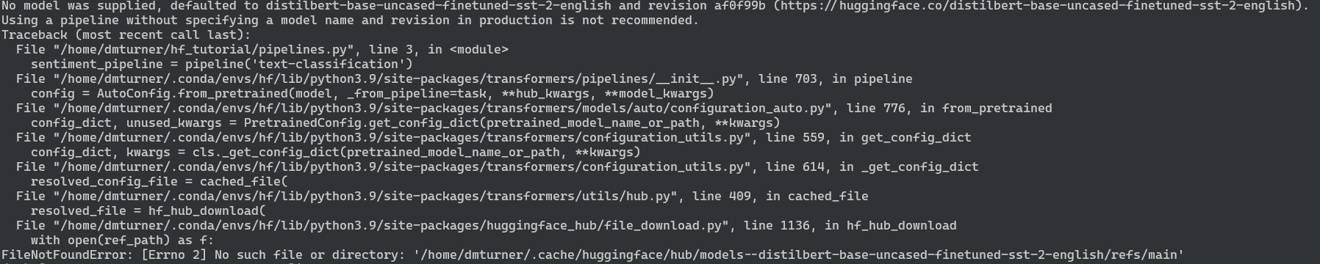
Example error of failed download from worker node.

Slide 33
Downloading models and datasets
Any code that fetches models or datasets should be run for the first time on the head or login node. Subsequent runs will use the cache so they can be run from worker nodes.
On the head node of adroit:
Activate the hf environment we just created
module load anaconda3/2022.5
. activate hf
Run the download script to fetch some models we will work with today
python download_models.py
In general, do not run these models on the head node, they are computationally expensive, and this is a shared environment. Run the models on a worker node …

Slide 34
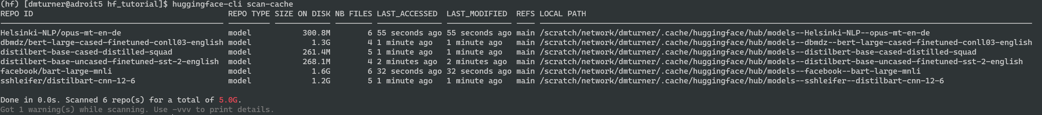
Models and datasets are big
Models and datasets are large, if you are done using them, delete them to clear up space. You can always download them again if you need them. Space is especially precious on /scratch
You can scan currently downloaded datasets and models using the huggingface-cli command (make sure your conda environment is activated!)
huggingface-cli scan-cache

Slide 35
Cleanup models and datasets
You can delete your entire hugging face cache by just removing the cache directory.
rm –rf $HF_HOME
If you want to be more selective, try the command:
huggingface-cli delete-cache

Slide 36
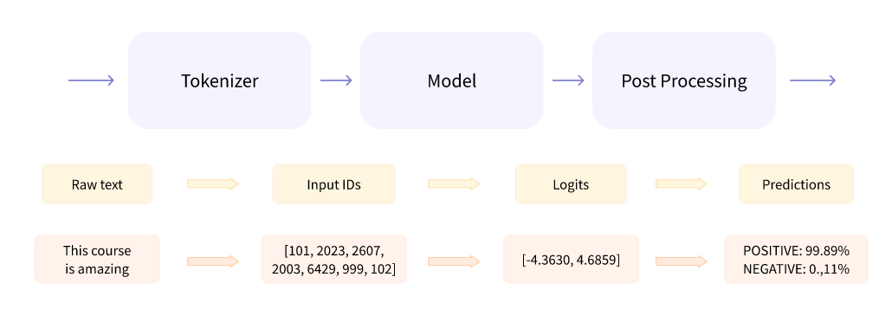
Pipelines
The absolute quickest way to get started with transformer models in hugging face is to use a pipeline.
Pipelines are NLP task oriented (classification, summarization, etc.)
Handle everything for you, input is raw text and output is task dependent. Below is a schematic for sentiment classification pipeline.

Slide 37
Run: Pipeline Examples
sbatch --reservation=language run_pipelines.sh
Reservation for this course, only active now, remove this after today.

Slide 38
Run: Pipeline Examples
salloc -t 00:2:00 --ntasks=1 --gres=gpu:1 --reservation=language python pipelines.py
Requested time, must make sure your script finishes before this time! Try not to
overestimate though or longer queues times will result.

Slide 39
run_pipelines.sh
#!/bin/bash
#SBATCH -t 00:02:00
#SBATCH -N 1
#SBATCH -n 1
#SBATCH --mem=10GB
#SBATCH --gres=gpu:1
# Load anaconda module so we have access to modern python interpreter
module load anaconda3/2022.5
# Activate the environment we created with setup_python_env.sh
conda activate hf
python -u pipelines.py
Requested time, must make sure your script finishes before this time! Try not to
overestimate though or longer queues times will result.

Slide 40
run_pipelines.sh
#!/bin/bash
#SBATCH -t 00:02:00
#SBATCH -N 1
#SBATCH -n 1
#SBATCH --mem=10GB
#SBATCH --gres=gpu:1
# Load anaconda module so we have access to modern python interpreter
module load anaconda3/2022.5
# Activate the environment we created with setup_python_env.sh
conda activate hf
python -u pipelines.py
Single node job, can leave this off because default is 1.

Slide 41
run_pipelines.sh
#!/bin/bash
#SBATCH -t 00:02:00
#SBATCH -N 1
#SBATCH -n 1
#SBATCH --mem=10GB
#SBATCH --gres=gpu:1
# Load anaconda module so we have access to modern python interpreter
module load anaconda3/2022.5
# Activate the environment we created with setup_python_env.sh
conda activate hf
python -u pipelines.py
Number of tasks, effectively the number of CPU cores to reserve on the node. In general, large number of tasks aren’t needed since these models execute on GPU. However, if using datasets package to preprocess text data, these can leverage CPU. This should probably be done in a separate CPU only and cached for later use.

Slide 42
run_pipelines.sh
#!/bin/bash
#SBATCH -t 00:02:00
#SBATCH -N 1
#SBATCH -n 1
#SBATCH --mem=10GB
#SBATCH --gres=gpu:1
# Load anaconda module so we have access to modern python interpreter
module load anaconda3/2022.5
# Activate the environment we created with setup_python_env.sh
conda activate hf
python -u pipelines.py
Max memory the job will use. I set this to 10GB to be on the safe side.

Slide 43
run_pipelines.sh
#!/bin/bash
#SBATCH -t 00:02:00
#SBATCH -N 1
#SBATCH -n 1
#SBATCH --mem=10GB
#SBATCH --gres=gpu:1
# Load anaconda module so we have access to modern python interpreter
module load anaconda3/2022.5
# Activate the environment we created with setup_python_env.sh
conda activate hf
python -u pipelines.py
How many GPUs you need. Don’t request more unless you are sure you have setup your code to utilize them efficiently. This requires testing.

Slide 44
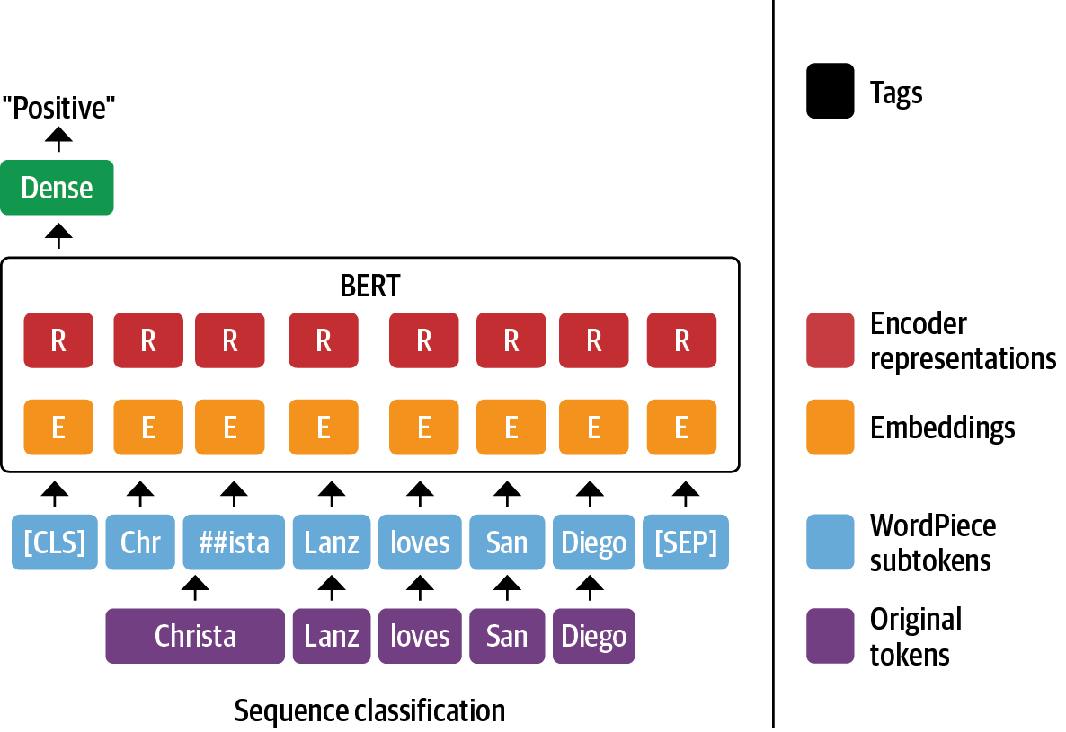
Sentiment Analysis
How a Transformer like BERT converts the inputs into atomic chunks called tokens which are then fed through the network to produce a single prediction

Slide 45
Pipelines – Example Text
Dear Amazon, last week I ordered an Optimus Prime action figure from your online
store in Germany. Unfortunately, when I opened the package, I discovered to my
horror that I had been sent an action figure of Megatron instead! As a lifelong
enemy of the Decepticons, I hope you can understand my dilemma. To resolve the
issue, I demand an exchange of Megatron for the Optimus Prime figure I ordered.
Enclosed are copies of my records concerning this purchase. I expect to hear
from you soon. Sincerely, Bumblebee.

Slide 46
Sentiment Analysis
sentiment_pipeline = pipeline(
"text-classification",
model="distilbert-base-uncased-finetuned-sst-2-english"
)
print(sentiment_pipeline(text))
How a Transformer like BERT converts the inputs into atomic chunks called tokens which are then fed through the network to produce a single prediction

Slide 47
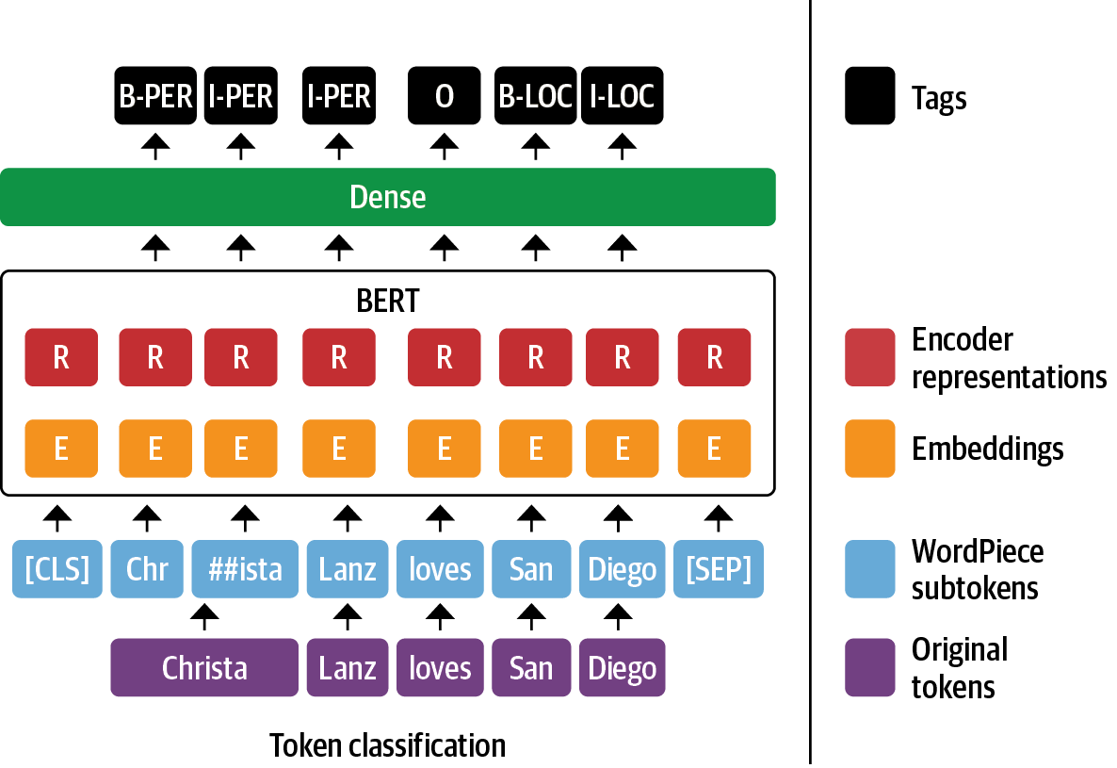
Named Entity Recognition (NER)
Extract entities such as organizations, locations, or individuals from the text. Instead of predicting just a class for the whole text a class is predicted for each token

Slide 48
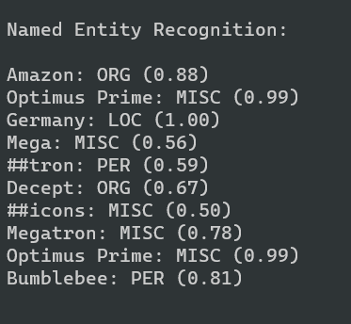
Named Entity Recognition (NER)
ner_pipeline = pipeline(
"ner",
model="dbmdz/bert-large-cased-finetuned-conll03-english“
)
entities = ner_pipeline(text, aggregation_strategy="simple")
print("Named Entity Recognition:\n")
for entity in entities:
print(f"{entity['word']}: {entity['entity_group']} ({entity['score']:.2f})")
Extract entities such as organizations, locations, or individuals from the text. Instead of predicting just a class for the whole text a class is predicted for each token

Slide 49
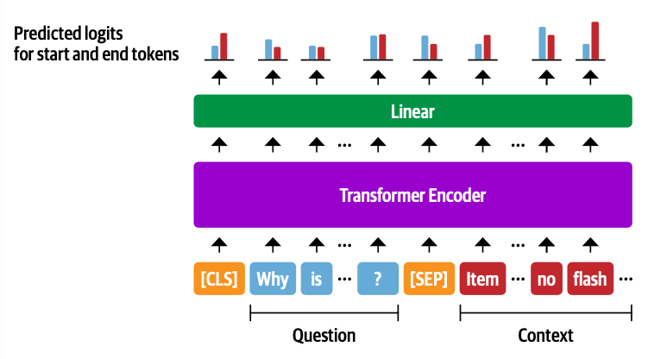
Question Answering
In this task, the model is given a question and a context and needs to find the answer to the question within the context. This problem can be rephrased as a classification problem: For each token the model needs to predict whether it is the start or the end of the answer. In the end we can extract the answer by looking at the span between the token with the highest start probability and highest end probability.

Slide 50
Question Answering
qa_pipeline = pipeline(
"question-answering",
model="distilbert-base-cased-distilled-squad"
)
question = "What does the customer want?"
outputs = qa_pipeline(question=question, context=text)
print("Question Answering:\n")
print(outputs)
In this task, the model is given a question and a context and needs to find the answer to the question within the context. This problem can be rephrased as a classification problem: For each token the model needs to predict whether it is the start or the end of the answer. In the end we can extract the answer by looking at the span between the token with the highest start probability and highest end probability.

Slide 51
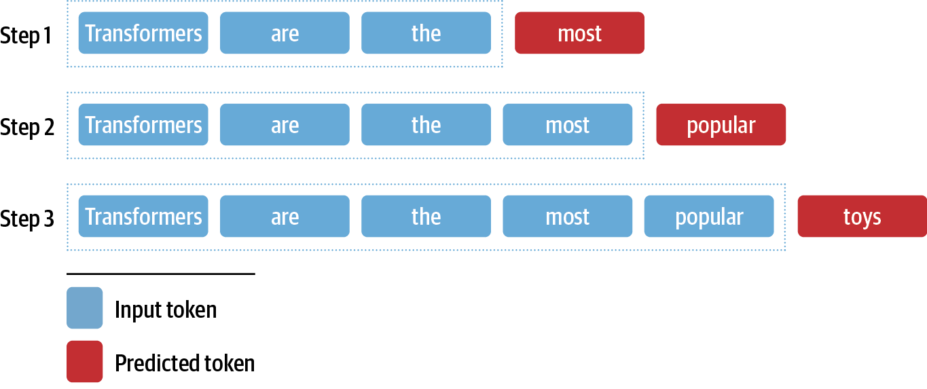
Summarization
Let's see if we can go beyond these natural language understanding tasks (NLU) where BERT excels and delve into the generative domain. Note that generation is much more computationally demanding since we usually generate one token at a time and need to run this several times.

Slide 52
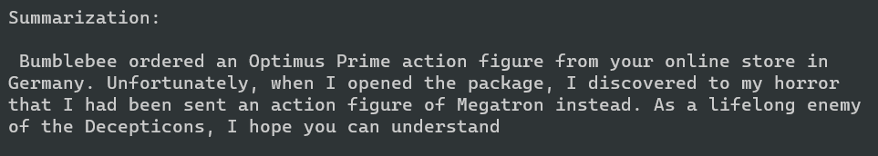
Summarization
summarization_pipeline = pipeline(
"summarization",
model="sshleifer/distilbart-cnn-12-6"
)
outputs = summarization_pipeline(
text,
max_length=60,
clean_up_tokenization_spaces=True
)
print("Summarization:\n")
print(outputs[0]["summary_text"])
Let's see if we can go beyond these natural language understanding tasks (NLU) where BERT excels and delve into the generative domain. Note that generation is much more computationally demanding since we usually generate one token at a time and need to run this several times.

Slide 53
Translation
translator = pipeline(
"translation_en_to_de",
model="Helsinki-NLP/opus-mt-en-de“
)
outputs = translator(
text,
clean_up_tokenization_spaces=True,
min_length=100
)
print(outputs[0]["translation_text"])
But what if there is no model in the language of my data? You can still try to translate the text. The Helsinki NLP team has provided over 1,000 language pair models for translation 🤯.

Slide 54
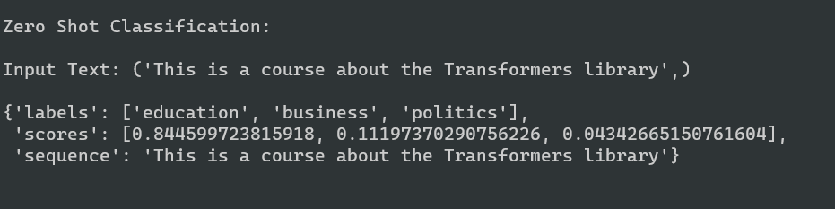
Zero-shot classification
zero_shot_classifier = pipeline(
"zero-shot-classification",
model="facebook/bart-large-mnli"
)
text = "This is a course about the Transformers library",
classes = ["education", "politics", "business"]
outputs = zero_shot_classifier(text, candidate_labels=classes)
print("Zero Shot Classification:\n")
print(f"Input Text: {text}\n")
print(outputs)
In zero-shot classification the model receives a text and a list of candidate labels and determines which labels are compatible with the text. Instead of having fixed classes this allows for flexible classification without any labelled data! Usually this is a good first baseline!

Slide 55
Cleanup models and datasets
You can delete your entire hugging face cache by just removing the cache directory.
rm –rf $HF_HOME
If you want to be more selective, try the command:
huggingface-cli delete-cache

Slide 56
Thanks
A great majority of the material from these slides was adapted from the open-source hugging face educational materials
https://huggingface.co/course
https://colab.research.google.com/github/huggingface/education-toolkit/blob/main/03_getting-started-with-transformers.ipynb
Other sources for figures and text are indicated throughout the slides.

Slide 57
Questions

