Slide 1
Frameworks
David Talby

Slide 2
Frameworks
“A reusable, semi-complete application that can be specialized to produce a custom application”
“A set of cooperating abstract and concrete classes that makes up a reusable design for a specific class of software”
An Object-Oriented Reuse Technique
  Design Reuse + Code Reuse

Slide 3
A Tiny Example: Calculators
interface Calculator
  getValue(), compute(Operator o), clear(), undo()
  Uses Command pattern, optionally Singleton
  Remembers parentheses, can iterate on their tree
interface Operator
  Descendants: UnaryOperator, BinaryOperator
  Concrete classes: Plus, Minus, Power, …
  Acts as Command class, supports Composites
interface VisualCalculator
  Observer on Calculator, can display operators on buttons, can display current computation tree
All are extendible, “Main” receives interfaces

Slide 4
Designing an OO Framework
Domain Knowledge
  What applications is the framework for?
  What is common to all of them?
Architecture
  Biggest, most critical technical decisions
  What is required besides classes?
Object-oriented design
  Design Reuse: Patterns
  Inversion of Control + Find right hooks

Slide 5
Domain Knowledge
a.k.a. Analysis or Modeling
Common “significant” decisions:
  Major concepts of the modeled domain
  Major operations
  Use cases: How users do common tasks
For example, a calculator
  Concepts: unary operator, binary operator, current value, in-memory value, shift key
  Operations: Clear, use operator, compute
  Use case: Computing an average of n numbers

Slide 6
Architecture
The set of significant decisions about the structure of software, the division to components and subsystems and their interfaces, and guidelines to composing them
Common “significant” decisions:
  Programming language, operating system, hardware
  Use of major external libraries or applications
  Physical Distribution, processes and threads
  Main Concepts: Kinds of modules and interfaces
  Communication and synchronization between modules
  Security Model
  Performance and scalability

Slide 7
For Example: JCA
Java Cryptography Architecture (JCA, JCE)
  Encryption, Digital Signatures, Key Management
  Open for new algorithms, new implementations
Main Concepts
  Provider: provides implementations for a subset of the Java Security API, identified by name
  Engine Classes: functionality for a type of crypto behavior, such as Signature and KeyPairGenerator
  Factory Methods: static methods in engine classes that return instances of them for a given algorithm
  Key Store: System identity scope

Slide 8
JCA II
Generating a public/private key pair:
  KeyPairGenerator keygen =
  KeyPairGenerator.getInstance(“DSA”, “MY_PROVIDER”);
  keygen.initialize(keySize, new SecureRandom(userSeed));
  KeyPair pair = keygen.generateKeyPair();
  Cast to DSAKeyPairGenerator is required to initialize it with algorithm-specific parameters (p,q,g)
Generating a signature:
  Signature sha = Signature.getInstance(“SHA-1”);
  PrivateKey priv = pair.getPrivate();
  sha.initSign(priv);
  byte[] sig = sha.sign();
  Provider is optional in getInstance()

Slide 9
JCA III
Although implementations will usually be non-Java, they must be wrapped in Java classes
Statically, add lines to java.security text file
  Security.providerName.n = com.acme.providerPackage
  n is the preference order of the provider, 1 is highest
Providers can be managed dynamically too:
  Class Security has addProvider(), getProvider()
  Class Provider has getName(), getVersion(), getInfo()
Providers must write a “Master class”
  Specifies which implementations are offered by it
  There are standard names for known algorithms

Slide 10
JCA IV: Summary
So what does the architecture answer?
  Domain Knowledge: What behavior (engine classes) should be supported at all?
  How are different algorithms and different implementations defined and selected?
  How should non-Java implementations be used?
  How can an administrator configure a key store and a trusted set of providers and implementations?
  How can commercial companies sell Java-compatible closed-source implementations of security features
Not only classes and interfaces
  Persistent key store, config files, non-Java code
  Practical, management and economic considerations

Slide 11
Inversion of Control
a.k.a. The Hollywood Principle
Don’t call us, we’ll call you
Benefits
  Code reuse: Flow of control is coded once
  Makes it clear when and how hooks are called
  Produces uniformity in program behavior, which makes it easier to understand
Drawbacks
  Debugging is more difficult
  Integrating two frameworks can be hard

Slide 12
Hooks
Hook = Hotspot = Plug-point
  Points where the FW can be customized
Design issues requiring domain knowledge
  How to find the right hooks?
  Few or many hooks?
  What should be the default behavior?
Implementation alternatives
  Template Method
  Strategy or Prototype
  Observer

Slide 13
Framework Colors
White-Box Frameworks
  Extended by inheritance from framework classes
  Template Method, Builder, Bridge, Abstract Factory
  Require intimate knowledge of framework structure
Black-Box Frameworks
  Extended by composition with framework classes
  Strategy, State, Visitor, Prototype, Observer
  More flexible, slightly less efficient
Gray-box Frameworks
  What usually happens in real life…

Slide 14
Framework Colors II
Frameworks tend to evolve to being black-box
AWT 1.0 had a white-box event model
  Each visual component had an handleEvent() method
  Each frame inherited and overrode it
  The method was a long switch statement
AWT 1.1 and Swing are black-box
  Observer pattern: UI components publish events to registered listeners
Why is black-box better?
  Separation of concerns: better abstractions
  Important for (automatic) code generation

Slide 15
Designing an OO Framework
Domain Knowledge
  What applications is the framework for?
  What is common to all of them?
Architecture
  Biggest, most critical technical decisions
  What is required besides classes?
Object-oriented design
  Design Reuse: Patterns
  Inversion of Control + Find right hooks

Slide 16
Application Domains
System Infrastructure
  Operating System Wrappers: MFC, MacApp
  Communication Protocols: RMI
  Database Access: ADO, JDO
  Security: JCA, JSA
User Interfaces
  SmallTalk-80 is the first widely used OOFW
  Swing, Delphi, MFC, COM…
  Integrated with development environments

Slide 17
Application Domains II
Middleware / Object Request Brokers
  Object Request Brokers: CORBA, COM+, EJB
  Web Services: .NET, Sun One
Enterprise Applications
  Enterprise = Critical to day-to-day work
  Usually developed inside organizations
  Notable Exception: IBM’s San-Francisco
  Telecomm, Manufacturing, Avionics, Finance, Insurance, Healthcare, Warehouses, Billing…

Slide 18
Framework Strengths
Reuse, Reuse, Reuse!
  Design + Code
Extensibility
  Enables the creation of reusable Components
Enforced Design Reuse
  An “Educational” Tool
Partitioning of Knowledge & Training
  Technical vs. Applicative Specialization

Slide 19
Framework Weaknesses
Development effort
  Generic frameworks are harder to design and build
  They are also hard to validate and debug
Maintenance
  Does the FW or the app need to change?
  Interface changes require updating all apps
Learning Curve
  Unlike class libraries, you can’t learn one class at a time
Integratibility of multiple frameworks
Efficiency
Lack of standards

Slide 20
There’s Big Money Involved
All “big players” develop and sell FWs
  So you must use our language (Swing)
  So you must use our operating system (MFC)
  So you must use our development tool (Delphi)
  So you must use our database (Oracle)
There’s a component industry too
  Companies that write and sell components
Frameworks are an economic necessity
  Unwise to develop UI, DB, ORB alone today

Slide 21
Frameworks:
Swing Case Study
David Talby

Slide 22
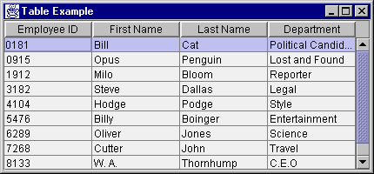
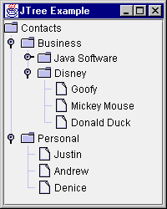
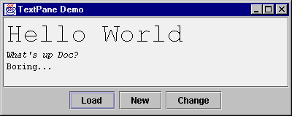
Swing
Java’s User Interface FW since JDK 1.2

Slide 23
The Problem
Hardware and operating system support primitive I/O operations
Drawing pixels and lines on the screen
  Class java.awt.Graphics has drawLine(), setColor(), fillRect(), setFont(), … methods
Receiving user input
  Reading file and device input streams
  Platform-dependent

Slide 24
The Problem II
Visual components are not reused
  Should be in standard library
  Look-and-feel should be consistent
  Easy to create / buy new visual components
Design of user interface is not reused
  Separating visual design, data structures, user input handling and applicative code
Code is not platform-independent
A lot of code & design is required

Slide 25
Swing Features
Wide variety of visual components
  Button, Label, List, Panel, Table, Tree, …
  Standard Dialog Boxes (Open, Save, Color, …)
Pluggable look-and feel
  Platform independence
  Dynamically changeable
MVC architecture
  Facilitates writing components or look-and-feels
Action objects
  Shared commands in toolbars and menus
  Generic Undo capability

Slide 26
Swing Features II
Keystroke Handling
  Global, form, container and component shortcuts
  Conflict management
Nested Containers
  Windows, Dialogs, Frames, Panels, Tables, …
  Virtually anything can be in anything, at any depth
Text Manipulation
  HTML and RTF editing (multi-font, colors, etc.)
Accessibility
  Alternative user interface support: Braille, sound…

Slide 27
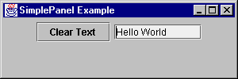
A Simple Form
The application will show this dialog box:
We’ll use JButton and JTextField
Inside a JPanel container
Inside a JFrame (a window container)
Whose main() method will run the show

Slide 28
The Simple Form Code
Step 1 is to subclass JPanel:
  class SimplePanel extends JPanel {
  JTextField textField;
  JButton button;
  public SimplePanel() {
  button = new JButton("Clear Text");
  add(button);
  textField = new JTextField(10);
  add(textField);
  button.addActionListener(new ActionListener() {
  public void actionPerformed(ActionEvent e) {
  textField.setText(""); } });
  } }

Slide 29
The Simple Form Code II
Step 2 is to subclass JFrame:
  public class SimplePanelTest extends JFrame {
  static final int WIDTH = 300;
  static final int HEIGHT = 100;
  SimplePanelTest(String title) {
  super(title);
  SimplePanel simplePanel = new SimplePanel();
  Container c = getContentPane();
  c.add(simplePanel, BorderLayout.CENTER);
  }

Slide 30
The Simple Form Code III
The same class also contains main():
  public static void main(String args[]) {
  JFrame frame =
  new SimplePanelTest("SimplePanel Example");
  frame.addWindowListener(new WindowAdapter() {
  public void windowClosing(WindowEvent e) {
  System.exit(0); }
  });
  frame.setSize(WIDTH, HEIGHT);
  frame.setVisible(true); } }
The framework takes over after main()

Slide 31
The Framework in Action
Inversion of Control
  Event loop is handled by a Swing thread
  Hardware- and OS-specific input formats are translated to standard interfaces
Hooks
  Building the visual controls is white-box style
  Registering to events is black-box style
Design Patterns
  Composite: JPanel.add(Component c)
  Observer: JButton.addActionListener(al)

Slide 32
Patterns in Swing
Command
  All text editors shared some commands (cut, paste)
  These are encapsulated in Action objects
  Each text components supports getActions()
  Action objects are globally shared, and are used on menu items, toolbars and shortcuts
Strategy
  The LookAndFeel interface has several heirs
  The UIManager singleton points to the current one
  It has methods to dynamically change look and feel

Slide 33
Patterns in Swing II
State
  JEditorPane is a visual editor that supports reading and writing files in multiple formats
  Each format is represented by an EditorKit that registers with the JEditorPane
  Upon reading a file, its format is used to select an EditorKit for it
  That kit is used to read, write, list actions, …
Prototype
  Editor Kits are created by cloning the prototype
  However, this is done by reflection on class name

Slide 34
Patterns in Swing III
Builder
  Editor Kits act as builders: their input is the hirarchical Document interface
  Their output is the View interface: has paint method,
  can layout, translate coordinates, …
Abstract Factory
  interface ViewFactory creates views
  Two heirs: HTMLViewFactory, BasicTextUI
  Another singleton
Factory Method
  Editor kits use factory methods to facilitate changing parser, view factory and default document

Slide 35
Patterns in Swing IV
Chain of Responsibility
  A KeyMap is a <KeyStroke,Action> map
  A text component has one or more Keymaps
  Custom Keymaps can be added and removed
  Keymap matching is by most-specific-first
Command
  Package javax.swing.undo offers UndoableEdit
  Also AbstractUndoableEdit and CompoundEdit classes
  Class UndoManager manages done commands
  Extends CompoundEdit - supports addEdit(), undo(), redo(), setLimit(), trimEdits(), undoTo(), redoTo(), …

Slide 36
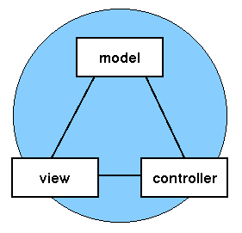
Model / View / Controller
The Basic User Interface Design Pattern
  Origin is SmallTalk-80, the first OOFW

Slide 37
MVC Participants
Model
  Data structure of displayed data
  Notifies observers on state change
View
  Paints the data on the screen
  Observer on its model
Controller
  Handles user input
  Changes model, which causes views to update

Slide 38
MVC Benefits
Three elements can be reused separately
Synchronized user interface made easy
  Multiple views observe one model
Models know nothing about presentation
  Easy to modify or create views
  Easy to dynamically change views
More efficient
  Shared models & controllers save memory
  Easy to maintain pools of views and models

Slide 39
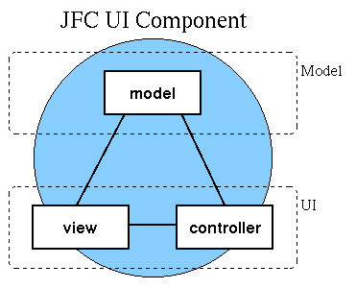
Document / View
View and Controller are often merged
  MFC: “Document” and “View”
  Swing (Text Editors): “Document” and “View”
  Swing (Components): “Model” and “UI”

Slide 40
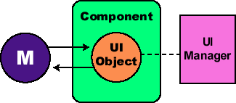
MVC Inside a Component
Each component is a façade for two objects
  Each components defines getModel() and getUI()
  Usually only one component per model and delegate
UIManager is a singleton
  Holds current look & feel properties
ComponentUI defines drawing interface
  javax.swing.plaf.* includes ButtonUI, SliderUI, …

Slide 41
Swing and MVC
There are several levels of using MVC
“Manually”, to synchronize complex views
  A file explorer, with a tree and current dir
In forms or complex components
  Custom form logic to synchronize its field
  A table or tree and its sub-components
  A variation of the Mediator design pattern
Event-handling at the application level

Slide 42
The Façade Pattern
A flexible framework becomes very complex
It is important to provide simple façades
JEditorPane class
  No need to know EditorKit & its subclasses, Document, Element, View, ViewFactory, KeyMap, …
JButton class
  No need to know ComponentModel, ComponentUI, UIManager, LookAndFeel, …
Provide users only with concepts they know
  Button, Window, Action, Menu
  X Document, ViewFactory, EditorKit

Slide 43
Other Features
Swing supports several other features that we don’t have time to cover:
  Drag & Drop
  Printing
  Internationalization
  Trees and Tables
  Menus & Popup menus
  Layout Management
Other standard Java graphic libraries:
  2D drawing, 3D drawing, Multimedia

Slide 44
Summary
Swing is a classic OOD framework
  Contains a lot of domain knowledge
  Highly customizable through design patterns
  Comes with a set of implemented components
  Also intended for writing new ones
  Inversion of control + hooks
It’s a medium-sized framework
  Several hundred classes and interfaces
  Plus free & commercial 3rd party components

