Slide 1
Components
David Talby

Slide 2
This Lecture
What Components Are
  With Demonstrations in Delphi
Common Object Model (COM)
  Creating and calling objects
  Distributed COM
Component-Oriented Software

Slide 3
Components
The Holy Grail of Software Engineering
Build software by connecting existing components in simple ways
“Beyond Object-Oriented Software”
  Small-scale success, large-scale failure
The three parts of industry-scale reuse
  A widely used object-oriented framework
  Developers building components for it
  Other developers using them to build apps

Slide 4
Using Components in Delphi
Visual Components
  Visual editors, containers, dialogs
  Use of properties, events, methods
Database Connectivity
  Non-visual components
  Delegation & Inheritance between components
Office Automation
  Visual & Non-Visual use
  Whole programs as components

Slide 5
Writing Components in Delphi
Writing Components
  Inheritance
  Use of properties, events, methods
3rd Party Components
  Tens of thousands of components
  Many are freeware or shareware
  www.torry.net and others
Delphi’s Framework
  Based on Object Pascal
  Can import components from COM, CORBA, COM+, EJB, Web Services
TObject
TPersistent
TComponent
TControl
TWinControl
TCustomListControl
TCustomCombo
TCustomComboBox
TComboBox

Slide 6
A Component’s Interface
A component’s interface has:
  Methods - like draw() and disconnect()
  Properties – like color and name
  (wrappers to getter and setter methods)
  Events – like onClick and onNetworkError
  (pointer to function or list of such pointers)
What about implementation?
  Completely unavailable to clients
  Can be one or many classes
  Can be in another language

Slide 7
Defining Components
Definition: a software component is a module with these properties:
  It can be used by other software modules, called clients (not just humans)
  Only its specification (interface) is required for clients to use it
  The clients and their authors do not need to be known to the component’s authors

Slide 8
Defining Components II
Usually there’s another property:
  It can be used within a visual designer tool
  To do so, it must be derived from the framework the tool supports
Commercial component frameworks
  COM (Visual Basic, Visual C++)
  JavaBeans (Eclipse, NetBeans, JBuilder)
  Delphi (Delphi)
  .NET (Visual Studio.NET)

Slide 9
Comparison of Reuse Techniques
Components are less abstract than frameworks
  Frameworks are incomplete applications: They compile, but they don’t run
  Components are usually framework-specific
  Frameworks make components possible
Frameworks are less abstract than patterns
  Include actual code, not just essays
  Specific to one programming language
  Specific to one application domain
  Many patterns came from successful FWs

Slide 10
COM: Common Object Model
Most widely used component FW on earth
Microsoft’s goals in the early 90’s
  Attracting developers to Windows
  Combining the speed and power of C++ with the ease of use of Visual Basic
  Versioning of Windows UI & Services
  OLE (Object Linking & Embedding) and
  Clipboard features in Office
COM introduced in 1995 as OLE 2.0

Slide 11

A Binary Standard
COM objects are used via interface pointers
Use by normal methods calls
COM is a binary standard for doing this:
  calling methods: calling convention, argument passing
  Common data types, marshalling
  Creating and destroying objects

Slide 12

Supporting Interfaces
An object can implement many interfaces
  All COM objects implement IUnknown
IUnknown defines QueryInterface()
  Cast to another interface by giving its ID
  Implementations can be changed dynamically
IUnknown also defines AddRef() and Release()
  COM manages memory by reference counting

Slide 13
Versioning
COM interfaces are logically immutable
  Change = New version of interface
  Not enforced, but required from developers
For example, each Office version is backward compatible to old interfaces:
  “Word.Application.7”, “Word.Application.8”, …
  Current (last) version is “Word.Application”
Windows UI is updated in the same way
  Buttons, Windows, Standard dialogs, …

Slide 14
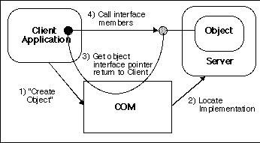
Creating Objects
Create objects using the Windows API
The Registry names a “server” – EXE or DLL – which contains the implementation
Object is created in server, and the “client” receives a pointer to it

Slide 15
Creating Objects II
An interface must be uniquely identified
  CoCreateInstance() receives a CLSID
  CLSID is a 128-bit globally unique identifier
  PROGID is easier: “Word.Application.10”
The Windows Registry
  \HKEY_CLASSES_ROOT\
  CLSID\
  {000209FF-0000-0000-C000-000000000046}\
  LocalServer32 = C:\Program Files\...\WINWORD.EXE
  Word.Application.10\
  CLSID = {000209FF-0000-0000-C000-000000000046}

Slide 16
Creating Objects III
COM “Servers”
  EXE or DLL file, with a server entry function
  DLL can be in-process or out-of-process
  Server can enquire client & context
  Request cannot specify an implementation
  OS manages DLLs and object pools
Consequences
  Requires operating system support
  A dynamic, very expensive operation
  Works on all versions of Windows since ‘95

Slide 17

Calling Methods
Simplest case: In-process DLL
  “Client” and “Server” in same process
Calls are dispatched using virtual tables
  Same as standard C++ (multiple inheritance)
  Calling convention is also same as in C/C++
  Should be as efficient as virtual methods
  In reality slower, due to less optimization

Slide 18
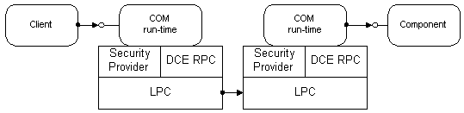
Calling Methods II
The COM object can be in a different process
  If it’s implemented in an EXE or out-of-process DLL
  Less efficient calls
  Shared data between clients
  Failure of either process won’t terminate the other

Slide 19
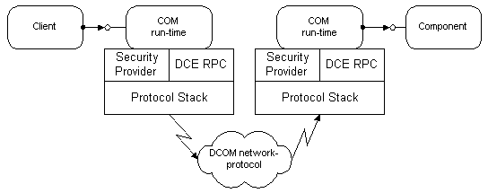
Calling Methods III
The COM object can be in a different machine
  This is DCOM: Distributed COM
  Transparent: Add network location in Registry
  Each method call is very expensive

Slide 20
Language Support
Any language can use COM objects
  And can be used for writing such objects
Each language has a syntax for interfaces
  class in C++, interface in Delphi and Java
Compiler Support Required
  Handle COM method calls transparently
  Replace creation operator by CoCreateInstance()
  Replace casting with QueryInterface()
  Call AddRef() and Release() in = operator code
  Wrap returned error codes with exceptions

Slide 21
Defining COM Interfaces
Microsoft Interface Definition Language
  Interface names, CLSID and properties
  Method names, argument names and types
  Properties & events have a special syntax
  Data Types: Primitives, arrays, COM objects
  ‘in’ and ‘out’ parameters, and other settings
MIDL Compiler
  Produces “Type Libraries” (*.TLB Files)
  Used by compilers & tools that support COM

Slide 22
Writing a COM Server
Start a new “COM Server” project
  Development tool generates code for server entry, register and unregister functions
  Development tool generates empty IDL file
Define interfaces and implement them
  Define interface in IDL (or visual tool)
  Implement in your favorite language
Build the DLL or EXE
  Then use regsvr32.exe to register it

Slide 23
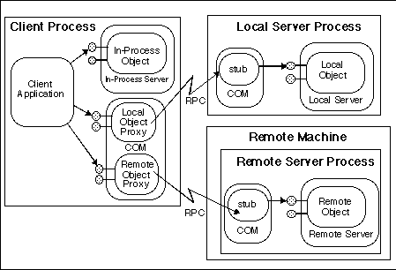
Calling Methods Summary

Slide 24
Distributed COM
DCOM is COM’s extension to networks
Location Transparency
Language Neutrality
Simple, two-way connection model
  Easier than a custom socket-based protocol
Connection Management
  Shared connection pool between clients
Distributed garbage collection
  Efficient ping: per machine, groups all remote object IDs, and piggy-backed on messages

Slide 25
Distributed COM II
Scalability
  Thread pool, multi-processing
Protocol Neutrality: UDP, TCP, others
Flexible deployment & redeployment
  No server downtime during redeployment
  Exploits COM’s support for versioning
Referral: passing remote references
  A directory of waiting remote chess players
  A load-balancing broker component
  DCOM automatically short-circuits middleman

Slide 26
Distributed COM III
Security
  Transparent: NT’s basis & online admin tool
  Can also be programmatic
  Any NT security provider – supports encryption and many authentication protocols
Distributed Components
  Injecting server code into the client side
  An infrastructure for load balancing and fault tolerance (hot failover, recovery cache)
  Used by MTS for distributed transactions

Slide 27
DCOM Design Issues
Each method call is very expensive
  Violate command-query separation to minimize network round-trips (=method calls)
  Also useful for ordinary COM objects
Stateless components are more scalable
Transparent proxy & stub model is also useful when objects are a different:
  Thread
  Security Context
  Transaction Context

Slide 28
COM Based Technologies
All ’90s MS technologies for software developers are based on COM
  Tied to the Windows platform
  Efficient, scalable, language neutral
A few examples
  ActiveX: “applications” inside web browsers
  MTS and COM+: Transaction services
  VBA and Windows Scripting
  DirectX, Internet Explorer, ODBC & ADO, ...

Slide 29
The Competition: JavaBeans
The Java Component Model
  Component = Can be used in a visual designer
  A component is a Java class
  With a default constructor
Relies heavily on reflection
  Property = defined by getAbc() and setAbc()
  Event = same as Swing’s event model
With added information in java.beans.*
  Names, version, company, …

Slide 30
Summary: Back to Basics
What is a component?
  A software module that can be used by
  other modules, knowing only its interface
  Written “inside” a framework
  Can usually be inserted into a visual designer
Components are key to large-scale reuse
  Delphi, COM, JavaBeans reuse is a success
  Object-oriented methods alone aren’t
  A few leading frameworks lead the industry
  Write your software as components!

