Slide 1
Intro to Software Engineering
Extreme Programming
Course Summary
David Talby

Slide 2
This Lecture
Introduction to Software Engineering
  The Software Crisis
  Methodologies
Extreme Programming
  Agile Development Principles
  XP Practices
Software Architectures
Course Summary

Slide 3
The Software Crisis
75% of the enterprise software products are considered to be a failure – they are not in use or do not fit customer’s requirements
Software errors cost US economy $59.5 billion annually (In Q2 of 2003 – investments of $200 billion in software development)
Based on: Mullet, D. (July, 1999). The Software Crisis, Benchmarks Online - a monthly publication of Academic Computing Services 2(7).
The National Institute of Standards and Technology (NIST), New Release of June 28, 2002.

Slide 4
The Software Crisis II
Small software projects take on average 100% more time and resources than planned
Large projects are one year late on average
Periods of excessive time pressure occur in 75% of large projects
60% of programmers report excessive time pressure
Based on: Standish Group, ‘94
Based on: Jones, ‘94
Based on: Glass, ‘94 and Jones, ‘94

Slide 5
The Software Crisis III
In Words
  Most software is totally unusable
  Most software is buggy, unstable and insecure
  Most software development plans are unreliable
  Yet, software runs the world

Slide 6
What is Software Engineering?
Repeatability
  Ability to do a similar project again well
  Same time, budget, quality are expected

Slide 7
What is Software Engineering? II
Methodology
  Well-defined roles: Architect, Engineer, Tester, Deployer, …
  Well-defined products: Designs, Specs, Code, Test scenarios, …
  Standard workflow of how things are done

Slide 8
What is Software Engineering? III
Legal Liability
  Both Civil and Criminal
  Certification required for life-critical issues
  Methodology & Notation are laws

Slide 9
State of the Software World
Large Scale
  Lack of repeatability, even for small projects
  Inability to provide quality software
  No standard definition of roles & products
  No standard for requirements, design, tests, …
  It’s a “wild west” profession
Small Scale
  Developers don’t produce working software
  Developer tools are also far from perfect

Slide 10
Development Methodologies
A methodology describes
  An entire life cycle of a software product
  Roles, Products, Workflow
  Best Practices
Classic methodologies: Linear
  Linear/Incremental: Waterfall model
  Iterative: Rational Unified Process
Modern methodologies: Agile
  Adaptive
  Extreme

Slide 11
Rational Unified Process
By Rational, see rational.com/rup
Iterative Development
Decompose large system to sub-systems
  A team and development effort per system
  Architects Team does overall design, sharing
Five stages of each system’s life cycle
  Business modeling, Requirements, Analysis & Design, Implementation, Test
  Many artifacts are not code or tests
Highly managed, highly automated process

Slide 12
Extreme Programming
Slides courtesy of
Yael Dubinsky

Slide 13
The Agile Manifesto
Individuals and interactions over processes and tools
Working software over comprehensive documentation
Customer collaboration over contract negotiation
Responding to change over following a plan
That is, while there is value in the items on
the right, we value the items on the left more.
http://agilemanifesto.org/

Slide 14
Agile Software Development Methods
Adaptive
Crystal
DSDM
Extreme Programming
FDD
Lean Development
Scrum
All acknowledge
that the main issue
of software
development is
people:
customers,
communication

Slide 15
What is Extreme Programming?
Extreme Programming emerged by software practitioners
Differences from traditional methodologies
  Emphasis on people vs. development activities & schedule
12 practices
4 values: feedback, simplicity, communication, courage
The meaning of ‘Extreme’
“XP is a lightweight, efficient, low-risk, flexible, predictable, scientific, and fun way to develop software.” Beck, 2000
“XP is about social change.” Beck, 2nd edition, 2005
Beck, K. (2000). Extreme Programming explained, Addison Wesley.

Slide 16
Why XP?
Survey:
  31 XP/Agile-methods early adopter projects
  14 firms
  Findings:
    Cost reduction: 5-7% on average
    Time to market compression: 25-50% reduction
Reifer, D. (2002). How to get the most out of Extreme Programming/Agile
methods? Proceedings of the XP/Agile Universe 2002, pp. 185-196.

Slide 17
How XP? - Project Timetable:
1 release (2 months), 4 iterations (2 weeks each)
Business Day
Business Day
Week 1, Release 1, Iteration 1 | Week 2, Release 1, Iteration 1 | Week 3, Release 1, Iteration 2 | Week 4, Release 1, Iteration 2
Week 5, Release 1, Iteration 3 | Week 6, Release 1, Iteration 3 | Week 7, Release 1, Iteration 4 | Week 8, Release 1, Iteration 4
Release 2 starts
Business Day
Business Day
Business Day

Slide 18

Business Day
On-site customer
Planning game
Small releases
Simple design
Metaphor
Source: http://www.rolemodelsoftware.com/

Slide 19

Development Day
Stand-up meeting
The development environment
Pair programming
Testing (Test Driven Development)
Code standards
Refactoring
Simple design
Continuous integration
Collective ownership
Sustainable pace
Source: http://www.rolemodelsoftware.com/

Slide 20
Extreme Programming Practices
Code/Technical Perspective | Human/Social Perspective
Refactoring Simple design Coding standards Testing Continuous integration Small releases | Collective ownership Pair programming Sustainable pace On-site customer Planning game Metaphor

Slide 21
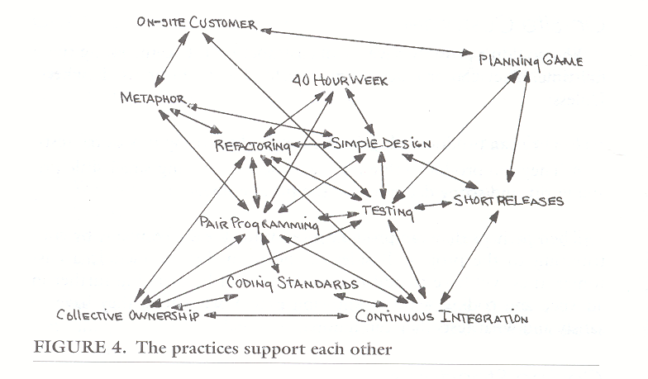
XP practices support each other
Note:
nothing is new; gathering the practices together is XP uniqueness
Beck, K. (2000). eXtreme Programming explained, Addison Wesley.

Slide 22
Agile/XP in Practice: Conceptual Changes
XP encourages changes in culture:
  Cooperation (vs. knowledge-is-power)
  Simplicity (vs. habit-of-increase-complexity)
  Change in work habits
  Change in customer’s conception, involvement and relationships with the software team
Therefore, XP is not easy to implement
  Match to project and team must be verified

Slide 23
Summary
Writing Software ≠ Delivering Products
  Requirements, Architecture, Design, Code, Integrate, Test, Deploy, Maintain, Update
The Software Crisis
Beware of which process you work in

Slide 24
Software Architectures and
Course Summary
David Talby

Slide 25
Why Object Oriented Design?
Software Today
  < 20% of existing code is Object-Oriented
  > 90% of new code is Object-Oriented
  Reuse: Libraries, Components, Web Services
  Major Frameworks/Platforms: Java and .NET
  A lot developed on non-traditional platforms

Slide 26
Selected Topics
Programmer’s Day-to-Day Skills
  Design Patterns
  Tools and work habits
  Language features
Prepare for the future
  Framework and components
  Development methods
And now to a few subjects we didn’t cover…

Slide 27
Platforms
Cellular Phones
  J2ME, Windows Mobile
Enterprise Application Servers
  J2EE, .NET
Web Applications
  JSP + Additions, ASP.NET
Small Devices
  Palm Pilot, Windows CE, PlayStation
Media Centers

Slide 28
Platforms II
Rich Client Web Applications
  AJAX, Struts, …
Workflows & Business Process Management
  Oracle BPEL
  Microsoft WWF
  Business Rule Engines
Office
  Tools for Office
  Smart Documents

Slide 29
Frameworks
Desktop Search Engines
  Architecture, API
Development Platforms
  Eclipse, Net Beans, Visual Studio
Database Access
  JDO, Hibernate, ADO.NET
Game Development
  OpenGL, DirectX, Graphic Engines
Enterprise Portals
  SharePoint, IBM

Slide 30
Frameworks II
Security
  Identity Management (JAAS, LDAP, Biometrics)
  Digital Rights Management
  Mal-ware: Classification, Constructions, Detection
Remote Monitoring & Management
Google
  Site Search, AdSense, …
UI Component Frameworks
  Delphi vs. Swing vs. .NET
Web Services (WSE 3.0, …)

Slide 31
Development Tools
Model Driven Development
  UML Based (Together, …)
  DSL Based (Visual Studio, …)
Code Generation
Testing
  Automatic unit and acceptance testing
  Load testing
Open Source
Team Development Tools
  Configuration Control, Defect Tracking, …

Slide 32
A few final words…
Use this material
Keep learning
Keep in touch
and Good Luck!

