Slide 1
Object Oriented Design
David Talby

Slide 2
Contents
Introduction
UML
  Use Case Diagrams
  Interaction Diagrams
  Class Diagrams
Design Patterns
  Composite

Slide 3
Welcome!
Course Goals
  For Software Professionals
  Know the Problems
  Learn a Toolbox
  Go Mainstream
  Hands-on Experience

Slide 4
The Big Problem
Most software projects don’t deliver
  Size
  Complexity
  Change
  Teamwork
  Diversity
This affects (our) careers and lives

Slide 5
Course Material
Material = Current Best Practices
  Mainstream solutions for programmers
Object Oriented Design & Patterns
Tools
Programming Techniques
Frameworks and Components

Slide 6
Course Structure
Material
  Class and exercise lectures
  On-line slides, Resources
  Reception Hour
Practical Exercises
  Design, Code, Experiment with Tools
Theoretical Exercises
Final Exam

Slide 7
Contents
Introduction
UML
  Use Case Diagrams
  Interaction Diagrams
  Class Diagrams
Design Patterns
  Composite

Slide 8
UML
Unified Modeling Language
  Standard for describing designs
  Visual: a set of diagrams
Unifies entire design process:
  Use Cases for requirements
  Static class diagrams
  Object & Interaction diagrams
  Components, Packages, …

Slide 9
Use Cases
A Use case is a narrative document that describes the sequence of events of an actor using a system to complete a process.
A use case diagram visualizes relationships between a system’s use cases and actors

Slide 10
Use Case Document
Name: Sell Item
Initiator: Customer
Type: Primary, Required
Actions: 1. Customer asks for X
2. Sales clerk checks if X
is in stock
3. …
Error Case A: if … then …

Slide 11
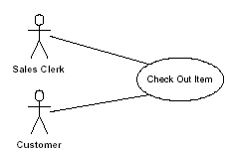
Use Case Diagram
Actors participate in use cases
Use cases use or extend others

Slide 12
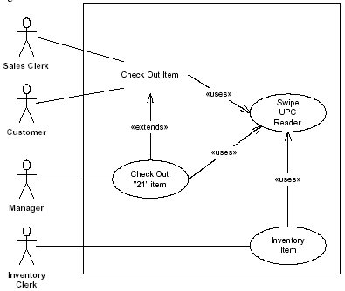
Use Case Diagram II

Slide 13
Sequence Diagrams
A sequence diagram visualizes an ordered interaction between objects, by showing the messages sent between them.
One way to start a design is:
  Translating a UC to a sequence
  Turn its actions to messages

Slide 14
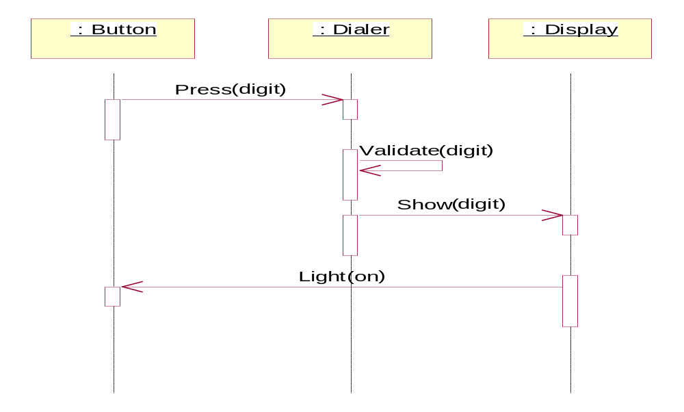
A Sequence Diagram

Slide 15
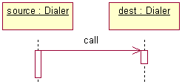
Sequence Diagrams II
Good time-line visualization
Supports messages to self
Supports object of same class:

Slide 16
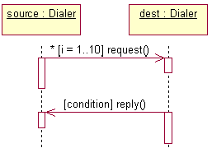
Sequence Diagrams III
Supports conditions and loops:

Slide 17
Collaboration Diagrams
Another visual way to show the same information that a sequence diagram shows
Uses numbering of messages instead of a timeline
Both diagrams are also called interaction diagrams

Slide 18
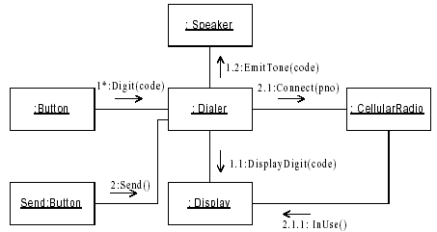
Collaboration Diagrams

Slide 19

Collaboration Diagrams
Good object-centric view
Identical to Sequence diagrams
  Loops, conditions, arguments
  Automatic translation possible

Slide 20
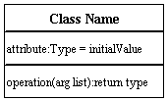
Class Diagrams
Class diagrams show the static picture of the system’s classes
And relationships between them

Slide 21
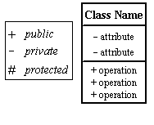
Diagramming a Class
All Additions are optional
  Types and argument lists
  Initial values and constants

Slide 22

Dependency
Class A requires B to compile
Creates it (Instantiates)
  Gets an argument

Slide 23
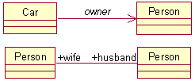
Association
Class A points to a B object
  Can be Uni- or Bi-Directional
  Each role can be named

Slide 24

Aggregation
Class A contains a list of B’s
  But B’s can exist without A’s
  Can be Uni- or Bi-Directional
  Can be numbered

Slide 25

Composition
Class A contains a list of B’s
  B’s are destroyed with their
  container A is destroyed
  Can be Uni/Bi-Di, Numbered

Slide 26
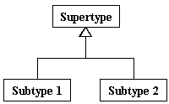
Inheritance
Class A inherits from class B

Slide 27
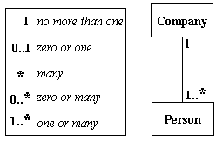
Numbering
Association, Aggregation and Composition can constraint lists

Slide 28
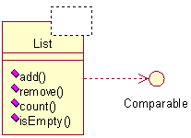
Templates & Interfaces
Both are supported
T

Slide 29
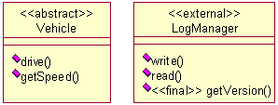
Stereotypes
Attributes of classes or methods
  Standard: Interface, Abstract
  Can be project-specific

Slide 30
Package Diagrams
Organize a system’s elements into related groups to minimize dependencies between them
Provides a high-level view
A UML package is analogous to
  a Java package
  a C++ namespace

Slide 31
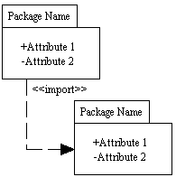
Package Diagrams II

Slide 32
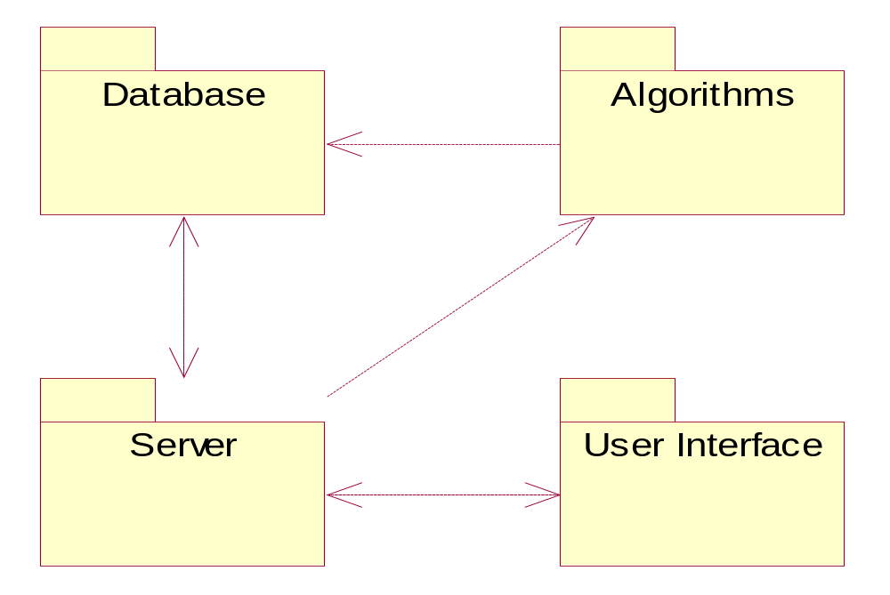
Package Diagrams III

Slide 33
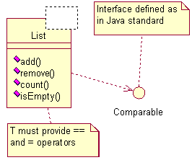
UML Notes
Can be attached to anything
T

Slide 34
Other UML Diagrams
State diagrams illustrate the states of a system or an object, and events that cause state transitions
Component diagrams show compiler and runtime dependencies between components.
Deployment diagrams show the distribution of processes and components to processing nodes.
UML is a large standard

Slide 35
Contents
Introduction
UML
  Use Case Diagrams
  Interaction Diagrams
  Class Diagrams
Design Patterns
  Composite

Slide 36
Design Patterns
O-O Design is Hard
Errors are expensive
Reuse experts’ designs
Pattern = Documented experience

Slide 37
Expected Benefits
Finding the right classes
Finding them faster
Common design jargon
Consistent format
Coded infrastructures

Slide 38
O-O Programming
An interface is a contract to clients.
A class implements interface(s).
Objects are instances of classes.
Objects are only accessed through their public interfaces.
Only two relations between classes: Inheritance and composition

Slide 39
Object Relationships
Inheritance: Static and efficient, but exposes and couples modules
Composition: Hides more from client and can change dynamically
Gang of Four:
“Favor composition over inheritance”
Dijkstra: “Most problems in computer science can be solved by another level of indirection”

Slide 40
Designing for Change
The Open-Closed Principle
The Single-Choice Principle
Non-clairvoyance
Key Issue: Prepare for change!
Well, prepare for what?

Slide 41
Causes of Redesign
Dependence on hardware or software platform
Dependence on representation or implementation
Specifying a class upon creation
Algorithmic dependence
Tight coupling
Overuse of inheritance
Inability to alter classes easily

Slide 42
Pattern Categories
Creational - Replace explicit creation problems, prevent platform dependencies
Structural - Handle unchangeable classes, lower coupling and offer alternatives to inheritance
Behavioral - Hide implementation, hides algorithms, allows easy and dynamic configuration of objects

Slide 43
Pattern of Patterns
Encapsulate the varying aspect
Interfaces
Inheritance describes variants
Composition allows a dynamic choice between variants
Criteria for success:
Open-Closed Principle
Single Choice Principle

Slide 44
Contents
Introduction
UML
  Use Case Diagrams
  Interaction Diagrams
  Class Diagrams
Design Patterns
  Composite

Slide 45
1. Composite
A program must treat simple and complex objects uniformly
For example, a painting program has simple objects (lines, circles and texts) as well as composite ones (wheel = circle + six lines).

Slide 46
The Requirements
Treat simple and complex objects uniformly in code - move, erase, rotate and set color work on all
Some composite objects are defined statically (wheels), while others dynamically (user selection)
Composite objects can be made of other composite objects
We need a smart data structure

Slide 47
The Solution
All simple objects inherit from a common interface, say Graphic:
class Graphic {
void move(int x, int y) = 0;
void setColor(Color c) = 0;
void rotate(double angle) = 0;
}
The classes Line, Circle and others inherit Graphic and add specific features (radius, length, etc.)

Slide 48
The Solution II
This new class inherits it as well:
class CompositeGraphic
: public Graphic,
public list<Graphic>
{
void rotate(double angle) {
for (int i=0; i<count(); i++)
item(i)->rotate();
}
}

Slide 49
The Solution III
Since a CompositeGraphic is a list, it had add(), remove() and count() methods
Since it is also a Graphic, it has rotate(), move() and setColor() too
Such operations on a composite object work using a ‘forall’ loop
Works even when a composite holds other composites - results in a tree-like data structure

Slide 50
The Solution IV
Example of creating a composite:
CompositeGraphic *cg;
cg = new CompositeGraphic();
cg->add(new Line(0,0,100,100));
cg->add(new Circle(50,50,100));
cg->add(t); // dynamic text graphic
cg->remove(2);
Can keep order of inserted items if the program needs it

Slide 51
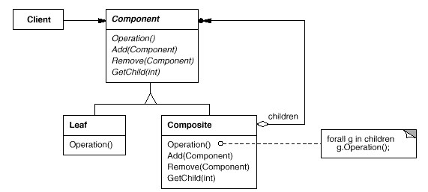
The GoF UML
Single Inheritance
Root has add(), remove() methods

Slide 52
The Fine Print
Sometimes useful to let objects hold a pointer to their parent
A composite may cache data about its children (count is an example)
Make composites responsible for deleting their children
Beware of circles in the graph!
Any data structure to hold children will do (list, array, hashtable, etc.)

Slide 53
Known Uses
In almost all O-O systems
Document editing programs
GUI (a form is a composite widget)
Compiler parse trees (a function is composed of simpler statements or function calls, same for modules)
Financial assets can be simple (stocks, options) or a composite portfolio

Slide 54
Pattern of Patterns
Encapsulate the varying aspect
Interfaces
Inheritance describes variants
Composition allows a dynamic choice between variants
Criteria for success:
Open-Closed Principle
Single Choice Principle

