Slide 1
Design Patterns
David Talby

Slide 2
Contents
Representing Data Structures
  Composite
  Flyweight
  Decorator
Traversing Data Structures
  Iterator
  Visitor

Slide 3
Design Patterns – Reminder
Documented Proved Design Experience
  Finding the right classes
  Finding them faster
  Common design jargon
  Consistent format
  Coded infrastructures
Criteria for Success
  Open-Closed Principle
  Single Choice Principle

Slide 4
1. Composite
A program must treat simple and complex objects uniformly
For example, a painting program has simple objects (lines, circles and texts) as well as composite ones (wheel = circle + six lines).

Slide 5
The Requirements
Treat simple and complex objects uniformly in code - move, erase, rotate and set color work on all
Some composite objects are defined statically (wheels), while others dynamically (user selection)
Composite objects can be made of other composite objects
We need a smart data structure

Slide 6
The Solution
All simple objects inherit from a common interface, say Graphic:
class Graphic {
void move(int x, int y) = 0;
void setColor(Color c) = 0;
void rotate(double angle) = 0;
}
The classes Line, Circle and others inherit Graphic and add specific features (radius, length, etc.)

Slide 7
The Solution II
This new class inherits it as well:
class CompositeGraphic
: public Graphic,
public list<Graphic>
{
void rotate(double angle) {
for (int i=0; i<count(); i++)
item(i)->rotate();
}
}

Slide 8
The Solution III
Since a CompositeGraphic is a list, it had add(), remove() and count() methods
Since it is also a Graphic, it has rotate(), move() and setColor() too
Such operations on a composite object work using a ‘forall’ loop
Works even when a composite holds other composites - results in a tree-like data structure

Slide 9
The Solution IV
Example of creating a composite:
CompositeGraphic *cg;
cg = new CompositeGraphic();
cg->add(new Line(0,0,100,100));
cg->add(new Circle(50,50,100));
cg->add(t); // dynamic text graphic
cg->remove(2);
Can keep order of inserted items if the program needs it

Slide 10
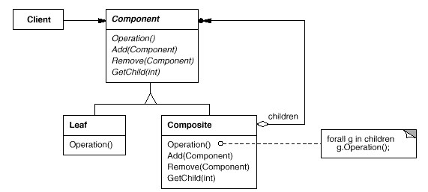
The GoF UML
Single Inheritance
Root has add(), remove() methods

Slide 11
The Fine Print
Sometimes useful to let objects hold a pointer to their parent
A composite may cache data about its children (count is an example)
Make composites responsible for deleting their children
Beware of circles in the graph!
Any data structure to hold children will do (list, array, hashtable, etc.)

Slide 12
Known Uses
In almost all O-O systems
Document editing programs
GUI (a form is a composite widget)
Compiler parse trees (a function is composed of simpler statements or function calls, same for modules)
Financial assets can be simple (stocks, options) or a composite portfolio

Slide 13
Pattern of Patterns
Encapsulate the varying aspect
Interfaces
Inheritance describes variants
Composition allows a dynamic choice between variants
Criteria for success:
Open-Closed Principle
Single Choice Principle

Slide 14
Contents
Representing Data Structures
  Composite
  Flyweight
  Decorator
Traversing Data Structures
  Iterator
  Visitor

Slide 15
A Word Processor
Pages, Columns, Lines, Letters, Symbols, Tables, Images, ...
Font and style settings per letter
Frames, Shadows, Background, Hyperlink attached to anything
Unlimited hierarchy: Tables with several Paragraphs containing hyper-linked images inside tables
Should be open for additions...

Slide 16
A Data Structure
First, a uniform interface for simple things that live in a document:
class Glyph
{
void draw(Window *w) = 0;
void move(double x, double y) = 0;
bool intersects(Point *p) = 0;
void insert(Glyph *g, int i) = 0;
void remove(int i) = 0;
Glyph* child(int i) = 0;
Glyph* parent() = 0;
}

Slide 17
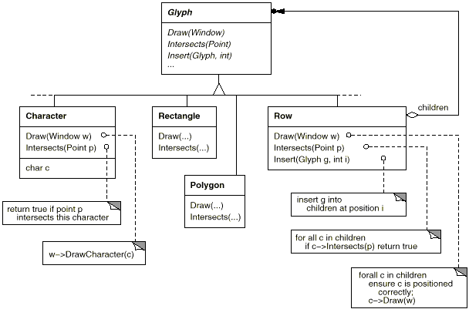
Composite Documents

Slide 18
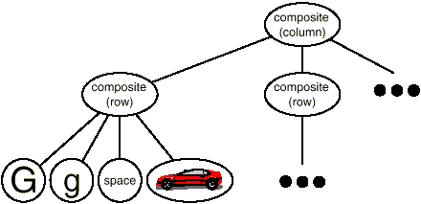
At Runtime
Unlimited Hierarchy problem solved
Dynamic selection of composites
Open for additions

Slide 19
2. Flyweight
Use sharing to support a large number of small objects efficiently
For example, if every character holds font and style data, a long letter will require huge memory
Even though most letters use the same font and style
How do we make it practical to keep each character as an object?

Slide 20
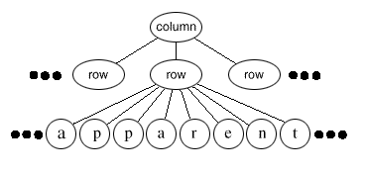
The Requirements
Reduce the memory demands of having an object per character
Keep the flexibility to customize each character differently

Slide 21
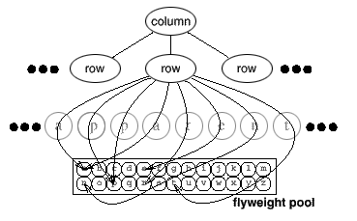
The Solution
Intrinsic state = worth sharing
Extrinsic state = not worth sharing

Slide 22
The Solution II
Put extrinsic state in a class:
class CharacterContext {
Font* font;
bool isItalic, isBold, ...;
int size;
int asciiCode;
// many others…
draw(int x, int y) { ... }
// other operational methods
}

Slide 23
The Solution III
Original class holds rest of state:
class Character : public Glyph {
CharacterContext *cc;
int x, y;
draw() {
cc->draw(x,y);
}
}

Slide 24
The Solution IV
A factory manages the shared pool
It adds the object to the pool if it doesn’t exists, and returns it
Here’s Character’s constructor:
Character(int x, int y, Font *f, …) {
this->x = x;
this->y = y;
this->cc =
factory.createCharacter(f, …);
}

Slide 25
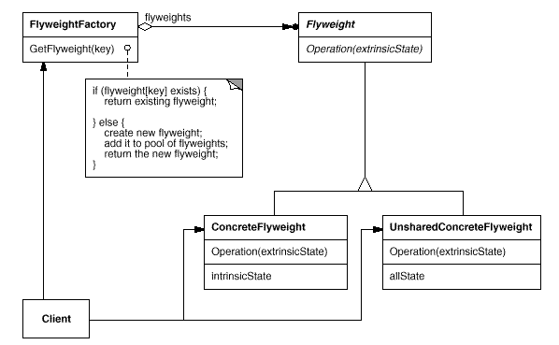
The UML

Slide 26
The Fine Print
There’s a lot of tradeoff in what is defined as “extrinsic”
Shared pool is usually a hash table
Use reference counting to collect unused flyweights
Don’t rely on object identity
  Different objects will seem equal

Slide 27
Known Uses
Word processors
  Average 1 flyweight per 400 letters
Widgets
  All data except location, value
Strategy design pattern
State design pattern

Slide 28
Contents
Representing Data Structures
  Composite
  Flyweight
  Decorator
Traversing Data Structures
  Iterator
  Visitor

Slide 29
3. Decorator
Attach additional features to an object dynamically
For example, many features can be added to any glyph in a document
  Background, Note, Hyperlink, Shading, Borders, …

Slide 30
The Requirements
We can freely combine features
  An image can have a background,
  a border, a hyper-link and a note
Features are added and removed dynamically
Can’t afford a class per combination
Should be easy to add new features
  Don’t put it all in Glyph

Slide 31
The Solution
Meet Decorator, a class for adding responsibilities to another glyph:
class Decorator : public Glyph
{
void draw() {
component->draw();
}
// same for other features
private:
Glyph *component;
}

Slide 32
The Solution II
Define concrete decorators:
class BackgroundDecorator
: public Decorator
{
void draw() {
drawBackground();
glyph->draw();
}
}

Slide 33
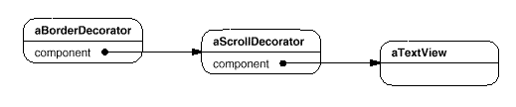
The Solution III
Many decorators can be added and removed dynamically:
Behavior can be added before and after calling the component
Efficient in space
Order of decoration can matter

Slide 34
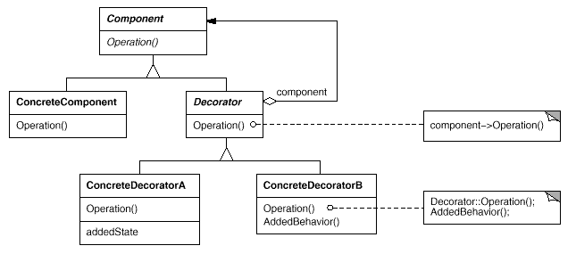
The UML

Slide 35
The Fine Print
The Decorator class can be omitted if there’s only one decorator or Glyph is very simple
The Glyph class should be lightweight and not store data

Slide 36
Known Uses
Embellishing Document
  Background, Border, Note, ...
Communication Streams
  Encrypted, Buffered, Compressed

Slide 37
Data Structure Summary
Patterns work nicely together
  Composite, Decorator, Flyweight don’t interfere
Data structures are not layered
  Instead, clients work on a Glyph interface hiding structures of unknown, dynamic complexity

Slide 38
Saving and Loading
Each Glyph should have “deep” read() and write() methods
Save to disk / Send over network by simply writing the root Glyph object of a document
All optimizations saved as well!
Also works on subtrees
Little coding

Slide 39
Cut, Copy, Paste
Cut = Detach a subtree
Copy = Clone a subtree
Paste = Attach a subtree
Also works on composite glyphs
Glyphs should hold a reference to parents for the cut operations
Cloning of a flyweight should only increase its reference count!

Slide 40
Contents
Representing Data Structures
  Composite
  Flyweight
  Decorator
Traversing Data Structures
  Iterator
  Visitor

Slide 41
4. Iterator
Traverse a data structure without exposing its representation
An extremely common pattern
For example, a list should support forward and backward traversals
  Certainly not by exposing its internal data structure
Adding traversal methods to List’s interface is a bad idea

Slide 42
The Requirements
Traversal operations should be separate from List<G>’s interface
Allow several ongoing traversals on the same container
Reuse: it should be possible to write algorithms such as findItem that work on any kind of list

Slide 43
The Solution
Define an abstract iterator class:
class Iterator<G> {
void first() = 0;
void next() = 0;
bool isDone() = 0;
G* item() = 0;
}

Slide 44
The Solution II
Each data structure implementation will also implement an iterator class:
  ListIterator<G>
  HashTableIterator<G>
  FileIterator<G>
  StringIterator<G>
Each data structure can offer more than one iterator:
  Forward and backward iterators
  Preorder, inorder, postorder

Slide 45
The Solution III
For example:
class BackwardArrayIterator<G>
: public Iterator<G>
{
Array<G> *container;
int pos;
public:
BackwardArrayIterator(Array *a)
{ container = a; first(); }
next()
{ --pos; }
// other methods easy
}

Slide 46
The Solution IV
A data structure’s interface should return iterators on itself:
class List<G>
{
Iterator<G>* getForwardIterator()
{ return new
ListForwardIterator(this); }
Iterator<G>* getBackwardIterator()
// similarly
}
Now every LinkedList object can have many active iterators

Slide 47
The Solution V
Writing functions for containers:
void print(Iterator<int>* it)
{
for (it->first();
!it->isOver();
it->next())
cout << it->item();
}
Using them:
print(myList->getBackwardIterator());
print(myTable->getColumnItr(“Age”));
print(myTree->getPostOrderIterator());

Slide 48
The Solution VI
Generic algorithms can be written:
G* findItem(Iterator<G>* it,
G *element)
{
while (!it->isOver())
{
if (it->item() == element)
return element;
it->next();
}
return NULL;
}

Slide 49
The Requirements II
Some iterators are generic:
  Traverse every n’th item
  Traverse items that pass a filter
  Traverse only first n items
  Traverse a computed view of items
Such iterators should be coded once
It should be easy to combine such iterators and add new ones
Their use should be transparent

Slide 50
The Solution
Use the Decorator design pattern
For example, FilteredIterator<G> receives another iterator and the filtering function in its constructor
It delegates all calls to its internal iterator except first() and next():
void next() {
do it->next()
while (!filter(it->item() &&
!it->isOver());
}

Slide 51
The Solution II
It is then easy to combine such generic iterators
Print square roots of the first 100 positive elements in a list:
print(new LimitedIterator(100,
new ComputedIterator(sqrt,
new FilteredIterator(positive,
list->getForwardIterator()))));
Adding an abstract DecoratorIterator reduces code size if many exist

Slide 52
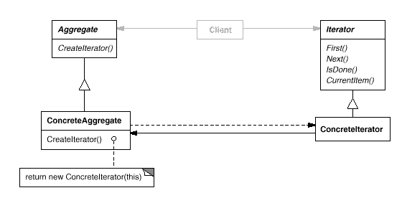
The UML

Slide 53
The Fine Print
Everything is a container
  Character strings
  Files, both text and records
  Socket streams over the net
  The result of a database query
  The bits of an integer
  Stream of random or prime numbers
This allows reusing the print, find and other algorithms for all of these

Slide 54
The Fine Print II
Iterators may have privileged access
  They can encapsulate security rights
Kinds of abstract iterators
  Direct access iterators
  Access the previous item
Robustness issues
  Is the iterator valid after insertions or removals from the container?
Iterators and the Composite pattern

Slide 55
Known Uses
All major standard libraries of popular programming languages
  STL for C++
  The Java Collections Framework
New libraries for file, network and database access in C++ conform to STL’s iterators as well

Slide 56
Contents
Representing Data Structures
  Composite
  Flyweight
  Decorator
Traversing Data Structures
  Iterator
  Visitor

Slide 57
5. Visitor
Separate complex algorithms on a complex data structure from the structure’s representation
For example, a document is a composite structure involved in many complex operations
  Spell check, grammar check, hyphenation, auto-format, …
How do we avoid cluttering Glyph subclasses with all this code?

Slide 58
The Requirements
Encapsulate complex algorithms and their data in one place
Outside the data structure
Easily support different behavior for every kind of Glyph
Easily add new tools

Slide 59
The Solution
Say hello to class Visitor:
class Visitor {
public:
void visitImage(Image *i) { }
void visitRow(Row *r) { }
void visitTable(Table *t) { }
// so on for every Glyph type
}
Every tool is a subclass:
  class SpellChecker : public Visitor

Slide 60
The Solution II
Add to Glyph’s interface the ability to accept visitors:
void accept(Visitor *v) = 0;
Every glyph subclass accepts a visitor by an appropriate callback:
class Image : public Glyph {
void accept(Visitor *v)
{ v->visitImage(this); }
This way the visitor is activated for the right kind of glyph, with its data

Slide 61
The Solution III
Initiating a spell check (one option):
  Create a SpellChecker object
  root->accept(sc);
Graphic non-text glyphs will just ignore the visit
  This is why Visitor includes default empty method implementations
Composite glyphs also do nothing
  They can forward the visit to children. This can be coded once in CompositeGlyph

Slide 62
The Solution IV
Easy to add operations
  Word count on characters
  Filters such as sharpen on images
  Page layout changes on pages
Works on any glyph
  In particular, a dynamic selection as long as it’s a composite glyph
Adding a tool does not require recompilation of Glyph hierarchy

Slide 63
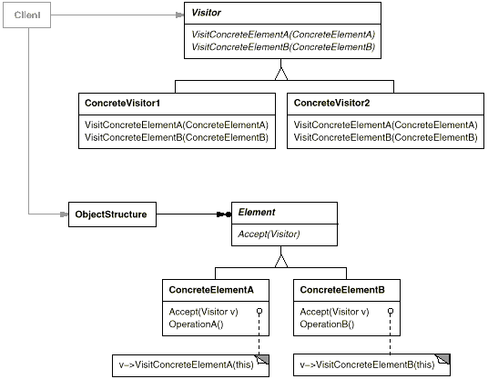
The UML

Slide 64
The Fine Print
The big problem: adding new Glyph subclasses is hard
  Requires small addition to Visitor, and recompilation of all its subclasses
How do we traverse the structure?
  Using an iterator
  From inside the accept() code
  From inside the visitxxx() code
Visitors are really just a workaround due to the lack of double dispatch

Slide 65
Known Uses
Document Editors
  Spell Check, Auto-Format, …
Photo Editors
  Filters & Effects
Compilers
  Code production, pretty printing, tests, metrics and optimizations
  on the syntax tree

Slide 66
Summary
Pattern of patterns
  Encapsulate the varying aspect
  Interfaces
  Inheritance describes variants
  Composition allows a dynamic choice between variants
Design patterns are old, well known and thoroughly tested ideas
  Well over twenty years!

