Slide 1
Design Patterns
David Talby

Slide 2
This Lecture
Handle Synchronization & Events
  Observer
Simplify Complex Interactions
  Mediator
Change Behavior Dynamically
  Strategy, State
Undo, Macros and Versions
  Command

Slide 3
10. Observer
Define a one-to-many dependency between objects, so that changing one automatically updates others
For example, a spreadsheet and several charts of it are open
Changing data in a window should be immediately reflected in all

Slide 4
The Requirements
Document and Chart classes must not know each other, for reuse
Easily add new kinds of charts or other links
A dynamic number of charts

Slide 5
The Solution
Terminology
  Subject and Observer
  Publisher and Subscriber
  Listeners
Subjects attach and detach listeners, and notify of events
Clients update themselves after receiving a notification

Slide 6
The Solution II
Here’s an abstract observer:
class Observer {
void update() = 0;
}
Concrete observers such as class Chart will inherit Observer

Slide 7
The Solution III
Here’s the (concrete!) subject:
class Subject {
void attach(Observer *o)
{ observers.add(o); }
void detach(Observer *o)
{ observers.remove(o); }
void notify() {
for i in observers do
o->update();
}
protected:
List observers;
}

Slide 8
The Solution IV
Both subject and observer will usually inherit from other classes as well
If multiple inheritance is not available, the observer must be a separate class that has a reference to the chart object and updates it
Java has a special mechanism – Inner classes – to make this easier

Slide 9
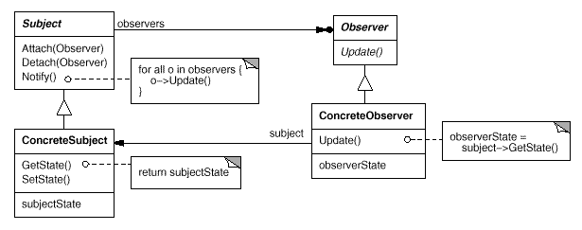
The UML

Slide 10
The Fine Print
Observing more than one subject
  Update must include an extra argument to tell who is updating
Observing only certain events
  Attach must include an extra argument to tell which events interest this observer
Observing small changes
  Update includes arguments to tell what changed, for efficiency

Slide 11
The Fine Print II
Who calls Notify?
  Greedy – the subjects, on change
  Lazy – the observers, on query
Common errors
  Forgetting to detach an object when it is destroyed
  Calling Notify in an inconsistent state
Java includes Observer as part of the standard libraries
  In package java.util

Slide 12
Known Uses
All frameworks of all kinds
  MFC, COM, Java, EJB, MVC, …
Handle user interface events
Handle asynchronous messages

Slide 13
11. Mediator
Encapsulate a complex interaction to preserve loose coupling
Prevent many inter-connections between classes, which means that changing their behavior requires subclassing all of them
For example, a dialog box includes many interactions of its widgets. How do we reuse the widgets?

Slide 14
The Requirements
A widget is a kind of colleague
Colleague don’t know about the interactions they participate in
  Can be reused for different dialogs
Colleagues don’t know about others
  Allow only O(n) connections
Easy to change interactions

Slide 15
The Solution
All colleagues talk with a mediator
The mediator knows all colleagues
Whenever a colleague changes, it notifies its mediator
The mediator codes the interaction logic, and calls operations on other colleagues

Slide 16
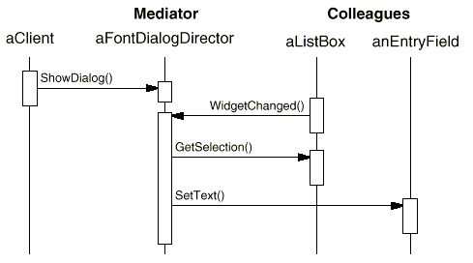
The Solution II
An example interaction:

Slide 17
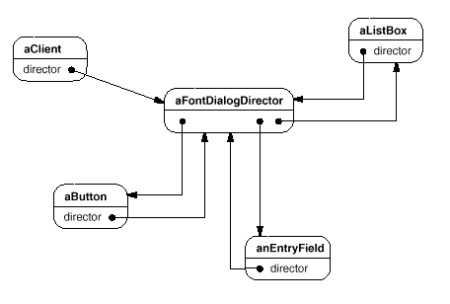
The Solution III
Only O(n) connections:

Slide 18
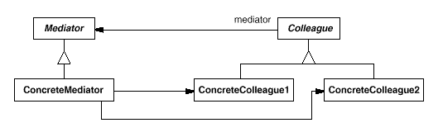
The UML

Slide 19
The Fine Print
The interaction logic (mediator) and colleagues can be reused separately and subclassed separately
Protocols are simpler since n-to-1 relations replace n-to-m relations
Abstract mediator class is unnecessary if there’s only one mediator
Observer or mediator?
  One-to-many or many-to-many?
  Should the logic be centralized?

Slide 20
Known Uses
Widgets in a user interface
  Delphi and VB “hide” this pattern
Connectivity constraints in diagrams

Slide 21
12. Strategy
A program must switch between complex algorithms dynamically
For example, a document editor has several rendering algorithms, with different time/beauty tradeoffs
Word is a common example

Slide 22
The Requirements
Algorithms are complex, would be havoc to have them inside the one Document class
Switch algorithms dynamically
Easy to add new algorithms

Slide 23
The Solution
Define an abstract class that represents an algorithm:
class Renderer {
void render(Document *d) = 0;
}
Each specific algorithm will be a descendant class
FastRenderer, TexRenderer, …

Slide 24
The Solution II
The document itself chooses the rendering algorithm:
class Document {
render() {
renderer->render(this);
}
setFastRendering() {
renderer = new FastRenderer();
}
private: Renderer *renderer;
}

Slide 25
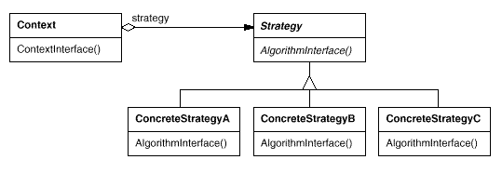
The GoF UML

Slide 26
The Fine Print
Inheriting a strategy would deny a dynamic switch
Some strategies may not use all information passed from Context
Strategies can be stateless, and then they can be shared
In some cases strategy objects are optional

Slide 27
Known Uses
Document rendering programs
Compiler code optimizations
Different heuristic algorithms (games, portfolio selection)
Different memory management schemes (Booch components)
Validation of dialog boxes (optional strategies, Borland ObjectWindows)

Slide 28
13. State
Allow an object to alter its behavior when its internal state changes
For example, most methods of a TCPConnection object behave in different ways when the connection is closed, established or listening
How do we encapsulate the logic and data of every state?

Slide 29
The Requirements
A class has a state diagram, and many methods behave in wildly different ways in different states
When in a state, only allocate memory for data of that state
The logic of a specific state should be encapsulated

Slide 30
Pattern of Patterns
Encapsulate the varying aspect
  State of an object
Interfaces
  Let’s have a TCPState interface that has all the state-sensitive methods
Inheritance describes variants
  TCPEstablished, TCPListen and TCPClosed implement the interface
Composition allows a dynamic choice between variants

Slide 31
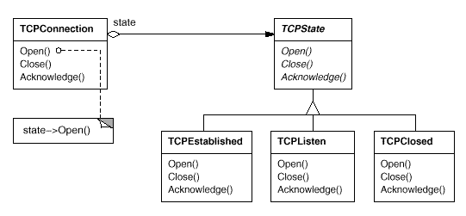
The Solution II
A TCPConnection codes state transitions and refers to a TCPState

Slide 32
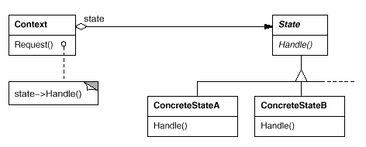
The UML

Slide 33
The Fine Print
In complex cases it is better to let states define transitions, by adding a SetState method to Context
States may be created on-demand or on Context’s creation
This pattern is really a workaround for the lack of dynamic inheritance
State is very much like Strategy
  State = Many (small) actions
  Strategy = One (complex) action

Slide 34
Known Uses
Streams and connections
Different tools on a drawing program
  Select, Erase, Crop, Rotate, Add, …

Slide 35
14. Command
Encapsulate commands as objects
We’ll take the the uses one by one:
  Undo/Redo
  Macros
  Queues and logs
  Version control
  Crash recovery
  Message Grouping

Slide 36
The Requirements I
Undo / redo at unlimited depth
Only store relevant data for undo
Easy to add commands

Slide 37
The Solution
Repesent a command as a class:
class Command
{
public:
virtual void execute() = 0;
virtual void undo() = 0;
}

Slide 38
The Solution II
Concrete commands hold undo data:
class DeleteLine : public Command {
void execute() {
line = document->getLine();
document->removeLine();
}
void undo() {
document->addLine(line);
}
private:
Line line;
}

Slide 39
The Solution III
Keep a list of executed commands:
  Array<Command*> commands;
  int i;
When you click the ‘Undo’ button:
  commands(i)->undo();
  i--;
When you click the ‘Redo’ button:
  commands(i)->execute();
  i++;

Slide 40
The Solution IV
Whenever a command is activated:
  commands.add(new_command);
  i = commands.count();
When you save a document:
  document->save();
  commands.clear();
  i = 0;
The commands list may or may not be limited in size
Only relevant undo data is kept

Slide 41
The Requirements II
Macros are a series of commands
Any command with any of its options may be used
There are also for and while loops, if statements, calls to other macros...

Slide 42
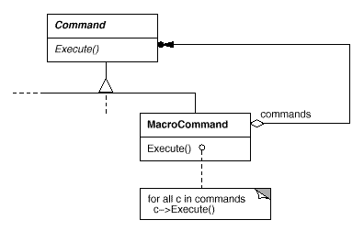
The Solution
A macro is a Composite Command
if, for, while are Decorator Commands

Slide 43
The Requirements III
Commands are accessible from menus as well as toolbars
A command may be available from more than one place
We’d like to configure the menus and toolbars at runtime

Slide 44
The Solution
Each MenuItem or ToolbarItem
refers to its command object
Just as it refers to an image
The command can be configured
  Less command classes
Macros fit in the picture as well!

Slide 45
The Requirements IV
Keep multiple versions of a document
When saving, only store the changes from the previous version

Slide 46
The Solution
The changes are exactly the list of commands since the last version was loaded
In addition, a compaction algorithm is needed for commands that cancel each other
Save = Serialize the compacted list
Load = Read early version and call
execute on command lists

Slide 47
(More!) Known Uses
Programs log commands to disk so they can be used in case of a crash
  Works, since commands are small
  Usually in a background thread
Commands can be grouped and sent as one command to a server
  Grouping for efficient communication
  Grouping to define a transaction
  Works even for user defined macros!

Slide 48
Summary
Pattern of patterns
  Encapsulate the varying aspect
  Interfaces
  Inheritance describes variants
  Composition allows a dynamic choice between variants
Design patterns are old, well known and thoroughly tested ideas
  Over twenty years!

