Slide 1
Design Patterns
David Talby

Slide 2
This Lecture
The Creational Patterns
  Abstract Factory
  Builder
  Prototype
  Factory Method
Choosing Between Them

Slide 3
Creational Patterns
Easily Change:
  What gets created?
  Who creates it?
  When is it created?
Hide the concrete classes that get created from client code
Competing patterns, each with its own strengths

Slide 4
6. Abstract Factory
A program must be able to choose one of several families of classes
For example, a program’s GUI should run on several platforms
Each platform comes with its own set of GUI classes:
WinButton, WinScrollBar, WinWindow
MotifButton, MotifScrollBar, MotifWindow
pmButton, pmScrollBar, pmWindow

Slide 5
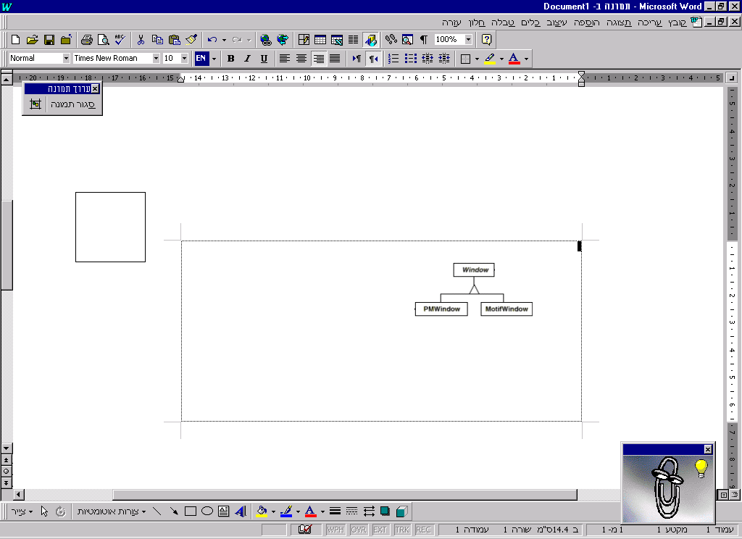
The Requirements
Uniform treatment of every button, window, etc. in the code
  Easy - Define their interfaces:
Uniform object creation
Easy to switch between families
Easy to add a family

Slide 6
The Solution
Define a Factory - a class that creates objects:
class WidgetFactory {
Button* makeButton(args) = 0;
Window* makeWindow(args) = 0;
// other widgets…
}

Slide 7
The Solution II
Define a concrete factory for each of the families:
class WinWidgetFactory {
Button* makeButton(args) {
return new WinButton(args);
}
Window* makeWindow(args) {
return new WinWindow(args);
}
}

Slide 8
The Solution III
Select once which family to use:
WidgetFactory* wf =
new WinWidgetFactory();
When creating objects in the code, don’t use ‘new’ but call:
Button* b = wf->makeButton(args);
Switch families - once in the code!
Add a family - one new factory, no effect on existing code!

Slide 9

The Big (UML) Picture

Slide 10
The Fine Print
The factory doesn’t have to be abstract, if we expect a remote possibility of having another family
Usually one factory per application, a perfect example of a singleton
Not easy to extend the abstract factory’s interface

Slide 11
Known Uses
Different operating systems
(could be Button, could be File)
Different look-and-feel standards
Different communication protocols

Slide 12
7. Builder
Separate the specification of how to construct a complex object from the representation of the object
For example, a converter reads files from one file format
It should write them to one of several output formats

Slide 13
The Requirements
Single Choice Principle
  Same reader for all output formats
  Output format chosen once in code
Open-Closed Principle
  Easy to add a new output format
  Addition does not change old code
Dynamic choice of output format

Slide 14
The Solution
We should return a different object depending on the output format:
  HTMLDocument, RTFDocument, …
Separate the building of the output from reading the input
Write an interface for such a builder
Use inheritance to write different concrete builders

Slide 15
The Solution II
Here’s the builder’s interface:
class Builder {
void writeChar(char c) { }
void setFont(Font *f) { }
void newPage() { }
}

Slide 16
The Solution III
Here’s a concrete builder:
class HTMLBuilder
: public Builder
{
private:
HTMLDocument *doc;
public:
HTMLDocument *getDocument() {
return doc;
}
// all inherited methods here
}

Slide 17
The Solution IV
The converter uses a builder:
class Converter
{
void convert(Builder *b) {
while (t = read_next_token())
switch (o.kind) {
CHAR: b->writeChar(o);
FONT: b->setFont(o);
// other kinds…
}
}
}

Slide 18
The Solution V
This is how the converter is used:
RTFBuilder *b = new RTFBuilder;
converter->convert(b);
RTFDocument *d = b->getDocument();

Slide 19
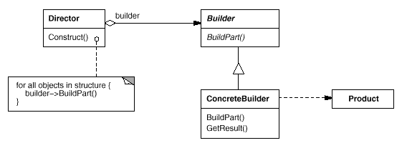
The UML

Slide 20
The Fine Print
The builder’s interface affects the ease of coding concrete builders
Kinds of documents don’t need a common base class
Methods in class Builder are empty and not abstract
getResult() is not always trivial
  Optimizations
  Lazy Creation

Slide 21
Known Uses
Converting to different formats
Building a parse tree in a compiler
Building a normalized database

Slide 22
8. Prototype
Specify the kind of object to create using a prototypical instance
For example, a photo/map editor has a palette of tools and objects that can be created
How do we have only one class for creations, and parameterize it by the class of objects it initializes?

Slide 23
The Requirements
One class for the creation tool
Easy to add new objects
Dynamic toolbox configuration

Slide 24
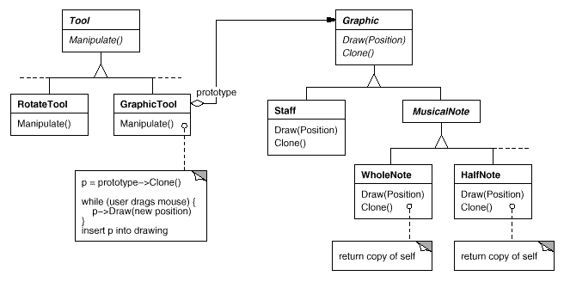
The Solution
Hold a prototype of object to create
Creation is by cloning the prototype

Slide 25
The Solution II
Less classes in the system
Can be even less: same Graphic object with different properties can be used for different tools
Tools can be chosen and configured at runtime

Slide 26
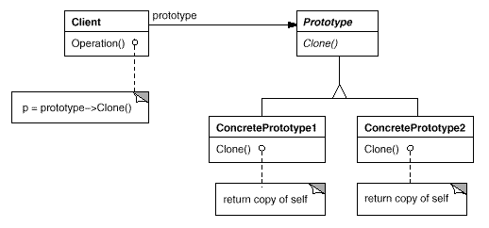
The UML

Slide 27
The Fine Print
Prototype Manager - a runtime registry of prototype can handle dynamically linked classes
Java, SmallTalk, Eiffel provide a default clone() method. C++ has copy constructors
All of these are shallow by default
When implementing deep clone, beware of circular references!

Slide 28
Known Uses
Toolboxes / Palettes
Supporting dynamically defined debuggers in a uniform GUI
EJB / COM Servers
Basically a plug-in mechanism

Slide 29
9. Factory Method
Let subclasses decide which objects to instantiate
For example, a framework for a windowing application has a class Application which must create an object of class Document
But the actual applications and documents are not written yet!

Slide 30
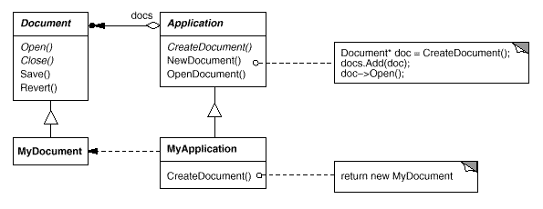
The Solution
Separate creation into a method

Slide 31
Second Variant
A remote services package has a RemoteService class that returns objects of class Proxy to client
A few clients wish to write a more potent CachedProxy
How do we support this without much hassle?

Slide 32
Second Variant Solution
Separate creation into a method
RemoteService will have a virtual method called CreateProxy()
Write CachedProxy, then write:
class CachedRemoteService
: public RemoteService
{
Proxy* createProxy(...) {
return new CachedProxy(...);
}
}

Slide 33
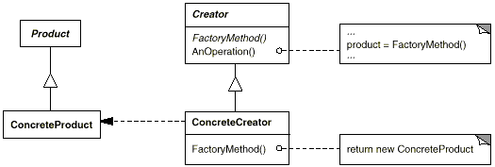
The UML

Slide 34
The Fine Print
Two Variants: Is the factory method abstract or not?
Good style to use factory methods even for a slight chance of need
Parameterized factory methods make it easy to add created products without affecting old code
Product* createProduct(int id) {
switch (id) { ... }
}

Slide 35
The Fine Print II
C++ warning: You can’t call a factory method from a constructor!
  Use lazy initialization instead
Product* getProduct() {
if (_product == NULL)
_product = createProduct();
return _product;
}
Use templates to avoid subclassing
  Application<ExcelDocument>
  complex<float>, complex<double>

Slide 36
Known Uses
A very common pattern
Framework classes
  Application, Document, View, ...
Changing default implementations
  Proxy, Parser, MemoryManager, …

Slide 37
Pattern of Patterns
Encapsulate the varying aspect
Interfaces
Inheritance describes variants
Composition allows a dynamic choice between variants
Criteria for success:
Open-Closed Principle
Single Choice Principle

Slide 38
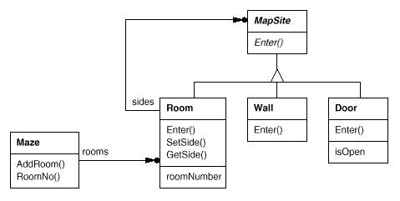
A Comparative Example

Slide 39
The Example Problem
Maze* MazeGame::CreateMaze () {
Maze* aMaze = new Maze;
Room* r1 = new Room(1);
Room* r2 = new Room(2);
Door* theDoor = new Door(r1, r2);
aMaze->AddRoom(r1);
aMaze->AddRoom(r2);
r1->SetSide(North, new Wall);
r1->SetSide(East, theDoor);
// set other sides, also for r2
return aMaze;
}

Slide 40
Enchanted Mazes
How do we reuse the same maze with EnchantedRoom, TrapDoor?
  Pass createMaze an object that can create different maze parts
  Pass createMaze an object that can build a maze and then return it
  Pass createMaze initialized samples of each kind of maze part
  Move creation with new to other methods that descendants redefine

Slide 41
Abstract Factory
Define a set of interfaces
  Door, Wall, Room, ...
Write families of classes
  SimpleDoor, SimpleRoom, …
  EnchantedDoor, EnchantedRoom,...
Define an abstract MazeFactory, and a concrete class for each family
  SimpleFactory, EnchantedFactory, …
Pass createMaze a factory

Slide 42
Abstract Factory II
Maze* MazeGame::CreateMaze (MazeFactory* mf) {
Maze* aMaze = mf->createMaze();
Room* r1 = mf->createRoom(1);
Room* r2 = mf->createRoom(2);
Door* d = mf->createDoor(r1,r2);
// rest is same as before
Families don’t have to be disjoint
Same factory can return variants of the same class

Slide 43
Abstract Factory Cons
Requires a new factory class for every family
Families are defined statically
Parts of the complex maze are returned right after creation
The client of the factory builds the connections between maze parts
Maze stands for any complex object

Slide 44
Builder Pros & Cons
Pros
  Each builder can create a totally different kind of object
  Object returned only at the end of construction - enables optimization
  Especially if object is on network
Cons
  Complex Interface to builder

Slide 45
Prototype Pros & Cons
Pros
  Less Classes
  Prototype can be customized between different creations
Cons
  Requires memory to hold prototype
  Many prototypes must be passed
  Clone() may be hard to implement

Slide 46
Factory Method P&C
Pros
  The simplest design
Cons
  Requires a new class for every change in creation
  Compile-time choice only

Slide 47
The Verdict
Use Factory Methods when there is little (but possible) chance of change
Use Abstract Factory when different families of classes are given anyway
Use Prototype when many small objects must be created similarly
Use Builder when different output representations are necessary

Slide 48
Some Easy Cases
Dynamic loading of classes whose objects must be created
  only Prototype
Creation can be highly optimized once entire structure is known
  only Builder

Slide 49
Summary: Connections
“Abstract Factories are usually implemented using Factory Methods but can also use Prototypes”
“Builders and Abstract Factories are often Singletons”
“Builders can use Abstract Factories to enjoy best of both worlds”

