Slide 1
Design Patterns
David Talby

Slide 2
This Lecture
Re-Routing Method Calls
  Proxy, Chain of Responsibility
Working with external libraries
  Adapter, Façade
Coding partial algorithms
  Template Method
The Singleton Pattern
Patterns Summary

Slide 3
15. Proxy
Provide a placeholder for another object, to control access to it
For example, we’d like to defer loading the images of a document until we must display it

Slide 4
The Requirements
Only load images when required
Client code must not know whether lazy load is used or not
Images may be loaded from a file, a database or a network
  Such code should be encapsulated
  Should be easy to add variations, such as security and compression

Slide 5
The Solution
Define a new graphic ImageProxy, which holds an image’s file name
Holds an uninitialized Image object
When its draw() method is called:
draw() {
if (image == NULL)
image = load(filename);
image->draw();
}

Slide 6
The Solution II
Many ways to implement load:
  Read from a file or database
  Use a complex network protocol
  Use encryption, compression, …
  Compute the returned object
Any such complex logic is well encapsulated in the proxy
The proxy can hold part of Image’s data for efficiency

Slide 7
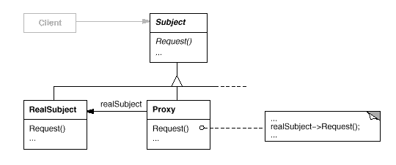
The UML

Slide 8
The Fine Print
The Proxy vocabulary
  Virtual Proxy – creates expensive objects on demand
  Remote Proxy – a local representative of an object in another address space
  Protection Proxy – controls access to the original object
  Smart Pointers – overload regular pointers with additional actions

Slide 9
The Fine Print II
Uses of smart pointers
  Reference counting
  Synchronization (lock management)
  Profiling and statistics
  Copy-on-write
  Cache coherence
  Pooling
Smart pointers are easy in C++ thanks to overloading = and –>

Slide 10
The Fine Print III
Proxy is very much like Decorator
Decorator = functional addition
Proxy = technical addition

Slide 11
Known Uses
Every programming language
Every middleware package
Every database package

Slide 12
16. Chain of Responsibility
Decouple the sender and receiver of a message, and give more than one receiver a chance to handle it
For example, a context-sensitive help system returns help on the object currently in focus
Or its parent if it has no help
Recursively

Slide 13
The Requirements
Allow calling for context-sensitive help from any graphical object
If the object can’t handle the request (it doesn’t include help),
it knows where to forward it
The set of possible handlers is defined and changed dynamically

Slide 14
The Solution
Define a HelpHandler base class:
class HelpHandler
{
handleHelp() {
if (successor != NULL)
successor->handleHelp();
}
HelpHandler* successor = NULL;
}

Slide 15
The Solution II
Class Graphic inherits HelpHandler
Graphic descendants that have help to show redefine handleHelp:
handleHelp() {
ShowMessage(“Buy upgrade”);
}
Either the root Graphic object or HelpHandler itself can redefine handleHelp to show a default

Slide 16
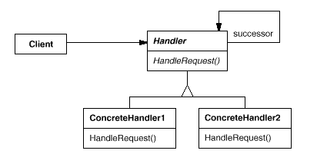
The UML

Slide 17
The Fine Print
Receipt isn’t guaranteed
Usually parents initialize the successor of
an item upon creation
  To themselves or their successor
The kind of request doesn’t have to be
hard-coded:
class Handler {
handle(Request* request) {
// rest as before

Slide 18
Known Uses
Context-sensitive help
Messages in a multi-protocol network service
Handling user events in a user interface framework
Updating contained objects/queries in a displayed document

Slide 19
17. Adapter
Convert the interface of a class into another that clients expect
For example, We’d like to use advanced Text and SpellCheck component that we bought
But Text doesn’t inherit Graphic or supply iterators, and SpellCheck doesn’t inherit Visitor
We don’t have their source code

Slide 20
The Requirements
Convert the interface of a class into a more convenient one
Without the class’s source code
  No compilation dependencies
The class may be a module in a non-object oriented language

Slide 21
The Solution
If you can’t reuse by inheritance, reuse by composition:
class TextGraphic
: public Graphic
{
public:
void draw() { text->paint(); }
// other methods adapted...
private:
BoughtTextComponent *text;
}

Slide 22
The Requirements II
Stacks and queues are kinds of lists, but they provide less functionality
LinkedQueue is a linked list implementation of interface Queue
We’d like to reuse LinkedList for it
Inheritance can’t be used if children offer less than their parents

Slide 23
The Solution II
Object Adapter
  Class LinkedQueue will hold a reference to a LinkedList and delegate requests to it
Class Adapter
  Class LinkedQueue will inherit from both Queue and LinkedList
  Method signatures in both classes must match
In C++ class adapters are safer thanks to private inheritance

Slide 24
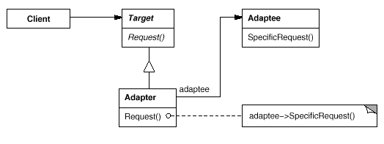
The UML
Object Adapter:

Slide 25
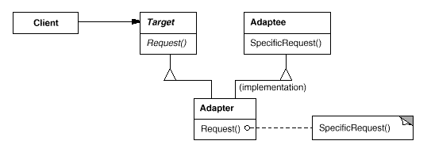
The UML II
Class Adapter:

Slide 26
Known Uses
Using external libraries
Reusing non O-O code
Limiting access to classes

Slide 27
18. Facade
Provide a unified interface to a set of interfaces of subsystems
For example, a compiler is divided into many parts
  Scanner, parser, syntax tree data structure, optimizers, generation, …
Most clients just compile files, and don’t need to access inner parts

Slide 28
The Requirements
Provide a simple, easy to use and remember interface for compilation
Keep the flexibility to tweak inner parts when needed

Slide 29
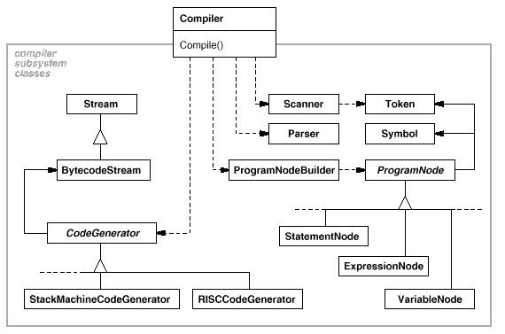
The Solution
Define a façade Compiler class as the entry point to the system

Slide 30
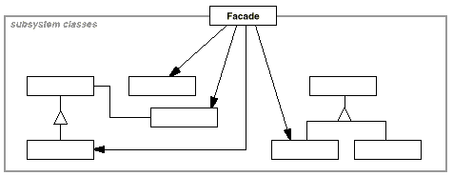
The UML

Slide 31
The Fine Print
Advantages of a façade:
  Most users will use a very simple interface for the complex system
  Clients are decoupled from the system
  Makes it easier to replace the entire system with another
Packages (Java) and namespaces (C++) are ways to define “systems” of classes and decide which classes are visible to the system’s clients

Slide 32
Known Uses
A Compiler or XML Parser
Browsing objects at runtime
The Choices O-O operating system
  The File and Memory systems

Slide 33
19. Template Method
Define the skeleton of an algorithm and let subclasses complete it
For example, a generic binary tree class or sort algorithm cannot be fully implemented until a comparison operator is defined
How do we implement everything except the missing part?

Slide 34
The Requirements
Code once all parts of an algorithm that can be reused
Let clients fill in the gaps

Slide 35
The Solution
Code the skeleton in a class where only the missing parts are abstract:
  class BinaryTree<G>
  {
  void add(G* item) {
  if (compare(item, root))
  // usual logic
  }
  int compare(G* g1, G* g2) = 0;
  }

Slide 36
The Solution II
Useful for defining comparable objects in general:
  class Comparable
  {
  operator <(Comparable x) = 0;
  operator >=(Comparable x) {
  return !(this < x);
  }
  operator >(Comparable x) {
  return !(this < x) &&
  !(this == x);
  }
  }

Slide 37
The Solution III
A very common pattern:
class HelpHandler
{
handleHelp() {
if (successor != NULL)
successor->handleHelp();
}
HelpHandler* successor = NULL;
}

Slide 38
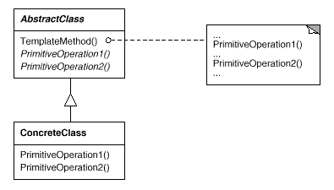
The UML

Slide 39
The Fine Print
The template method is public, but the ones it calls should be protected
The called methods can be declared with an empty implementation if this is a common default
This template can be replaced by passing the missing function as a template parameter
Java sometimes requires more coding due to single inheritance

Slide 40
Known Uses
So fundamental that it can be found almost anywhere
Factory Method is a kind of template method specialized for creation

Slide 41
20. Singleton
Ensure that only one instance of a class exists, and provide a global access point to it
For example, ensure that there’s one WindowManager, FileManager or PrintSpooler object in the system
Desirable to encapsulate the instance and responsibility for its creation in the class

Slide 42
The Solution
O-O languages support methods shared by all objects of a class
  static in C++ and Java
  class methods in SmallTalk, Delphi
The singleton class has a reference to its single instance
The instance has a getter method which initializes it on the first request
The class’s constructor is protected to prevent creating other instances

Slide 43
The Solution
class Spooler {
public:
static Spooler* instance() {
if (_instance == NULL)
_instance = new Spooler();
return _instance;
}
protected:
Spooler() { ... }
private:
static Spooler* _instance = 0;
}

Slide 44
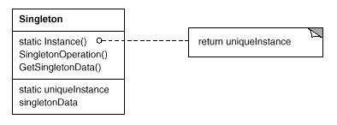
The UML

Slide 45
The Fine Print
Passing arguments for creation can be done with a create(...) method
Making the constructor public makes it possible to create other instance except the “main” one
  Not a recommended style
instance() can manage concurrent access or manage a list of instances
Access to singletons is often a bottleneck in concurrent systems

Slide 46
Known Uses
Every system has singletons!
WindowManager, PrinterManager, FileManager, SecurityManager, ...
Class Application in a framework
Log and error reporting classes
With other design patterns

Slide 47
21. Bridge
Separate an abstraction from its implementations
For example, a program must run on several platforms
An Entire Hierarchy of Interfaces must be supported on each platform
Using Abstract Factory alone would result in a class per platform per interface – too many classes!

Slide 48
22. Interpreter
Given a language, define a data structure for representing sentences along with an interpreter for it
For example, a program must interpret code or form layout, or support search with regular expression and logical criteria
Not covered here

Slide 49
23. Momento
Without violating encapsulation, store an object’s internal state so that it can be restored later
For example, a program must store a simulation’s data structures before a random or approximation action, and undo must be supported
Not covered here

Slide 50
Patterns Summary
O-O concepts are simple
  Objects, Classes, Interfaces
  Inheritance vs. Composition
Open-Closed Principle
Single Choice Principle
Pattern of patterns

Slide 51
The Benefits of Patterns
Finding the right classes
Finding them faster
Common design jargon
Consistent format
Coded infrastructures
and above all:
Pattern = Documented Experience

